Slide 1
Protein Sequence Analysis
Jack Leunissen

Slide 2
Protein Motif Searching

Slide 3
What is a motif?
A motif is a description of a particular element (of three dimensional structure) that contains a specific sequence pattern
Motifs are identified by
3D structural alignment
Multiple sequence alignment
Pattern searching programs

Slide 4
What is a motif?
Motifs are regions of similarity based on multiple alignments
Single motifs
Multiple motifs
Whole domains
Motif
Insertions
Adapted from D. Martin

Slide 5
Protein Motif Searching
Strict consensus pattern
use only strictly conserved residues
But what about:
variable residues?
gaps?
C--QASCDGIPLKMNDC
C---VTCEGLPMRMDQC
CERTLGCQPMPVH---C
C C P C
C?????C???P?????C

Slide 6
Protein Motif Searching
Strict consensus patterns contain
no alternative residues
no flexible regions
no mismatches
no gaps
C--QASCDGIPLKMNDC
C---VTCEGLPMRMDQC
CERTLGCQPMPVH---C
CxxxxxCxxxPxxxxxC
C C P C

Slide 7
Computer Lingo Intermezzo
Regular expressions are widely used in computer string searching
Example: the UNIX “grep” command(s):
% who | egrep ‘[Jj]ohns*on’
will list all logged-on users who’s name is Johnson, Johnsson, johnson, johnsson, ...

Slide 8
Protein Motif Searching
Most motifs defined as regular expressions
Motifs can contain
alternative residues
flexible regions
C-x(2,5)-C-x-[GP]-x-P-x(2,5)-C.
CXXXCXGXPXXXXXC
| | | | |
FGCAKLCAGFPLRRLPCFYG

Slide 9
Protein Motif Searching
Motifs can (usually) not contain
mismatches
gaps
Some programs can handle mismatches, but irrespective of the pattern position!
C-x(2,5)-C-x-[GP]-x-P-x(2,5)-C.
CXXCXGXPXXXXX-C
| ?| | | ?|
FGCA-CAGFPLRRLPKCFYG

Slide 10
Protein Motif Searching
Consensus patterns
no alternative residues
no flexible regions
no mismatches
no gaps
Regular expressions
allow alternative residues
allow flexible regions
no mismatches
no gaps
C--QASCDGIPLKMNDC
C---VTCEGLPMRMDQC
CERTLGCQPMPVH---C
PERL regex:
/C.{2,5}C.[GP].P.{2,5}C/
CxxxxxCxxxPxxxxxC

Slide 11
The PROSITE Syntax
A-[BC]-X-D(2,5)-{EFG}-H.
A
B or C
anything
2-5 D’s
not E, F, or G
H

Slide 12
Protein Motif Searching
Mandatory motifs characterise a protein (super-) family
ID SUBTILASE_ASP; PATTERN.
DE Serine proteases, subtilase family, aspartic acid active site.
PA [STAIV]-x-[LIVMF]-[LIVM]-D-[DSTA]-G-[LIVMFC]-x(2,3)-[DNH].
ID SUBTILASE_HIS; PATTERN.
DE Serine proteases, subtilase family, histidine active site.
PA H-G-[STM]-x-[VIC]-[STAGC]-[GS]-x-[LIVMA]-[STAGCLV]-[SAGM].
ID SUBTILASE_SER; PATTERN.
DE Serine proteases, subtilase family, serine active site.
PA G-T-S-x-[SA]-x-P-x(2)-[STAVC]-[AG].

Slide 13
Protein Motif Searching
Possible motifs occur frequently in proteins; they may not actually be present, such as
Post-translational modification sites
Leucine zippers
ID ASN_GLYCOSYLATION; PATTERN.
DE N-glycosylation site.
PA N-{P}-[ST]-{P}.
ID LEUCINE_ZIPPER; PATTERN.
DE Leucine zipper pattern.
PA L-x(6)-L-x(6)-L-x(6)-L.

Slide 14
Profiles: the consensus revisited
Weight matrix
A profile of the occurrence of an amino acid at a particular position
Provides a more sensitive match for less similar sequences
Computationally expensive compared to a single sequence search

Slide 15
Profiles
Many motifs cannot be easily defined using simple patterns
Such motifs can be defined using profiles
A profile is constructed from a multiple sequence alignment. For each position, each amino acid is given a score depending on how likely it is to occur

Slide 16
Profiles
A more formal definition:
A profile is a position-dependant scoring matrix, including position-specific gap penalties, created by evaluating the likelihood of occurrence for every residue position in a multiple alignment

Slide 17
Amino Acid groups
Proteins have a variety of side chains with similar physico-chemical properties.
C_{SS}
P
A
G
I
V
T
C_{SH}
S
L
N
M
D
Y
K
E
F
H
Q
W
R
Polar
Charged
Hydrophobic
Aliphatic
Aromatic
Small

Slide 18
Calculating a Profile
For each alignment position: take the (weighted) average of the appropriate rows from the scoring matrix
An (extremely simple) example:
seq_01 A A A A A A A A A A W
seq_02 A A A A A A A A A W W
seq_03 A A A A A A A A W W W
seq_04 A A A A A A A W W W W
seq_05 A A A A A A W W W W W
seq_06 A A A A A W W W W W W
seq_07 A A A A W W W W W W W
seq_08 A A A W W W W W W W W
seq_09 A A W W W W W W W W W
seq_10 A W W W W W W W W W W

Slide 19
Excerpt from the EBLOSUM62 matrix:
A R N D C Q E G H I L K M F P S T W Y V B Z X *
A 4 -1 -2 -2 0 -1 -1 0 -2 -1 -1 -1 -1 -2 -1 1 0 -3 -2 0 -2 -1 0 -4
W -3 -3 -4 -4 -2 -2 -3 -2 -2 -3 -2 -3 -1 1 -4 -3 -2 11 2 -3 -4 -3 -2 -4
A C D E F G H I K L M
10A: 4.0 0.0 -2.0 -1.0 -2.0 0.0 -2.0 -1.0 -1.0 -1.0 -1.0
N P Q R S T V W Y
-2.0 -1.0 -1.0 -1.0 1.0 0.0 0.0 -3.0 -2.0 3.33 3.33
A C D E F G H I K L M
5A+5W: 1.0 -2.0 -6.0 -4.0 -1.0 -2.0 -4.0 -4.0 -4.0 -3.0 -2.0
N P Q R S T V W Y
-6.0 -5.0 -3.0 -4.0 -2.0 -2.0 -3.0 8.0 0.0 3.33 3.33
A C D E F G H I K L M
10W: -3.0 -2.0 -4.0 -3.0 1.0 -2.0 -2.0 -3.0 -3.0 -2.0 -1.0
N P Q R S T V W Y
-4.0 -4.0 -2.0 -3.0 -3.0 -2.0 -3.0 11.0 2.0 3.33 3.33
prophecy (EMBOSS), using Henikoff profile type, and BLOSUM62 matrix; please note that all calculated amino acid distances have been multiplied by a factor 10!

Slide 20
Algorithm (Henikoff & Henikoff)
Amino acid weight = 1 / r × s
r = number of different amino acids
s = number of amino acids

Slide 21
Algorithm (Henikoff & Henikoff)
For instance, the score for matching the alignment containing 5A5W is
A 1/(2 × 5) × D(A,A) + 1/(2 × 5) × D(W,A) =
1/10 × 4 + 1/10 × -3 = 0.1
F 1/(2 × 5) × D(A,F) + 1/(2 × 5) × D(W,F) =
1/10 × -2 + 1/10 × 1 = -0.1
W 1/(2 × 5) × D(A,W) + 1/(2 × 5) × D(W,W) =
1/10 × -3 + 1/10 × 11 = 0.8

Slide 22
Hydropathy Plot
Prediction hydrophobic and hydrophilic regions in a protein

Slide 23
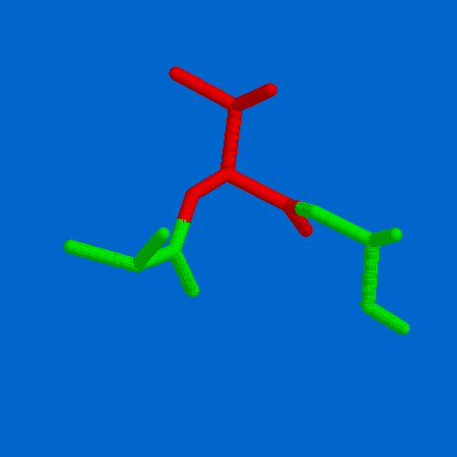
Partition coefficients
Hydrophilic
Hydrophobic
Oil
Water

Slide 24
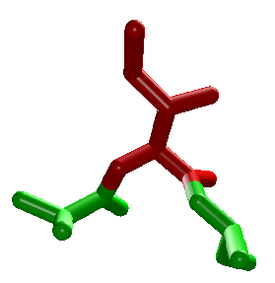

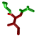
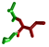

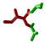
Partition coefficients
hydrophilic
hydrophobic
“oil”
water

Slide 25
Hydrophobicity/hydrophilicity values
Fauchere & Pliska Kyte & Doolittle Hopp & Woods Eisenberg
R -1.37 -4.50 3.00 -2.53
K -1.35 -3.90 3.00 -1.50
D -1.05 -3.50 3.00 -0.90
Q -0.78 -3.50 0.20 -0.85
N -0.85 -3.50 0.20 -0.78
E -0.87 -3.50 3.00 -0.74
H -0.40 -3.20 -0.50 -0.40
S -0.18 -0.80 0.30 -0.18
T -0.05 -0.70 -0.40 -0.05
P 0.12 -1.60 0.00 0.12
Y 0.26 -1.30 -2.30 0.26
C 0.29 2.50 -1.00 0.29
G 0.48 -0.40 0.00 0.48
A 0.62 1.80 -0.50 0.62
M 0.64 1.90 -1.30 0.64
W 0.81 -0.90 -3.40 0.81
L 1.06 3.80 -1.80 1.06
V 1.08 4.20 -1.50 1.08
F 1.19 2.80 -2.50 1.19
I 1.38 4.50 -1.80 1.38
hydrophilic hydrophobic

Slide 26
Hydrophobicity plot
Sum amino acid hydrophobicity values in a given window
Plot the value in the middle of the window
Shift the window one position

Slide 27
Sliding window approach
Calculate property for first sub-sequence
Use the result (plot/print/store)
Move to next residue position, and repeat
I L I K E I R
4.50 + 3.80 + 4.50 - 3.90 - 3.50 + 4.50 - 4.50
5.4 / 7 = 0.77

Slide 28
Hydrophobicity plot

Slide 29
Hydrophobicity plot
MEZCALTASTESVERYNICE

Slide 30
Hydrophobicity plot
MEZCALTASTESVERYNICE

Slide 31
Hydrophobicity plot
MEZCALTASTESVERYNICE

Slide 32
Hydrophobicity plot
MEZCALTASTESVERYNICE

Slide 33
Hydrophobicity plot
MEZCALTASTESVERYNICE

Slide 34
Hydrophobicity plot
MEZCALTASTESVERYNICE

Slide 36
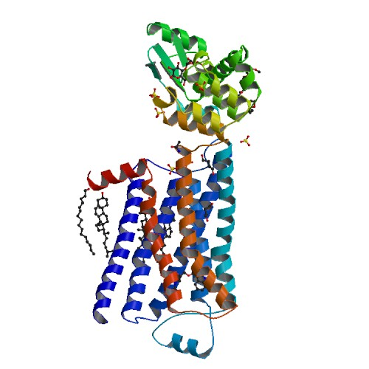
Transmembrane regions
Rotation is 100 degrees per amino acid
Climb is 1.5 Angstrom
per amino acid residue

Slide 37
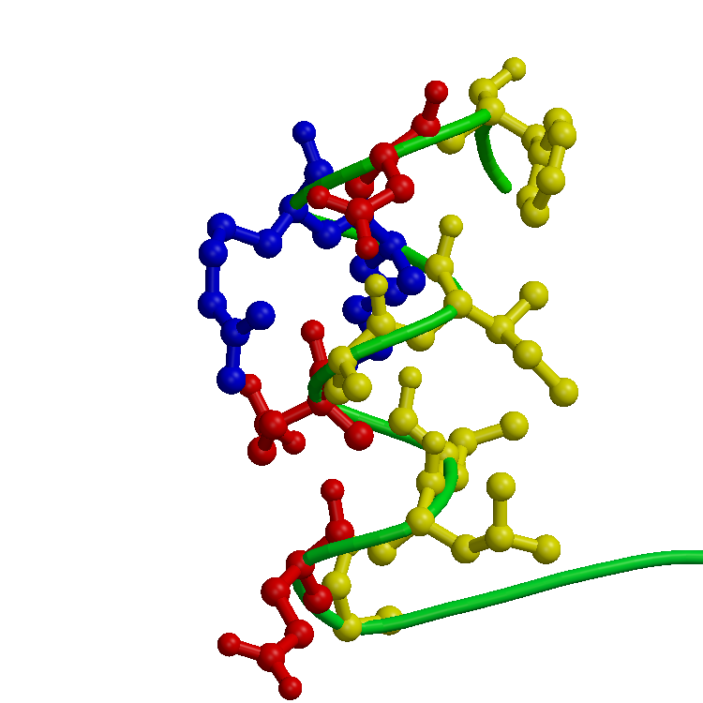
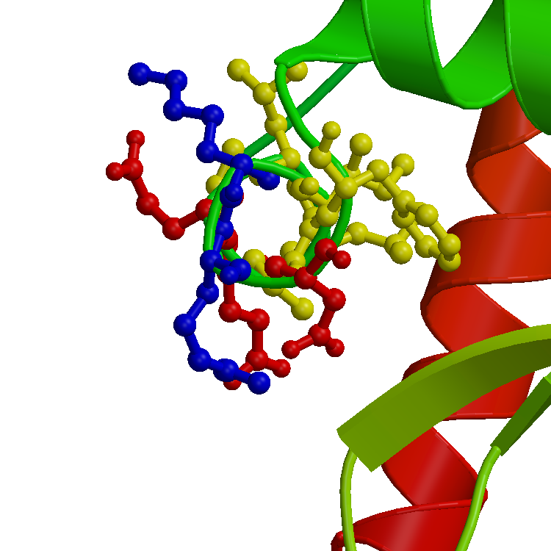
1.5 A
100 degrees

Slide 38
Transmembrane regions
So we need approx. 30 / 1.5 = 20 amino acids to span the membrane
30 angstrom

Slide 40
Adapting the window size to the size of the membrane spanning segments makes the picture easier to interpret

Slide 41
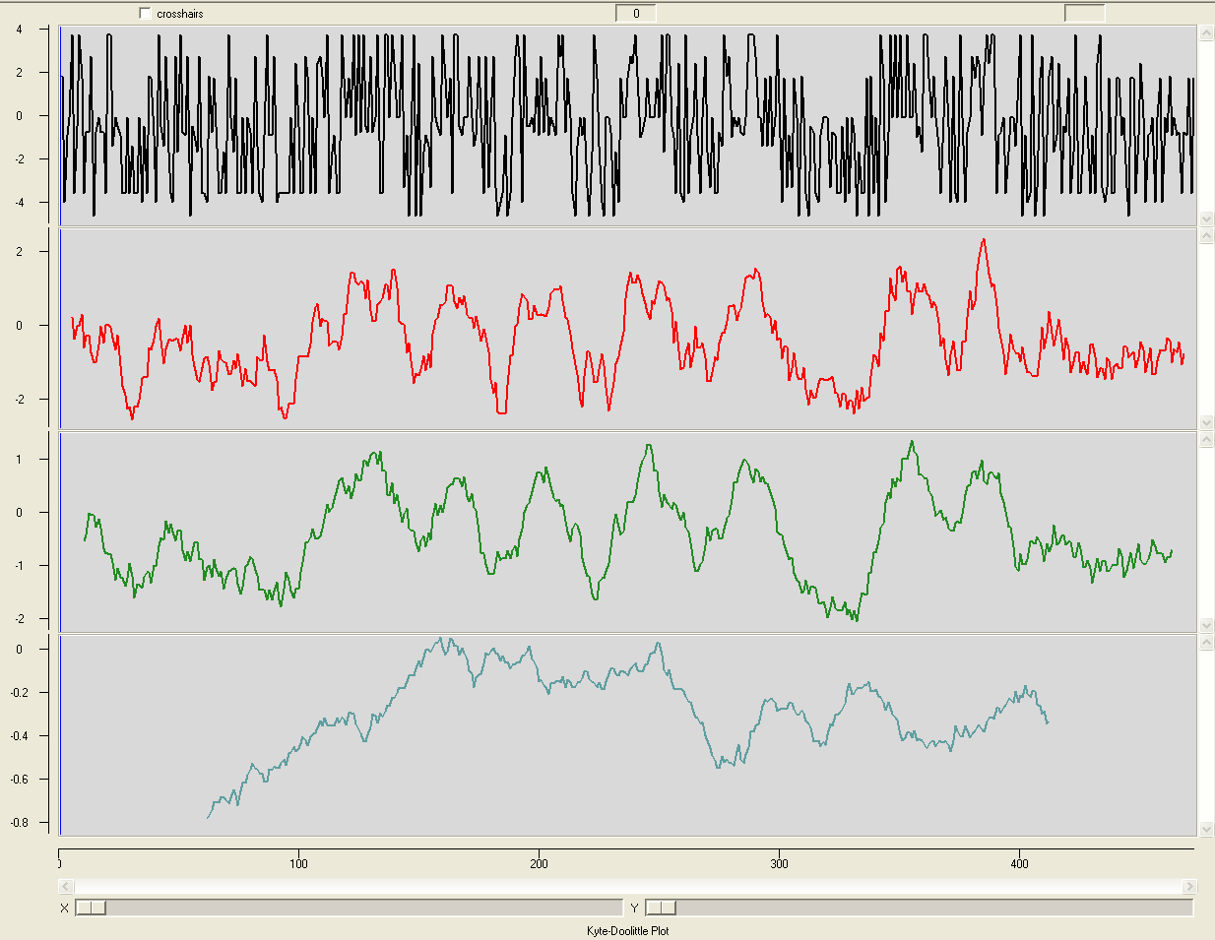
window = 1
window = 9
window = 19
window = 121

Slide 42
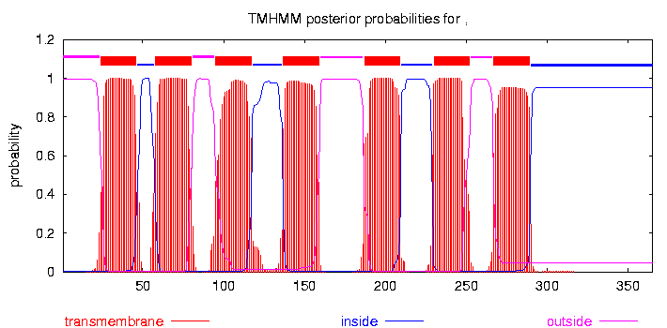

Slide 43
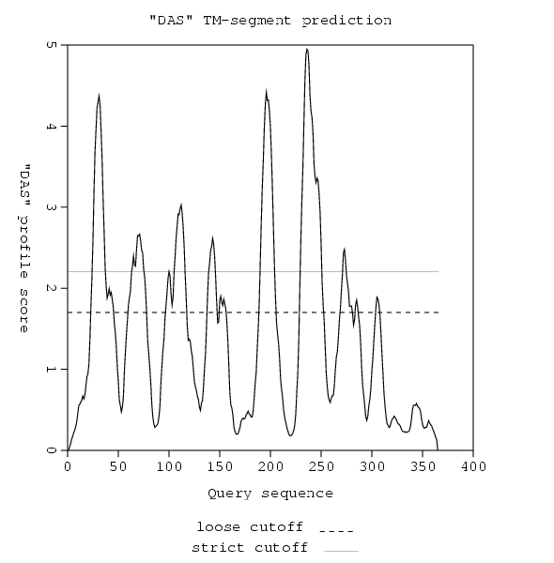

Slide 44
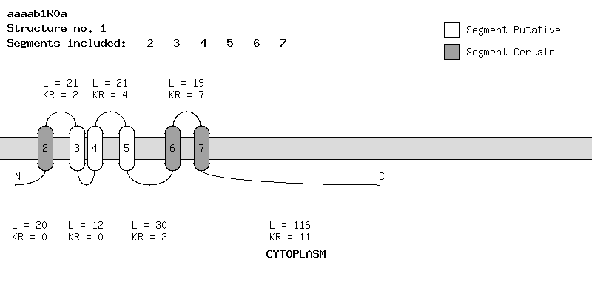

Slide 45
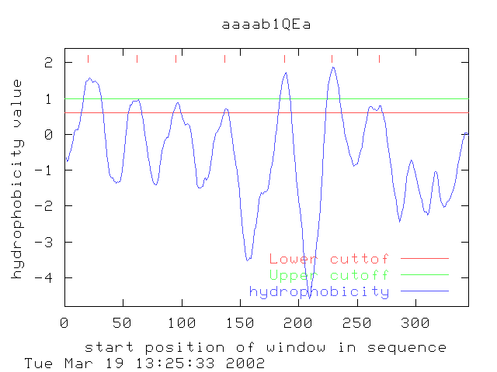

Slide 46
Secondary Structure Prediction

Slide 47
Secondary Structure Prediction
Only known as Robson’s method in the UK; the rest of the world uses its proper name, which is GARNIER or the GOR method, Dave!
Traditional methods
Chou & Fasman
Statistical & rule-based method
Lim
Stereochemical rules
Garnier, Osguthorpe & Robson
Statistical method
Accuracy ~ 60%

Slide 48
Secondary structure prediction
Traditional methods
Chou & Fasman
Statistical & rule-based method
Lim
Stereochemical rules
Garnier, Osguthorpe & Robson
Statistical method
Accuracy ~ 60%

Slide 49
GOR helix parameters
i-8 i-6 i-4 i-2 i i+2 i+4 i+6 i+8
Gly -5 -10 -15 -20 -30 -40 -50 -60 -86 -60 -50 -40 -30 -20 -15 -10 -5
ala 5 10 15 20 30 40 50 60 65 60 50 40 30 20 15 10 5
val 0 0 0 0 0 0 5 10 14 10 5 0 0 0 0 0 0
leu 0 5 10 15 20 25 28 30 32 30 28 25 20 15 10 5 0
ile 5 10 15 20 25 20 15 10 6 0 -10 -15 -20 -25 -20 -10 -5
ser 0 -5 -10 -15 -20 -25 -30 -35 -39 -35 -30 -25 -20 -15 -10 -5 0
thr 0 0 0 -5 -10 -15 -20 -25 -26 -25 -20 -15 -10 -5 0 0 0
asp 0 -5 -10 -15 -20 -15 -10 0 5 10 15 20 20 20 15 10 5
glu 0 0 0 0 10 20 60 70 78 78 78 78 78 70 60 40 20
asn 0 0 0 0 -10 -20 -30 -40 -51 -40 -30 -20 -10 0 0 0 0
gln 0 0 0 0 5 10 20 20 10 -10 -20 -20 -10 -5 0 0 0
lys 20 40 50 55 60 60 50 30 23 10 5 0 0 0 0 0 0
his 10 20 30 40 50 50 50 30 12 -20 -10 0 0 0 0 0 0
arg 0 0 0 0 0 0 0 0 -9 -15 -20 -30 -40 -50 -50 -30 -10
phe 0 0 0 0 0 5 10 15 16 15 10 5 0 0 0 0 0
tyr -5 -10 -15 -20 -25 -30 -35 -40 -45 -40 -35 -30 -25 -20 -15 -10 -5
trp -10 -20 -40 -50 -50 -10 0 10 12 10 0 -10 -50 -50 -40 -20 -10
cys 0 0 0 0 0 0 -5 -10 -13 -10 -5 0 0 0 0 0 0
met 10 20 25 30 35 40 45 50 53 50 45 40 35 30 25 20 10
pro -10 -20 -40 -60 -80 -100 -120 -140 -77 -60 -30 -20 -10 0 0 0 0

Slide 50
I S G A R N I E R H E L I X P R E D I C T
i-8 i-6 i-4 i-2 i i+2 i+4 i+6 i+8
Gly -5 -10 -15 -20 -30 -40 -50 -60 -86 -60 -50 -40 -30 -20 -15 -10 -5
ala 5 10 15 20 30 40 50 60 65 60 50 40 30 20 15 10 5
val 0 0 0 0 0 0 5 10 14 10 5 0 0 0 0 0 0
leu 0 5 10 15 20 25 28 30 32 30 28 25 20 15 10 5 0
ile 5 10 15 20 25 20 15 10 6 0 -10 -15 -20 -25 -20 -10 -5
ser 0 -5 -10 -15 -20 -25 -30 -35 -39 -35 -30 -25 -20 -15 -10 -5 0
thr 0 0 0 -5 -10 -15 -20 -25 -26 -25 -20 -15 -10 -5 0 0 0
asp 0 -5 -10 -15 -20 -15 -10 0 5 10 15 20 20 20 15 10 5
glu 0 0 0 0 10 20 60 70 78 78 78 78 78 70 60 40 20
asn 0 0 0 0 -10 -20 -30 -40 -51 -40 -30 -20 -10 0 0 0 0
gln 0 0 0 0 5 10 20 20 10 -10 -20 -20 -10 -5 0 0 0
lys 20 40 50 55 60 60 50 30 23 10 5 0 0 0 0 0 0
his 10 20 30 40 50 50 50 30 12 -20 -10 0 0 0 0 0 0
arg 0 0 0 0 0 0 0 0 -9 -15 -20 -30 -40 -50 -50 -30 -10
phe 0 0 0 0 0 5 10 15 16 15 10 5 0 0 0 0 0
tyr -5 -10 -15 -20 -25 -30 -35 -40 -45 -40 -35 -30 -25 -20 -15 -10 -5
trp -10 -20 -40 -50 -50 -10 0 10 12 10 0 -10 -50 -50 -40 -20 -10
cys 0 0 0 0 0 0 -5 -10 -13 -10 -5 0 0 0 0 0 0
met 10 20 25 30 35 40 45 50 53 50 45 40 35 30 25 20 10
pro -10 -20 -40 -60 -80 -100 -120 -140 -77 -60 -30 -20 -10 0 0 0 0

Slide 51
NOG IN TE VULLEN
Hier een dia met de vier GOR curves, waaruit duidelijk wordt dat GOR gewoon de hoogste voorspelde waarde neemt.
Maak ook duidelijk dat Chou-Fasman nog wat extra regels m.b.t. element-lengte en vormers/brekers hanteert

Slide 52
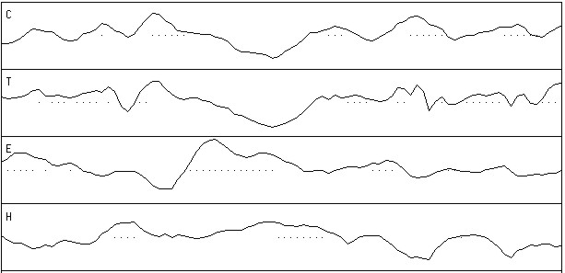
GOR prediction
beta sheet
helix

Slide 53
Secondary structure prediction
Recent methods
Neural networks = flexible statistics
Multiple alignments = variability
Heuristics = common sense
Or a combination of the above
Accuracy ~ 70% and beyond

Slide 54
Heuristics
Conserved parts are structurally and/or functionally important
Segments with many gaps must be in loop regions

Slide 55
....,....1....,....2....,....3....,....4....,....5....,....6 AA |MGNITADNSSMSCTIDHTIHQTLAPVVYVTVLVVGFPANCLSLYFGYLQIKARNELGVYL| PHD sec | EEEEEEEEEEEEEEEE EEEEEEEEE EEEEH| Rel sec |999888777778664312114577778899998652421224545552233655401121| detail: prH sec |000000111111112344321110000000000001244542232323322111123434| prE sec |000000000000011011345677778899988773000136666665542111234454| prL sec |999888878888766543332111111100000225655310000000025766532000| subset: SUB sec |LLLLLLLLLLLLLL.......EEEEEEEEEEEEEE.......E.EEE....LLL......| accessibility 3st: P_3 acc |eeeeeeeeeeeebebeeebeebbbbbbbbbbbbbbbbbbbbbbbbbbbeeeeeebbbbbb| 10st: PHD acc |997667777777070777066000000000000000000000000000666777000000| Rel acc |011000101111010111101165348589989974232478979750001111121869| subset: SUB acc |......................bb.bbbbbbbbbbb...bbbbbbbb..........bbb| ....,....7....,....8....,....9....,....10...,....11...,....12 AA |CNLTVADLFYICSLPFWLQYVLQHDNWSHGDLSCQVCGILLYENIYISVGFLCCISVDRY| PHD sec |HHHHHHHHHHHHHHHHHEEHHHH HHHHHHHHHEEEEHHHHHHHHHHEEE EE| Rel sec |234678787876311431213521642122577887431133414542223323111135| detail: prH sec |556778887877544554455654112233677877654433245654555553334421| prE sec |332110000001211135543110012321001011234455621122332345444356| prL sec |000000101110234200000234764345211001111110132222111101211221| subset: SUB sec |...HHHHHHHHH.........H..L.....HHHHHH.........H.............E| accessibility 3st: P_3 acc |bbbbbbbbbbbbbbbbbbbbbbeee bbbbebbbebbbbbbbbbbbbbbbbbbbbbbbbb| 10st: PHD acc |000000000000000000000067750000600060000000000000000000000000| Rel acc |858788377766363416310200003045137917423532535379878966665227| subset: SUB acc |bbbbbb.bbbbb.b.b.b..........bb..bb.bb..b..b.b.bbbbbbbbbbb..b|

Slide 56
....,....1....,....2....,....3....,....4....,....5....,....6 AA |MGNITADNSSMSCTIDHTIHQTLAPVVYVTVLVVGFPANCLSLYFGYLQIKARNELGVYL| PHD htm | TTTTTTTTTTTTTTTTTTTTTTTTTTTT TTTTT| Rel htm |999999999999999998874036778888887777777777777653101332012456| detail: prH htm |000000000000000000012468889999998888888888888876554333456778| prL htm |999999999999999999987531110000001111111111111123445666543221| PHDRhtm | TTTTTTTTTTTTTTTTTTTT TT| PHDThtm |ooooooooooooooooooooooooTTTTTTTTTTTTTTTTTTTTiiiiiiiiiiiiiiTT| subset: SUB htm |LLLLLLLLLLLLLLLLLLLLL..HHHHHHHHHHHHHHHHHHHHHHHH..........HHH|
....,....7....,....8....,....9....,....10...,....11...,....12 AA |CNLTVADLFYICSLPFWLQYVLQHDNWSHGDLSCQVCGILLYENIYISVGFLCCISVDRY| PHD htm |TTTTTTTTTTTTTTTTTTTTTT TTTTTTTTTTTTTTTTTTTTTTTTTTTTT| Rel htm |777777777777777776542013443443102246777777777777777777777766| detail: prH htm |888888888888888888776543223223456678888888888888888888888888| prL htm |111111111111111111223456776776543321111111111111111111111111| PHDRhtm |TTTTTTTTTTTTTTTTT TTTTTTTTTTTTTTTTTTTTTTT | PHDThtm |TTTTTTTTTTTTTTTTToooooooooooooooooooTTTTTTTTTTTTTTTTTTTTTTTi| subset: SUB htm |HHHHHHHHHHHHHHHHHHHH....LL.LL.....HHHHHHHHHHHHHHHHHHHHHHHHHH|

Slide 57
Secondary structure prediction
Strategy
Use homologous sequences
Use as many methods as possible
Combine predictions into consensus prediction

Slide 58
Why can’t it be 100% correct?
All current 2D prediction schemes are based upon observation of occurrence of 2D elements in 3D structures
Deduction of 2D elements from structures is ambiguous!
DSSP, Stride, and the PDB (human) annotation do not always agree upon the assigned elements

Slide 59
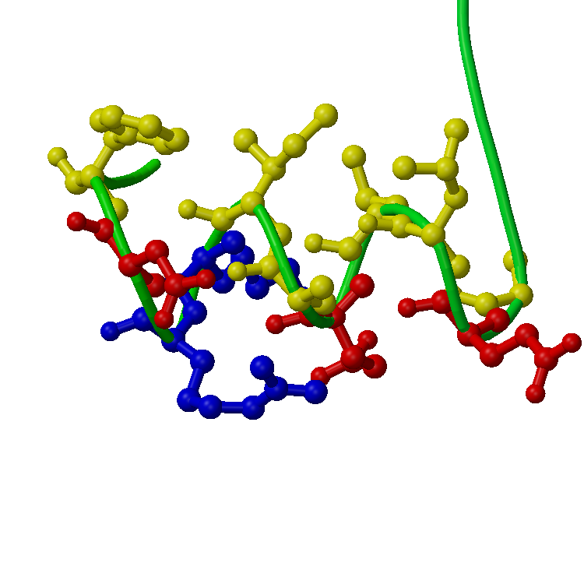
Do these residues still belong to the helix?

Slide 60
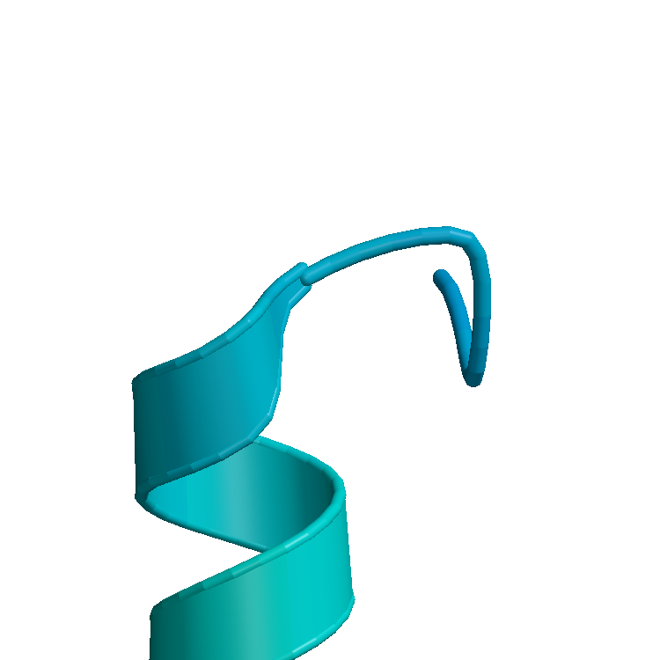

Slide 61
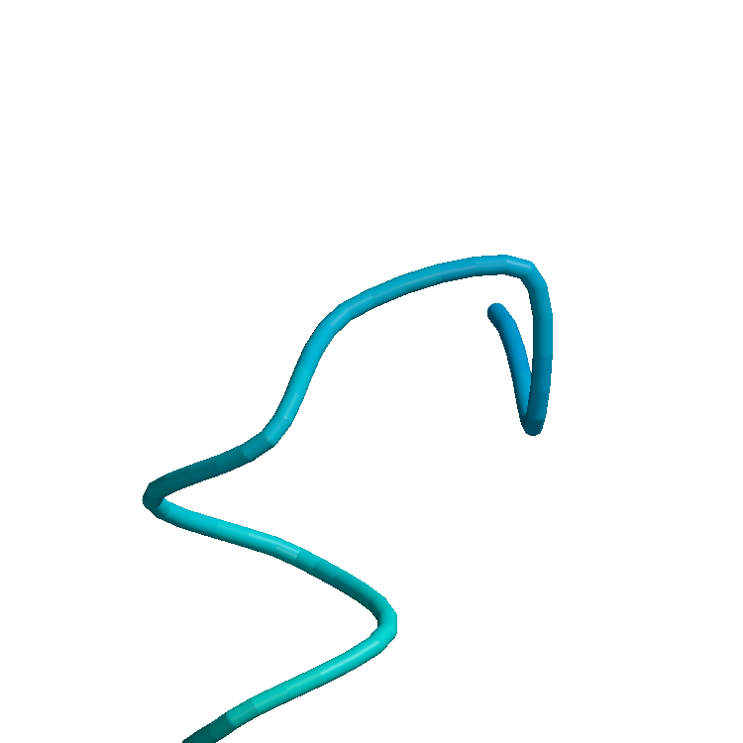

Slide 62
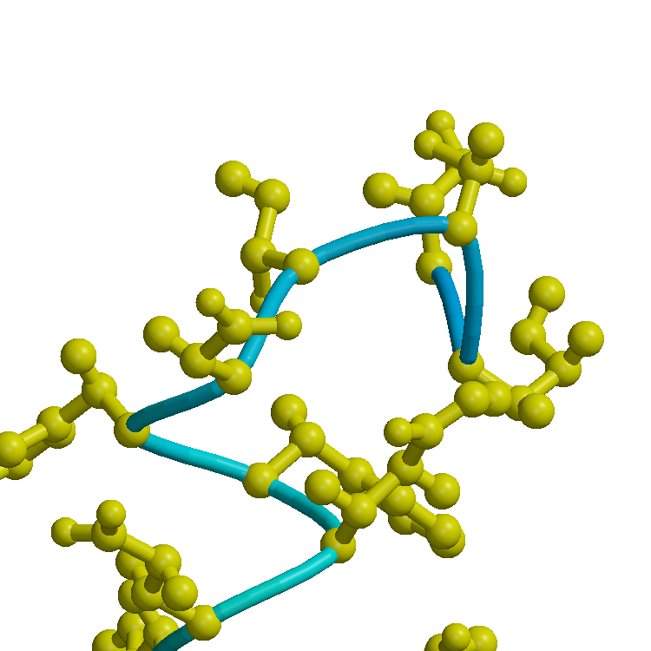

Slide 63
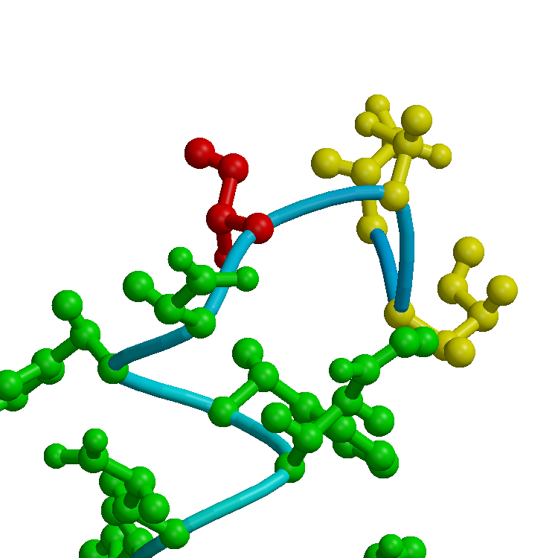

Slide 64
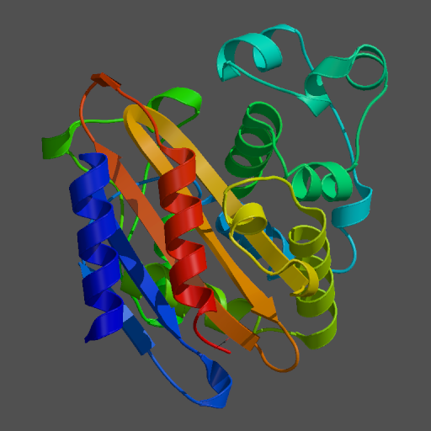
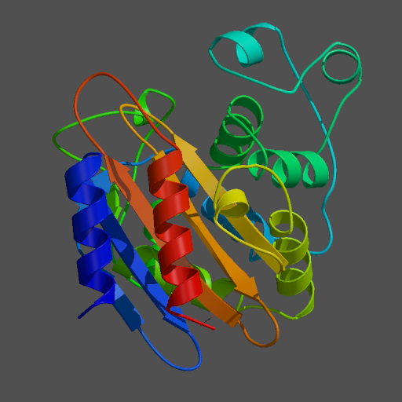
Hydrolase
PDB
H-bonds

Slide 65
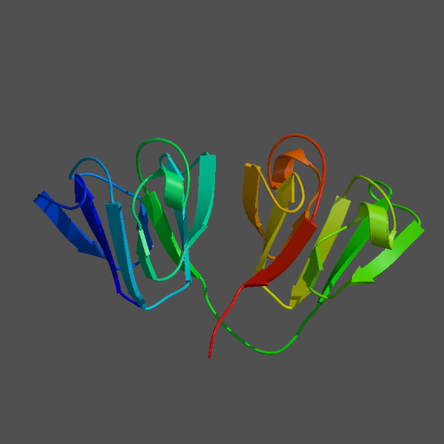
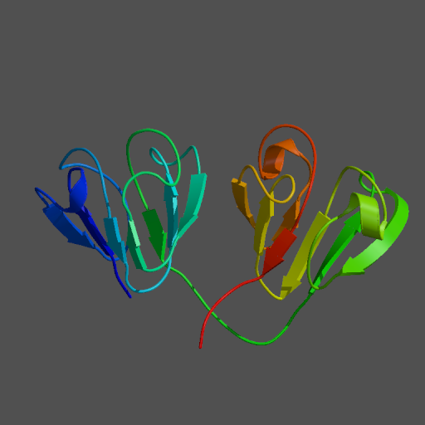
Gamma4 crystallin
PDB
H-bonds

Slide 66
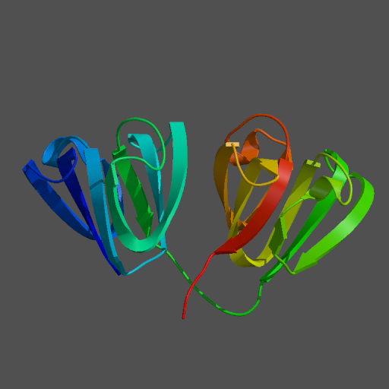
Gamma4 crystallin
PDB
C-alpha

Slide 67
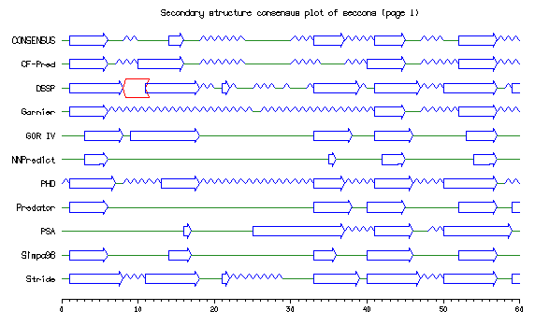

Slide 68
Hydrophobic Moment
Looking for amphipathic helices

Slide 69
Amphipathic helices
An amphipathic helix is a helix in which there is a distinct difference in distribution of hydrophobic and hydrophilic residues

Slide 71
Hydrophobic moment
V
Hydropathy vectors are distributed more or less equally in all directions, hence resultant vector has small or zero size
I
L
F
A
C
M

Slide 72
Hydrophobic moment
V
Hydropathy vectors are distributed unequally over all directions, hence resultant vector has a greater than zero size.
R
L
D
A
K
M
This helix is amphipathic!

Slide 73
Hydrophobic moment plot
In text: the hydrophobic moment is the sum the vectors of the hydrophobicity values of all amino acids in a window, while imposing a certain secondary structure element to it.
Alpha-helix: delta = 100, beta-sheet: delta = ~ 160

Slide 74
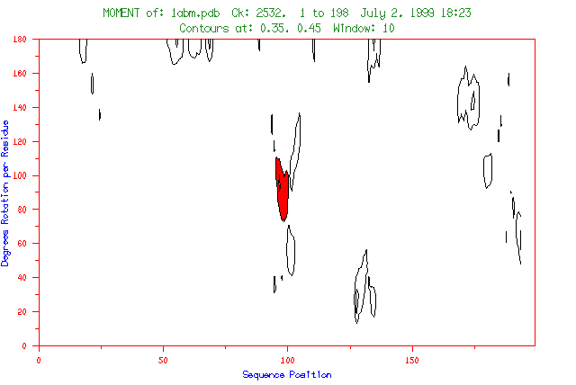

Slide 76
Contour level 2
Contour level 1

Slide 78
Contour level 2
Contour level 1

Slide 79
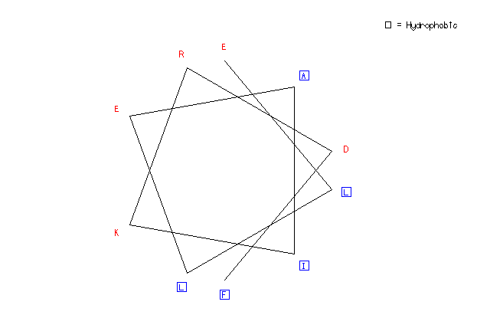
Helical wheel plot

Slide 80
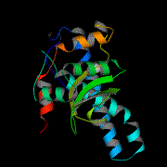
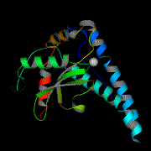
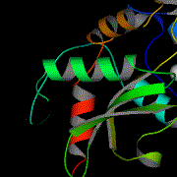
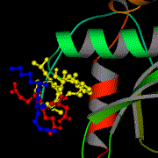
Amphipathic helices
Manganese superoxide dismutase (PDB:1ABM)

Slide 87
hydro-
phobic
hydrophilic

Slide 88
Amphipathic helices
Manganese superoxide dismutase (PDB:1ABM)

Slide 89
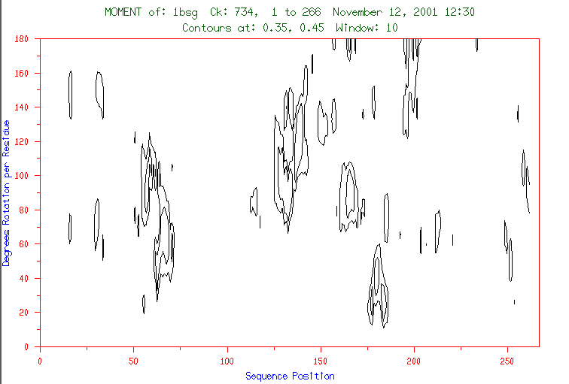

Slide 90
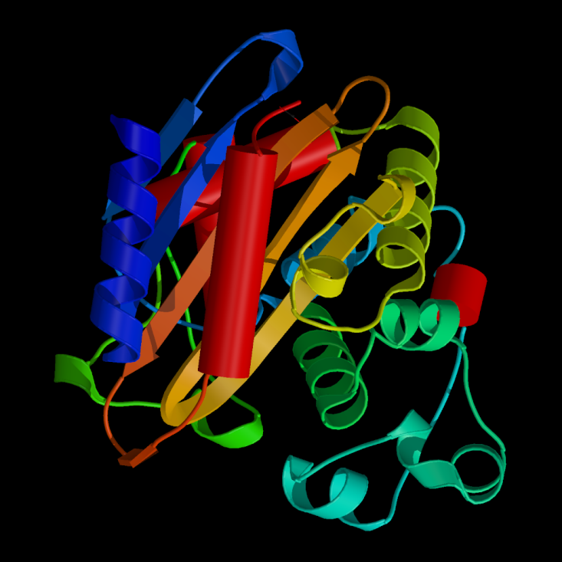
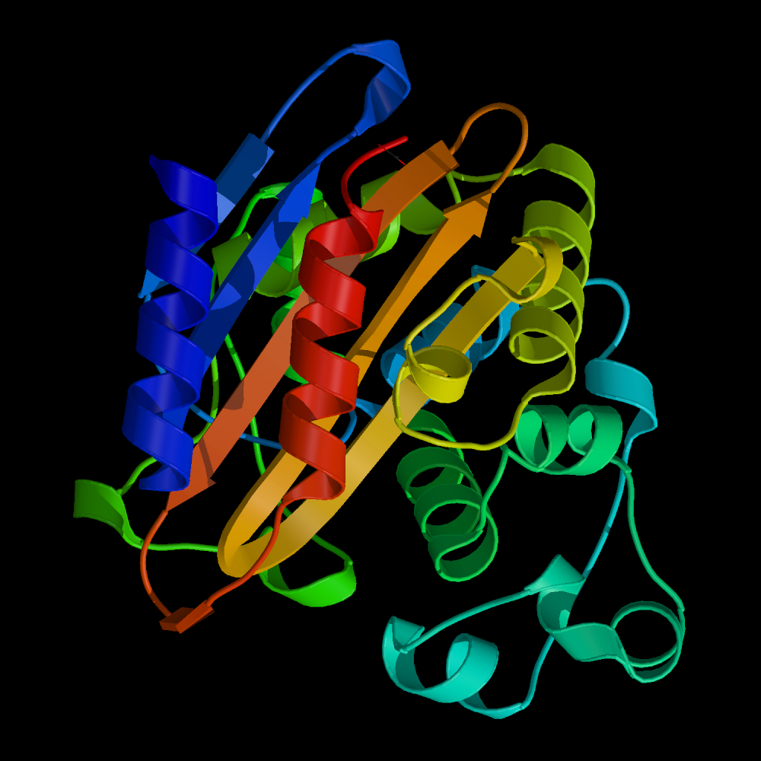
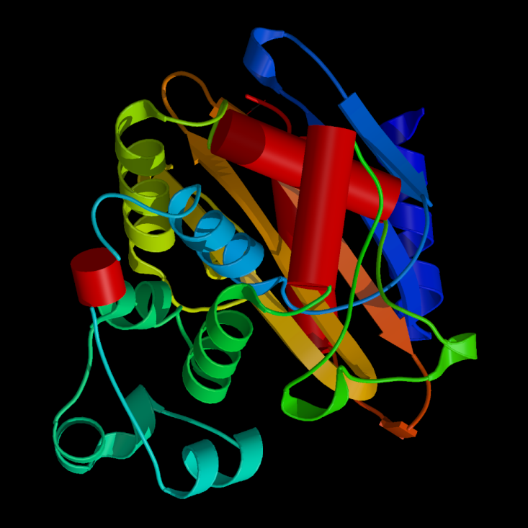

Slide 91
Coiled-Coil Prediction

Slide 92
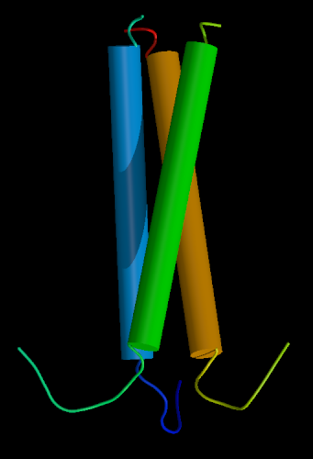
Coiled-coil helices
Intertwined helices form a three-helix bundle
Typical example: keratins, intermediary filament proteins

Slide 93
Coiled-coil helices
Intertwined helices form a three-helix bundle
Typical example: keratins, intermediary filament proteins

Slide 94
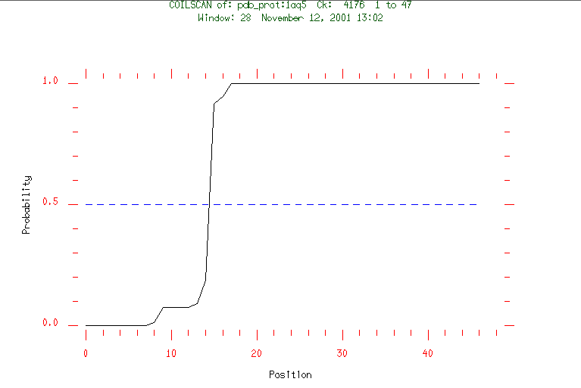
PEPCOIL of MATN1_CHICK
using a window of 28 residues
Other structures from 1 to 461 (461 residues)
Max score: 1.290 (probability 0.23)
Prediction starts at 462
Probable coiled-coil from 462 to 493 (32 residues)
Max score: 1.912 (probability 1.00)

Slide 95
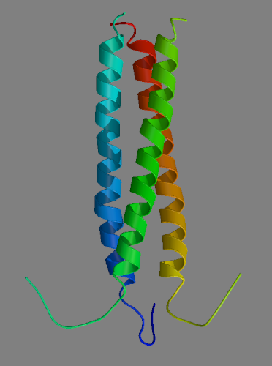
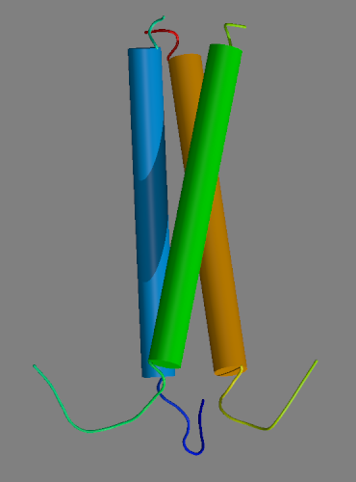
Coiled-coil Prediction
PDB:1AQ5
Chicken cartilage matrix protein

Slide 96
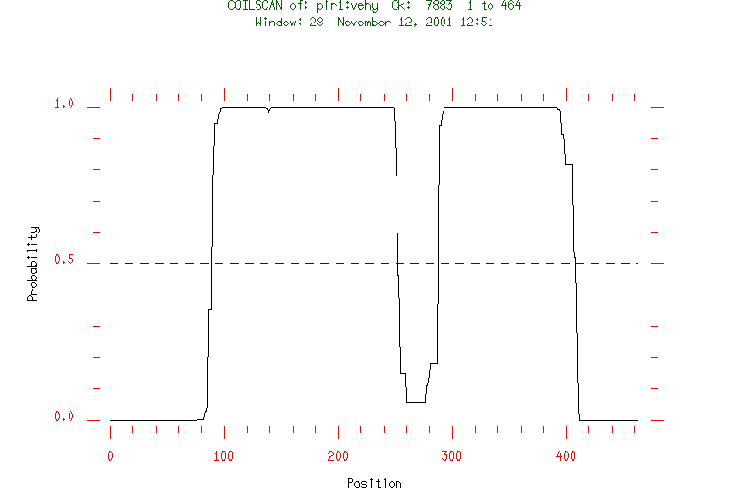
Intermediate Filament Proteins
PEPCOIL of VEHY using a window of 28 residues
Other structures from 1 to 90 (90 residues)
Max score: 1.317 (probability 0.33)
Prediction starts at 91 probable coiled-coil from 91 to 250 (159 residues)
Max score: 1.926 (probability 1.00)
Other structures from 251 to 291 (41 residues)
Max score: 1.341 (probability 0.44)
Prediction starts at 292 probable coiled-coil from 292 to 410 (118 residues)
Max score: 1.747 (probability 1.00)
Other structures from 411 to 464 (54 residues)
Max score: 1.289 (probability 0.23)

