Slide 1
Bioinformatics Topics
Informatics
Biology
Operating
Systems
Windows, Macintosh both offer an intuitive GUI … familiarity can be assumed?
Linux with a Windows like GUI interface … also, familiarity can be assumed?

Slide 2
Bioinformatics Topics
Informatics
Biology
Operating
Systems
Linux command line! … complexity is overstated, but some instruction is required.
All OS options are conceptually identical … enabling control over files, folders, and programs.
Linux command line! … the only option for compute intense software.

Slide 3
Bioinformatics Topics
Informatics
Biology
Operating
Systems
Programming
Rarely is there a need to become a truly proficient programmer.
BUT - Sufficient skill to affect basic management of large datasets is important.
AS IS - Sufficient skill to construct simple customised pipelines.

Slide 4
Bioinformatics Topics
Informatics
Biology
Operating
Systems
Programming
Python is currently the most popular Programming Language for Bioinformatics.
Minimal programming skill levels
would allow:
The construction of small programs.
The understanding of slightly larger programs.
Ability to convey program specifications to a specialist.

Slide 5
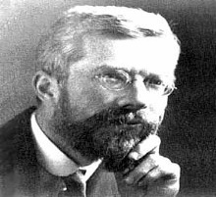
Bioinformatics Topics
Informatics
Biology
Operating
Systems
Programming
Statistics
A basic understanding of Statistics is just as vital when designing an experiment.
“To call in the statistician after the experiment is done may be no more than asking him to perform a post-mortem examination: he may be able to say what the experiment died of.”
As it is when large datasets need to be interpreted, which sensibly demands a working familiarity with a quality Statistical Package.
Bioinformatics software commonly employs statistics to select the most probable answer from a set of many possible answers to a given question.

Slide 6
End of Part 1

Slide 7

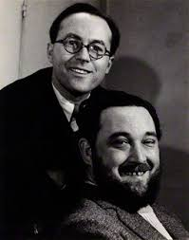



BREAK!
More to come I fear … but time for a swift cup of tea perchance?
Maybe time for a short jig? The whistling of a merry tune?
Or, mayhap, a delving into the melodic possibilities of youtube?
There be much good stuff there … I offer you a few of my favourites.
Once fully refreshed …. Click on mon braves!

