Slide 1
Bioinformatics Topics
Informatics
Biology
Operating
Systems
Windows, Macintosh both offer an intuitive GUI … familiarity can be assumed?
Linux with a Windows like GUI interface … also, familiarity can be assumed?
Notes:
The purpose of this talk is to consider the major components of Bioinformatics.
The intention here is not to be comprehensive, but to suggest a frame work in which to fit the topics covered in your course.
<Click>
Here, I have divided the Bioinformatic topics to be considered into those that are primarily "informatics" issues
<Click>
and those that are directly concerned with the management of Biological data.
<Click>
The most fundamental Informatics issue is the Operating system.
One must be able to control the computer before one can expect it to do anything useful!
<Click>
Currently, and many would argue unfortunately, Windows is still the most common operating system, followed ever more closely by the Macintosh Operating system.
Both Windows and the Macintosh offer very sophisticated and intuitive Graphical User Interfaces (or GUIs) with which most people under 35 have been familiar since birth!
<Click>
The Linux operating system is becoming increasingly popular.
These days, Linux comes with very good graphical user Interfaces that, distressingly to some, ever more closely mimic Windows.
Linux, with a good Graphical User Interface should seem very familiar to all of you.
I suggest it is safe to assume familiarity with any of these systems with a good GUI.
<Click>

Slide 2
Bioinformatics Topics
Informatics
Biology
Operating
Systems
Linux command line! … complexity is overstated, but some instruction is required.
All OS options are conceptually identical … enabling control over files, folders, and programs.
Linux command line! … the only option for compute intense software.

Slide 3
Bioinformatics Topics
Informatics
Biology
Operating
Systems
Programming
Rarely is there a need to become a truly proficient programmer.
BUT - Sufficient skill to affect basic management of large datasets is important.
AS IS - Sufficient skill to construct simple customised pipelines.
Notes:
The purpose of this talk is to consider the major components of Bioinformatics.
The intention here is not to be comprehensive, but to suggest a frame work in which to fit the topics covered in your course.
<Click>
Here, I have divided the Bioinformatic topics to be considered into those that are primarily "informatics" issues
<Click>
and those that are directly concerned with the management of Biological data.
<Click>
The most fundamental Informatics issue is the Operating system.
One must be able to control the computer before one can expect it to do anything useful!
<Click>
Currently, and many would argue unfortunately, Windows is still the most common operating system, followed ever more closely by the Macintosh Operating system.
Both Windows and the Macintosh offer very sophisticated and intuitive Graphical User Interfaces (or GUIs) with which most people under 35 have been familiar since birth!
<Click>

Slide 4
Bioinformatics Topics
Informatics
Biology
Operating
Systems
Programming
Python is currently the most popular Programming Language for Bioinformatics.
Minimal programming skill levels
would allow:
The construction of small programs.
The understanding of slightly larger programs.
Ability to convey program specifications to a specialist.

Slide 5
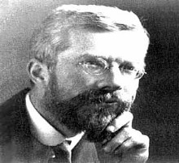
Bioinformatics Topics
Informatics
Biology
Operating
Systems
Programming
Statistics
A basic understanding of Statistics is just as vital when designing an experiment.
“To call in the statistician after the experiment is done may be no more than asking him to perform a post-mortem examination: he may be able to say what the experiment died of.”
As it is when large datasets need to be interpreted, which sensibly demands a working familiarity with a quality Statistical Package.
Bioinformatics software commonly employs statistics to select the most probable answer from a set of many possible answers to a given question.

Slide 6
Bioinformatics Topics
Informatics
Biology
Operating
Systems
Data
Generation
Programming
Statistics
Experimental Data types include :
Sequences - Typically Next-Generation DNA Sequencing (NGS).
3D Protein Structures - X-ray crystallography or
Nuclear magnetic resonance spectroscopy (NMR)
Gene Expression Data - Microarrays

Slide 7
Bioinformatics Topics
Informatics
Biology
Operating
Systems
Data
Generation
Data
Analysis
Programming
Statistics
The Alignment of Pairs of Homologous DNA/Protein sequences.
Fundamental to most forms of DNA/Protein Sequence analysis
Substitution
Deletion
Conservation
Insertion
… ACYGQWRWDVIS…
… ACYG-QWRWDVI-S…
Putative
Ancestor Sequence
… ACFGHQWRWDVIS…
Sequences of
Homologous Proteins
… ACFGHQWRWDVI-S…
… ACFGHQWRWDVILS…

Slide 8
Bioinformatics Topics
Informatics
Biology
Operating
Systems
Data
Generation
Data
Analysis
Programming
Statistics
The Alignment of Families of Homologous sequences.
First, find a family of Homologous sequences.
... APFELVISWKLIVESPAINCDWRTENGLANDSGMLVNOWPAI ...
... APYELVISQWKLIVESNPAINKDWRTYENGLANDSGMLVNOWAI ...
... APFELVISWKLIVESNPAINCDWRTENGLANDSGMLVNOWAI ...
... APFELVISQWKLIVESNPAINCDWRTENGLANDSGMLVNOWAI ...
... APYELVISWKLIVESNPINCDWRTENGLANDRSGMLINOWAI ...
... APFELVISQWKLIVESNPAINCDWRTENGLANDSGMLVNOWLI ...
... APFELVISQWKLIVESNPAINDWRTENGLANDSGMLVNOWAI ...
... APYELVISWKLIVESNPAINCDWRTENGLANDSGMLLNOWMI ...

Slide 9
Bioinformatics Topics
Informatics
Biology
Operating
Systems
Data
Generation
Data
Analysis
Programming
Statistics
The Alignment of Families of Homologous sequences.
Then, align by inserting “-”s representing InDels, in each sequence.
... APFELVIS-WKLIVES-PAINCDWRT-ENGLANDSGMLV-NOWPAI ...
... APFELVISWKLIVESPAINCDWRTENGLANDSGMLVNOWPAI ...
... APYELVISQWKLIVESNPAINKDWRTYENGLANDSGMLVNOWAI ...
... APYELVISQWKLIVESNPAINKDWRTYENGLANDSGMLV-NOW-AI ...
... APFELVIS-WRLIVESNPAINCDWRT-ENGLANDSGMLV-NOW-AI ...
... APFELVISWKLIVESNPAINCDWRTENGLANDSGMLVNOWAI ...
... APFELVISQWKLIVESNPAINCDWRT-ENGLANDSGMLV-NOW-AI ...
... APFELVISQWKLIVESNPAINCDWRTENGLANDSGMLVNOWAI ...
... APYELVIS-WKLIVESNP-INCDWRT-ENGLANDRSGMLINOW-AI ...
... APYELVISWKLIVESNPINCDWRTENGLANDRSGMLINOWAI ...
... APFELVISQWKLIVESNPAINCDWRT-ENGLANDSGMLV-NOW-LI ...
... APFELVISQWKLIVESNPAINCDWRTENGLANDSGMLVNOWLI ...
... APFELVISQWKLIVESNPAIN-DWRT-ENGLANDSGMLV-NOW-AI ...
... APFELVISQWKLIVESNPAINDWRTENGLANDSGMLVNOWAI ...
... APYELVIS-WKLIVESNPAINCDWRT-ENGLANDSGMLL-NOW-MI ...
... APYELVISWKLIVESNPAINCDWRTENGLANDSGMLLNOWMI ...

Slide 10
Bioinformatics Topics
Informatics
Biology
Operating
Systems
Data
Generation
Data
Analysis
Programming
Statistics
The Alignment of Families of Homologous sequences.
Next, identify the columns where Substitutions and/or InDels have been predicted.
... APFELVIS-WKLIVES-PAINCDWRT-ENGLANDSGMLV-NOWPAI ...
... APFELVISWKLIVESPAINCDWRTENGLANDSGMLVNOWPAI ...
... APFELVIS-WKLIVES-PAINCDWRT-ENGLANDSGMLV-NOWPAI ...
... APYELVISQWKLIVESNPAINKDWRTYENGLANDSGMLVNOWAI ...
... APYELVISQWKLIVESNPAINKDWRTYENGLANDSGMLV-NOW-AI ...
... APYELVISQWKLIVESNPAINKDWRTYENGLANDSGMLV-NOW-AI ...
... APFELVIS-WRLIVESNPAINCDWRT-ENGLANDSGMLV-NOW-AI ...
... APFELVISWKLIVESNPAINCDWRTENGLANDSGMLVNOWAI ...
... APFELVIS-WRLIVESNPAINCDWRT-ENGLANDSGMLV-NOW-AI ...
... APFELVISQWKLIVESNPAINCDWRT-ENGLANDSGMLV-NOW-AI ...
... APFELVISQWKLIVESNPAINCDWRTENGLANDSGMLVNOWAI ...
... APFELVISQWKLIVESNPAINCDWRT-ENGLANDSGMLV-NOW-AI ...
... APYELVIS-WKLIVESNP-INCDWRT-ENGLANDRSGMLINOW-AI ...
... APYELVISWKLIVESNPINCDWRTENGLANDRSGMLINOWAI ...
... APYELVIS-WKLIVESNP-INCDWRT-ENGLANDRSGMLINOW-AI ...
... APFELVISQWKLIVESNPAINCDWRT-ENGLANDSGMLV-NOW-LI ...
... APFELVISQWKLIVESNPAINCDWRTENGLANDSGMLVNOWLI ...
... APFELVISQWKLIVESNPAINCDWRT-ENGLANDSGMLV-NOW-LI ...
... APFELVISQWKLIVESNPAIN-DWRT-ENGLANDSGMLV-NOW-AI ...
... APFELVISQWKLIVESNPAINDWRTENGLANDSGMLVNOWAI ...
... APFELVISQWKLIVESNPAIN-DWRT-ENGLANDSGMLV-NOW-AI ...
... APYELVIS-WKLIVESNPAINCDWRT-ENGLANDSGMLL-NOW-MI ...
... APYELVISWKLIVESNPAINCDWRTENGLANDSGMLLNOWMI ...
... APYELVIS-WKLIVESNPAINCDWRT-ENGLANDSGMLL-NOW-MI ...

Slide 11
Bioinformatics Topics
Informatics
Biology
Operating
Systems
Data
Generation
Data
Analysis
Programming
Statistics
The Alignment of Families of Homologous sequences.
Then, identify the columns where full Conservation has been predicted.
... APFELVIS-WKLIVES-PAINCDWRT-ENGLANDSGMLV-NOWPAI ...
... APFELVIS-WKLIVES-PAINCDWRT-ENGLANDSGMLV-NOWPAI ...
... APYELVISQWKLIVESNPAINKDWRTYENGLANDSGMLV-NOW-AI ...
... APYELVISQWKLIVESNPAINKDWRTYENGLANDSGMLV-NOW-AI ...
... APFELVIS-WRLIVESNPAINCDWRT-ENGLANDSGMLV-NOW-AI ...
... APFELVIS-WRLIVESNPAINCDWRT-ENGLANDSGMLV-NOW-AI ...
... APFELVISQWKLIVESNPAINCDWRT-ENGLANDSGMLV-NOW-AI ...
... APFELVISQWKLIVESNPAINCDWRT-ENGLANDSGMLV-NOW-AI ...
... APYELVIS-WKLIVESNP-INCDWRT-ENGLANDRSGMLINOW-AI ...
... APYELVIS-WKLIVESNP-INCDWRT-ENGLANDRSGMLINOW-AI ...
... APFELVISQWKLIVESNPAINCDWRT-ENGLANDSGMLV-NOW-LI ...
... APFELVISQWKLIVESNPAINCDWRT-ENGLANDSGMLV-NOW-LI ...
... APFELVISQWKLIVESNPAIN-DWRT-ENGLANDSGMLV-NOW-AI ...
... APFELVISQWKLIVESNPAIN-DWRT-ENGLANDSGMLV-NOW-AI ...
... APYELVIS-WKLIVESNPAINCDWRT-ENGLANDSGMLL-NOW-MI ...
... APYELVIS-WKLIVESNPAINCDWRT-ENGLANDSGMLL-NOW-MI ...

Slide 12
Bioinformatics Topics
Informatics
Biology
Operating
Systems
Data
Generation
Data
Analysis
Programming
Statistics
The Alignment of Families of Homologous sequences.
Finally … Identify the Glorious Message!!!!.
... APFELVIS-WKLIVES-PAINCDWRT-ENGLANDSGMLV-NOWPAI ...
... APFELVIS-WKLIVES-PAINCDWRT-ENGLANDSGMLV-NOWPAI ...
... APYELVISQWKLIVESNPAINKDWRTYENGLANDSGMLV-NOW-AI ...
... APYELVISQWKLIVESNPAINKDWRTYENGLANDSGMLV-NOW-AI ...
... APFELVIS-WRLIVESNPAINCDWRT-ENGLANDSGMLV-NOW-AI ...
... APFELVIS-WRLIVESNPAINCDWRT-ENGLANDSGMLV-NOW-AI ...
... APFELVISQWKLIVESNPAINCDWRT-ENGLANDSGMLV-NOW-AI ...
... APFELVISQWKLIVESNPAINCDWRT-ENGLANDSGMLV-NOW-AI ...
... APYELVIS-WKLIVESNP-INCDWRT-ENGLANDRSGMLINOW-AI ...
... APYELVIS-WKLIVESNP-INCDWRT-ENGLANDRSGMLINOW-AI ...
... APFELVISQWKLIVESNPAINCDWRT-ENGLANDSGMLV-NOW-LI ...
... APFELVISQWKLIVESNPAINCDWRT-ENGLANDSGMLV-NOW-LI ...
... APFELVISQWKLIVESNPAIN-DWRT-ENGLANDSGMLV-NOW-AI ...
... APFELVISQWKLIVESNPAIN-DWRT-ENGLANDSGMLV-NOW-AI ...
... APYELVIS-WKLIVESNPAINCDWRT-ENGLANDSGMLL-NOW-MI ...
... APYELVIS-WKLIVESNPAINCDWRT-ENGLANDSGMLL-NOW-MI ...

Slide 13
Bioinformatics Topics
Informatics
Biology
Operating
Systems
Data
Generation
Data
Analysis
Programming
Statistics
Searching for Homologous Sequences in a Sequence Database.
Database searching is the most common Bioinformatics process by far.
Database searching is pairwise comparison repeated many times.
Non-optimal comparison methods are essential for practical reasons.
A list of matches, ordered by the improbability of occurring just by chance is generated.

Slide 14
Bioinformatics Topics
Informatics
Biology
Operating
Systems
Data
Generation
Data
Analysis
Programming
Statistics
Searching for Homologous Sequences in a Sequence Database.
Database searching seeks “Similarity”. Users seek “Homology”.
Homology?
Query
KLYPLRPQTPEPPPPPPPPPPPPLPAAPPQP
Similarity
+L P +P P P PP P PP PP+P
Database Entry
RLTPPQPLMMPPRPTPPTPLPPATLTVPPRP
Or 2 proteins including a lot of Prolines??

Slide 15
Bioinformatics Topics
Informatics
Biology
Operating
Systems
Data
Generation
Data
Analysis
Programming
Statistics
Searching for Homologous Sequences in a Sequence Database.
Database searching seeks “Similarity”. Users seek “Homology”.
Homology?
Query
TCTCCCATTCGTAAAAAAAAAAAAAAAAAA
Similarity
||| ||||| ||||||||||||||||||||
Database Entry
TCTTCCATTTGTAAAAAAAAAAAAAAAAAA
Or 2 unrelated mRNAs??

Slide 16
Bioinformatics Topics
Informatics
Biology
Operating
Systems
Data
Generation
Data
Analysis
Programming
Statistics
Searching for Homologous Sequences in a Sequence Database.
Database searching seeks “Similarity”. Users seek “Homology”.
Homology?
Query
TTAGCAAGATCAGCCCTAACTCGGCATCTT
Similarity
| || | || | | | || | || |
Database Entry
CTTGCGCGCTCTGTCTTGACGAGACACTTA
A very unconvincing alignment!!

Slide 17
Bioinformatics Topics
Informatics
Biology
Operating
Systems
Data
Generation
Data
Analysis
Programming
Statistics
Searching for Homologous Sequences in a Sequence Database.
Database searching seeks “Similarity”. Users seek “Homology”.
TTAGCAAGATCAGCCCTAACTCGGCATCTT
L A R S C L T R H L
Homology?
Query
TTAGCAAGATCAGCCCTAACTCGGCATCTT
Similarity
| || | || | | | || | || |
L A R S C L T R H L
Database Entry
CTTGCGCGCTCTGTCTTGACGAGACACTTA
L A R S C L T R H L
CTTGCGCGCTCTGTCTTGACGAGACACTTA
Probable --- a perfect protein match??
In all circumstances – always align at the protein level wherever possible.

Slide 18
Bioinformatics Topics
Informatics
Biology
Operating
Systems
Data
Generation
Data
Analysis
Programming
Statistics
Searching for simple sequence patterns Sequences
in DNA.
Largely a matter of finding short sequences within longer ones.
Computationally trivial.
A concrete example is required:
Restriction Mapping
Detecting Restriction Enzyme Recognition Sites is complicated by their redundancy.
Few Recognition Sites can be simply defined using only the codes A, C, G and T.

Slide 19

The solution is to use the Nucleotide Ambiguity Codes defined by IUPAC.
IUPAC DNA Alphabet
Code Meaning
A A
C C
G G
T/U T/U
M `aMino` A|C
R `puRine` A|G
W `Weak` A|T
S `Strong` C|G
Y `pYrimidine` C|T
K `Keto` G|T
V `not T` A|C|G
H `not G` A|C|T
D `not C` A|G|T
B `not A` C|G|T
N `aNy` A|C|G|T
Unambiguous site (EcoRI):
G/AATC
Ambiguous site (PpuMI):
RG/GWCCY
Cut here
And here
AGGACCT
TTAGCAAGATCAGGACCTACTCGGCATCTTCCTGGGTCCC
GGGTCCC
RGGWCCY

Slide 20
Bioinformatics Topics
Informatics
Biology
Operating
Systems
Data
Generation
Data
Analysis
Programming
Statistics
Searching for simple sequence patterns Sequences
in Proteins.
Patterns can be derived manually to represent conserved regions of MSAs
… CQVLNPYYHWGQCGGIGWSGPTVCASGTT …
… CQYSNDYYHWGQCGGIGWSGCKTCTSGTT …
… CHVLNPYYQWGQCGGIGWTPSTTCASPYT …
… CSTLNPYYVWGQCGGIGWSGPTNCAPGSA …
… CVYSNDYYVWGQCGGIGWSGPTCCASGST …
Simple where conservation is 100%
WGQCGGIGW
Pattern

Slide 21
Bioinformatics Topics
Informatics
Biology
Operating
Systems
Data
Generation
Data
Analysis
Programming
Statistics
Searching for simple sequence patterns Sequences
in Proteins.
… CQVLNPYYHWGQCGGIGWSGPTVCASGTT …
… CQYSNDYYHWGQCGGIGWSGCKTCTSGTT …
… CHVLNPYYQWGQCGGIGWTPSTTCASPYT …
… CSTLNPYYVWGQCGGIGWSGPTNCAPGSA …
… CVYSNDYYVWGQCGGIGWSGPTCCASGST …
Not so easy where conservation is less than perfect
… CQVLNPYYHWKQCGGLGWSGPTVCASGTT …
… CQYSNDYYHWGQCPGIGWSGCKTCTSGTT …
… CHVLNPYYQWAQCFGVGWTPSTTCASPYT …
… CSTLNPYYVWLQCYGIGWSGPTNCAPGSA …
… CVYSNDYYVWAQCGGVGWSGPTCCASGST …
An Amino Acid Alphabet including all ambiguities is not practical!
W{P}QCxG[LIV]GW
Pattern
The solution is a simple syntax for ambiguous amino acid sequences.
NOT a P
Anything
L or I or V

Slide 22
Bioinformatics Topics
Informatics
Biology
Operating
Systems
Data
Generation
Data
Analysis
Programming
Statistics
Searching for simple sequence patterns Sequences
in Proteins.
Match Here
Feature Site?
… GGSKFAWDGMYDKLRMLMRLWLQCKGVGWRTSFTQEQIEALEKEFERRQASNTPSHPI …
WLQCKGVGW
W{P}QCxG[LIV]GW

Slide 23
Bioinformatics Topics
Informatics
Biology
Operating
Systems
Data
Generation
Data
Analysis
Programming
Statistics
Searching for simple sequence patterns Sequences
in Proteins.
F
F
F
Y
F
F
F
F
Simple Protein patterns are of limited precision.
Only highly conserved regions can be described usefully.
[FY] --- or --- [FY] ?
Patterns cannot weight possibilities by frequency.

Slide 24
Bioinformatics Topics
Informatics
Biology
Operating
Systems
Data
Generation
Data
Analysis
Programming
Statistics
Searching for simple sequence patterns Sequences
in Proteins.
F
F
F
Y
F
F
F
F
F
F
F
F
F
F
F
F
Simple Protein patterns are of limited precision.
[FY] --- or --- [FY] ?
F --- or --- [FY] ?
Patterns do not reflect commonly accepted substitutions.

Slide 25
Bioinformatics Topics
Informatics
Biology
Operating
Systems
Data
Generation
Data
Analysis
Programming
Statistics
Searching for Protein properties with better models.
Again, start with an MSA of instances of the feature to be modelled.
Create a “suitable” representation of the relevant portion of MSA
Compare the model along other protein sequences was illustrated for simple patterns.
Where matches are detected, the corresponding protein property is likely to occur.

Slide 26
Bioinformatics Topics
Informatics
Biology
Operating
Systems
Data
Generation
Data
Analysis
Programming
Statistics
Searching for Protein properties with better models.
A variety of simple models have been developed (e.g. Position Weight Matrices)
for a number of purposes, including:
- Gene discovery in bacteria genomes (DNA) - TATA box Detection (DNA)
- Early versions of 2D protein Structure Prediction - Helix-Turn-Helix (HTH) Prediction
- Transmembrane Alpha Helix prediction - Prediction of Coiled Coils
The most powerful and prolific current profiles are Hidden Markov Models (HMMs)

Slide 27
Bioinformatics Topics
Informatics
Biology
Operating
Systems
Data
Generation
Data
Analysis
Programming
Statistics
Estimating evolution - Phylogeny.
Broadly, the estimation of evolutionary history from available evidence.
“Evidence” does not have to be a carefully crafted MSA of Orthologous sequences from a range of organisms.
However, in the context of Bioinformatics, it invariably is.

Slide 28
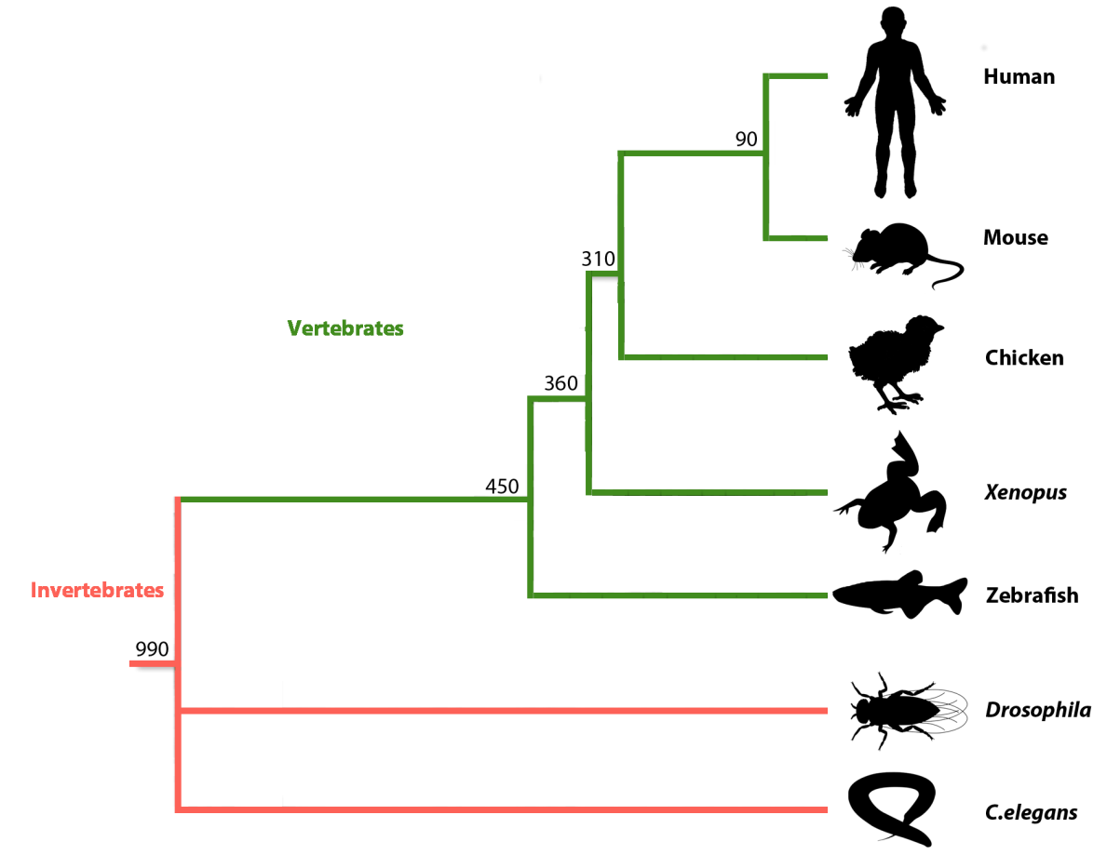
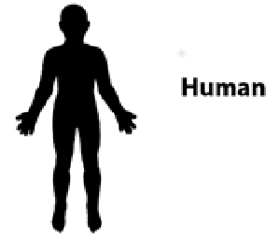
Typically, conclusions of Phylogenetic analysis are represented as Evolutionary Trees.
Which are very Beautiful!!
My personal preference is for trees that place ME as far away from a MOUSE as possible!!!!

Slide 29
Bioinformatics Topics
Informatics
Biology
Operating
Systems
Data
Generation
Data
Analysis
Programming
Statistics
Estimating evolution - Phylogeny.
Phylogeny is another example of an analysis based on MSAs.
One very effective Phylogenetic strategy is to seek an answer to the question:
“What is the most probable Evolutionary Tree, given I believe this MSA to be perfect?”
Reinforcing how central is the role of Statistics in Bioinformatics.

Slide 30
Bioinformatics Topics
Informatics
Biology
Operating
Systems
Data
Generation
Data
Analysis
Programming
Statistics
Protein structure prediction.
Secondary Structure.
Essentially predicting the locations of Alpha Helices, Beta Sheets and Turns.
Modern methods employ Machine Learning to generate Artificial Neural Networks.
That is profiles computed by “learning” from observation of examples.

Slide 31
Bioinformatics Topics
Informatics
Biology
Operating
Systems
Data
Generation
Data
Analysis
Programming
Statistics
Protein structure prediction.
Secondary Structure.
Better predictions are obtained from MSA data than from individual protein sequences.
General principle being, the more information offered, the more reliable the prediction.
Some systems will automatically generate an MSA if offered a solitary protein sequence.
Prediction will be based on the MSA, computed by iterative database searching.

Slide 32
Bioinformatics Topics
Informatics
Biology
Operating
Systems
Data
Generation
Data
Analysis
Programming
Statistics
Protein structure prediction.
Tertiary Structure.
Predicting Tertiary Structure directly from Primary Structure is not currently practical.
De novo protein structure prediction requires better algorithms and more computing power.
Homology modelling requires a reliable Tertiary Structure for a homologous protein.
Tertiary Structure for a protein is predicted by comparison with the homologous structure.
Homology modelling is hampered by low volumes and uneven spread of available structures.

Slide 33
Bioinformatics Topics
Informatics
Biology
Operating
Systems
Data
Generation
Data
Analysis
Data/Information
Storage/Access
Programming
Statistics
Overview.
Raw Experimental Data, can next be Annotated in the light of analytical revelation.
Data + Annotation = Information.
Information can now be stored in Databases that allow users easy and unrestricted access.

Slide 34


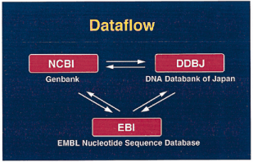


Primary DNA Sequence Databases
Original submission by experimentalists
Content controlled by the submitter

Slide 35

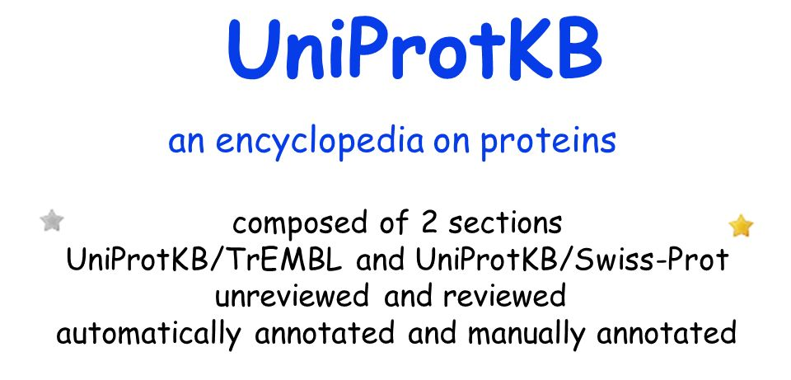


Primary Protein Sequence Databases

Slide 36
Derivative Sequence Databases
Built from primary data
RefSeq
Submission by experimentalists
Significant redundancy
Annotation inconsistent
DNA and RNA only
non-redundant
richly annotated
DNA, RNA, protein
diverse taxa
akin to the primary
research literature
akin to the review literature

Slide 37








Derivative Databases for Protein Features
Collections of HMMs representing Protein Domains and/or Motifs derived from Protein sequence Databases.
Some of the available domain/motif Databases.

Slide 38

Derivative Databases for Protein Features
It is generally wise to use more than one Feature Searching service.
This can be tedious, involving many websites and different search tools.
is a consortium of member databases.
defines protein families, domains, regions, repeats and sites according to matches against member databases
enables any subset of member databases to be searched together

Slide 39
Bioinformatics Topics
Informatics
Biology
Operating
Systems
Data
Generation
Data
Analysis
Data/Information
Storage/Access
Programming
Statistics
Genome Databases.
Genome Databases store entire genome sequence(s) AND their interpretation.
Each new sequenced genome or significantly re-assembled existing genome is fully analysed.
The individual processes for manual analysis are the same as those for automatic analysis.
Most have been mentioned in this simple talk.
Analysing an individual gene can be done manually.
Analysing an entire genome is only practical using automated strategies.

Slide 40



Bioinformatics Topics
Informatics
Biology
Operating
Systems
Data
Generation
Data
Analysis
Data/Information
Storage/Access
Programming
Statistics
Genome Databases.
The Three foremost Genome Database options
Ensembl and UCSC Browser software can be downloaded and used for private datasets.

Slide 41




Bioinformatics Topics
Informatics
Biology
Operating
Systems
Data
Generation
Data
Analysis
Data/Information
Storage/Access
Programming
Statistics
Protein Structure Databases.

Slide 42
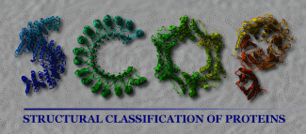


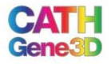
Bioinformatics Topics
Informatics
Biology
Operating
Systems
Data
Generation
Data
Analysis
Data/Information
Storage/Access
Programming
Statistics
Protein Structure Databases.

Slide 43
Bioinformatics Topics
Informatics
Biology
Operating
Systems
Data
Generation
Data
Analysis
Data/Information
Storage/Access
Programming
Statistics
Genetic Variation Databases.
Databases storing the many genetic variations that occur between individuals and species.
Widely incorporated into Genome Databases, such as Ensembl.
Since High Throughput Sequencing (HTS) has become standard, variation detection has become easier. Databases have developed dramatically.

Slide 44
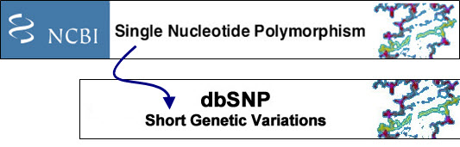
Bioinformatics Topics
Informatics
Biology
Operating
Systems
Data
Generation
Data
Analysis
Data/Information
Storage/Access
Programming
Statistics
Genetic Variation Databases.
dbSNP is the largest general database for genetic variations.
Originally just Single Nucleotide Polymophisms (SNPs).
Now includes other types of Short Genetic Variation.
dbSNP, originally focused on human variations, now covers many organisms.
dbSNP now records relationships between variation and phenotype.

Slide 45


Bioinformatics Topics
Informatics
Biology
Operating
Systems
Data
Generation
Data
Analysis
Data/Information
Storage/Access
Programming
Statistics
Other relevant databases include:
Microarray databases
There are a considerable number, both commercial and public domain.
Two major Public Domain Microarray Databases are:
The Gene Expression Omnibus (GEO), maintained in America.
ArrayExpress, maintained in Europe.

Slide 46
Bioinformatics Topics
Informatics
Biology
Operating
Systems
Data
Generation
Data
Analysis
Data/Information
Storage/Access
Programming
Statistics
Other relevant databases include:
Microarray databases
High Throughput Sequencing (HTS) has become a viable option to the use of Microarrays.
Accordingly, both GEO and ArrayExpress now manage HTS data sets.
ArrayExpress regularly imports data from GEO.

Slide 47
Bioinformatics Topics
Informatics
Biology
Operating
Systems
Data
Generation
Data
Analysis
Data/Information
Storage/Access
Programming
Statistics
Other relevant databases include:
Literature databases
Many free literature search/access services are available via the INTERNET.
You will be introduced to, arguably, the best and most famous as a part of this course.

Slide 48
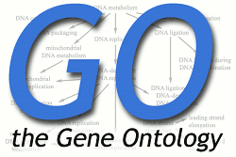
Bioinformatics Topics
Informatics
Biology
Operating
Systems
Data
Generation
Data
Analysis
Data/Information
Storage/Access
Programming
Statistics
Other relevant databases include:
Gene Ontology Database
Early Primary Database annotation was poor.
Annotation was left to the submitted and then not curated .
In consequence, Database Searching just by Keyword was far from reliable.

Slide 49
Bioinformatics Topics
Informatics
Biology
Operating
Systems
Data
Generation
Data
Analysis
Data/Information
Storage/Access
Programming
Statistics
Other relevant databases include:
Gene Ontology Database
The Gene Ontology (GO) database provides a hierarchy of formally agreed terms to describe gene products accurately and unambiguously.
Searching with these terms radically improves the efficacy of annotation searching.

Slide 50
Bioinformatics Topics
Biology
Data
Generation
Data
Analysis
Data/Information
Storage/Access
Data
Annotation
Data/Information
Storage
Data/Information
Access
A simplistic ordering for the Bioinformatics Topics discussed here

Slide 51
And now … Once again … Your turn!
Some issue for consideration, discussion and reaction
The Bioinformatics topics mentioned here do not constitute a comprehensive list.
What would suggest is missing … in order of importance?
The term algorithm was mentioned once or twice. There are slightly differing definitions. Pick the one you like best and justify your selection.
Define the three terms Homologue, Paralogue and Orthologue, being ever assiduous to ignore offensive American misspellings!

Slide 52
The is but one basic strategy for computing Pairwise Alignments that is considered optimal. However, this strategy can be implemented to compute either Global Alignments or Local Alignments.
Just informally, how do these two possibilities differ?
Generally speaking, would you compute MSAs using a Global or a Local approach? Briefly justify your choice.
Generally speaking, would you conduct Database Similarity searches using a Global or a Local approach? Briefly justify your choice.

Slide 53
“Sequence alignment only makes sense for sequences representing Homologous entities”
A profound observation made by the ever sagacious David Philip Judge whilst sipping an eventide cup of Tesco’s very cheapest tea in the penthouse suite of his Ivory Tower (personal communication, 2016.06.10).
Consider and comment upon this fundamental truth.
“A Multiple Alignment of Homologous sequences which were a mixture of Orthologues and Paralogues would not be suitable as input data for Phylogenetic analysis ”
Another deep one from DPJ
Consider and comment upon this further pearl of enlightenment.
In the course of the dialogue for this presentation, there was mention of “Accepted Substitutions”, more formally referred to as “Accepted Point Mutations”, or … if you enjoy clumsy for the sake of a pronounceable acronym, “Point Accepted Mutation” (PAM).
How would you informally define an “Accepted Point Mutation”?

Slide 54
The Extended syntax for ScanProsite is the most common syntax used for protein pattern definition. ScanProsite being the program for searching the of the Prosite database. Prosite was first created way back in the 1980s and, initially, was composed exclusively of protein patterns.
There is no great value, at this stage, to be entirely familiar with this very simple syntax. However, from the hints in this presentation and a quick glance at the appropriate web pages, can you interpret the pattern?
C{P}x(3,7)[FY](2)Wx(2)[VIL]
In the slides preceding, Protein Domains and Protein Sequence Motifs were mentioned with rather sparse explanation.
Define both of these terms and describe simply the difference between them.
In the slide notes, there is mention of Position Weight Matrices (PWMs).
Can you say, simply, what a Position Weight Matrix might be and how it might be used?
What obvious property does a PWM possess that is lacking in a simple sequence pattern (or consensus sequence)?

Slide 55
The best secondary structure programs are reckoned to be around 80% accurate.
It is further suggested that 80% is about as good as it is possible to achieve.
Stated simply, why would you suppose that 100% accuracy might be unobtainable?
Hint: Do you think that two human experts, given the very best evidence of Tertiary Structure, would also agree upon the exact amino acid positions where an Alpha Helix starts and finishes?
Homology Modelling is mentioned in the slides as a method for predicting tertiary structure when structure(s) of protein(s) homologous to the query protein are available. The process involves aligning the query protein with the known structure, using the known sequence as a guide.
It is also possible to predict Tertiary Structure when, known structures thought to be appropriate exist, but only for sequences that ARE NOT HOMOLOGOUS. In such cases, the Primary Sequence corresponding to the known structure will be of little assistance.
Tricky eh!? What are the name(s) for those types of method? ONLY if you can do so VERY simply. Say a few words to say how they over come the lack of a homologous sequence.

Slide 56
It was noted in the slides that often different Protein Feature searches often do not exactly agree.
It is common for two services to agree upon the presence of a domain, but not upon it precise start and end positions within a protein.
Would you find this to be worrying? Surprising? If not, why not?

Slide 57
The End

Slide 58

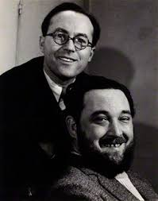
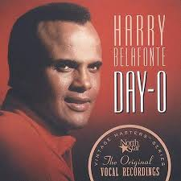
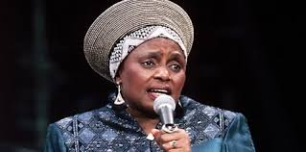

BREAK!
More to come I fear … but time for a swift cup of tea perchance?
Maybe time for a short jig? The whistling of a merry tune?
Or, mayhap, a delving into the melodic possibilities of youtube?
There be much good stuff there … I offer you a few of my favourites.
Once fully refreshed …. Click on mon braves!

