Slide 1
Bioinformatics Topics
Informatics
Biology
Operating
Systems
Data
Generation
Data
Analysis
Data/Information
Storage/Access
Programming
Statistics
Overview.
Raw Experimental Data, can next be Annotated in the light of analytical revelation.
Data + Annotation = Information.
Information can now be stored in Databases that allow users easy and unrestricted access.

Slide 2


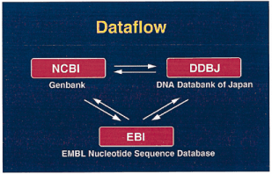


Primary DNA Sequence Databases
Original submission by experimentalists
Content controlled by the submitter

Slide 3

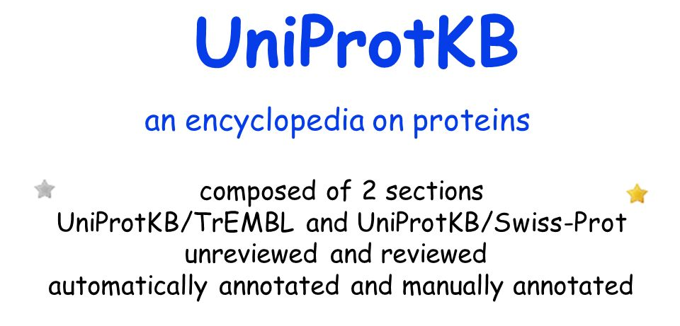


Primary Protein Sequence Databases

Slide 4
Derivative Sequence Databases
Built from primary data
RefSeq
Submission by experimentalists
Significant redundancy
Annotation inconsistent
DNA and RNA only
non-redundant
richly annotated
DNA, RNA, protein
diverse taxa
akin to the primary
research literature
akin to the review literature

Slide 5








Derivative Databases for Protein Features
Collections of HMMs representing Protein Domains and/or Motifs derived from Protein sequence Databases.
Some of the available domain/motif Databases.

Slide 6

Derivative Databases for Protein Features
It is generally wise to use more than one Feature Searching service.
This can be tedious, involving many websites and different search tools.
is a consortium of member databases.
defines protein families, domains, regions, repeats and sites according to matches against member databases
enables any subset of member databases to be searched together

Slide 7
Bioinformatics Topics
Informatics
Biology
Operating
Systems
Data
Generation
Data
Analysis
Data/Information
Storage/Access
Programming
Statistics
Genome Databases.
Genome Databases store entire genome sequence(s) AND their interpretation.
Each new sequenced genome or significantly re-assembled existing genome is fully analysed.
The individual processes for manual analysis are the same as those for automatic analysis.
Most have been mentioned in this simple talk.
Analysing an individual gene can be done manually.
Analysing an entire genome is only practical using automated strategies.

Slide 8



Bioinformatics Topics
Informatics
Biology
Operating
Systems
Data
Generation
Data
Analysis
Data/Information
Storage/Access
Programming
Statistics
Genome Databases.
The Three foremost Genome Database options
Ensembl and UCSC Browser software can be downloaded and used for private datasets.

Slide 9




Bioinformatics Topics
Informatics
Biology
Operating
Systems
Data
Generation
Data
Analysis
Data/Information
Storage/Access
Programming
Statistics
Protein Structure Databases.

Slide 10
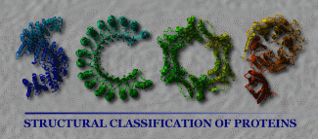
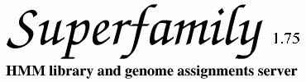
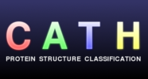
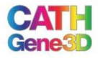
Bioinformatics Topics
Informatics
Biology
Operating
Systems
Data
Generation
Data
Analysis
Data/Information
Storage/Access
Programming
Statistics
Protein Structure Databases.

Slide 11
Bioinformatics Topics
Informatics
Biology
Operating
Systems
Data
Generation
Data
Analysis
Data/Information
Storage/Access
Programming
Statistics
Genetic Variation Databases.
Databases storing the many genetic variations that occur between individuals and species.
Widely incorporated into Genome Databases, such as Ensembl.
Since High Throughput Sequencing (HTS) has become standard, variation detection has become easier. Databases have developed dramatically.

Slide 12
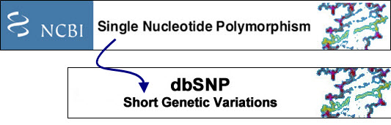
Bioinformatics Topics
Informatics
Biology
Operating
Systems
Data
Generation
Data
Analysis
Data/Information
Storage/Access
Programming
Statistics
Genetic Variation Databases.
dbSNP is the largest general database for genetic variations.
Originally just Single Nucleotide Polymophisms (SNPs).
Now includes other types of Short Genetic Variation.
dbSNP, originally focused on human variations, now covers many organisms.
dbSNP now records relationships between variation and phenotype.

Slide 13


Bioinformatics Topics
Informatics
Biology
Operating
Systems
Data
Generation
Data
Analysis
Data/Information
Storage/Access
Programming
Statistics
Other relevant databases include:
Microarray databases
There are a considerable number, both commercial and public domain.
Two major Public Domain Microarray Databases are:
The Gene Expression Omnibus (GEO), maintained in America.
ArrayExpress, maintained in Europe.

Slide 14
Bioinformatics Topics
Informatics
Biology
Operating
Systems
Data
Generation
Data
Analysis
Data/Information
Storage/Access
Programming
Statistics
Other relevant databases include:
Microarray databases
High Throughput Sequencing (HTS) has become a viable option to the use of Microarrays.
Accordingly, both GEO and ArrayExpress now manage HTS data sets.
ArrayExpress regularly imports data from GEO.

Slide 15
Bioinformatics Topics
Informatics
Biology
Operating
Systems
Data
Generation
Data
Analysis
Data/Information
Storage/Access
Programming
Statistics
Other relevant databases include:
Literature databases
Many free literature search/access services are available via the INTERNET.
You will be introduced to, arguably, the best and most famous as a part of this course.

Slide 16
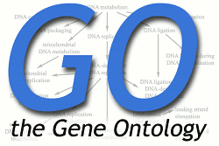
Bioinformatics Topics
Informatics
Biology
Operating
Systems
Data
Generation
Data
Analysis
Data/Information
Storage/Access
Programming
Statistics
Other relevant databases include:
Gene Ontology Database
Early Primary Database annotation was poor.
Annotation was left to the submitted and then not curated .
In consequence, Database Searching just by Keyword was far from reliable.

Slide 17
Bioinformatics Topics
Informatics
Biology
Operating
Systems
Data
Generation
Data
Analysis
Data/Information
Storage/Access
Programming
Statistics
Other relevant databases include:
Gene Ontology Database
The Gene Ontology (GO) database provides a hierarchy of formally agreed terms to describe gene products accurately and unambiguously.
Searching with these terms radically improves the efficacy of annotation searching.

Slide 18
Bioinformatics Topics
Biology
Data
Generation
Data
Analysis
Data/Information
Storage/Access
Data
Annotation
Data/Information
Storage
Data/Information
Access
A simplistic ordering for the Bioinformatics Topics discussed here

Slide 19
End of Part 2

Slide 20
The End

Slide 21
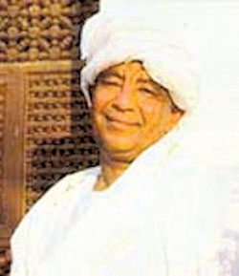
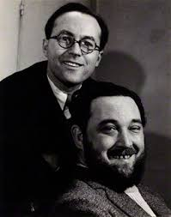
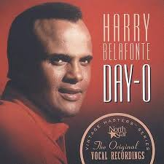
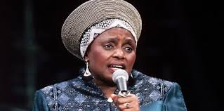
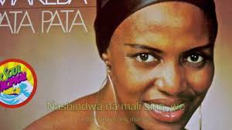
BREAK!
More to come I fear … but time for a swift cup of tea perchance?
Maybe time for a short jig? The whistling of a merry tune?
Or, mayhap, a delving into the melodic possibilities of youtube?
There be much good stuff there … I offer you a few of my favourites.
Once fully refreshed …. Click on mon braves!

