Slide 1
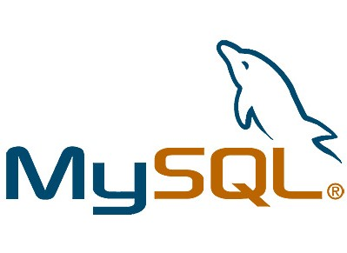


The “One Size Fits All” Database
Relational model dominant for decades
Tons of databases, all slight variations of each other
PostgreSQL
MySQL
Oracle
SQL Server
DB2

Slide 2
Possible Issues
SQL is full-featured
is that always necessary?
Do traditional DBMSs scale?
horizontal vs. vertical scaling
parallel DBMSs
ACID guarantees can be expensive
are they always necessary

Slide 3

Scalability
What is Horizontal vs. Vertical Scalability?

Slide 4


Scalability
What would vertical scaling mean?
Advantages? Disadvantages?

Slide 5
Scalability
What would horizontal scaling mean?
Advantages? Disadvantages?

Slide 6
ACID Guarantees?
A
Atomicity
C
Consistency
I
Isolation
D
Durability
Guarantees dB operations are processed reliably

Slide 7
Atomicity
A transaction must be “all or nothing”.
If part of the transaction fails, the entire transaction fails and no state is changed.

Slide 8
Consistency
Any transaction must bring the dB from one state to another, where both states are valid.
Programming errors cannot result in the violation of any defined rules (constraints, cascades, triggers, etc)

Slide 9
Isolation
Concurrent executions of transactions result in a system state that would be obtained if transactions were instead executed serially.
How and when transactions made by one operation become visible to other operations.

Slide 10
Durability
Once a transaction has been committed, the state will account for that transaction, even in the event of power loss, crashes, or errors.
Use of non-volatile memory is critical.

Slide 11
Why might ACID be important?
Transactions in a dB
Account A wants to transfer money to Account B. What is involved?

Slide 12
Why might ACID be unimportant

Slide 13
NoSQL
Design points
high availability
horizontal scaling
no SQL
usually just key-value stores (not always)
great for web applications
Consistency
many (not all) use eventual consistency model
Classes
Key-Value, Document, Column, Graph

Slide 14



Driving Force Behind NoSQL
The needs of the modern tech world.

Slide 15
NoSQL Advantages
Scales very well horizontally, easy to deploy on clusters of machines.
Traditional problem for SQL.
Better control over availability (or partial availability).
Data structures can be more flexible than SQL tables.
Popular for real-time applications and big data.

Slide 16
NoSQL Example: Key-Value
Key-Value Stores
Dynamo
Voldemort
RAMCloud
Riak
Redis
Oracle NoSQL Database (OnDB)
Key-Value Cache
Memcached
fast, but not persistent

Slide 17
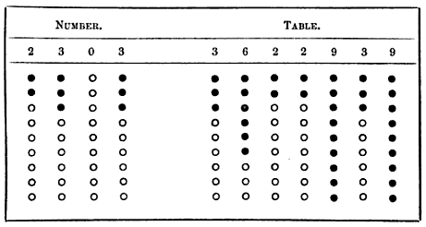
Key-Value dBs
An old idea…
When was it first proposed?
1837 by Charles Babbage

Slide 18
Key-Value Stores
Associative Arrays, aka a hash, or dictionary.
Store objects, or records which may have multiple fields using a unique key.
In contrast to dBs which have a well defined schema, key-value stores are opaque, each record may have different fields.

Slide 19
BASE vs. ACID
Often use a different model than ACID:
B
Basically
A
Available
S
Soft state
E
Eventual consistency

Slide 20
Eventual Consistency

Slide 21
EC vs SEC
Eventual Consistency
Liveness guarantee
Updates will be observed eventually
Strong Eventual Consistency
Safety guarantee
Any two nodes that have received the same (unordered) set of updates will be in the same state.

Slide 22
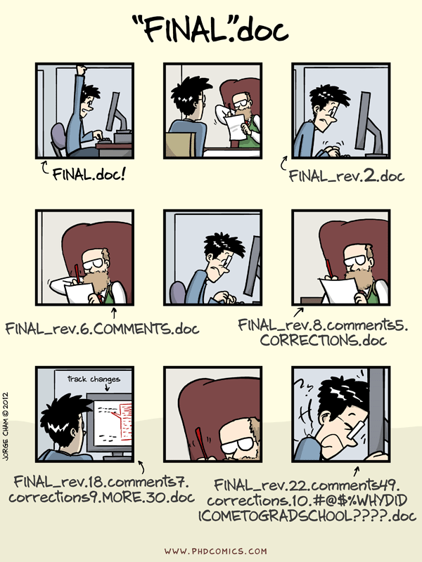
Conflict Resolution
Eventual consistency necessitates conflicts!

Slide 23
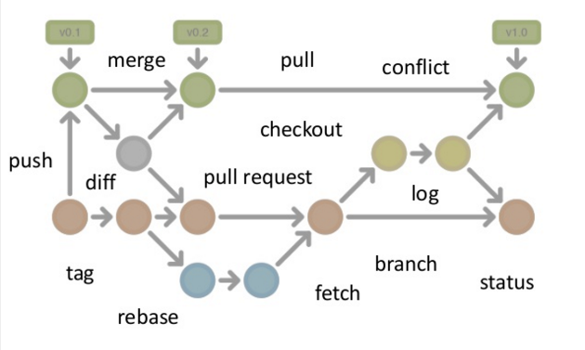
Conflict Resolution

Slide 24
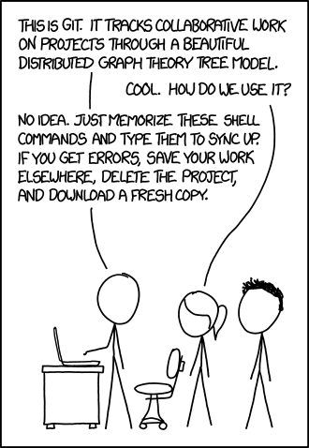
Conflict Resolution

Slide 25
Conflict Resolution
Need to ensure replica convergence – a system must be able to reconcile differences between multiple copies of a distributed dB.
Exchange versions or updates between servers (anti-entropy)
Choose an appropriate final state when concurrent updates have occurred (reconciliation)
Most common approach? Last writer wins

Slide 26
NoSQL Example: Document Stores
Documents contain semi-structured data
e.g. Table Students
each student “document” would contain all data for that student
can vary the fields stored in each document
Examples
MongoDB, Couchbase

Slide 27
Document Stores
Central concept is a “document”
Documents
Encapsulate and encode data in some standard format
XML, YAML, JSON, BSON, etc
Addressed via a unique key
Distinguished from Key-value through the existence of an API or query language that can access document contents.

Slide 28
Document Stores
How to organize documents?
Collections
Tags
Non-visible metadata
Directory hierarchies

Slide 29
Document Stores vs SQL
SQL – strongly typed
Document Stores – not strongly typed
Document stores are generally more flexible, easily maps into program objects and deals with optional values without storage penalty.

Slide 30
Structure in a Document Store
Documents are, to some degree, self describing.
Bob Q. Public
CEAS
EECS
PhD CSE
555-555-5555
555-459-5555
bob.public@uc.edu

Slide 31
Structure in a Document Store
<studentrecord>
<firstname>Bob</firstname>
<middlename>Q.</middlename>
<lastname>Public</lastname>
<college>CEAS</college>
<department>EECS</department>
<degree>PhD CSE</degree>
</studentrecord>

Slide 32
Structure in a Document Store
<studentrecord>
<firstname>Bob</firstname>
<middlename>Q.</middlename>
<lastname>Public</lastname>
<college>CEAS</college>
<department>EECS</department>
<degree>PhD CSE</degree>
<phone type=work>555-555-5555</phone>
<phone type=home>555-459-5555</phone>
<email type=work>bob.public@uc.edu</email>
</studentrecord>

Slide 33
NoSQL Example: Column Stores
Data is organized by columns, rather than rows
Great for storing sparse datasets
Example
HBase
modeled after Google BigTable
runs on HDFS (modeled after GFS)
can run Hadoop jobs that input/output HBase tables

Slide 34
Column Stores
Work very well for data warehousing, CRM systems, medical/clinical data, and other ad-hoc inquiry system
Optimized for computing aggregates over large sets of similar items.

Slide 35
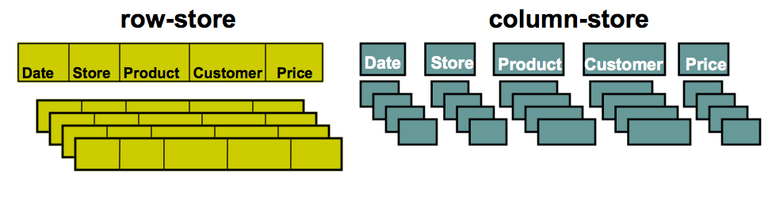
Column Stores
Easy to add and modify records
Requires access to unneccesary data
Minimizes access to irrelevant data
Record writes require multiple accesses.

Slide 36
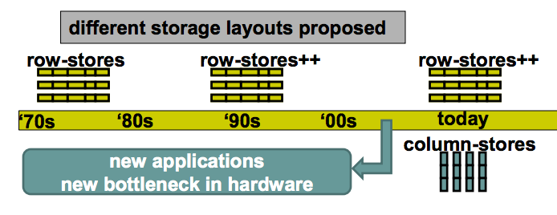
Column Stores
Fundamental difference is in the layout of the storage
In performance, seek time dominates CPU time.

Slide 37
NoSQL Example: Graph Databases
graph structured data can be very complex
not a good fit for relational model
queries run on graph data are also unique
Example
Neo4J
most popular by far
written in Java with Java API
fully transactional and consistent

Slide 38
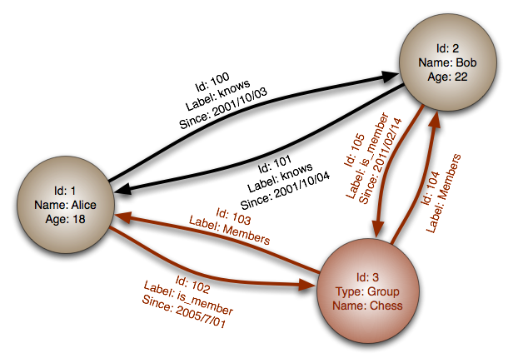
Graph Databases

Slide 39
Graph Databases
Nodes, properties, edges
Nodes – entities to keep track of
Edges – relationships between nodes
Properties – information that relate to nodes or edges
Powerful for graph-like queries and associative data sets.

Slide 40
NoSQL Today
many systems are adding back SQL-like functionality
why?
key-value queries are limited
often referred to now as “Not Only SQL”
tons of other examples, a lot of them have a free version

Slide 41
NewSQL
NoSQL focused on scalability and availability
Question: Can we do that and still maintain ACID?
financial transactions
Goal is to scale out
Maintain SQL, but focus on on-line transaction processing (OLTP) workloads
short-lived transactions that access small subsets of data
in contrast to OLAP (i.e. analytical workloads)

Slide 42
Shared-Nothing Architectures
Nodes in a cluster don’t share resources
In terms of databases, means data is horizontally partitioned, or sharded, across nodes in the cluster
How should we shard the data?
…depends on the workload, among other things
Do shared-nothing architectures always increase performance?

Slide 43
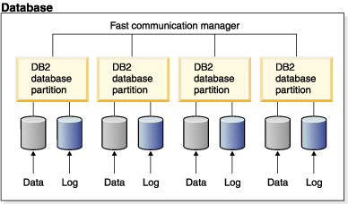
Shared-Nothing Diagram

Slide 44
Conclusion
NoSQL
move away from ACID properties
come in several different forms
NewSQL
designed specifically for OLTP workloads
maintain ACID properties
scale-out using sharding/partitioning

