Slide 1
Big Data in the 1800s
The US Census in 1880 surveyed a record 50,189,209 people.
In 1870 the total had been 39,818.449
Took 8 years to count and calculate!

Slide 2

Census in 1890
Had to find a new way to calculate the results.
Hired a major company to come up with a new method

Slide 3
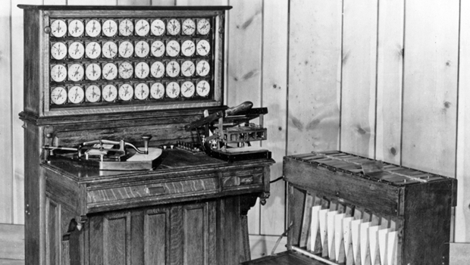
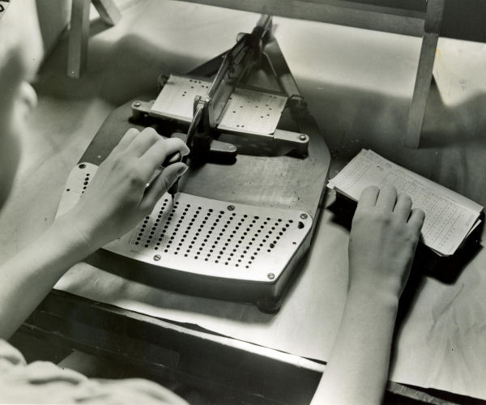
Census in 1890
New methods were effective!
50M people to 62M people
8 years to process to 1 year to process!

Slide 4
Dealing with Big Data
How do we work smarter, instead of harder?
Dealing with the modern census:
How could we quickly determine the population of a city?

Slide 5
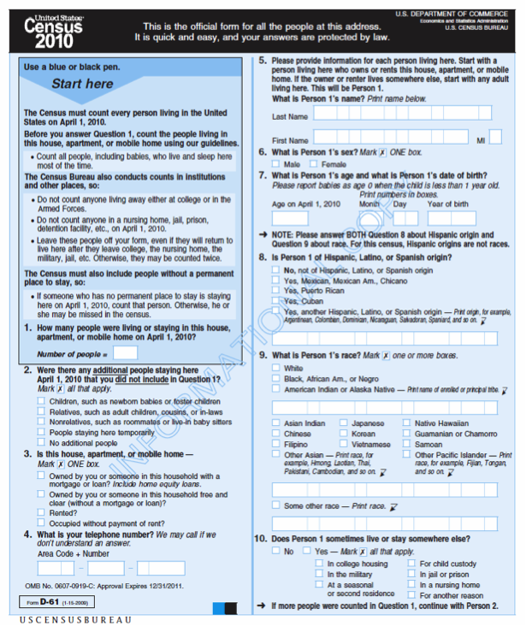
Older Analogies
Say you have 10,000 employees whose job it is to collate census forms by city.
How would you organize and complete this task?

Slide 6
Challenges
Suppose people take vacations, get sick, or work at different rates…
Suppose some forms are filled out incorrectly and need to be corrected or thrown out…
Suppose a supervisor gets sick…
How do we monitor progress…

Slide 7
Define the Challenges
What is the main challenge?
Are the individual task complicated?
What makes this challenging?
How resilient is our solution?
How well does it balance work across employees?
What factors affect this?
How general is the set of techniques?

Slide 8
Dealing with the Details
Wouldn't it be nice if there were some system that took care of all these details for you?
Ideally, you'd just tell the system what needs to be done
That's the MapReduce framework.

Slide 9
Abstracting into a digital data flow
CountStack
Worker
Filter+Stack
Worker
Cincinnati: 4k
CountStack
Worker
Columbus: 4k
Filter+Stack
Worker
CountStack
Worker
Cleveland: 3k
Filter+Stack
Worker
CountStack
Worker
Toledo: 1k
Filter+Stack
Worker
CountStack
Worker
Indianapolis: 4k

Slide 10
Abstracting once more
There are two kinds of workers:
Those that take input data items and produce output items for the “stacks”
Those that take the stacks and aggregate the results to produce outputs on a per-stack basis
We’ll call these:
map: takes (item_key, value), produces one or more (stack_key, value’) pairs
reduce: takes (stack_key, {set of value’}), produces one or more output results – typically (stack_key, agg_value)
We will refer to this key as the reduce key

Slide 11
Why MapReduce?
Scenario:
You have a huge amount of data, e.g., all the Google searches of the last three years
You would like to perform a computation on the data, e.g., find out which search terms were the most popular
How would you do it?
Analogy to the census example:
The computation isn't necessarily difficult, but parallelizing and distributing it, as well as handling faults, is challenging
Idea: A programming language!
Write a simple program to express the (simple) computation, and let the language runtime do all the hard work

Slide 12
What is MapReduce?
A famous distributed programming model
In many circles, considered the key building block for much of Google’s data analysis
A programming language built on it: Sawzall, http://labs.google.com/papers/sawzall.html
… Sawzall has become one of the most widely used programming languages at Google. … [O]n one dedicated Workqueue cluster with 1500 Xeon CPUs, there were 32,580 Sawzall jobs launched, using an average of 220 machines each. While running those jobs, 18,636 failures occurred (application failure, network outage, system crash, etc.) that triggered rerunning some portion of the job. The jobs read a total of 3.2x10¹⁵ bytes of data (2.8PB) and wrote 9.9x10¹² bytes (9.3TB).
Other similar languages: Yahoo’s Pig Latin and Pig; Microsoft’s Dryad
Cloned in open source: Hadoop, http://hadoop.apache.org/

Slide 13
The MapReduce programming model
Simple distributed functional programming primitives
Modeled after Lisp primitives:
map (apply function to all items in a collection) and
reduce (apply function to set of items with a common key)
We start with:
A user-defined function to be applied to all data, map: (key,value) → (key, value)
Another user-specified operation reduce: (key, {set of values}) → result
A set of n nodes, each with data
All nodes run map on all of their data, producing new data with keys
This data is collected by key, then shuffled, and finally reduced
Dataflow is through temp files on GFS

Slide 14
Simple example: Word count
map(String key, String value) { // key: document name, line no // value: contents of line }
reduce(String key, Iterator values) { }
// key: a word // values: a list of counts int result = 0; for each v in values: result += ParseInt(v); emit(key, result)
for each word w in value: emit(w, "1")
Goal: Given a set of documents, count how often each word occurs
Input: Key-value pairs (document:lineNumber, text)
Output: Key-value pairs (word, #occurrences)
What should be the intermediate key-value pairs?

Slide 15
Simple example: Word count
Key range the node is responsible for
(apple, 3)
(apple, 1)
(apple, 1)
(apple, 1)
Mapper (1-2)
(apple, {1, 1, 1})
Reducer (A-G)
(an, 2)
(an, {1, 1})
(an, 1)
(an, 1)
(because, 1)
(1, the apple)
(because, {1})
(because, 1)
(green, 1)
(green, {1})
(2, is an apple)
(green, 1)
Mapper (3-4)
(is, 1)
(is, 1)
Reducer (H-N)
(is, 2)
(3, not an orange)
(is, {1, 1})
(not, 1)
(not, 1)
(not, 2)
(not, {1, 1})
(4, because the)
(5, orange)
(orange, 1)
(orange, 1)
(orange, 1)
Mapper (5-6)
(orange, {1, 1, 1})
Reducer (O-U)
(orange, 3)
(the, {1, 1, 1})
(6, unlike the apple)
(the, 1)
(the, 1)
(the, 1)
(the, 3)
(unlike, {1})
(unlike, 1)
(7, is orange)
(unlike, 1)
(8, not green)
Mapper (7-8)
Reducer (V-Z)
2
The reducers process their input one group at a time
1
The mappers process the KV-pairs one by one
Each KV-pair output by the mapper is sent to the reducer that is responsible for it
5
3
4
Each mapper receives some of the KV-pairs as input
The reducers sort their input by key and group it

Slide 16
MapReduce dataflow
Intermediate (key,value) pairs
Mapper
Reducer
Mapper
Reducer
Input data
Output data
Mapper
Reducer
Mapper
Reducer
"The Shuffle"
What is meant by a 'dataflow'? What makes this so scalable?

Slide 17
More examples
Distributed grep – all lines matching a pattern
Map: filter by pattern
Reduce: output set
Count URL access frequency
Map: output each URL as key, with count 1
Reduce: sum the counts
Reverse web-link graph
Map: output (target,source) pairs when link to target found in souce
Reduce: concatenates values and emits (target,list(source))
Inverted index
Map: Emits (word,documentID)
Reduce: Combines these into (word,list(documentID))

Slide 18
Common mistakes to avoid
Mapper and reducer should be stateless
Don't use static variables - after map + reduce return, they should remember nothing about the processed data!
Reason: No guarantees about which key-value pairs will be processed by which workers!
Don't try to do your own I/O!
Don't try to read from, or write to, files in the file system
The MapReduce framework does all the I/O for you:
All the incoming data will be fed as arguments to map and reduce
Any data your functions produce should be output via emit
HashMap h = new HashMap();
map(key, value) { if (h.contains(key)) { h.add(key,value); emit(key, "X"); } }
Wrong!
map(key, value) { File foo = new File("xyz.txt"); while (true) { s = foo.readLine(); ... } }
Wrong!

Slide 19
More common mistakes to avoid
map(key, value) { emit("FOO", key + " " + value); }
reduce(key, value[]) { /* do some computation on all the values */
}
Wrong!
Mapper must not map too much data to the same key
In particular, don't map everything to the same key!!
Otherwise the reduce worker will be overwhelmed!
It's okay if some reduce workers have more work than others
Example: In WordCount, the reduce worker that works on the key 'and' has a lot more work than the reduce worker that works on 'syzygy'.

Slide 20
Designing MapReduce algorithms
Key decision: What should be done by map, and what by reduce?
map can do something to each individual key-value pair, but it can't look at other key-value pairs
Example: Filtering out key-value pairs we don't need
map can emit more than one intermediate key-value pair for each incoming key-value pair
Example: Incoming data is text, map produces (word,1) for each word
reduce can aggregate data; it can look at multiple values, as long as map has mapped them to the same (intermediate) key
Example: Count the number of words, add up the total cost, ...
Need to get the intermediate format right!
If reduce needs to look at several values together, map must emit them using the same key!

Slide 21
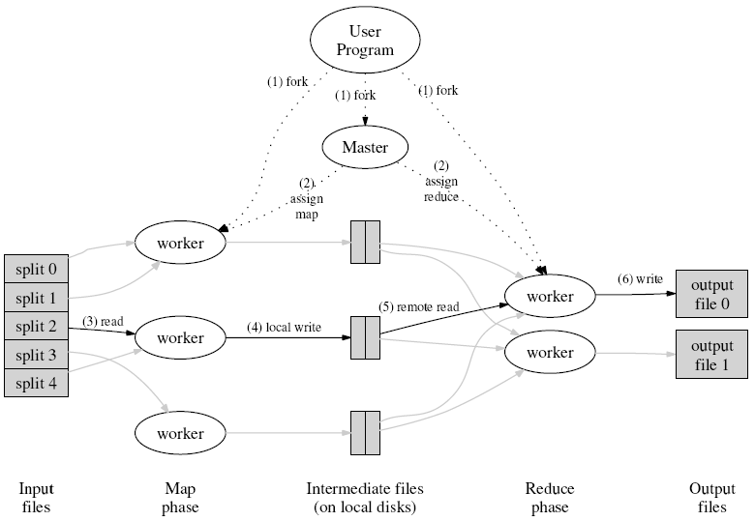
More details on the MapReduce data flow
Coordinator
(Default MapReduce uses Filesystem)
Map computation partitions
Reduce computation partitions
http://static.googleusercontent.com/media/research.google.com/en//archive/mapreduce-osdi04.pdf
Data partitions by key
Redistribution by output’s key ("shuffle")

Slide 22
Some additional details
To make this work, we need a few more parts…
The file system (distributed across all nodes):
Stores the inputs, outputs, and temporary results
The driver program (executes on one node):
Specifies where to find the inputs, the outputs
Specifies what mapper and reducer to use
Can customize behavior of the execution
The runtime system (controls nodes):
Supervises the execution of tasks
Esp. JobTracker

Slide 23
Some details
Fewer computation partitions than data partitions
All data is accessible via a distributed filesystem with replication
Worker nodes produce data in key order (makes it easy to merge)
The master is responsible for scheduling, keeping all nodes busy
The master knows how many data partitions there are, which have completed – atomic commits to disk
Locality: Master tries to do work on nodes that have replicas of the data
Master can deal with stragglers (slow machines) by re-executing their tasks somewhere else

Slide 24
What if a worker crashes?
We rely on the file system being shared across all the nodes
Two types of (crash) faults:
Node wrote its output and then crashed
Here, the file system is likely to have a copy of the complete output
Node crashed before finishing its output
The JobTracker sees that the job isn’t making progress, and restarts the job elsewhere on the system
(Of course, we have fewer nodes to do work…)
But what if the master crashes?

Slide 25
Other challenges
Locality
Try to schedule map task on machine that already has data
Task granularity
How many map tasks? How many reduce tasks?
Dealing with stragglers
Schedule some backup tasks
Saving bandwidth
E.g., with combiners
Handling bad records
"Last gasp" packet with current sequence number

Slide 26
Scale and MapReduce
From a particular Google paper on a language built over MapReduce:
… Sawzall has become one of the most widely used programming languages at Google. … [O]n one dedicated Workqueue cluster with 1500 Xeon CPUs, there were 32,580 Sawzall jobs launched, using an average of 220 machines each. While running those jobs, 18,636 failures occurred (application failure, network outage, system crash, etc.) that triggered rerunning some portion of the job. The jobs read a total of 3.2x10¹⁵ bytes of data (2.8PB) and wrote 9.9x10¹² bytes (9.3TB).
Source: Interpreting the Data: Parallel Analysis with Sawzall (Rob Pike, Sean Dorward, Robert Griesemer, Sean Quinlan)

