Slide 1
Map-Reduce Problem
Work in groups to design a Map-Reduce of K-means clustering.

Slide 2
Map-Reduce Problem
How could we map reduce a Random Forest?

Slide 3
Map-Reduce Problem
How could we map reduce a Random Forest?
What about ID3?

Slide 4
Some additional details
To make this work, we need a few more parts…
The file system (distributed across all nodes):
Stores the inputs, outputs, and temporary results
The driver program (executes on one node):
Specifies where to find the inputs, the outputs
Specifies what mapper and reducer to use
Can customize behavior of the execution
The runtime system (controls nodes):
Supervises the execution of tasks
Esp. JobTracker

Slide 5
Some details
Fewer computation partitions than data partitions
All data is accessible via a distributed filesystem with replication
Worker nodes produce data in key order (makes it easy to merge)
The master is responsible for scheduling, keeping all nodes busy
The master knows how many data partitions there are, which have completed – atomic commits to disk
Locality: Master tries to do work on nodes that have replicas of the data
Master can deal with stragglers (slow machines) by re-executing their tasks somewhere else

Slide 6
What if a worker crashes?
We rely on the file system being shared across all the nodes
Two types of (crash) faults:
Node wrote its output and then crashed
Here, the file system is likely to have a copy of the complete output
Node crashed before finishing its output
The JobTracker sees that the job isn’t making progress, and restarts the job elsewhere on the system
(Of course, we have fewer nodes to do work…)
But what if the master crashes?

Slide 7
Other challenges
Locality
Try to schedule map task on machine that already has data
Task granularity
How many map tasks? How many reduce tasks?
Dealing with stragglers
Schedule some backup tasks
Saving bandwidth
E.g., with combiners
Handling bad records
"Last gasp" packet with current sequence number

Slide 8
Scale and MapReduce
From a particular Google paper on a language built over MapReduce:
… Sawzall has become one of the most widely used programming languages at Google. … [O]n one dedicated Workqueue cluster with 1500 Xeon CPUs, there were 32,580 Sawzall jobs launched, using an average of 220 machines each. While running those jobs, 18,636 failures occurred (application failure, network outage, system crash, etc.) that triggered rerunning some portion of the job. The jobs read a total of 3.2x10¹⁵ bytes of data (2.8PB) and wrote 9.9x10¹² bytes (9.3TB).
Source: Interpreting the Data: Parallel Analysis with Sawzall (Rob Pike, Sean Dorward, Robert Griesemer, Sean Quinlan)

Slide 9
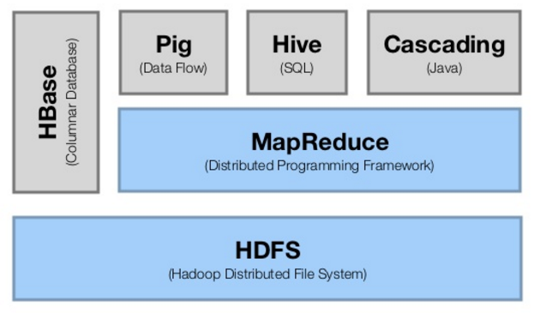
Hadoop

Slide 10
HDFS
Hadoop Distributed File System
A distributed file system with
Redundant storage
Highly reliable using commodity hardware
Designed to expect and tolerate failures
Intended for use with large files
Designed for batch inserts

Slide 11
HDFS - Structure
Files – stored as collection of blocks
Blocks – 64 MB chunks of a file
All blocks are replicated on at least 3 nodes
The NameNode (NN) manages metadata about files and blocks
The SecondaryNameNode (SNN) holds backups of the NN data.
DataNodes (DN) store and serve blocks

Slide 12
HDFS - Replication
Multiple copies of a block are stored
Strategy
Copy #1 on another node in the same rack
Copy #2 on another node in a different rack

Slide 13
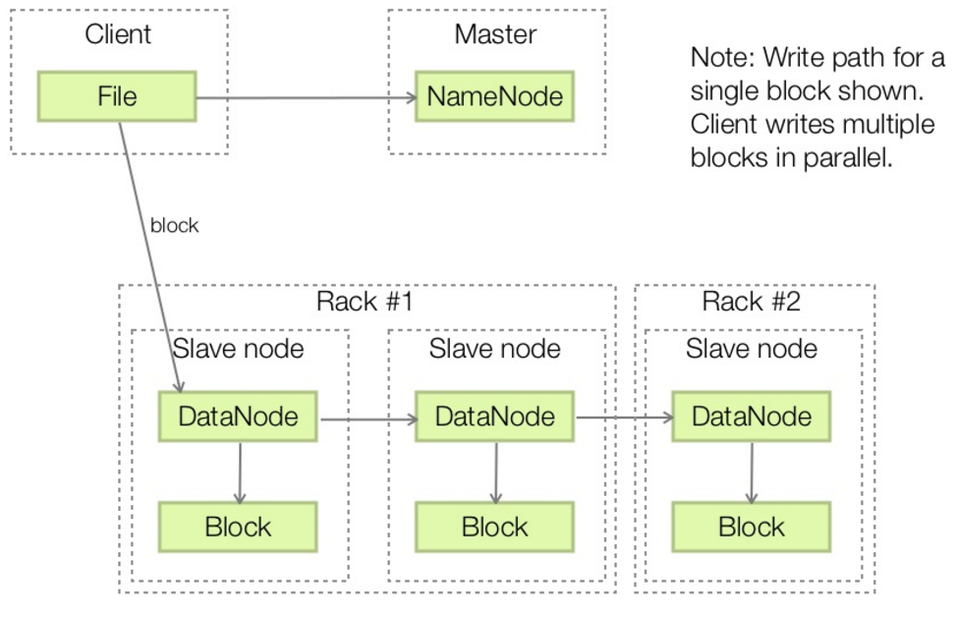
HDFS – Write Handling

Slide 14
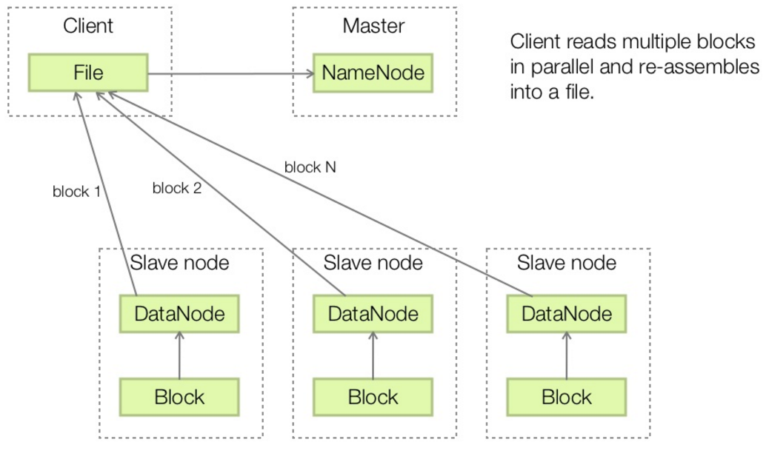
HDFS – Read Handling

Slide 15
Handling Node Failure
DNs check in with the NN to report health.
Upon failure the NN orders DNs to replicate under-replicated blocks.
Automated fail-over.
But highly inefficient
What does this optimize for?

Slide 16
MapReduce – Jobs and Tasks
Job – a user submitted map/reduce implementation
Task – a single mapper or reducer task
Failed tasks get retried automatically
Tasks are run local to their data, if possible
JobTracker (JT) manages job submission and task delegation
TaskTrackers (TT) ask for work and execute tasks

Slide 17
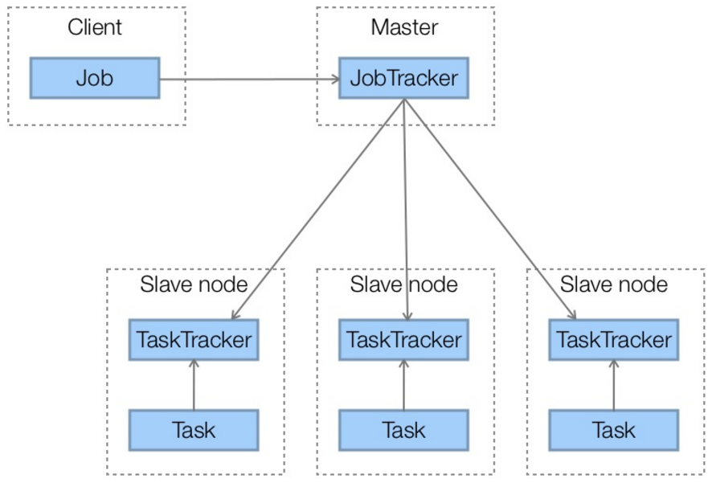
MapReduce Architecture

Slide 18
What happens when a task fails?
Tasks WILL fail!
JT automatically retries failed tasks up to N times
After N failed attempts for a task, the job fails.
Why?

Slide 19
What happens when a task fails?
Tasks WILL fail!
JT automatically retries failed tasks up to N times
After N failed attempts for a task, the job fails.
Some tasks slower than others
Speculative execution is JT starting up multiples of the same task
First one to complete wins, others are killed
When is this useful?

Slide 20
Data Locality
Move computation to the data!
Moving data between nodes is assumed to have a high cost
Try to schedule tasks on nodes with data
When not possible TT has to fetch data from DN.

Slide 21
MapReduce is good for…
Embarrassingly parallel problems
Summing, grouping, filtering, joining
Offline batch jobs on massive data sets
Analyzing an entire large dataset

Slide 22
MapReduce is ok for…
Iterative jobs
Graph algorithms
Each iteration must read/write data to disk
IO/latency cost of each iteration is high

Slide 23
MapReduce is bad for…
Jobs with shared state or coordination
Tasks should be share-nothing
Shared-state requires a scalable state store
Low-latency jobs
Jobs on small datasets
Finding individual records

Slide 24
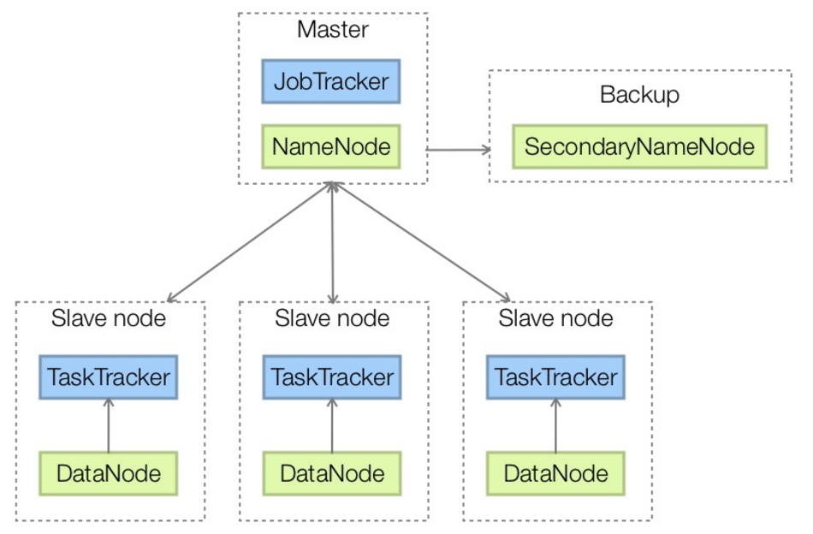
Hadoop Architecture

Slide 25
Hadoop Stack

Slide 26
Hadoop Stack Components
HBase – open source, non-relational, distributed database. Provides fault tolerant way to store large quantities of sparse data
Pig – high level platform for creating MapReduce programs using the language Pig Latin.
Hive – data warehousing infrastructure, provides summarization, query, and analysis.
Cascading – software abstraction layer to create and execute complex data processing workflows

Slide 27
Apache Spark

Slide 28
What is Spark?
Not a modified version of Hadoop
Separate, fast, MapReduce-like engine
In-memory data storage for very fast iterative queries
General execution graphs and powerful optimizations
Up to 40x faster than Hadoop
Compatible with Hadoop’s storage APIs
Can read/write to any Hadoop-supported system, including HDFS, HBase, SequenceFiles, etc

Slide 29
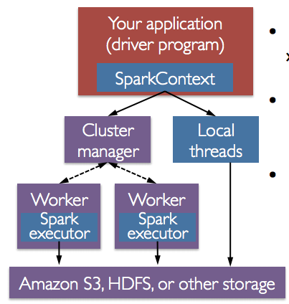
Spark Programs divided into two:
Driver program
Workers programs
Worker programs run on cluster nodes, or local threads
RDDs are distributed across workers

Slide 30
Why a New Programming Model?
MapReduce greatly simplified big data analysis
But as soon as it got popular, users wanted more:
More complex, multi-stage applications (e.g. iterative graph algorithms and machine learning)
More interactive ad-hoc queries
Both multi-stage and interactive apps require faster data sharing across parallel jobs

Slide 31
Data Sharing in MapReduce
HDFS read
HDFS write
HDFS read
HDFS write
iter. 1
iter. 2
. . .
Input
HDFS read
query 1
result 1
query 2
result 2
query 3
result 3
Input
. . .
Slow due to replication, serialization, and disk IO
Notes:
Each iteration is, for example, a MapReduce job

Slide 32

Data Sharing in Spark
iter. 1
iter. 2
. . .
Input
query 1
one-time processing
query 2
query 3
Input
Distributed memory
. . .
10-100× faster than network and disk

Slide 33
Spark Programming Model
Key idea: resilient distributed datasets (RDDs)
Distributed collections of objects that can be cached in memory across cluster nodes
Manipulated through various parallel operators
Automatically rebuilt on failure
Interface
Clean language-integrated API in Scala
Can be used interactively from Scala console

Slide 34
Constructing RDDs
Parallelize existing collections (python lists)
Transforming existing RDDs
Build from files in HDFS or other storage systems.

Slide 35
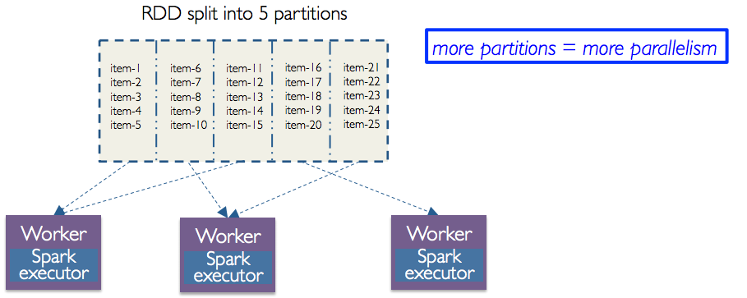
RDDs
Programmer Specifies number of partitions for an RDD
Two types of operations: transformations and actions

Slide 36
RDD Transforms
Transforms are lazy
Not computed immediately
Transformed RDD is executed only when an action runs on it
Why?
Persist (cache) RDDs in memory or disk

Slide 37
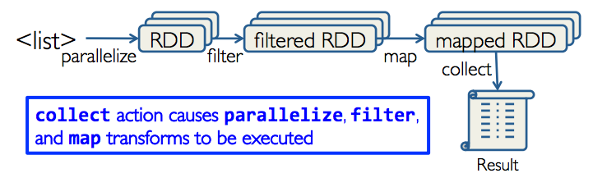
Working with RDDs
Create an RDD from a data source
Apply transformations to an RDD (map, filter)
Apply actions to an RDD (collect, count)

Slide 38
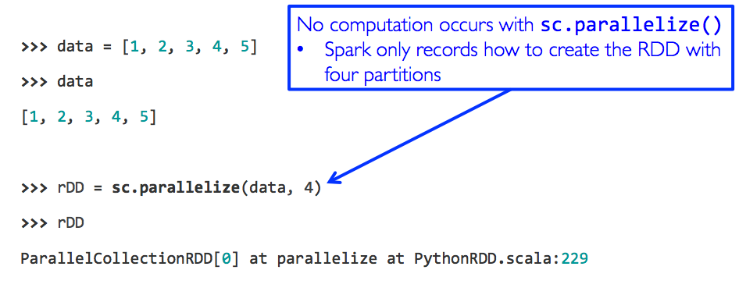
Creating an RDD
Create an RDD from a Python collection

Slide 39
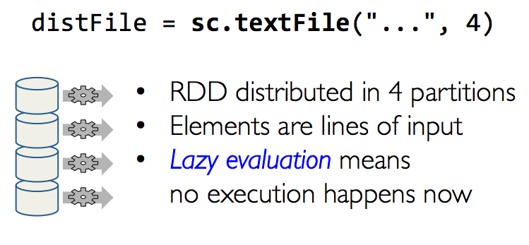
Create an RDD from a File

Slide 40

Example: Log Mining
Load error messages from a log into memory, then interactively search for various patterns
Base RDD
Cache 1
lines = spark.textFile(“hdfs://...”)
errors = lines.filter(_.startsWith(“ERROR”))
messages = errors.map(_.split(‘\t’)(2))
cachedMsgs = messages.cache()
Transformed RDD
Worker
results
tasks
Block 1
Driver
Action
cachedMsgs.filter(_.contains(“foo”)).count
cachedMsgs.filter(_.contains(“bar”)).count
Cache 2
Worker
. . .
Cache 3
Result: full-text search of Wikipedia in <1 sec (vs 20 sec for on-disk data)
Worker
Block 2
Result: scaled to 1 TB data in 5-7 sec (vs 170 sec for on-disk data)
Block 3
Notes:
Key idea: add “variables” to the “functions” in functional programming

Slide 41
RDD Fault Tolerance
RDDs maintain lineage information that can be used to reconstruct lost partitions
Ex:
messages = textFile(...).filter(_.startsWith(“ERROR”))
.map(_.split(‘\t’)(2))
HDFS File
Filtered RDD
Mapped RDD
filter (func = _.contains(...))
map (func = _.split(...))

Slide 42
Example: Logistic Regression
Goal: find best line separating two sets of points
random initial line
+
+
+
+
+
+
–
+
+
–
–
–
+
+
–
–
–
–
–
–
target
Notes:
Note that dataset is reused on each gradient computation

Slide 43
Example: Logistic Regression
val data = spark.textFile(...).map(readPoint).cache()
var w = Vector.random(D)
for (i <- 1 to ITERATIONS) {
val gradient = data.map(p =>
(1 / (1 + exp(-p.y*(w dot p.x))) - 1) * p.y * p.x
).reduce(_ + _)
w -= gradient
}
println("Final w: " + w)
Notes:
Key idea: add “variables” to the “functions” in functional programming

Slide 44
Logistic Regression Performance
127 s / iteration
first iteration 174 s
further iterations 6 s
Notes:
This is for a 29 GB dataset on 20 EC2 m1.xlarge machines (4 cores each)

Slide 45
Supported Operators
map
filter
groupBy
sort
join
leftOuterJoin
rightOuterJoin
reduce
count
reduceByKey
groupByKey
first
union
cross
sample
cogroup
take
partitionBy
pipe
save
...

