Slide 2
Working modes
Input mode
Command mode
Type wq
Exit
ESC
:
Press ENTER to accomplish commands and return to vi mode
Type iao
vi mode
vi filename
Enter

Slide 3
/
home
ana
zeam
var
Lib
bin
www
…
…
…

Slide 4
FASTA
String:
>chr1\nACGCTAGCTAGTCAGTCGATCGT\nCGTAGCTAGCTAG\n>chr2\nCTGCGGGCTAAATCGATCGATCG\nGTACGTACGAGCTAGCTA\n>chr3\nCTGCGGGCTAAATCGATCGATCG\nGTACGTACGAGCTAGCTA
Chunk 1:
>chr1\nACGCTAGCTAGTCAGTCGATCGT\nCGTAGCTAGCTAG\n>
Chunk 2:
chr2\nCTGCGGGCTAAATCGATCGATCG\nGTACGTACGAGCTAGCTA\n>
Chunk 3:
chr3\nCTGCGGGCTAAATCGATCGATCG\nGTACGTACGAGCTAGCTA\n>

Slide 5
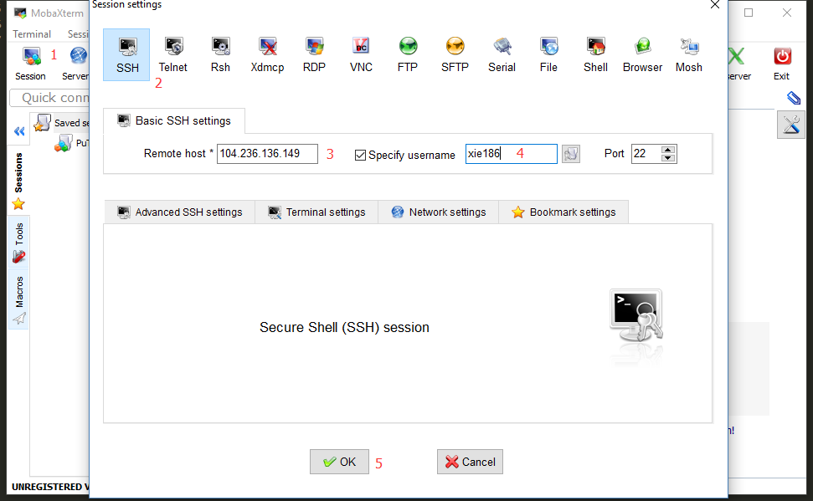

Slide 6
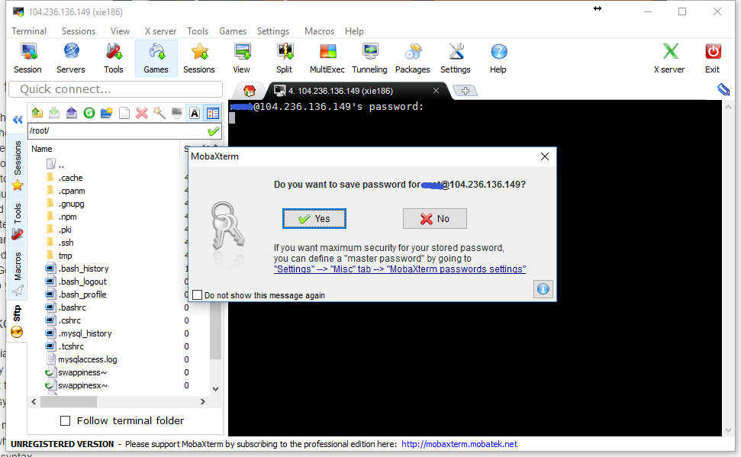

Slide 7
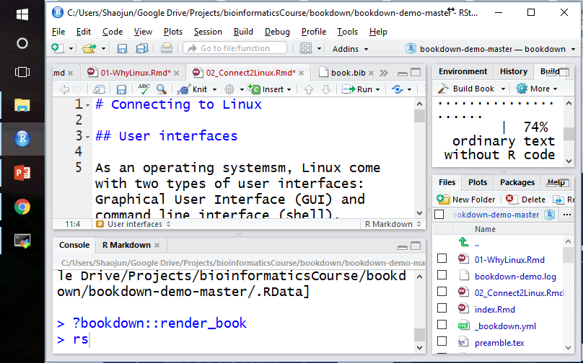

Slide 8
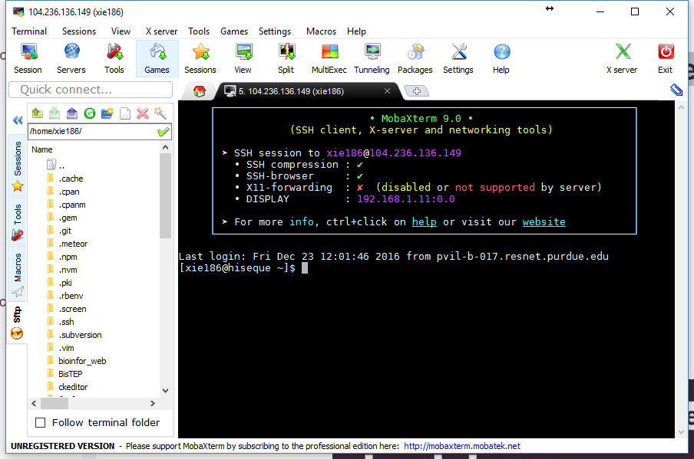

Slide 9
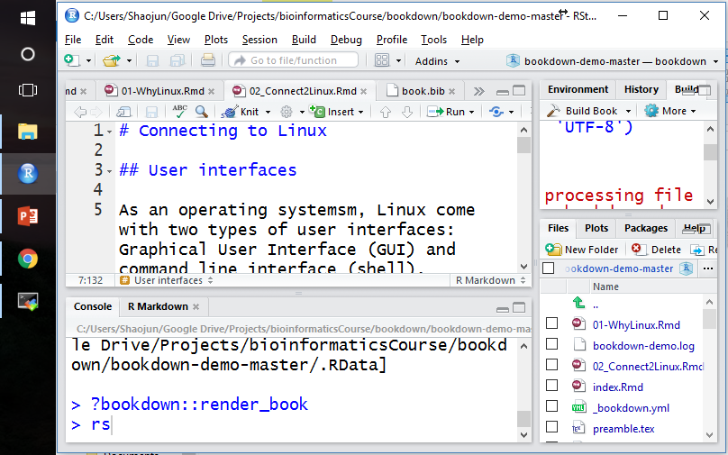

Slide 10
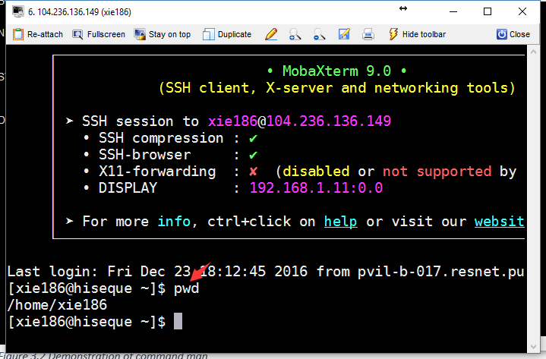

Slide 11
