Slide 1
Coral Recruitment Patterns in Different Reef Environments
Hannah Merges

Slide 2
What is a coral?
Plant (photosynthetic algal symbiont)
Animal (coral host)
Rock (calcium carbonate skeleton)

Slide 3
What is coral recruitment?
The introduction of new individuals to a community
Increases genetic diversity
Aids in post-disturbance recovery

Slide 4
Different types of reef environments
Fringing reef (nearest the shore)
Backreef (close to where the waves break)
Forereef (usually closest to the reef wall which is in in open water and slopes/drops off to larger depths)

Slide 5
Loading libraries
library(tidyverse) library(here) library(janitor) library(PNWColors)

Slide 6
Read in the data
recruits <- read_csv(here("Data","coral_recruit_tile_spat_counts_2006-2016_20180626.csv"))

Slide 7
Tidy the data
In a way that is useful for the plots and output we are trying to create Want to look at the change in recruit density over the years along the western shore particularly the lagoon
## ideally looking to combine total counts of all tiles and season into one count per year by species recruityears <- recruits %>% pivot_wider(names_from = side, values_from = count) %>% filter(family!="Unidentified", ##this filters out these families and says side does NOT include"A" family!="Other") %>% ## was going to filter out by shore, but "west" is only in 2006 select(-location, -A) %>% mutate(total_count = B+S+T) %>% group_by(nominal_year, family, habitat) %>% summarize(sum_total=sum(total_count))

Slide 8
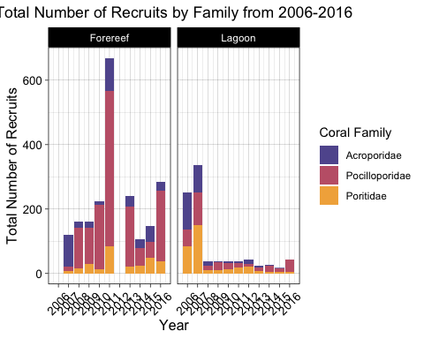
Plot this Data
Shows the total number of recruits by family per year.
ggplot(data=recruityears, aes(x=nominal_year, y=sum_total, fill=family)) + geom_col() + labs(x="Year", y="Total Number of Recruits", title="Total Number of Recruits by Family from 2006-2016", fill="Coral Family") + facet_wrap(~habitat) + theme_linedraw() + theme(plot.title=element_text(hjust=0.5), axis.text.x=element_text(size=10, angle = 45, vjust=0.5), ##to get the x axis slightly angled so text is not on top of each other. vjust moves text away from the actual axis axis.text.y=element_text(size=10), axis.title.x=element_text(size=12), axis.title.y=element_text(size=12)) + scale_x_continuous(breaks = c(2006, 2007, 2008, 2009, 2010, 2011, 2012, 2013, 2014, 2015, 2016)) + ##allows you to specifically decide what you want the column breaks to be scale_fill_manual(values=pnw_palette("Sunset2", n=3))

Slide 9
ggsave(here("Outputs", "totalrecruitment2.jpg"), width=10, height=7)

Slide 10
Now determine which side of the tile most recruits settle on
tileside <- recruits %>% filter(family!="Unidentified", ##this filters out these families family!="Other", side!="A") %>% select(-location) %>% ##removes columns by name group_by(family, side) %>% summarize(sum_total=sum(count))

Slide 11
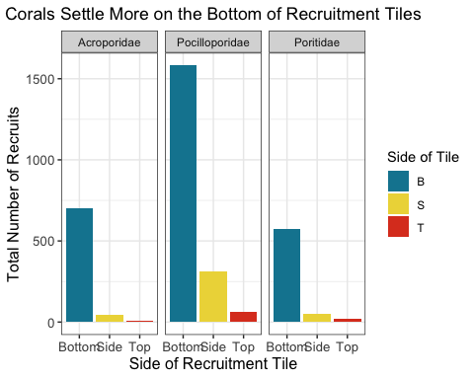
plot it
ggplot(data=tileside, aes(x=side, y=sum_total, fill=side)) + geom_col() + facet_wrap(~family) + theme_bw() + labs(y="Total Number of Recruits", x="Side of Recruitment Tile", title="Corals Settle More on the Bottom of Recruitment Tiles", fill="Side of Tile") + theme(plot.title=element_text(hjust=0.5), axis.text.x=element_text(size=10), ##to get the x axis slightly angled so text is not on top of each other. vjust moves text away from the actual axis axis.text.y=element_text(size=10), axis.title.x=element_text(size=12), axis.title.y=element_text(size=12)) + scale_x_discrete(labels = c("Bottom", "Side", "Top")) + scale_fill_manual(values = pnw_palette("Bay", n=3))

Slide 12
ggsave(here("Outputs","tilelocation.jpg"), height=7, width=10)

