Slide 1
Coral Recruitment Patterns in Different Reef Environments
Hannah Merges

Slide 2
What is a coral?
Plant (photosynthetic algal symbiont)
Animal (coral host)
Rock (calcium carbonate skeleton)

Slide 3
What is coral recruitment?
The introduction of new individuals to a community
Increases genetic diversity
Aids in post-disturbance recovery

Slide 4
Different types of reef environments
Fringing reef (nearest the shore)
Backreef (close to where the waves break)
Forereef (usually closest to the reef wall which is in in open water and slopes/drops off to larger depths)

Slide 5
Slide with R Output
summary(cars)
## speed dist ## Min. : 4.0 Min. : 2.00 ## 1st Qu.:12.0 1st Qu.: 26.00 ## Median :15.0 Median : 36.00 ## Mean :15.4 Mean : 42.98 ## 3rd Qu.:19.0 3rd Qu.: 56.00 ## Max. :25.0 Max. :120.00

Slide 6
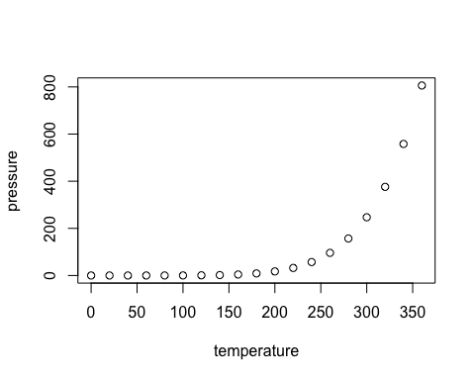
Slide with Plot
plot(pressure)

