Slide 2
Specifications
With the 3mL Syringe Attached
Dispense up to 1 ml or 1000 ul
Depending on the syringe:
Measure in increments of 100ul
With 1ml SYRINGE Attached
Dispense up to .35mL or 350uL
Measure in increments of 10uL

Slide 3
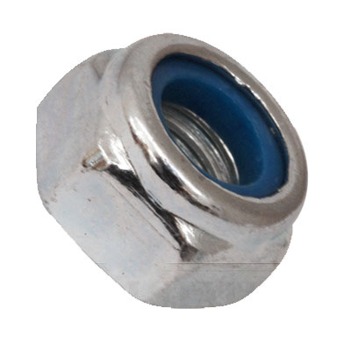
50 Trials to test drift
We set the pipette to about 200 microliters
Dispensed 50 times
Regression Line increased at a small rate
Fix Replacing the nut with a locking nut

Slide 4
Testing
To test the commercial pipettes against ours we performed 10 trials at various amounts
To test the 100-1000uL Pipette against ours we set both pipettes to 200uL
weighed the dispensed liquid in grams
Theoretical weight : 0.1999g
To test the 10-100uL Pipette against ours we set both pipettes to 50uL and to 20uL
weighed the dispensed liquid in grams
Theoretical weight (50uL) = 0.049999g
Theoretical weight (20uL) = 0.019999g

Slide 5
200uL
Commercial pipette
Test pipette
Average of ten trial : 0.20446
Percent Error: 2.233%
Standard Deviation : 0.00291
Percent Standard Deviation: 1.4215%
Average of ten trial : 0.19724
Percent Error: -1.377%
Standard Deviation : 0.00485
Percent Standard Deviation: 2.4588%

Slide 6
50uL
Commercial pipette
Test pipette
Average of ten trial : 0.0499
Percent Error: -0.197%
Standard Deviation : 0.00014
Percent Standard Deviation: 0.2834%
Average of ten trial : 0.05315
Percent Error: 6.303%
Standard Deviation : 0.00195
Percent Standard Deviation: 3.6754%

Slide 7
20uL
Commercial pipette
Test pipette
Average of ten trial : 0.01983
Percent Error: -0.847%
Standard Deviation : 0.00018
Percent Standard Deviation: 0.8911%
Average of ten trial : 0.01921
Percent Error: -3.967%
Standard Deviation : 0.00042
Percent Standard Deviation: 2.1948%

