Slide 1
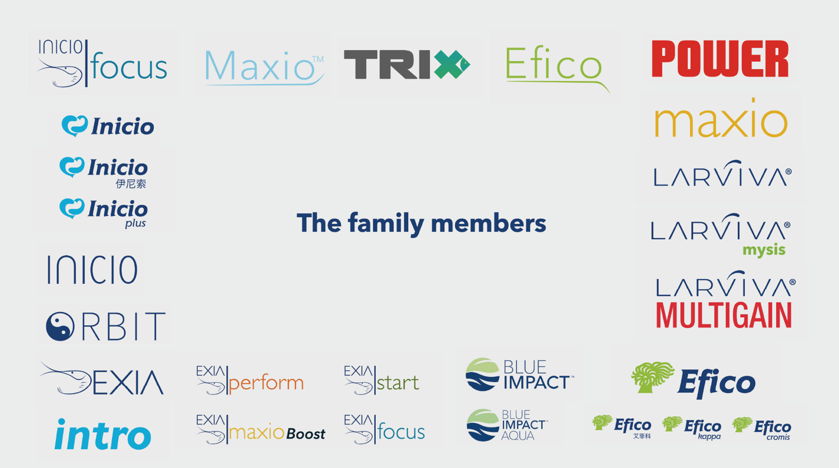
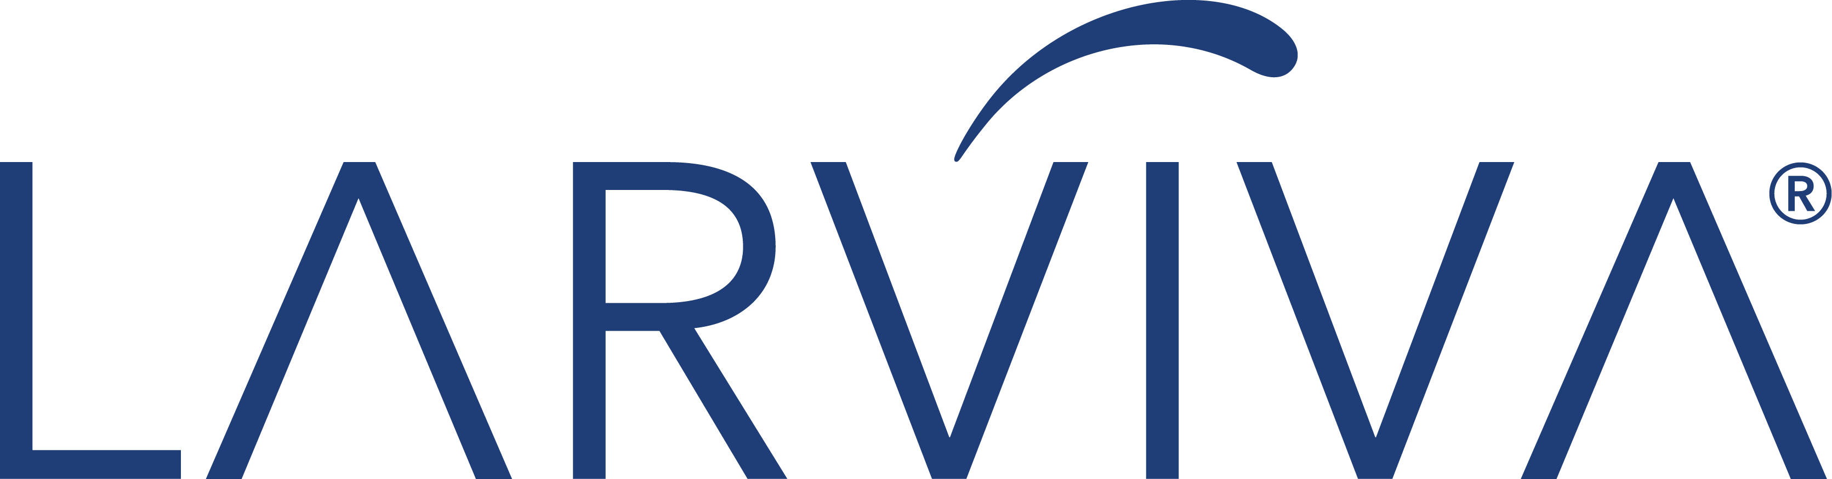













Recent Logo Rebranding
Before
All brands were treated independently from eachother. No alignment between them. Seem to be from different parents.
Now
All brands follow the same framework. Seem from the same parents. Have the swoosh.
Notes:
IS
Managing Brand Evolution
Talking points:
Recent logo update/rebranding initiative
Importance of maintaining consistency during transition
Roll-out across markets and materials
Updating templates, assets, documents, presentations, videos, and platforms
Coordination across departments and external suppliers
Design logistics behind implementation

