Slide 1
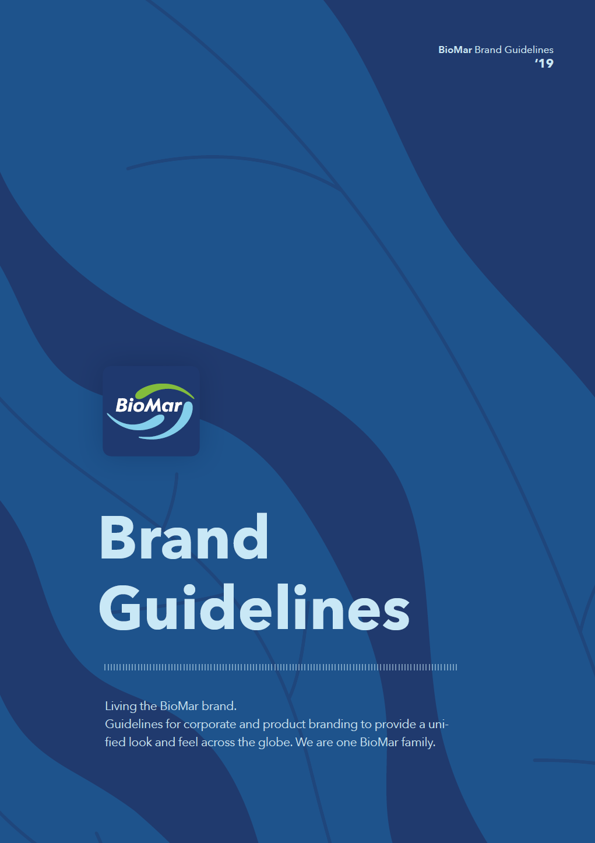
Brand Guidelines
Visual Branding & Design Governance
Key elements:
Logo usage
Typography
Color palette
Layout principles
Imagery style
Tone and consistency
Digital vs print applications
Guidelines are tools to support consistency while allowing flexibility for communication needs.
Notes:
IS

Slide 2
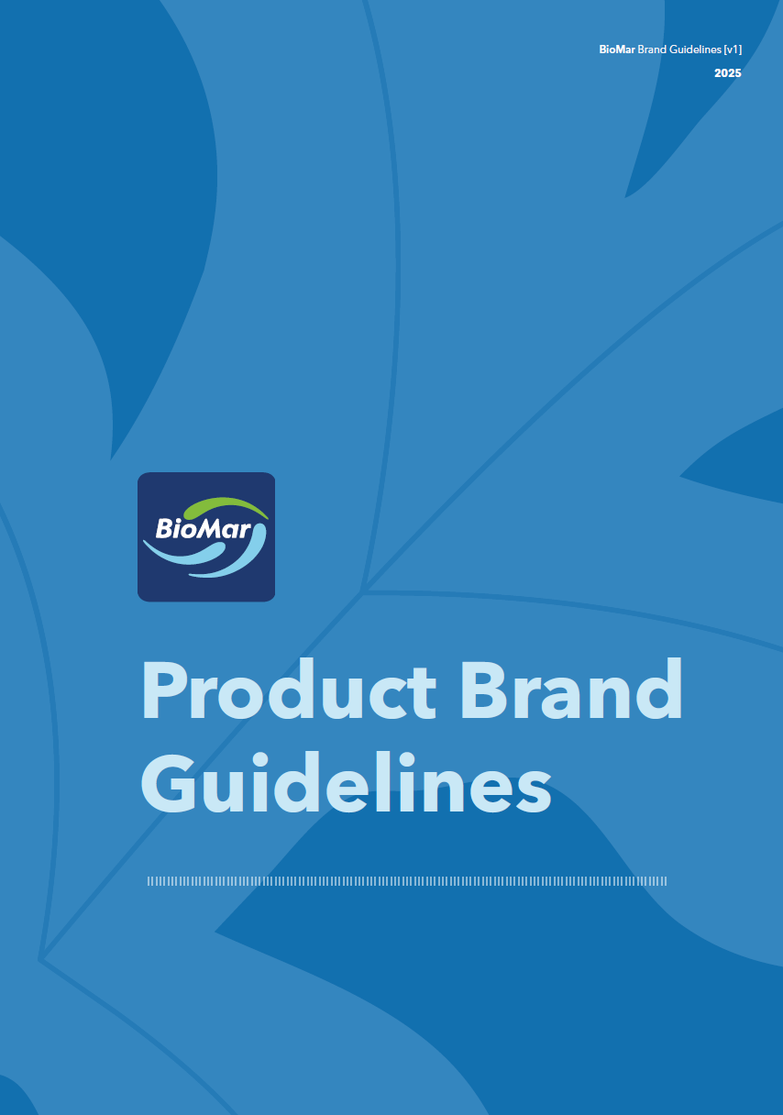
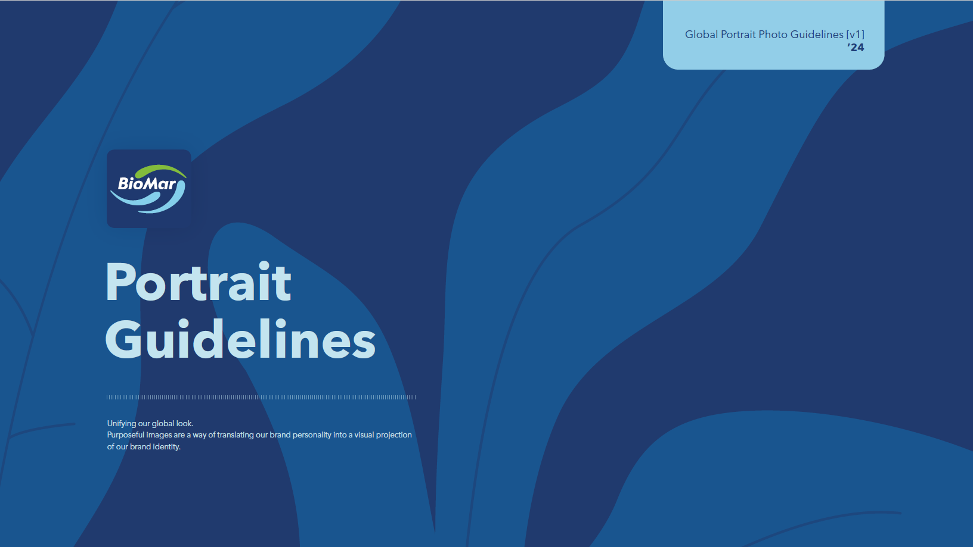

Additional Guidelines
All available on The Pond
Product communication standards
Packaging/product visual alignment
Art direction
Styling
Lighting & framing references
Image selection principles
Employee/profile photography consistency
Notes:
IS

Slide 3
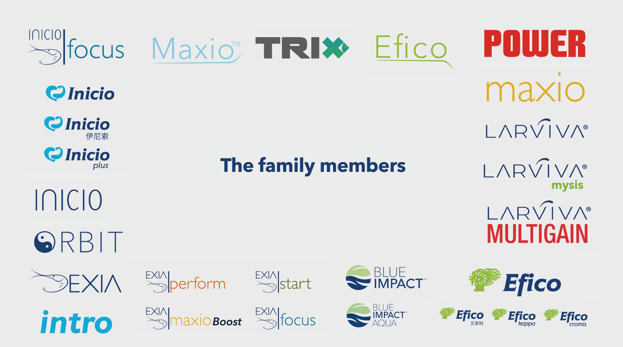














Recent Logo Rebranding
Before
All brands were treated independently from eachother. No alignment between them. Seem to be from different parents.
Now
All brands follow the same framework. Seem from the same parents. Have the swoosh.
Notes:
IS
Managing Brand Evolution
Talking points:
Recent logo update/rebranding initiative
Importance of maintaining consistency during transition
Roll-out across markets and materials
Updating templates, assets, documents, presentations, videos, and platforms
Coordination across departments and external suppliers
Design logistics behind implementation

