Slide 1
How we communicate

Slide 2
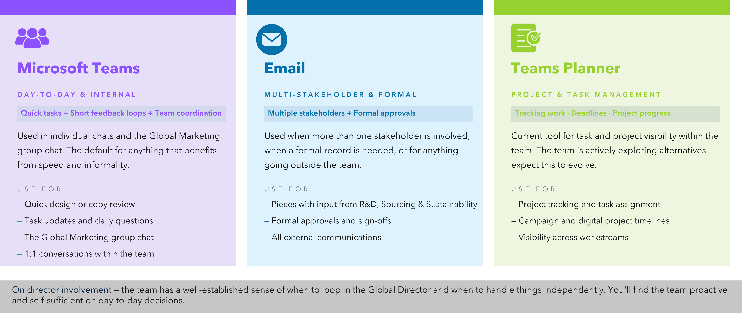
Channels

