Slide 1
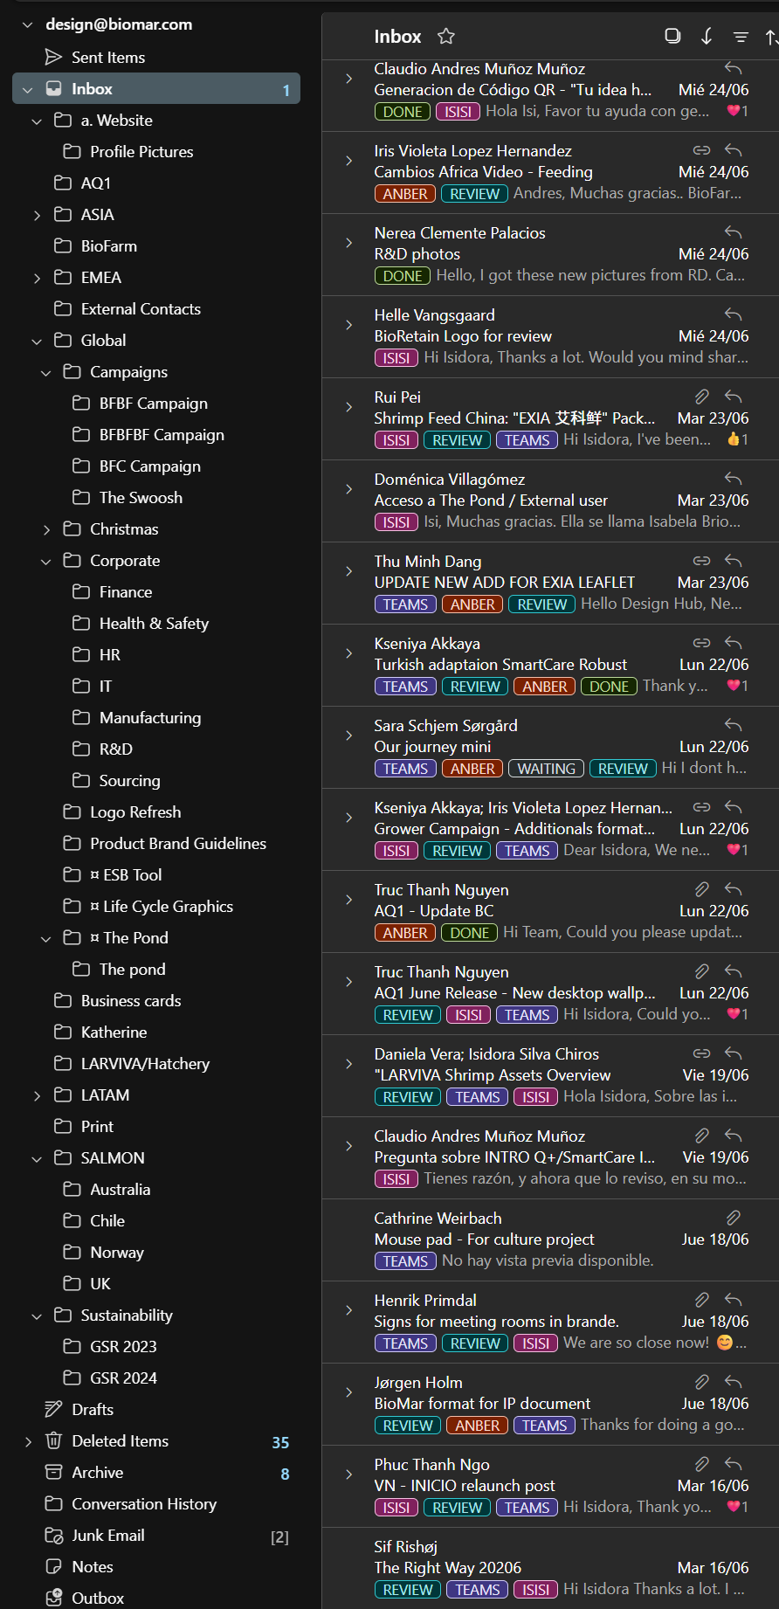
Everything starts with an email
Email Tags & Folder Structure
Teams: Used to indicate whether the request has been added to the task manager.
Teams – The request has been registered in the task manager.
No tag – Assume the request has not yet been added and needs to be reviewed.
Status: Used to track the progress of the project.
Waiting – The project is on hold while waiting for missing information, additional details, clarification, feedback, or confirmation from the requester.
Review – The proof version has been sent to the requester for feedback.
Done – The project has been completed and no further action is required.
Who: Used to identify who is responsible for the project.
Apply the tag with the designer's name once the task has been assigned.
This allows the team to quickly see who owns each project.
Folders: Once a project is completed, move the email to the corresponding folder to keep the inbox organized and make previous projects easy to find.
Emails are filed by market or business area (e.g. Global, Salmon, EMEA, ASIA, etc.).
This structure helps with future reference, project history, and retrieving previous files or conversations.
Tip: Keep tags updated throughout the project and archive completed requests in the appropriate folder. A well-maintained inbox makes collaboration, workload management, and handovers much more efficient.

