Slide 1
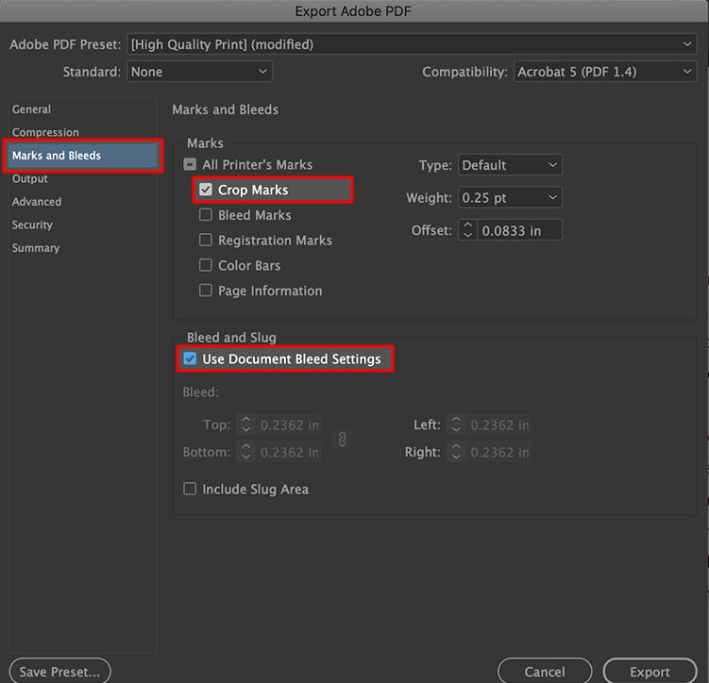
Exporting FINAL versions
PRINT: Usually print material will have bleed and/or crop-marks. Make sure ask what the supplier needs the document and to add them.
DIGITAL: Digital material is usually exported as Interactive PDF. Ask the requester where this will be displayed or used, to choose if the view should be 1 or 2 pages → or vertical or horizontal.

Slide 2
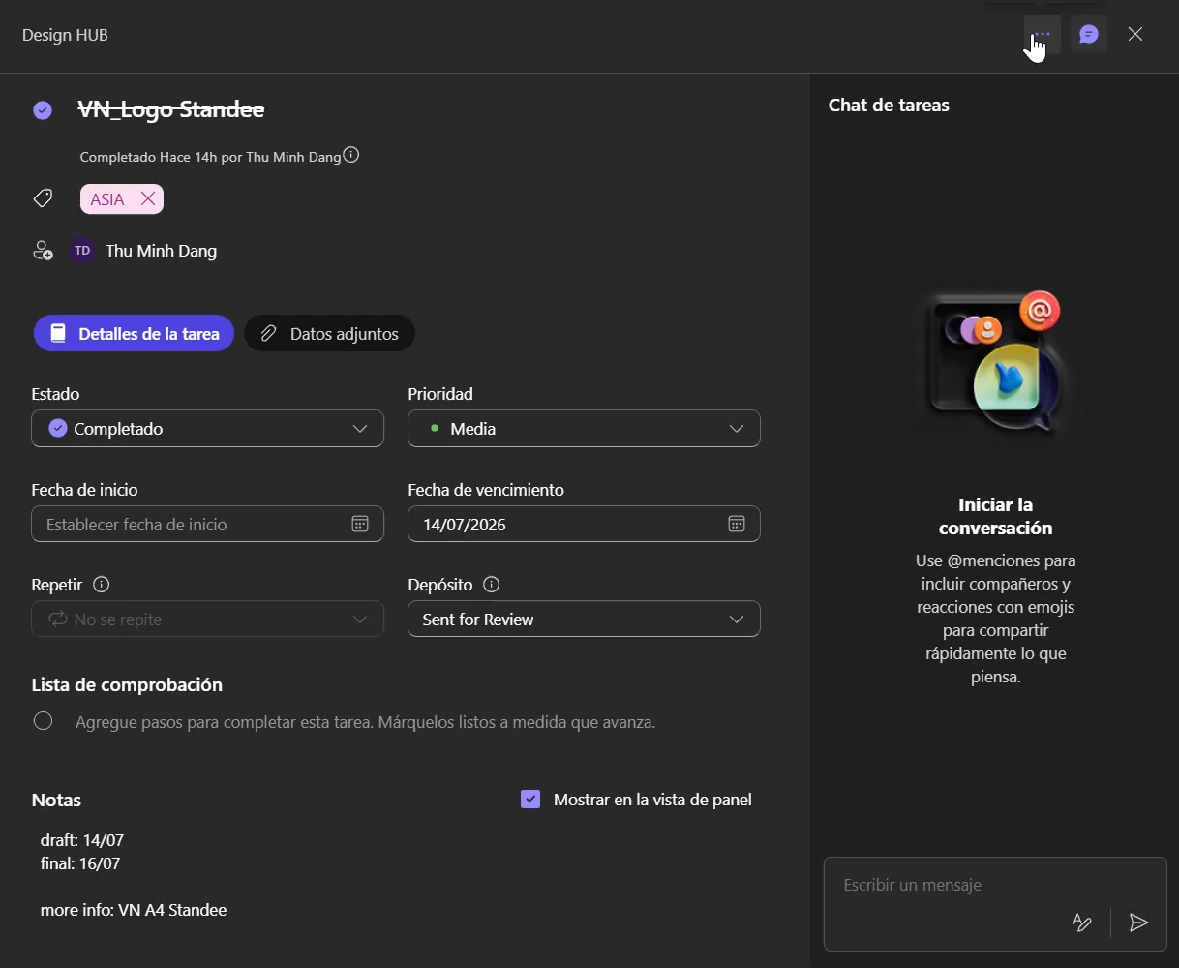
Closing tasks
Task manager
Once the task has been completed, it needs to be moved to the Completed section of the year, and categorized in the market it was made for.
In the case on the left, it is moved to “Completed 2026” and then categorized in “Vietnam”.

Slide 3
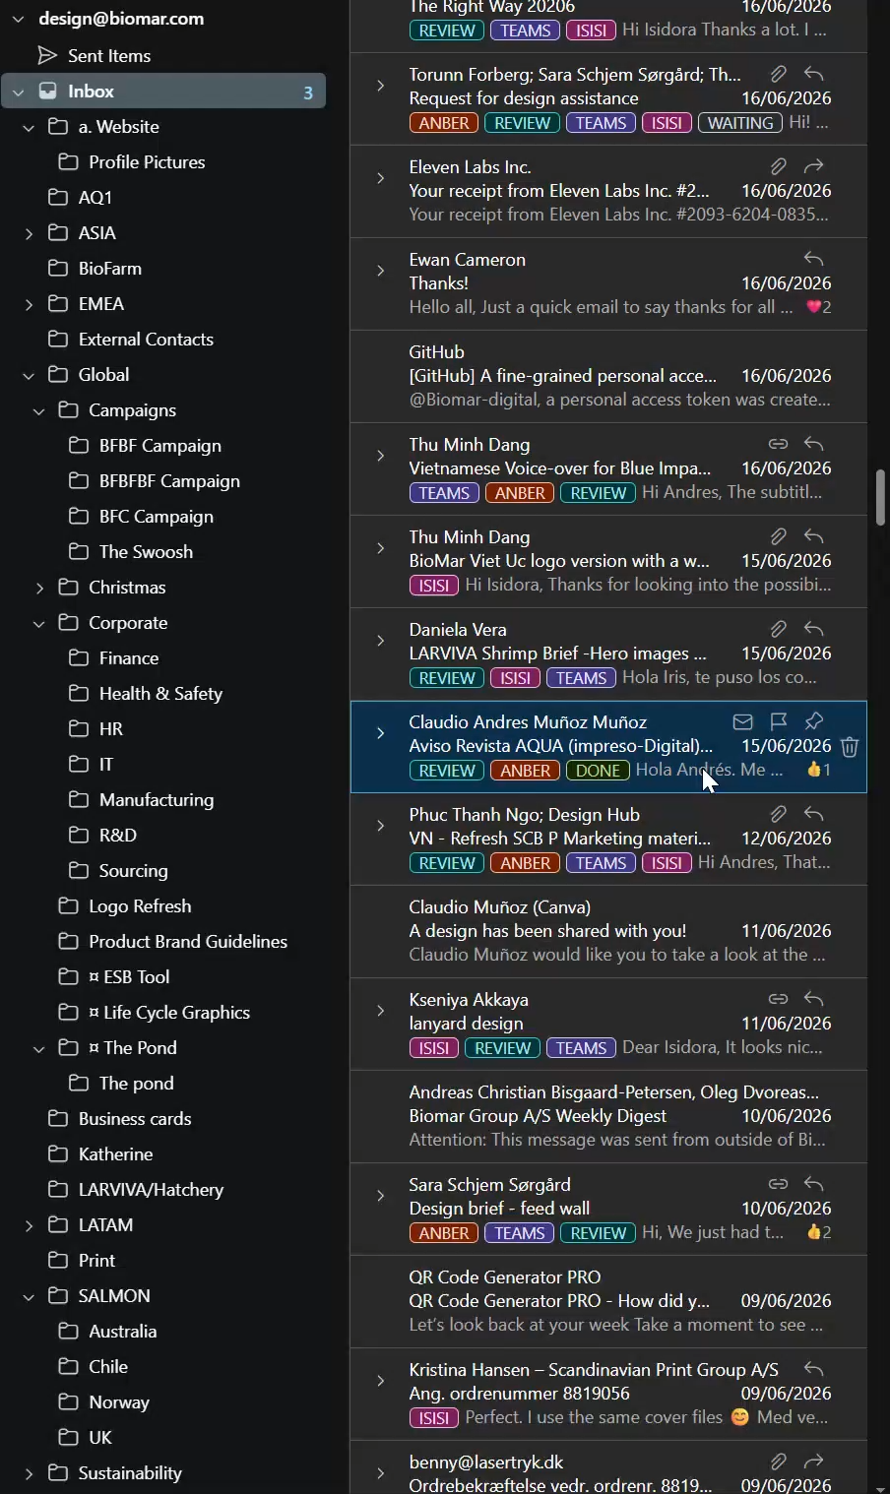
Closing tasks
Email Inbox
Once the task has been completed, it needs to be marked with the “done” tag and moved to the folder of the market that requested it.

