Slide 1

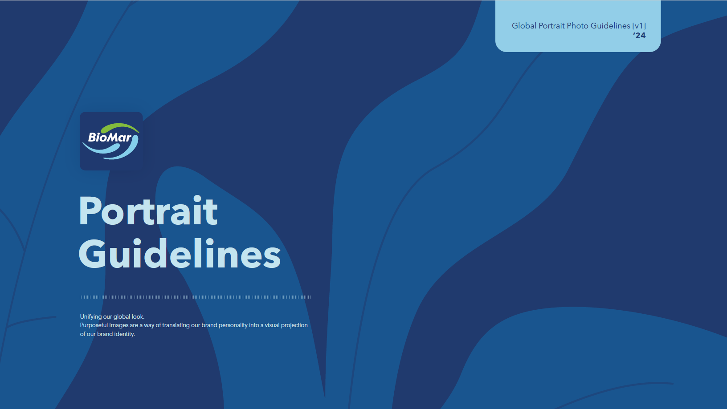

Additional Guidelines
All available on The Pond
Product communication standards
Packaging/product visual alignment
Art direction
Styling
Lighting & framing references
Image selection principles
Employee/profile photography consistency
Notes:
IS

