Slide 1
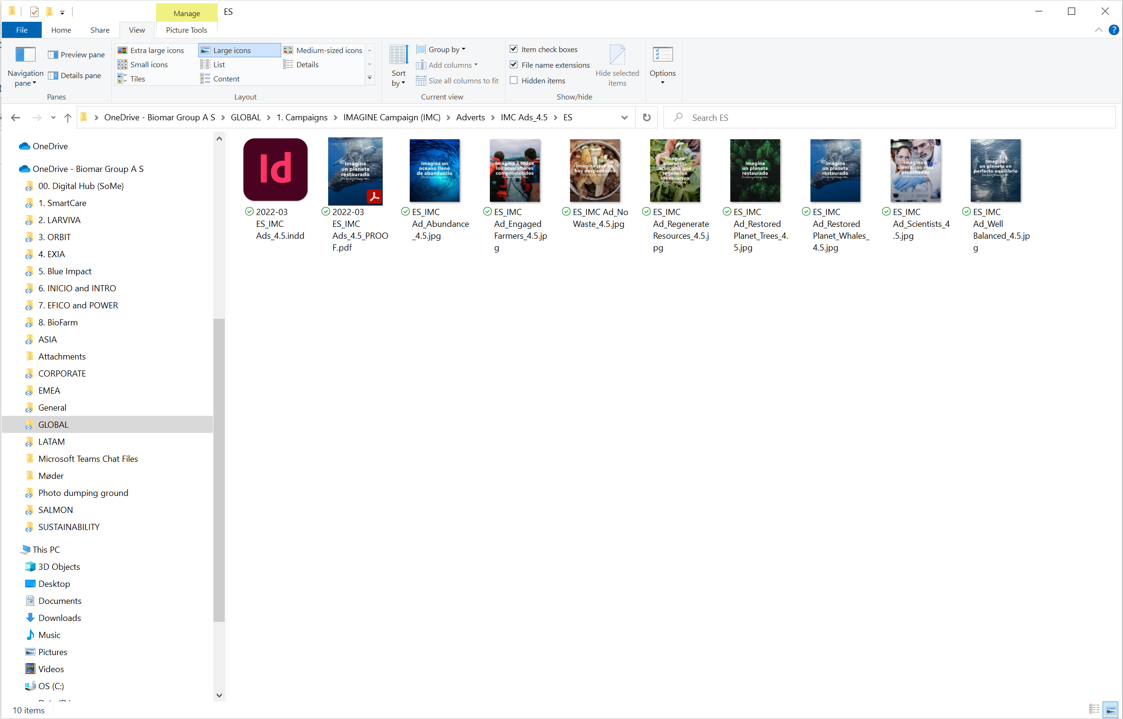
File Storage
You’ll always find:
Editable file (for Design Hub)
File for review (for Draft Date, ended in PROOF)
Final File (For Final Date, *ended in PRINT or DIGITAL)
*ONLY IF IT’S NEEDED TO MAKE THE DISTINCTION

Slide 2
Turn around times
+ rounds of review
Notes:
Otra cosa que consideramos definir son los tiempos de cada tarea o proyecto

Slide 3
Turn around times
Small Tasks | Project - Small | Project - Large | Logo Creation | New Product | New Concepts
1-4 days | 3-7 days | 2-3 weeks | 2-3 months | 3-6 months | 6-12 months
Updating documents – small notes, minor design changes | Brochures from existing material | Brochure from scratch Short Videos (>1min) | Logo creation from scratch or redesign with trademarking process Long videos (1-5 min) | New product within an existing brand concept | New brand or product concept Series of videos
Rounds of review
0-2
Rounds of review
1-3
Rounds of review
1-3
Rounds of review
3-5
Rounds of review
2-5
Rounds of review
2-5
The sooner you submit your project the sooner we can add to the calendar and give you a more accurate timeframe.
First come, first served. (Although prioritisation considerations taken into account)
All times are subject to change depending on workload, schedules and waiting times.
Notes:
Actualizar documentos,
Los Round de revisión
Crear cosas nuevas toma ya más tiempo.

Slide 4
Yearly Calendar
Calendars
JAN
FEB
MAR
APR
MAY
JUN
JUL
AUG
SEP
OCT
NOV
DEC
Sustainability Booklet
Christmas Artwork
Summer
Easter
Summer
Xmas
Notes:
Además, en este calendario pueden ver algunos eventos que sabemos que suceden año tras año.
Fechas en las que habrán menos personas trabajando.

