Slide 1
LARVIVA Hatchery Hub Signage
HATCHERY
28/09/23
2/10/23
Final due date for artwork only (not production of the material)
BioMar has invested in advanced larval research facilities at ATC Hirtshals, capable of performing trials in semi-industrial conditions.
The trial facilities will serve as a hub for: Research and development, product consolidation and validation, benchmark trails, training for technical support (Global), Show-room to customers, and building BioMar and LARVIVA innovation image.
Name of the specialized hatchery unit: LARVIVA Hatchery Hub
Opening event: end of October (signage to be produced and installed for opening event)
External signage for main unit: LARVIVA Hatchery Hub
External signage for small unit: Larvae Room 2
External signage giving direction to the units
Internal signage for 5 rooms inside main unit: Lab, Artemia Room, Rotifer Room, Trail Lab, Larvae Room 1
Wall design: LARVIVA+tagline
Wall decoration /canvas (LARVIVA hero image, etc)

Slide 2
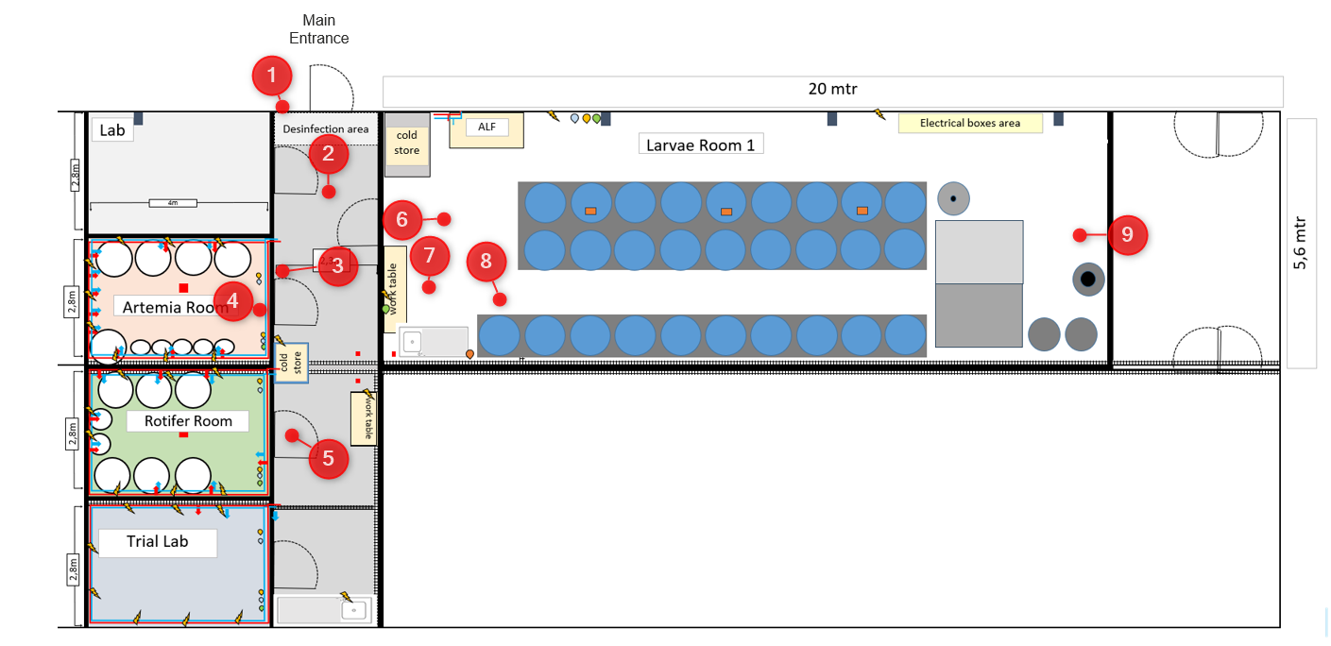
Trial facilities layout (II)

Slide 3
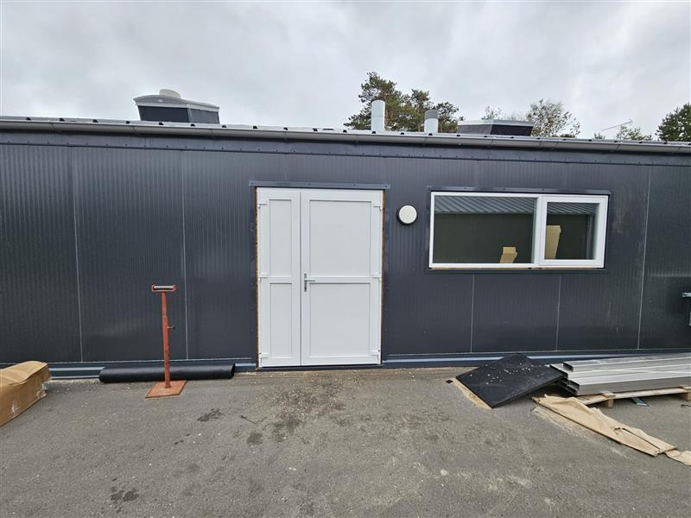
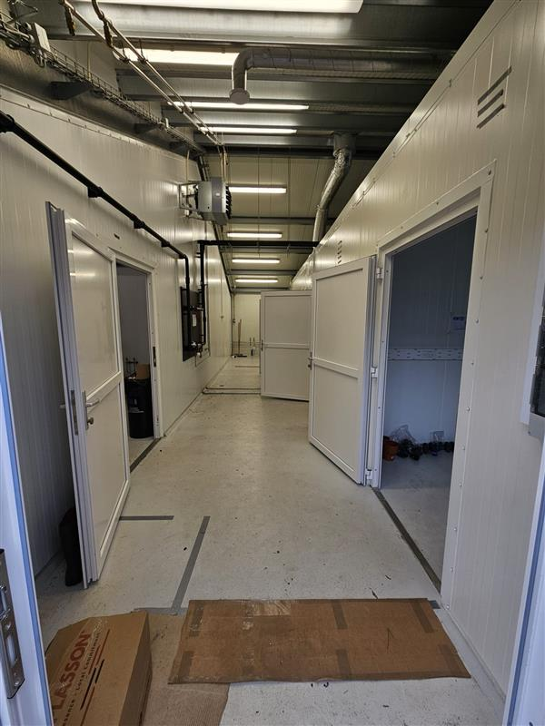
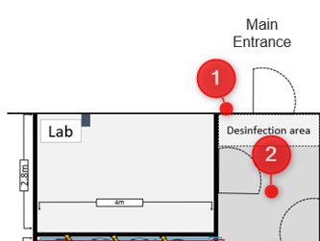
Trial facilities layout (III)
Wall space for design/canvas at the end of the hallway
1
2
Signage
60x40cm
Wall 1,2x2,5m

Slide 4
www.biomar.com

