Slide 1
Global and Group Marketing
The team, practicalities and how we work.

Slide 2
What is Global Marketing and Branding

Slide 3
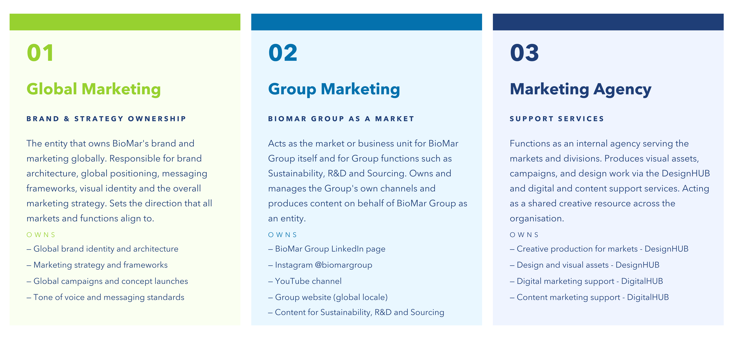
Our 3 working areas

Slide 4
Marketing Organisation

Slide 5
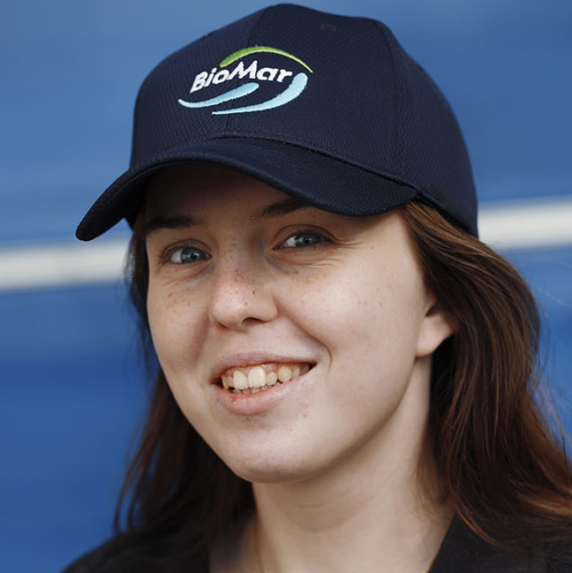
Global Marketing
Global Marketing Director
Helle Vansgaard
DESIGN HUB
DIGITAL MARKETING
Multimedia Designer
Andres Bernadou
Digital Marketing Platforms Specialist
Matt Evans
Content Creator
Nerea Palacios
Graphic Designer
Isidora Silva Chiros
Notes:
5

Slide 6




Manager Kseniya
Akkaya
Manager
Cathrine
Weirbach
Assistant Christina
Kravariti
Manager
Iris Hernandez
BioMar Marketing
Global Marketing manages the BioMar brand creates the positioning for all product concepts and services and runs a centralised Design and Digital Shared Services agency.
Product Marketing Management manages their segment and develops the product range in their product portfolio
Local Marketing launches its product range and runs marketing initiatives to support its businesses
EMEA
Marketing Manager
Valeria Triviño Alvarez
Marketing Assistant
Thu Minh Dang
Global Marketing
Daniela Vera
Xinru Wang
LATAM
Asia
Marketing Responsible
Steven Leon Ulloa
Marketing Manager
Ma Teng
Joana Silva
Salmon
Manager
Thomas
Hansen
Manager
Victoria
Valdenegro
= Location
Responsible
Andrew
Richardson
Manager
Claudio
Muñoz

