Slide 1
Marketing Stakeholders

Slide 2
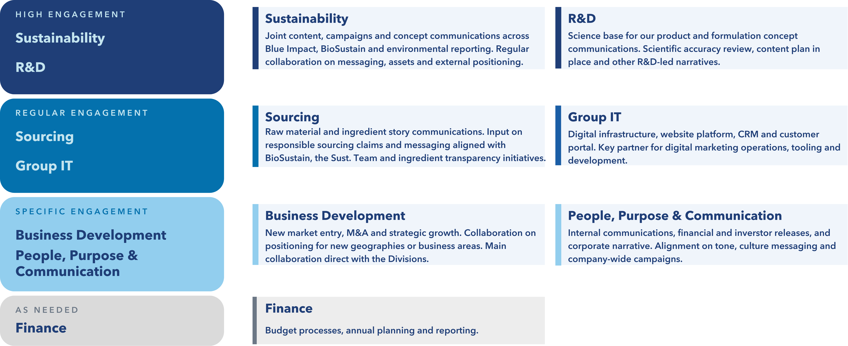
Our Group Function Stakeholders

Slide 3
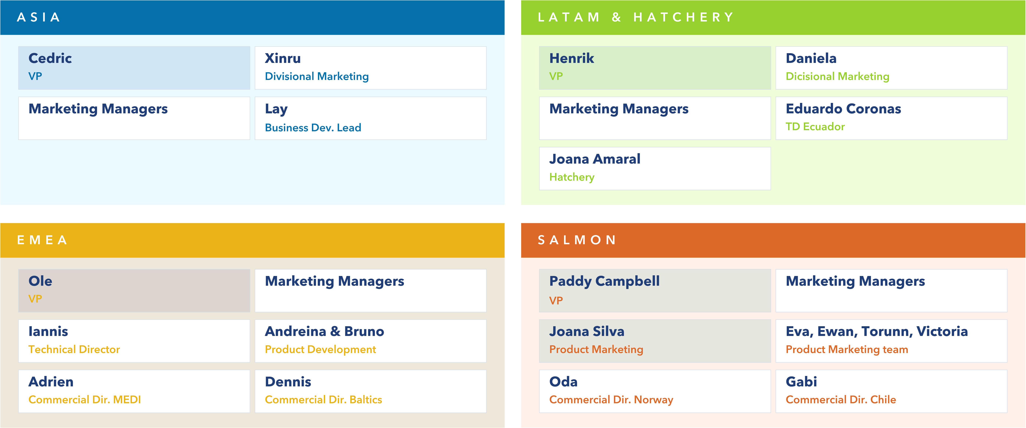
Some of our key stakeholders around the world

Slide 4
Marketing Meetings

Slide 5
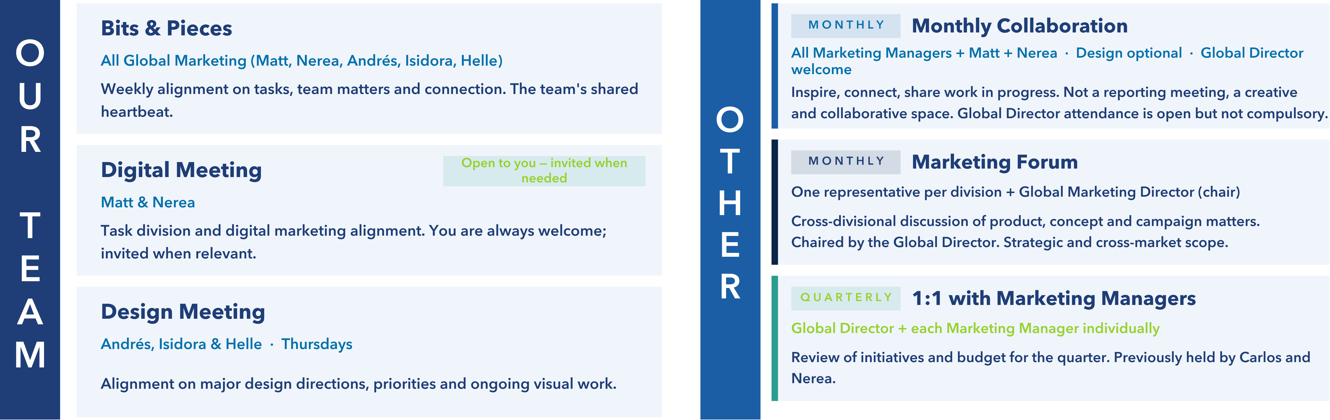
Regular meetings

Slide 6
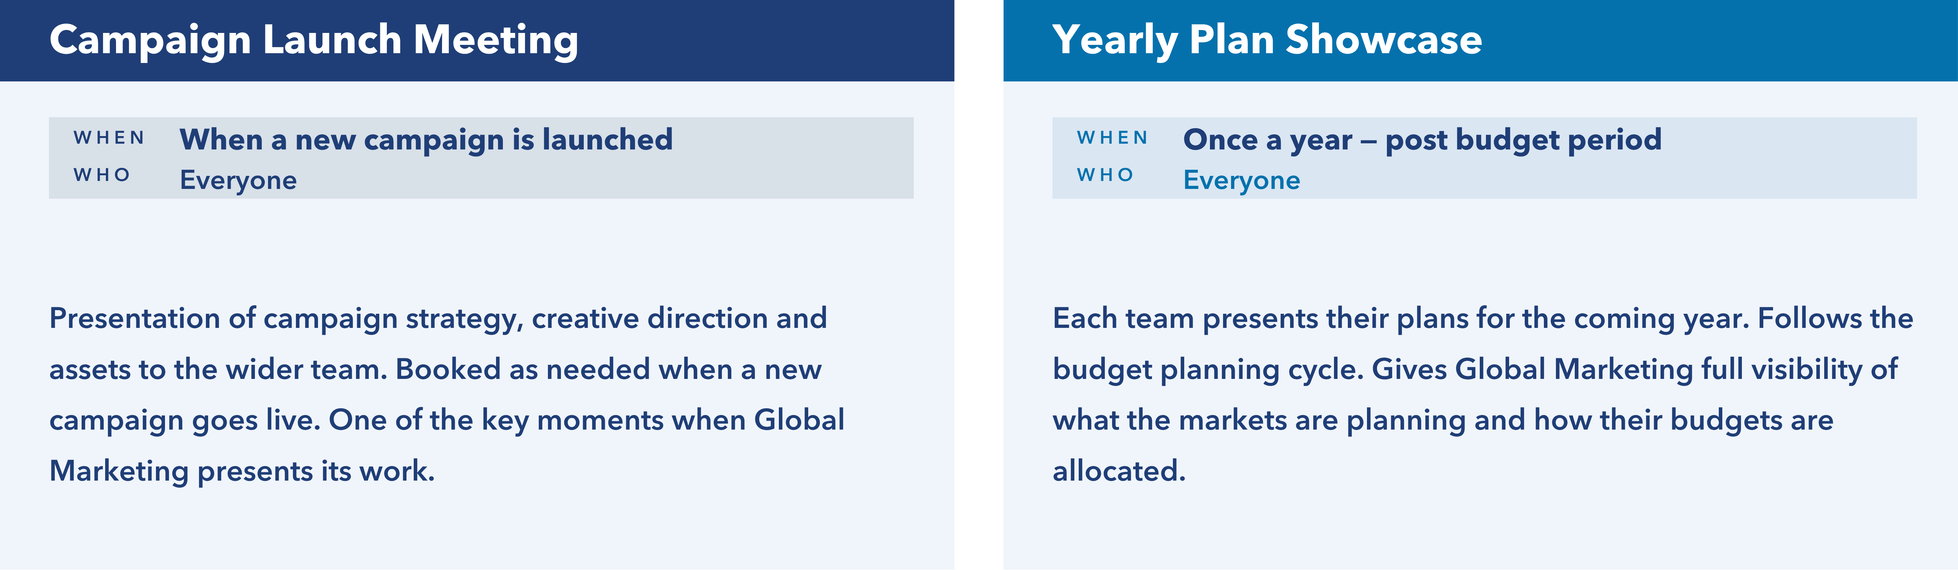
Special meetings

