Slide 1
How we communicate

Slide 2
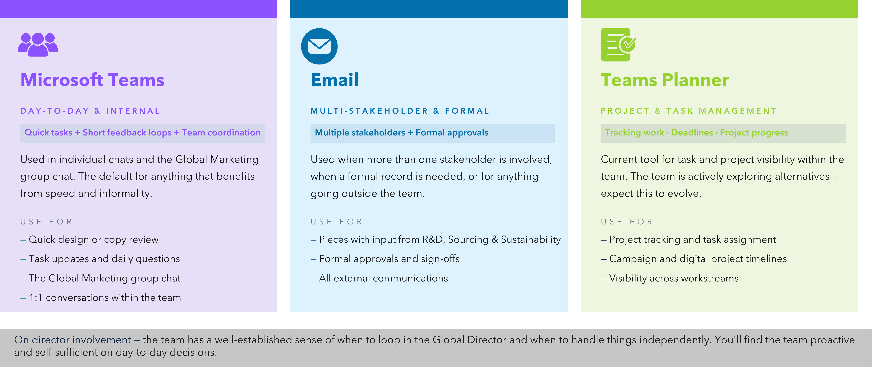
Channels

Slide 3
Global Marketing Plan
2026

Slide 4
Global
Group
 | January 2026 | February 2026 | March 2026 | April 2026 | May 2026 | June 2026 | July 2026 | August 2026 | September 2026 |  |  | October 2026 |  |  | November 2026 | December 2026
Events & Sponsorship
 |  |  | NASF | Blue Food Innovation Summit | Barcelona Show |  |  | TARS | GSF
Digital Marketing
Biomar.com |  | Gated Content |  |  | United Customer Journey
Customer Portal |  | Forecast |  |  |  |  | Data Exchange
Feeding Tool |  | Feeding Tool 1.5
Discover Seafood |  |  |  | Discover Seafood 1.5
Marketing Automation | WhatsApp Channel |  | Newsletter 1.5 |  |  | Market Roll-out Newsletter |  |  |  |  | Market Roll-out Newsletter |  |  |  | The Pond 3.0
Campaigns
Vision Elements |  |  |  |  | GSR | GSR | GSR |  |  |  |  |  |  |  | Manufactoring Excellence Award
Brand Image Elements | Health videos | Health videos |  | Swoosh |  |  | BFBFBF | BFBFBF
Commercial Elements | SmartCare | SmartCare |  |  |  | Grower Campaign |  |  | Formulation Concept |  |  | Formulation Concept
Social Media
Vision |  |  |  | Launch + CA | CA | CR | EP
Brand Image |  | BioFarm Campaign Round 2 | BioFarm Campaign Round 2 |  | ISFNF (Driven by Innovation) |  |  | Community | Behind the Feed |  |  | Behind the Feed |  |  | Sustainable Nutrition Campaign | Sustainable Nutrition Campaign
Commercial |  |  | International Women Day |  |  |  |  |  |  |  |  |  |  |  | International Day of the Child

Slide 5
Budgets

