Slide 1
Design Hub Playbook

Slide 2
Table of Content

Slide 3
From Brief to Final Version
Overall Process
Email and briefing
Work on Version
Receive Feedback
Final Version
Close task

Slide 4
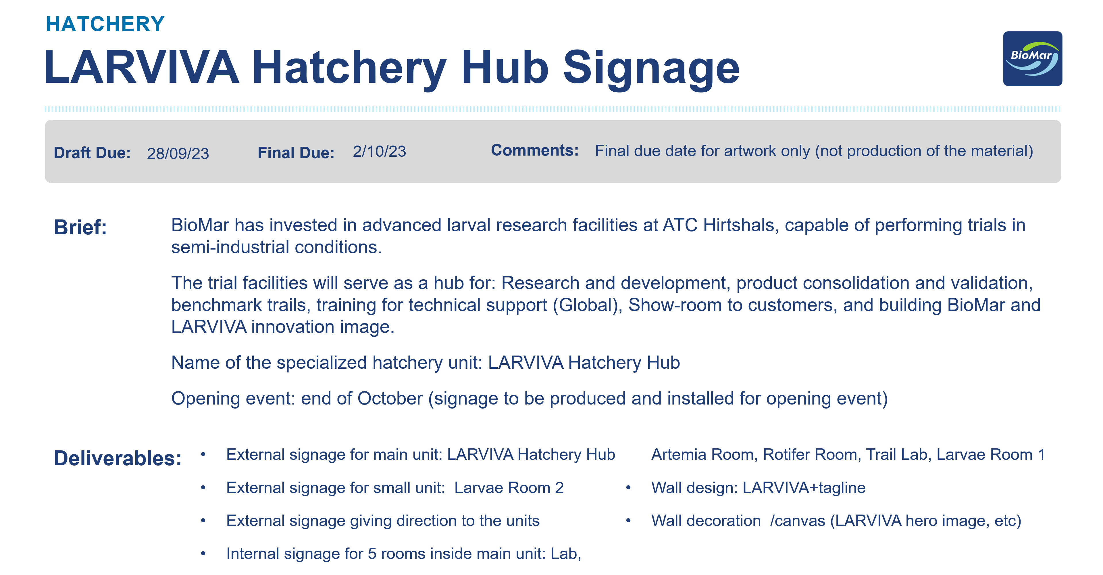
Everything starts with an email
The brief is the foundation of every project. It provides the essential information needed to understand the request, including the objective, target audience, deliverables, timeline, text copy, format specifications, and any relevant assets or references. A clear brief helps ensure the project starts with the right direction and minimizes revisions later in the process.
All design requests are received through design@biomar.com, the shared inbox for the Design Hub. This central mailbox allows the team to track incoming requests, maintain visibility across projects, and ensure a smooth handover whenever needed.

Slide 5
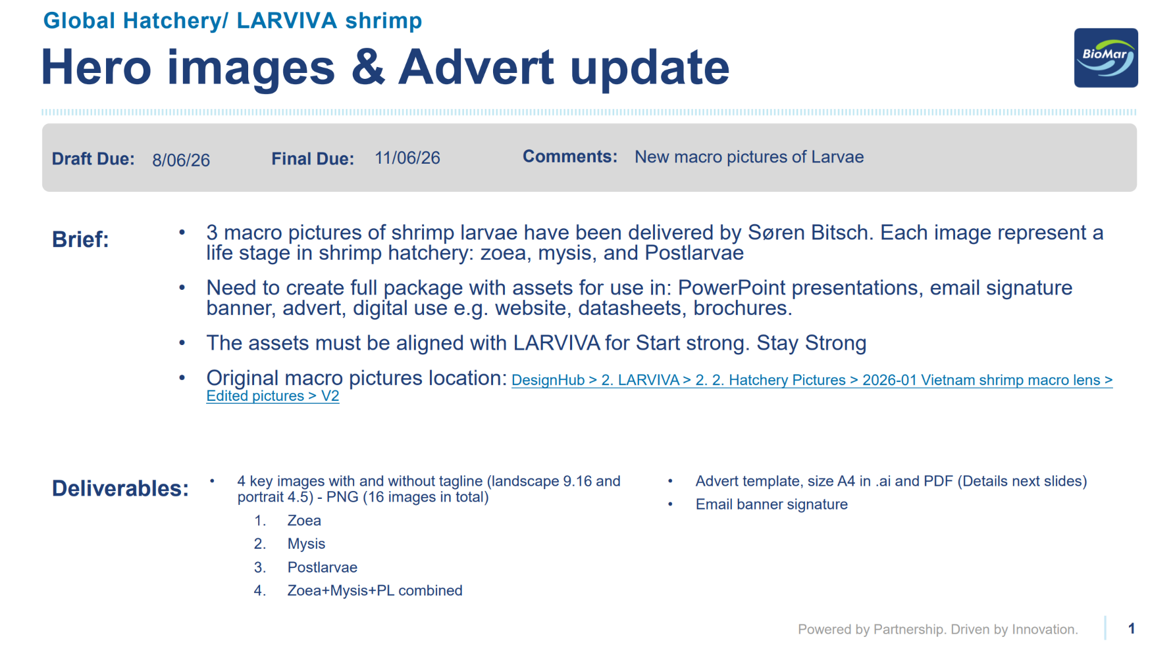
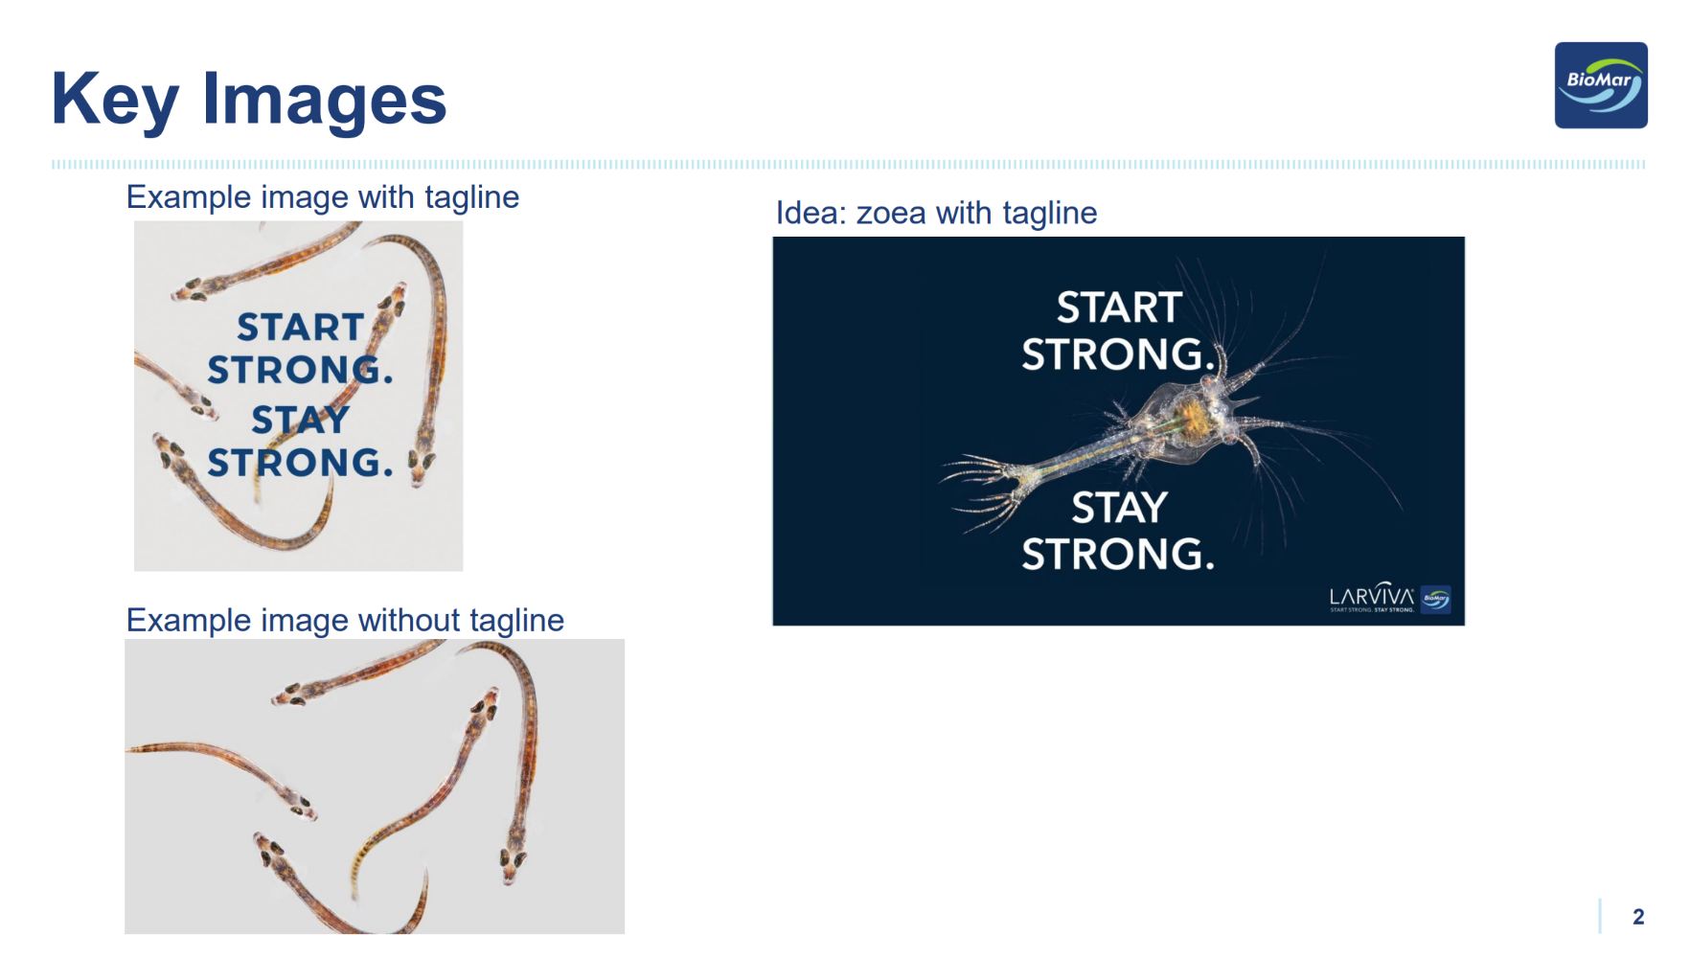
Everything starts with an email
Reviewing the Brief
Before starting any project, make sure the brief includes the minimum information required to proceed. This helps avoid unnecessary back-and-forth and ensures the project can be completed efficiently.
Minimum information required:
Purpose: What is the project for?
Timeline: Draft and final delivery dates.
Specifications: Format, dimensions, and any production requirements.
Content: Final copy/text and any supporting assets*.
*Assets are not always required. However, when applicable, request any materials that are specific to the project, such as third-party logos, certification logos, feed datasheets, event-related visuals, or market-specific images. BioMar brand assets can be sourced internally.

