Slide 1
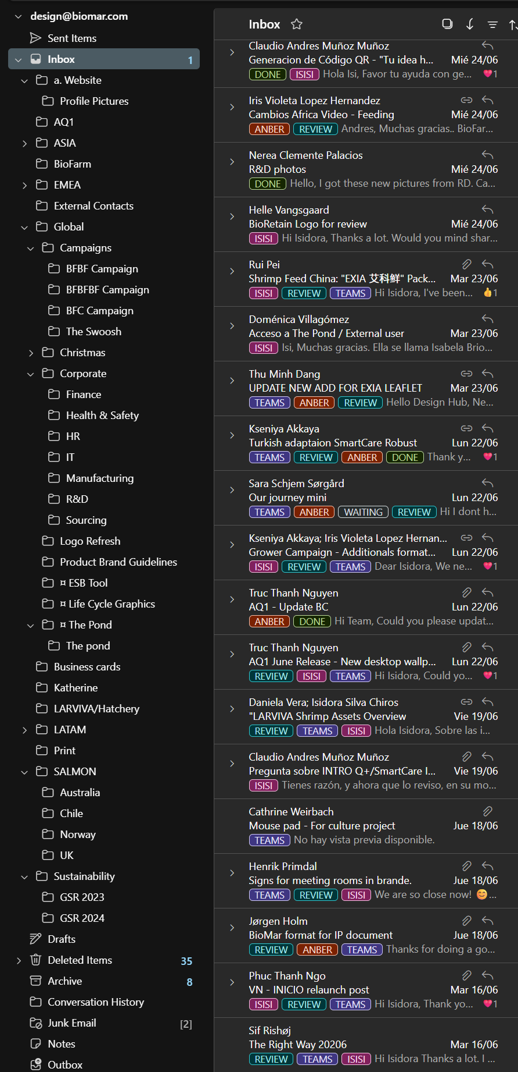
Everything starts with an email
Email Tags & Folder Structure
Teams: Used to indicate whether the request has been added to the task manager.
Teams – The request has been registered in the task manager.
No tag – Assume the request has not yet been added and needs to be reviewed.
Status: Used to track the progress of the project.
Waiting – The project is on hold while waiting for missing information, additional details, clarification, feedback, or confirmation from the requester.
Review – The proof version has been sent to the requester for feedback.
Done – The project has been completed and no further action is required.
Who: Used to identify who is responsible for the project.
Apply the tag with the designer's name once the task has been assigned.
This allows the team to quickly see who owns each project.
Folders: Once a project is completed, move the email to the corresponding folder to keep the inbox organized and make previous projects easy to find.
Emails are filed by market or business area (e.g. Global, Salmon, EMEA, ASIA, etc.).
This structure helps with future reference, project history, and retrieving previous files or conversations.
Tip: Keep tags updated throughout the project and archive completed requests in the appropriate folder. A well-maintained inbox makes collaboration, workload management, and handovers much more efficient.

Slide 2
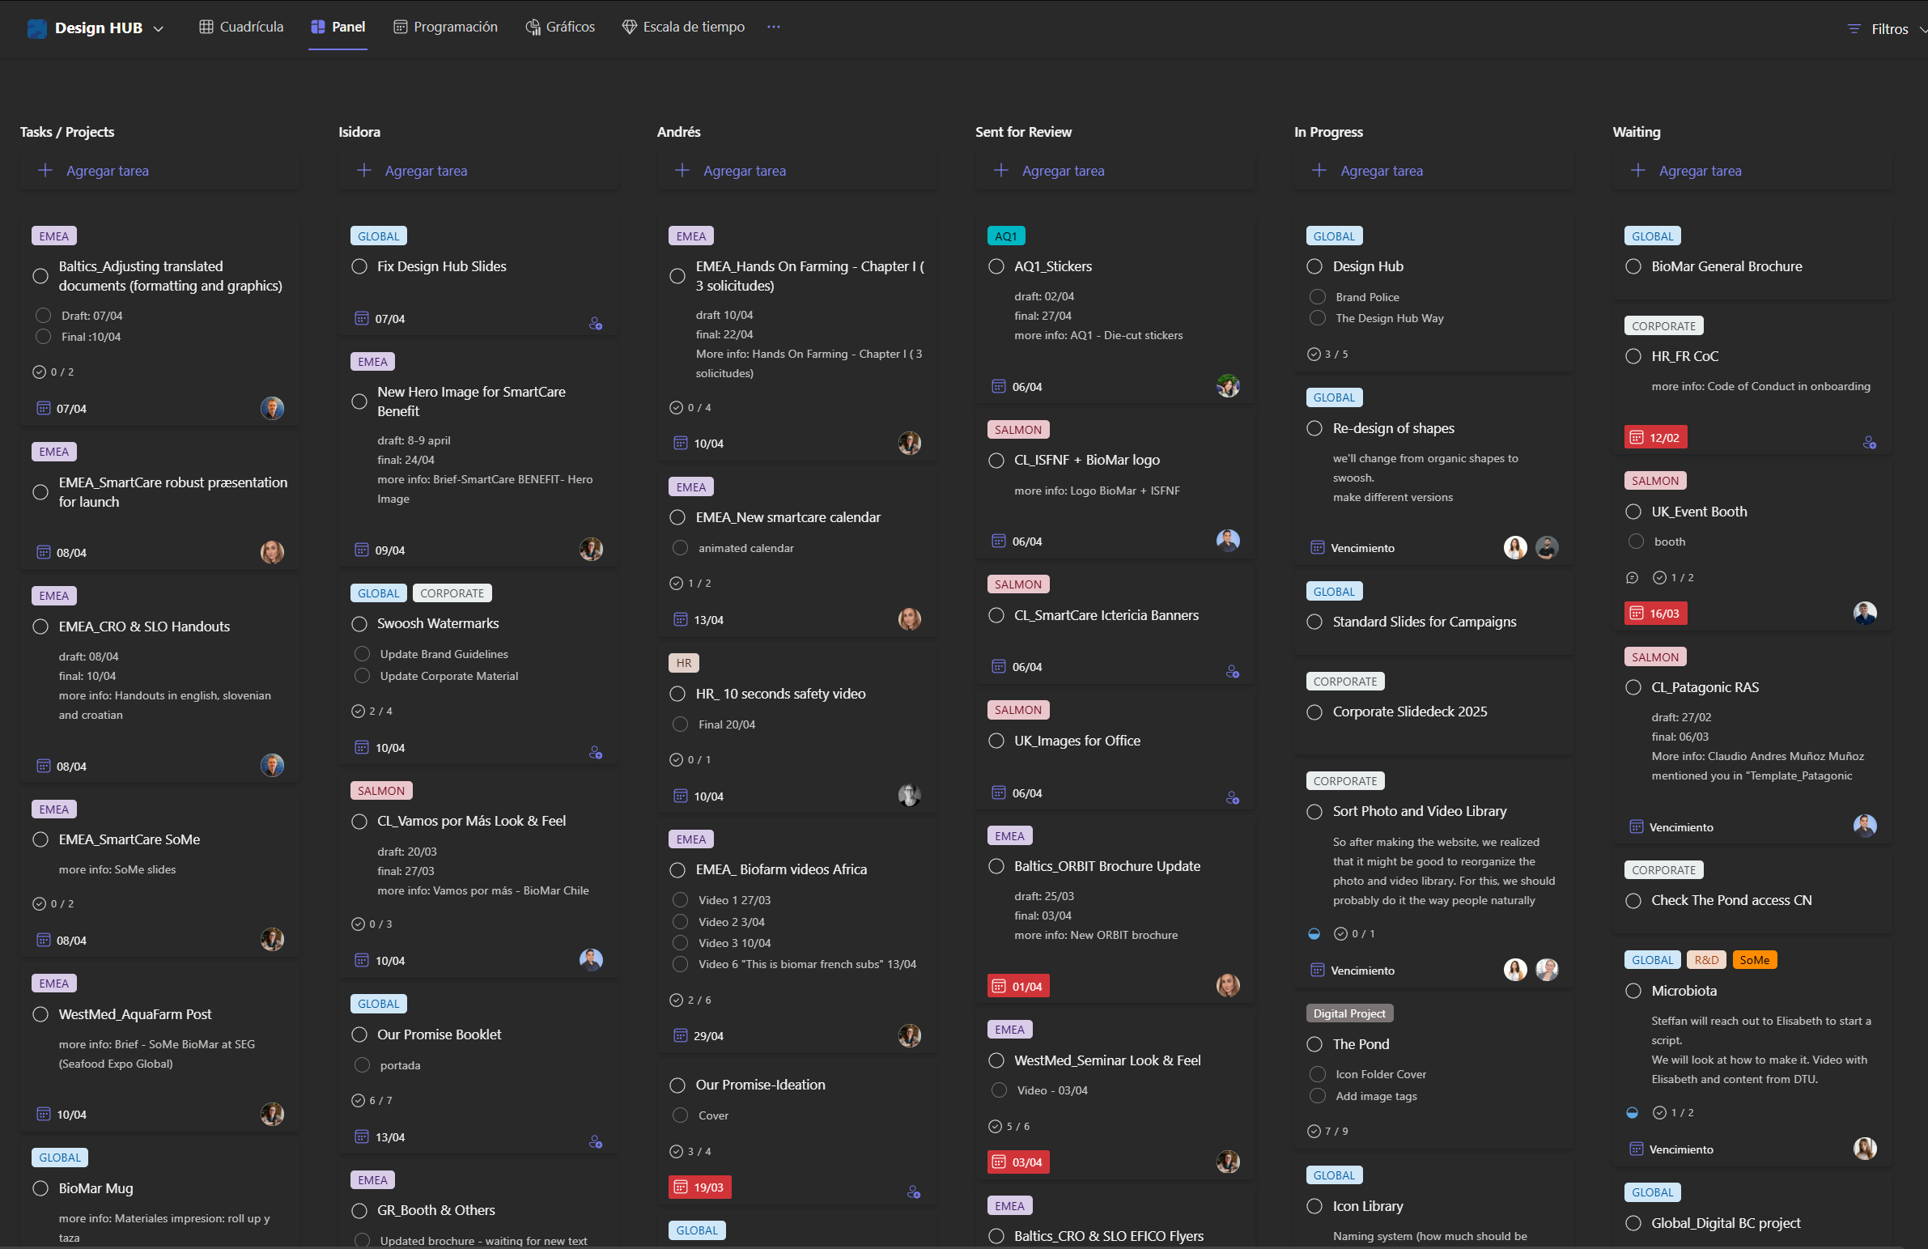
Design Hub Task Manager
Tasks / Projects Column
This is where all new requests are added when they enter the Design Hub. A task in this column means it is an active project, but it has not yet been assigned to a designer.

Slide 3
Design Hub Task Manager
Designer Columns
Once a designer starts working on a task, it should be moved to their personal column. This makes ownership clear and allows everyone in the Design Hub to quickly see who is responsible for each project.

Slide 4
Design Hub Task Manager
Status Columns
Status columns help track the progress of ongoing projects:
Sent for Review – The proof version has been shared with the requester and we are waiting for feedback or approval.
In Progress – Used for larger or longer-term projects that are actively being worked on by one or both designers.
Waiting – The task is temporarily on hold while waiting for missing information, additional details, clarification, feedback, or confirmation from the requester.

Slide 5
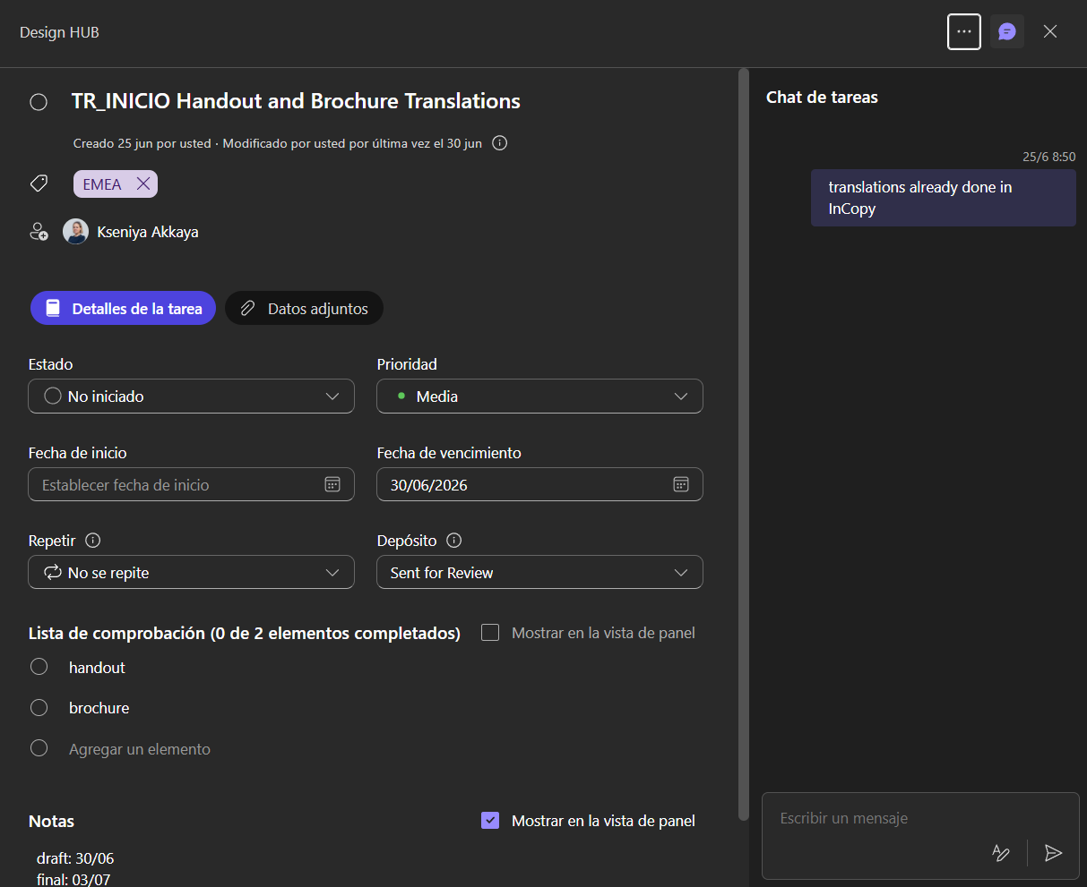
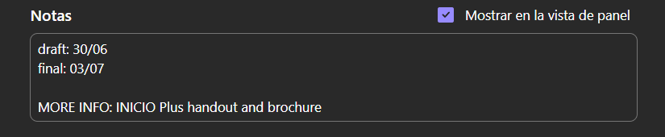
Design Hub Task Manager
Task Card Structure
Each task card contains all the relevant information needed to manage and track a project from start to finish.

Slide 6
Design Hub Task Manager
Title
The title should clearly identify the project. We use the market name at the beginning, followed by a short description of the request or deliverable.
Market Tags
Tags are added to identify which market the project belongs to. This helps with filtering, organization, and keeping track of workload across different areas.
People
Add the requester as a member of the task. Once added, they will receive an email notification and have access to the task, allowing them to follow updates and information related to the project.
Deadline
Deadlines should always be added and kept updated throughout the project lifecycle.
Initially, add the draft deadline provided by the requester.
Once the proof version has been sent, update it to the final deadline.
Additional dates can be added when needed (e.g., internal milestones or intermediate deliveries) to help organize the workflow and manage priorities.

Slide 7
Design Hub Task Manager
To-do
This section is not required for every task, but it is useful for projects with multiple deliverables or formats. It allows the different outputs to be listed and tracked individually.
Notes
Use this section to add any relevant project information.
At minimum, always include: Draft deadline; Final deadline; Email subject
Adding the email subject is especially important, as it makes it easier to find the original request, brief, and previous conversations when reviewing the project later.
Chat
The chat section is not frequently used, but it can be helpful for quick project updates or status notes, such as:
“Waiting for translation”
“InCopy setup completed”
“Feedback received from market”
It provides a simple way to keep track of small updates without changing the main task information.

