Slide 1
Task Process Walkthrough

Slide 2
First, where to find things? WIP
https://www.figma.com/board/KRZiC0me29aOCJBrfaRYPk/Untitled?node-id=3-579&t=JFX3InyRx8QNRx1h-1

Slide 3
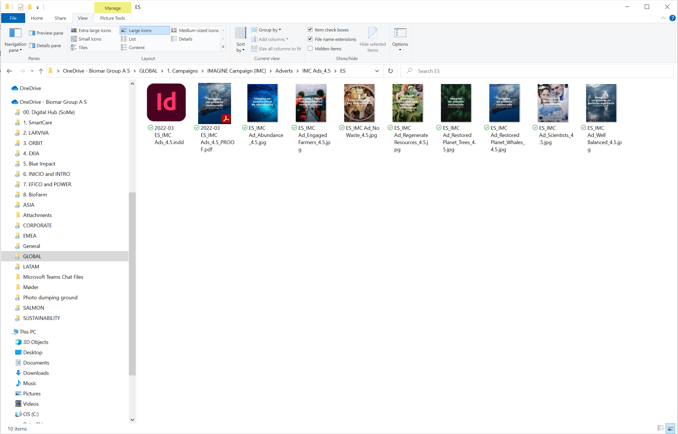
File Storage
You’ll always find:
Editable file (for Design Hub)
File for review (for Draft Date, ended in PROOF)
Final File (For Final Date, *ended in PRINT or DIGITAL)
*ONLY IF IT’S NEEDED TO MAKE THE DISTINCTION

Slide 4
File naming conventions
Design Files
Year-Month Language_Market
Brand/Product-FileType*
EXAMPLE:
2022-03 ES_Orbit_Brochure or DRAFT_2021-03 EN_EMEA SmartCare FOCUS (Marine) DM
*File Type:Brochure, Ad, Datasheet, Video, etc.
Images
Add on the name:
What it is (Species, Lifestage, Location, action, etc )
License/Shutterstock number/picture default name
EXAMPLE:
Trout_Smolt_Denmark_shutterstock_98966114
Videos
Add on the name:
What it is (Species, Lifestage, Location, action, etc )
License/Shutterstock number/picture default name
EXAMPLE:
Fish_Tilapia_Grower_shutterstock_25969904

Slide 5
Folders you can create for each project
To save files provided by who has made the request. Excel sheets, Word documents, images, videos, etc.
Files Provided
When you are starting a project, you can create folders that could be useful for an organized space
To save files useful that will be used and/on inserted on the project: Images, logos, datasheets, graphics, etc.
Assets
Once feedback has been received, the previous version can be saved here. This way the final version is first-reachable.
Previous Versions

