Slide 1
Versioning
Add screenshot
We use different versions naming to know at what stage we are:
DRAFT: Started a concept or idea. It isnt ready to be shown to the counterpart
PROOF: Version ready for review. This one is sent to the counterpart. If there more than one round of review, it can go like this: PROOF, PROOF2, PROOF3...
FINAL: this is when the file has been aprooved and can move to the stage to be used. We don’t really use final at the end of the file. Instead we use these 2 options:
PRINT: to say this one is print ready, meaning it has the specifications(e.g. Cropmarks, bleed, etc)
DIGITAL: meaning this is for digital use, such as computer or phones. Exported as an interactive PDF.

Slide 2
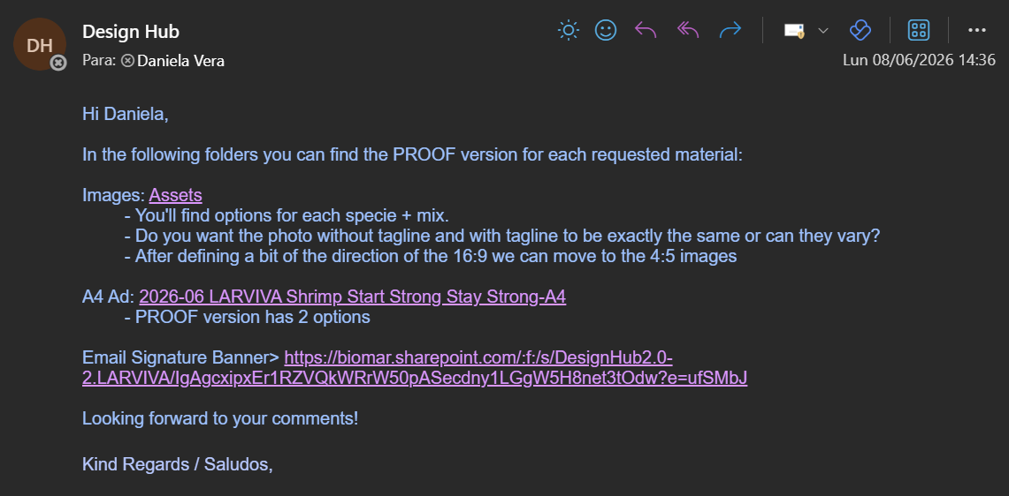
Sending a file to review
After you’ve exported the first version, you can send it to the counterpart via email. Instead of attaching the pdf, we usually send the link to the folder.

Slide 3
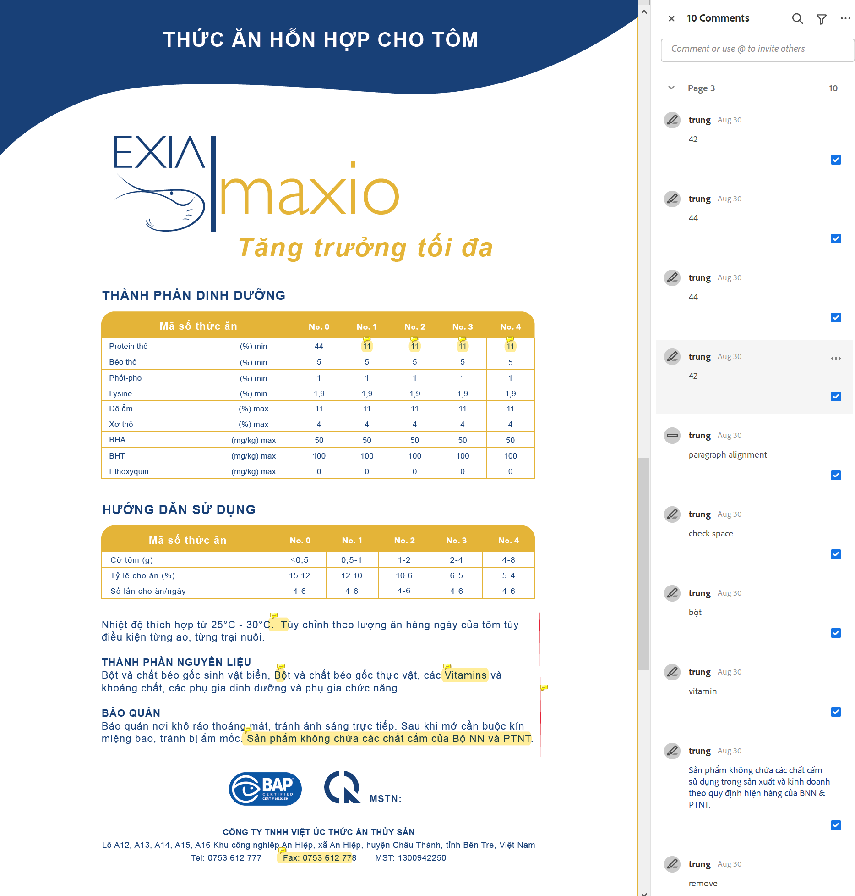
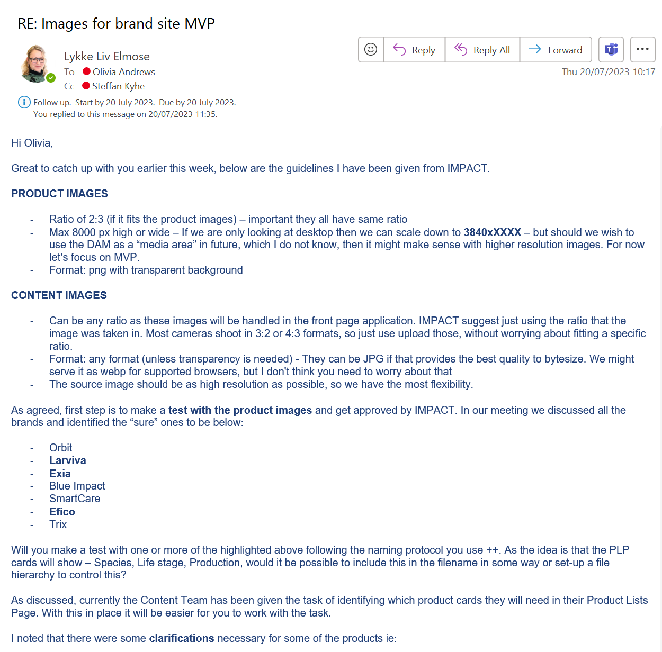
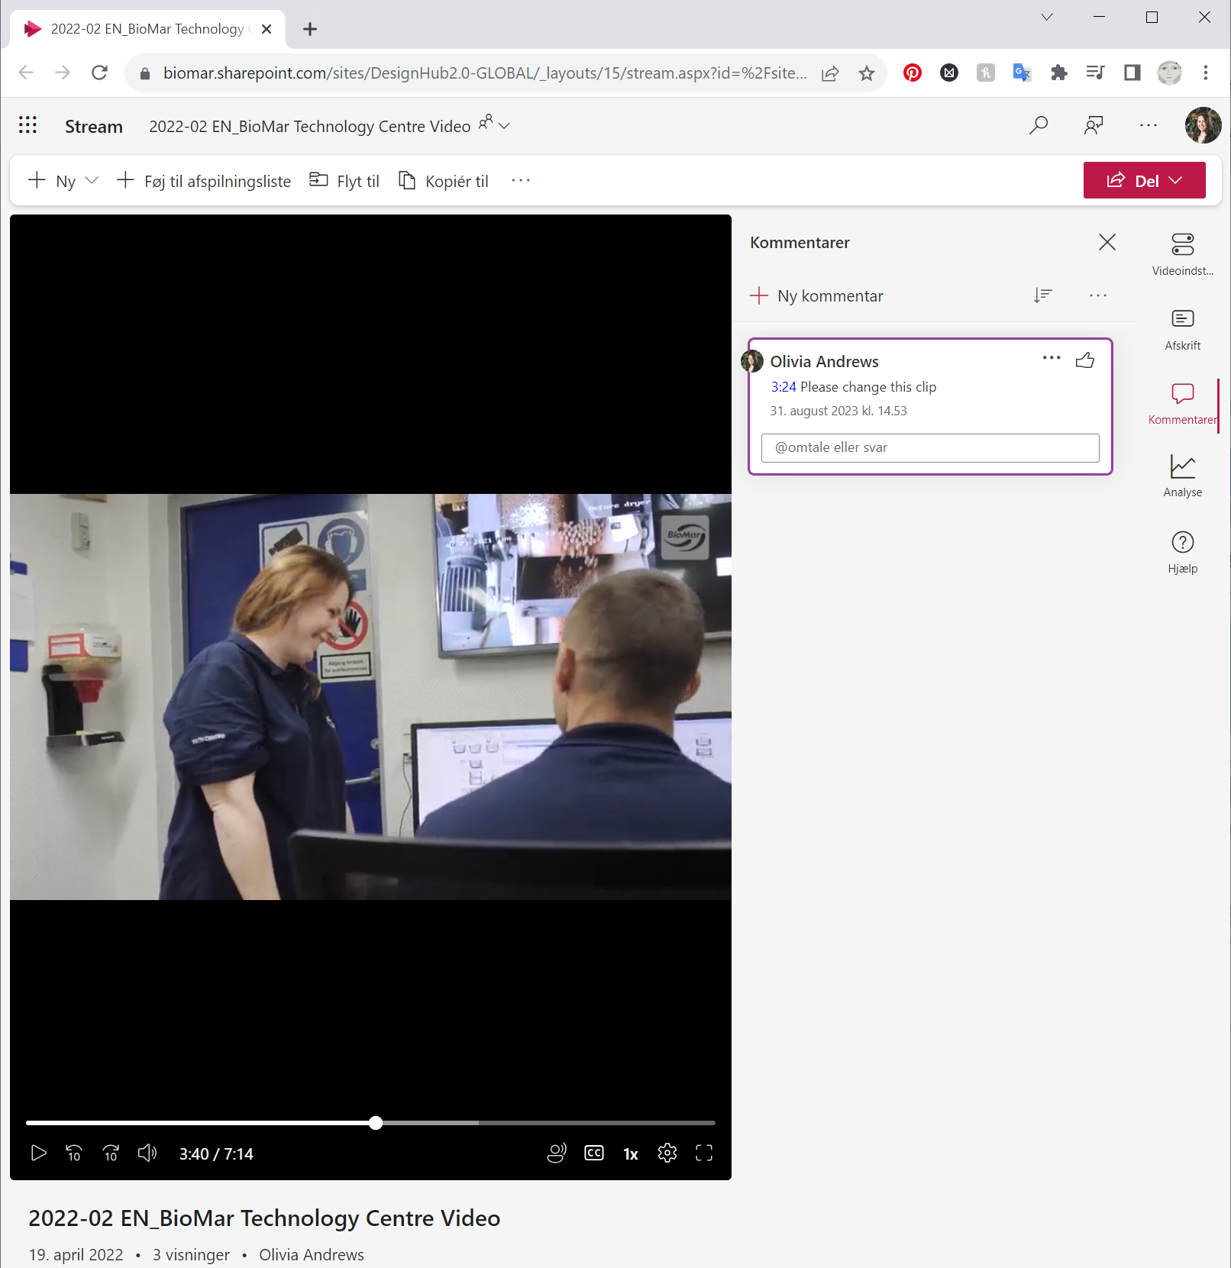
Receiving Feedback
PDF
JPG, PNG
Video
Must write timestamp as HH:MM:SS
Sent as link to folder
Sent as link to folder
Sent as link to Sharepoint
Notes:
Para PDFs por ejemplo, se les enviará el camino, o el link de la carpeta, para que puedan ver el archivo, y dejar sus comentarios en el pdf.
El proceso con las imágenes es similar.
En el caso de los videos, se les enviará el link del mismo via sharepoint, donde podrán dejar sus comentarios.

Slide 4
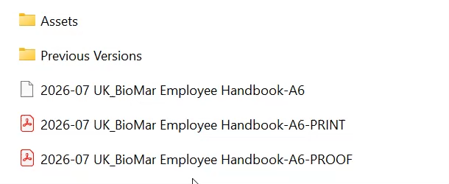
Previous Version Folder
After you’ve received feedback, you can move the PROOF version (and sometimes the editable file) into the Previous Version Folder. This way we can keep the last versions just in case they decide to go for a previous direction, or to check how things have evolved.

Slide 5
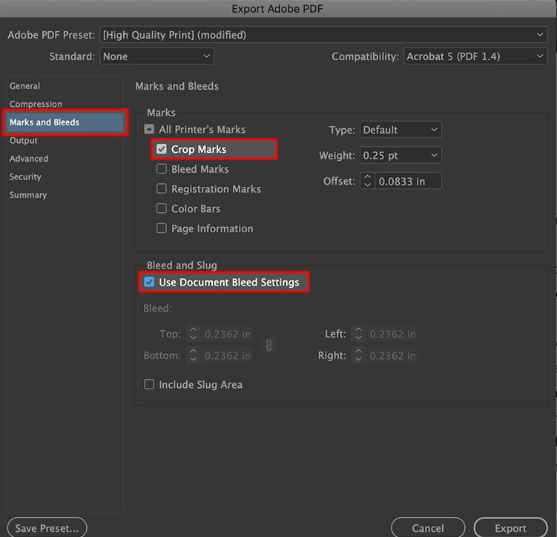
Exporting FINAL versions
PRINT: Usually print material will have bleed and/or crop-marks. Make sure ask what the supplier needs the document and to add them.
DIGITAL: Digital material is usually exported as Interactive PDF. Ask the requester where this will be displayed or used, to choose if the view should be 1 or 2 pages → or vertical or horizontal.

Slide 6
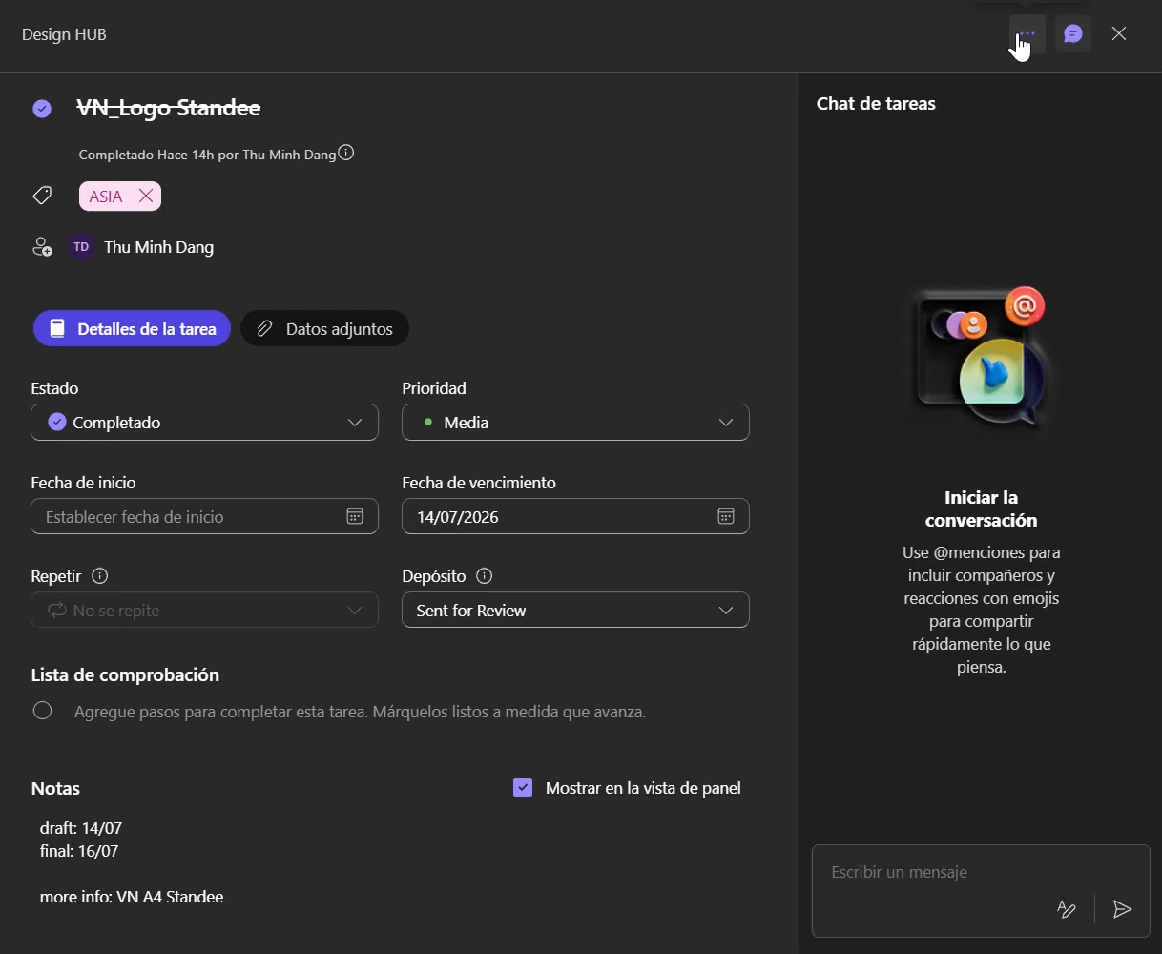
Closing tasks
Task manager
Once the task has been completed, it needs to be moved to the Completed section of the year, and categorized in the market it was made for.
In the case on the left, it is moved to “Completed 2026” and then categorized in “Vietnam”.

Slide 7
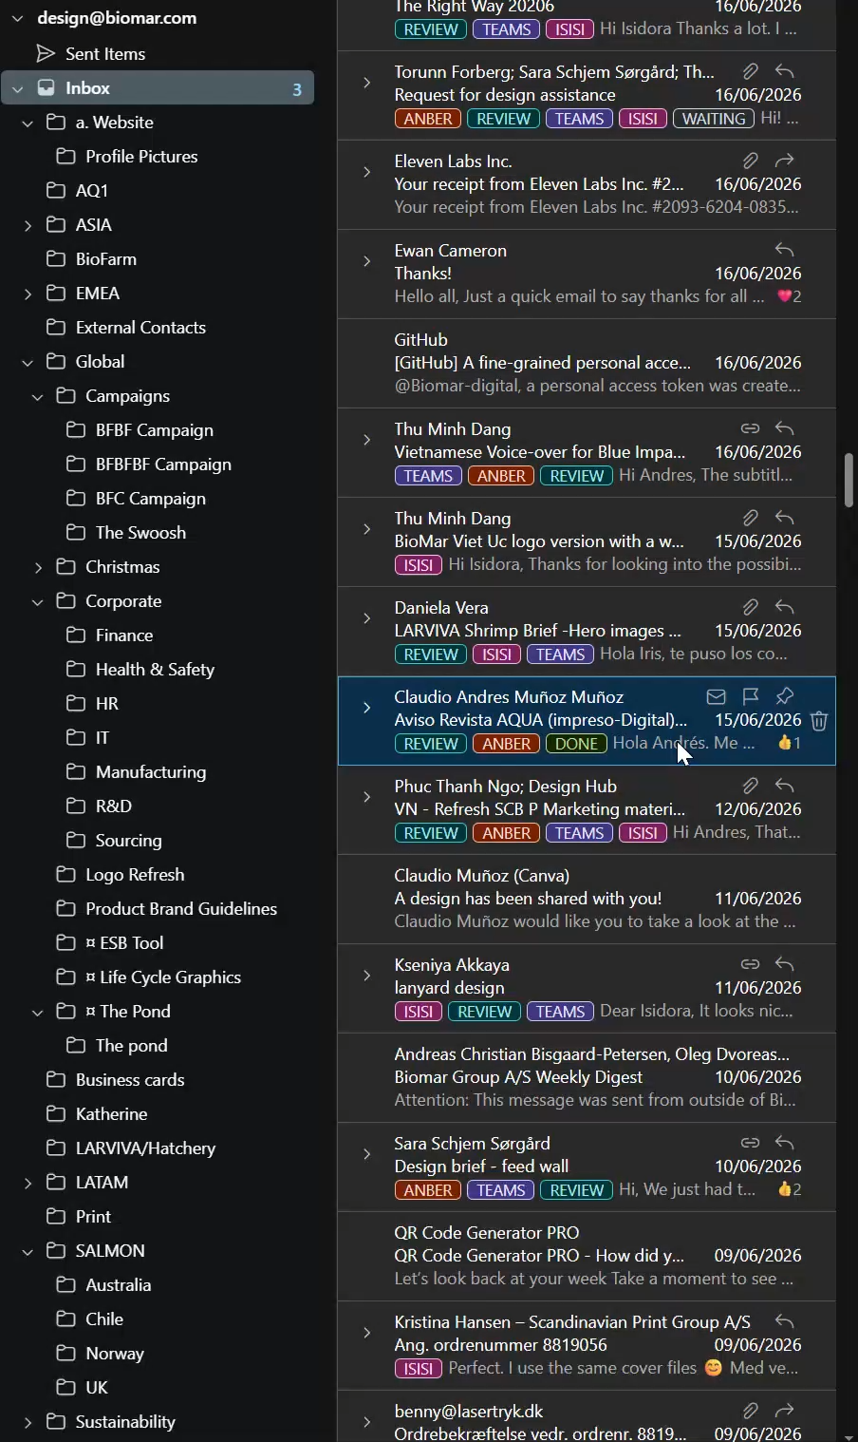
Closing tasks
Email Inbox
Once the task has been completed, it needs to be marked with the “done” tag and moved to the folder of the market that requested it.

