Slide 1
Design Hub: Who We Are, How We Work & How We Support the Business

Slide 2
What is the Design Hub?
Design Hub
Global
Marketing
Local
Markets
External
Agencies
Product and Technical Teams
Sustainability
Corporate & Internal Communications
AQ1
A Centralized Creative & Brand Support Function
Supports both global and local communication needs
Ensures brand consistency across markets and channels
Provides strategic and operational design support
Cross-functional collaboration with marketing, sustainability, corporate, product and technical teams, as well as external partners
Combines creative execution, brand governance and technical technology-based knowledge
Notes:
IS

Slide 3

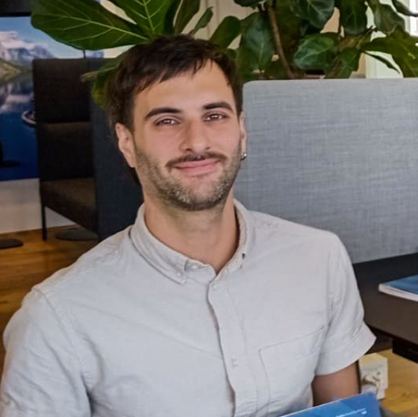
Who we are
Isidora Silva Ch.
Graphic Designer
Andres Bernadou
Multimedia Designer
3 Years at BioMar
Graphic & Print Design (External and Internal)
Supporting Brand Consistency Across Markets
Working with Campaigns & Corporate Communication
2 Years at BioMar
Video & digital Design (External and Internal)
Supporting storytelling and concept creation Across Markets
Working with Campaigns & Corporate Communication
Notes:
IS + AB

