Slide 1
Design Hub Process
Marketing/User
Design Hub
Collaborative rather than transactional approach
Continuous communication with local stakeholders
Support adaptation for local market needs while maintaining brand consistency
Prioritization based on timelines and business impact
Fill out Brief form and send via email to design@biomar.com
(Template Provided)
Feedback submitted is relevant to the media type. Inform Design Hub via email that feedback has been given.
Approve final files and inform Design Hub that the task/project is closed.
Review Brief, input to Design Hub, tag contact person and inform via email. (Request any missing information or seek clarifications).
Submit drafts via email following the same thread. Paths for files or links for videos.
Adjust based on feedback and submit final files.
Close task and move card to Completed tab.
Notes:
Esto partiría con el usuario, o sea ustedes, rellenando formulario con la información necesaria, y enviarlo al correo de diseño. Para este formulario hay un template en power point, que les mostrare más adelante.
Luego, nosotros como Design Hub tomamos la solicitud, la revisamos, la agregamos a nuestras tareas, y de ser necesario, pedimos información faltante o aclarar alguna duda.
Posteriormente, enviamos el borrador dentro de la misma línea de correos. Y se recibirá retroalimentación dentro de la misma.
Así, se harán los ajustes basados en el feedback, y se enviará la versión final.
Al ser aprobado, es necesario informarle al Design Hub, para que luego la tarea pueda ser marcada como completada.

Slide 2
Different Workflows Depending on Scope
Tasks vs Projects
 | Task | Project
What is it? | Small requests | Larger strategic initiatives. Multiple deliverables.
Timeline | Faster turnaround ( 2 to 6 days) | Longer turnaround (2 to 24 weeks)
Number of reviews | Limited reviews (1 to 3) | Several stakeholders/review rounds
Examples | Update existing document / Social media assets / Small edits / One-page documents / Internal banners | Campaigns / Publications / Rebranding initiatives / Product launches / Video productions
Notes:
IS

Slide 3


Design Hub through the years
2010
Fragmented design and communication in the markets
2020
Incorporation of full-time
in-house Designer for Global Marketing needs.
2019
BioMar rebranding.
New Brand Guidelines.
2021
Because of need of brand consistency through-out all markets, Design Hub starts working with local markets
2023
Incorporation of
a second in-house graphic designer, as marketing needs are broader and more complex.
2026
Based on the product logo rebrand, new swoosh watermarks were created. First major BioMar Brand Guidelines update
IPO launch support.
2025
A total of 489 task completed by Design Hub. +71% more than the previous year.
Product Logos Rebrand. Launch of Product Brand Guidelines v1.
2024
Incorporation of a multimedia designer to answer new needs for storytelling and format.
A total of 286 task completed by Design Hub.
Notes:
IS
11

Slide 4
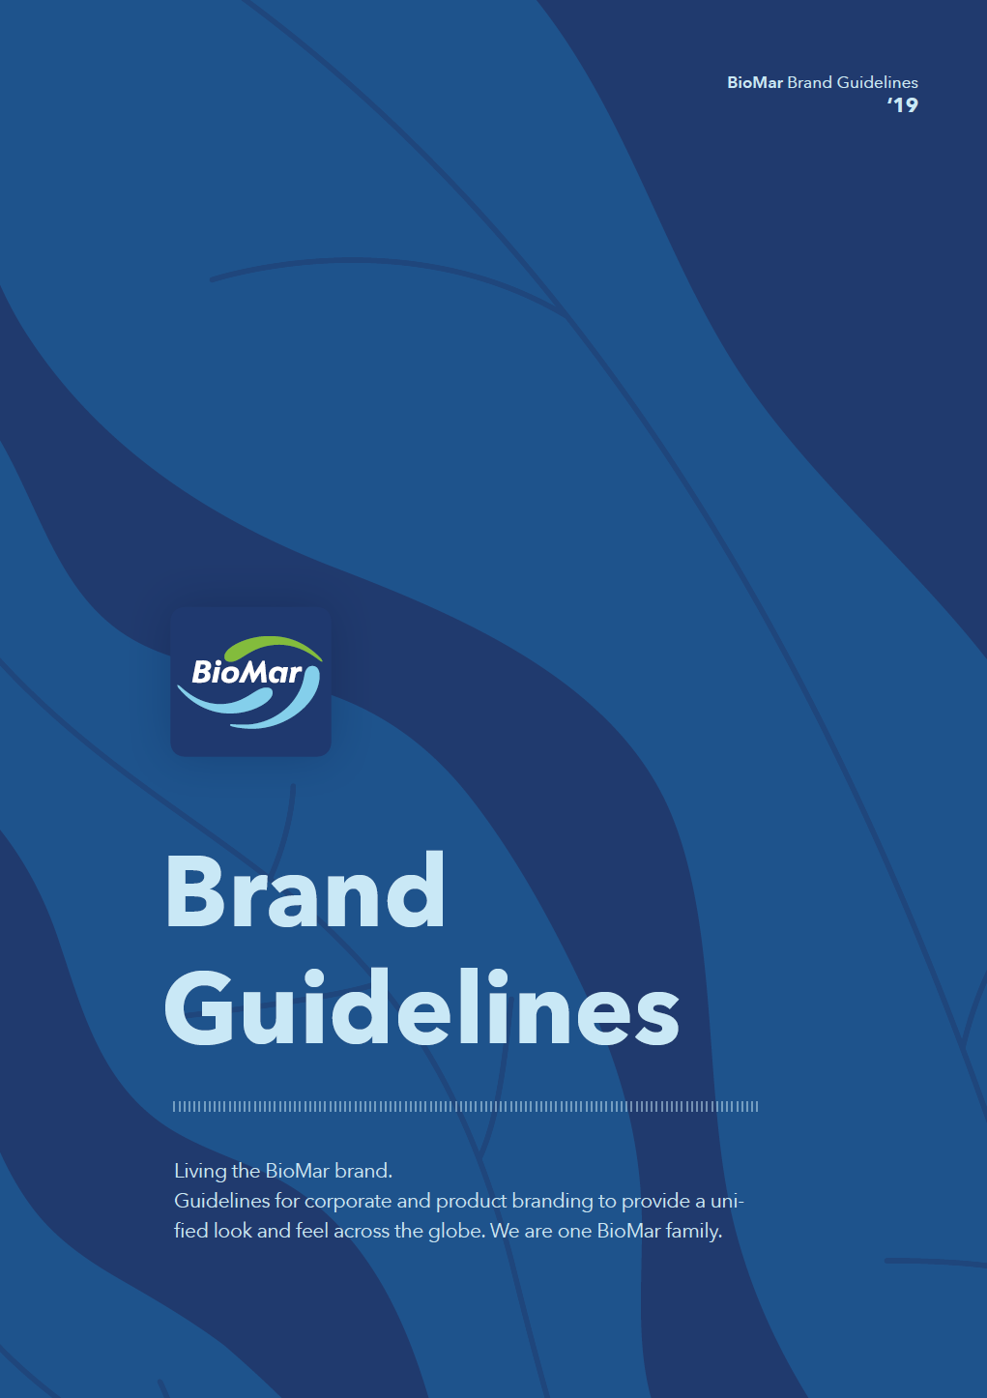
Brand Guidelines
Visual Branding & Design Governance
Key elements:
Logo usage
Typography
Color palette
Layout principles
Imagery style
Tone and consistency
Digital vs print applications
Guidelines are tools to support consistency while allowing flexibility for communication needs.
Notes:
IS

Slide 5
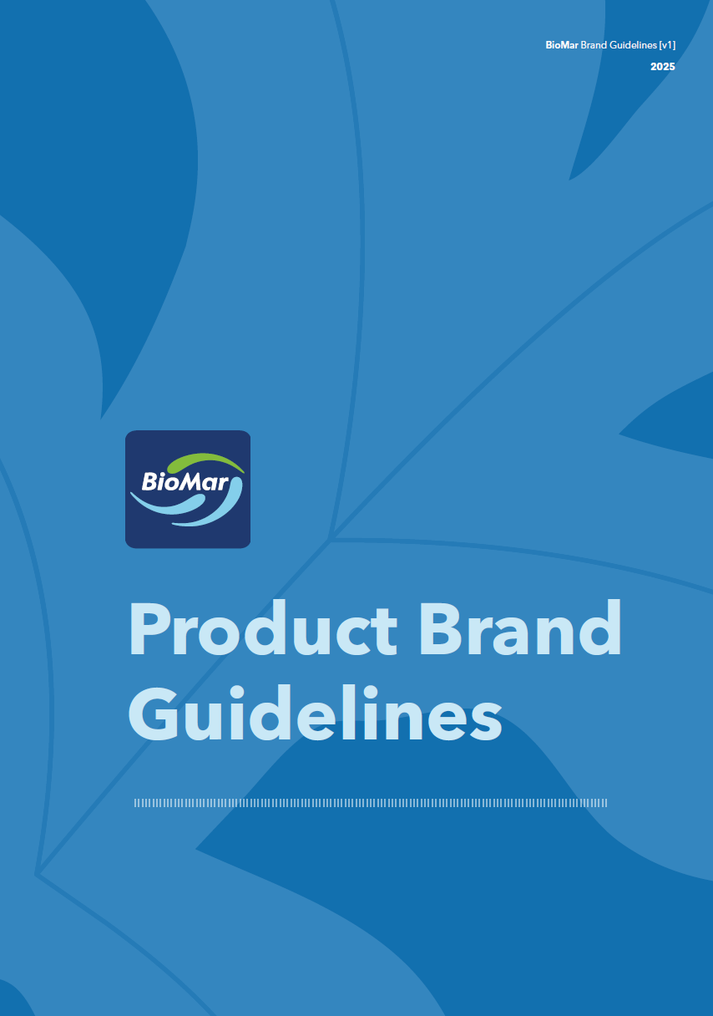
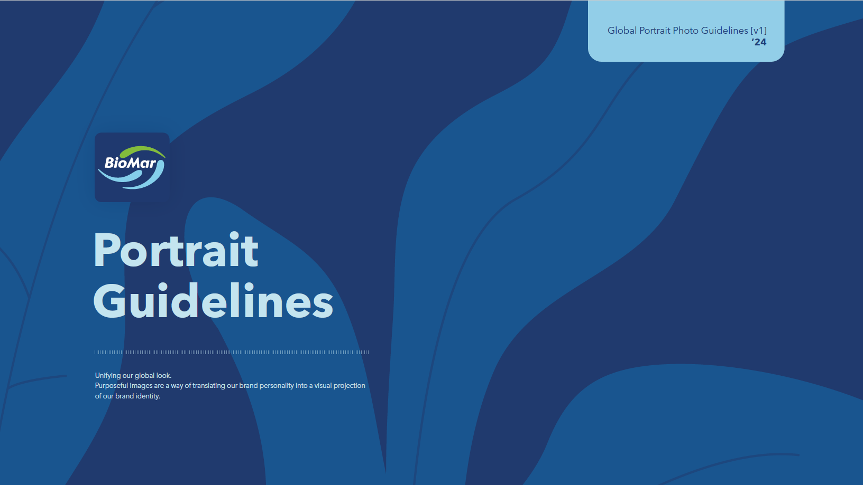
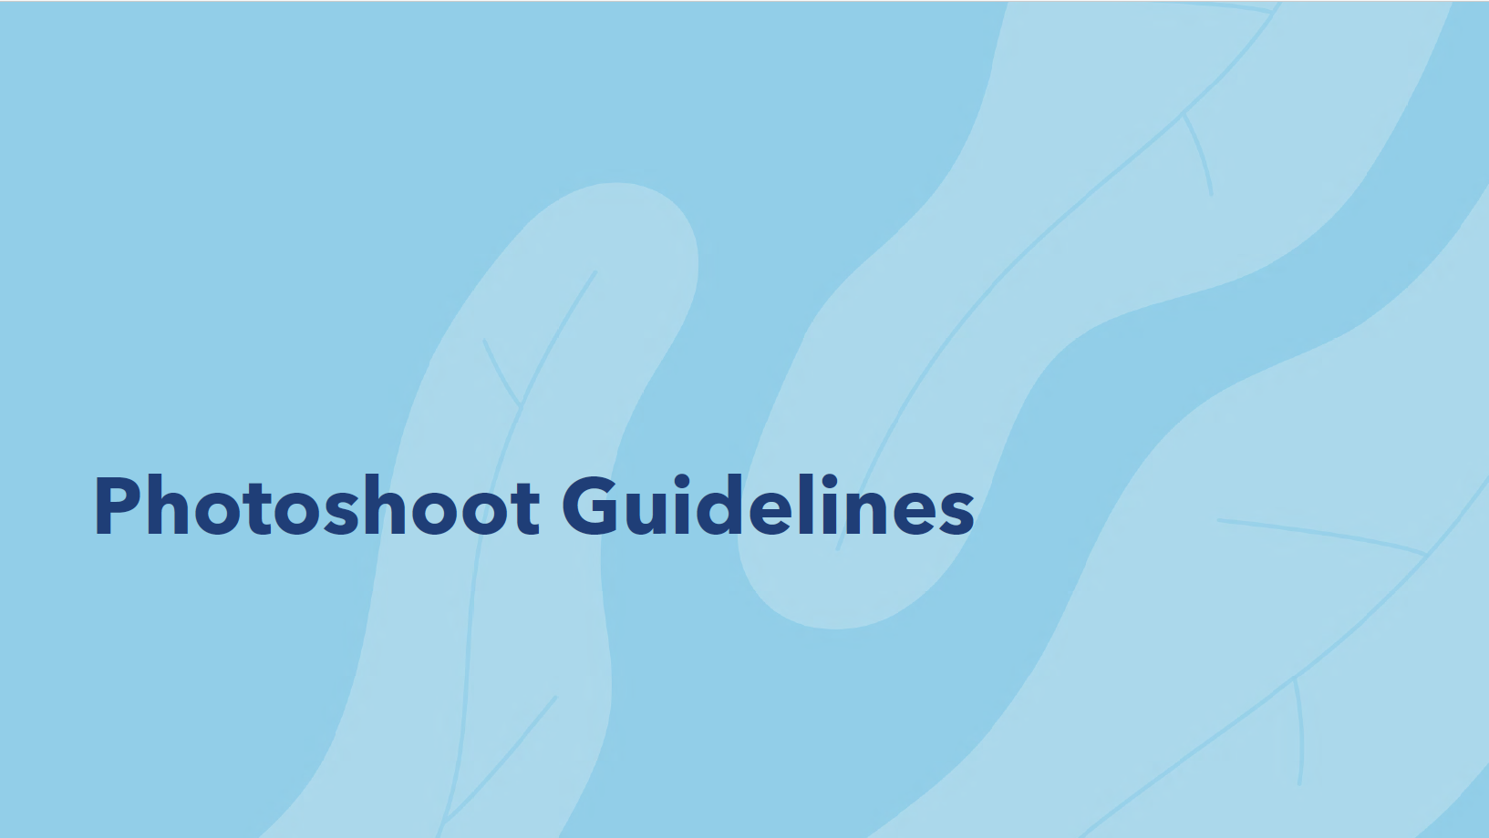
Additional Guidelines
All available on The Pond
Product communication standards
Packaging/product visual alignment
Art direction
Styling
Lighting & framing references
Image selection principles
Employee/profile photography consistency
Notes:
IS

Slide 6
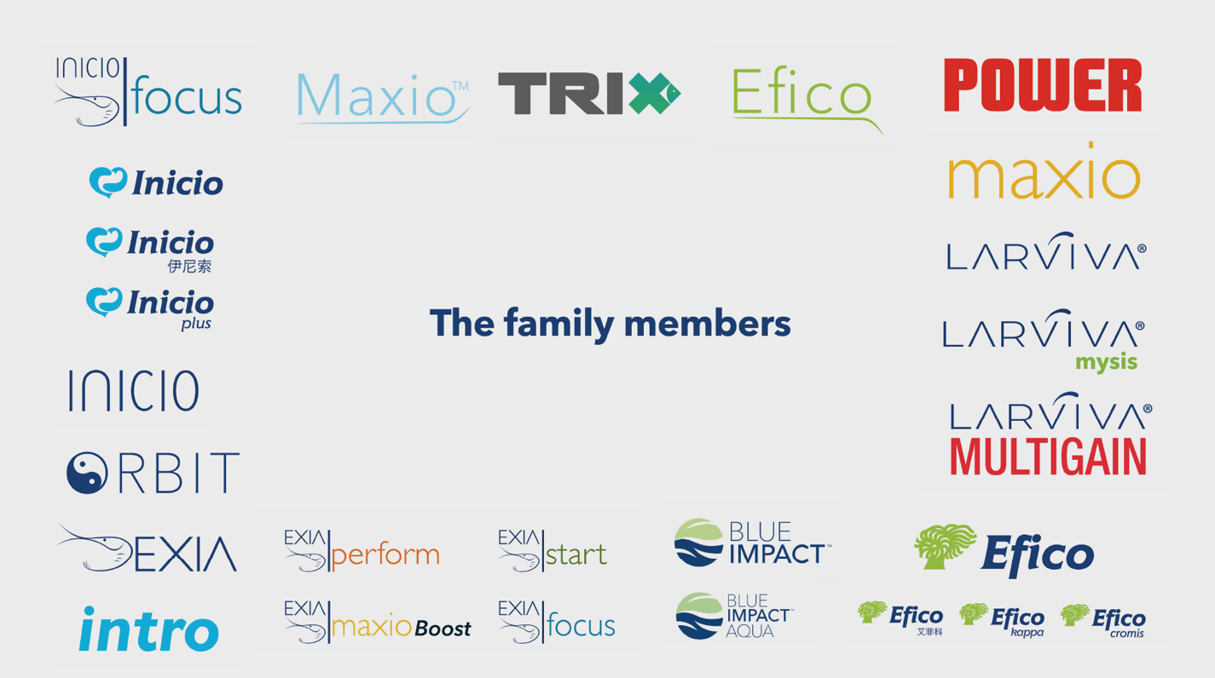














Recent Logo Rebranding
Before
All brands were treated independently from eachother. No alignment between them. Seem to be from different parents.
Now
All brands follow the same framework. Seem from the same parents. Have the swoosh.
Notes:
IS
Managing Brand Evolution
Talking points:
Recent logo update/rebranding initiative
Importance of maintaining consistency during transition
Roll-out across markets and materials
Updating templates, assets, documents, presentations, videos, and platforms
Coordination across departments and external suppliers
Design logistics behind implementation

