Slide 1
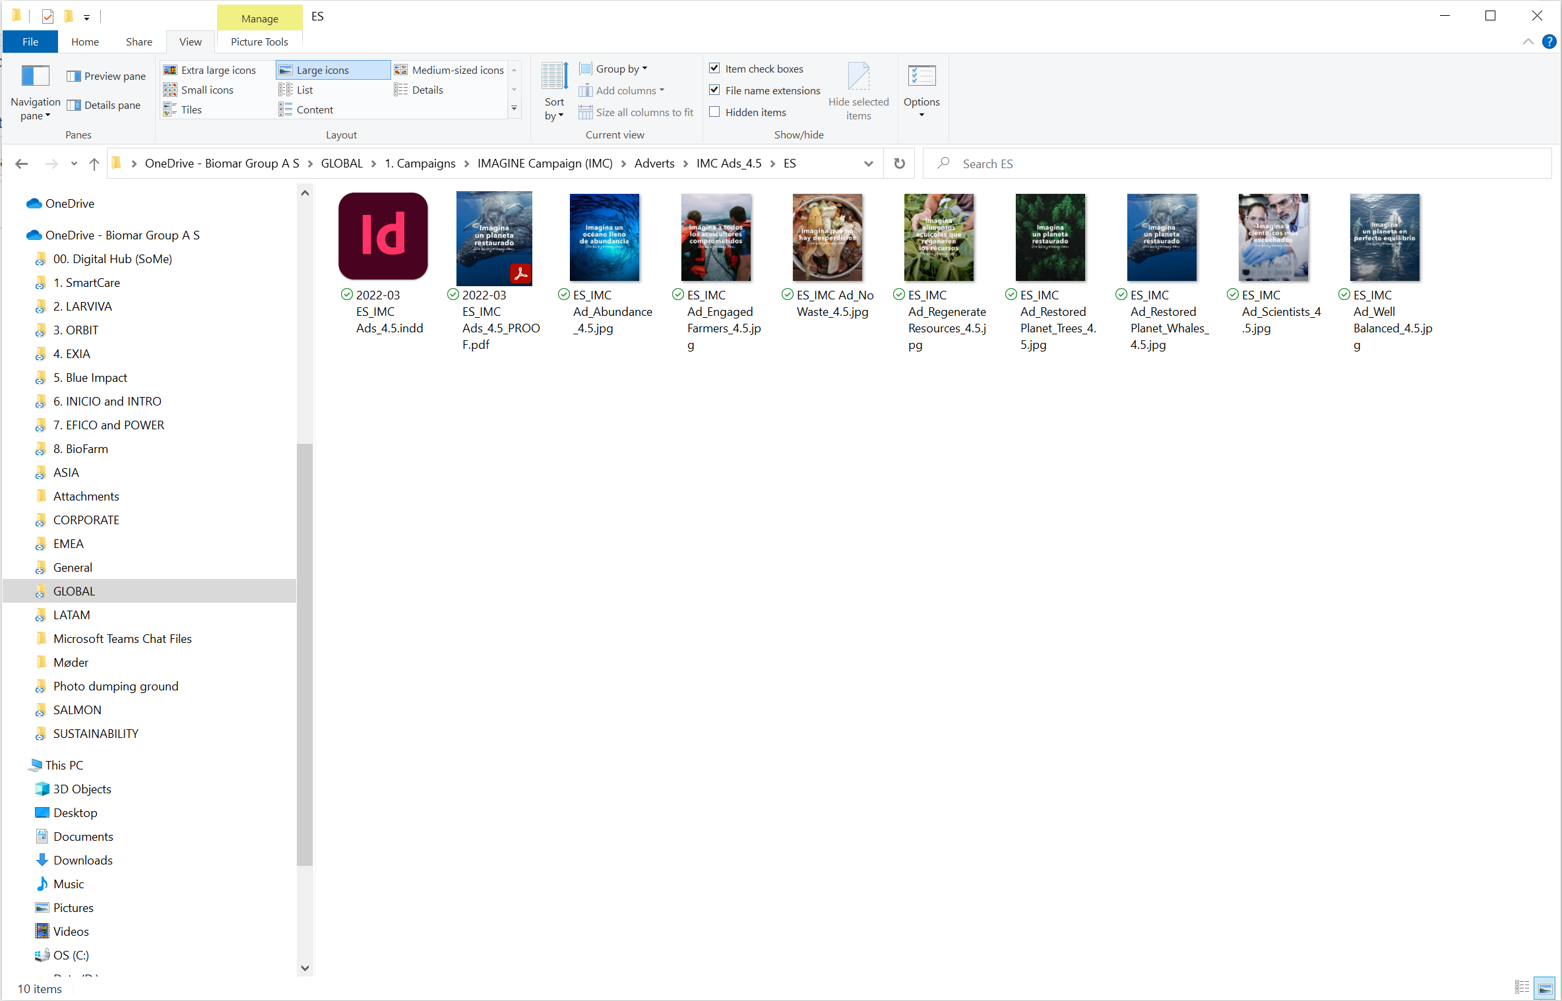
File Storage
You’ll always find:
Editable file (for Design Hub)
File for review (for Draft Date, ended in PROOF)
Final File (For Final Date, *ended in PRINT or DIGITAL)
*ONLY IF IT’S NEEDED TO MAKE THE DISTINCTION

