Slide 1
Design Hub Playbook

Slide 2
Table of Content

Slide 3
From Brief to Final Version
Overall Process
Email and briefing
Work on Version
Receive Feedback
Final Version
Close task

Slide 4
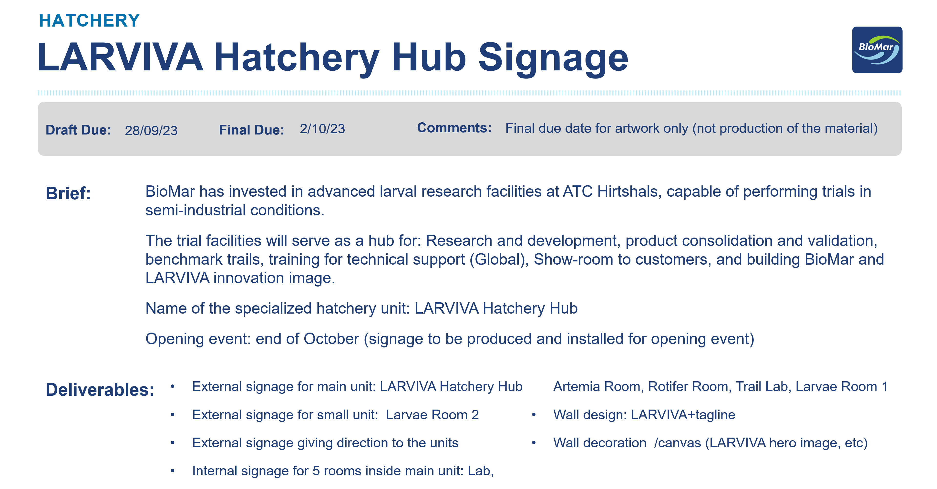
Everything starts with an email
The brief is the foundation of every project. It provides the essential information needed to understand the request, including the objective, target audience, deliverables, timeline, text copy, format specifications, and any relevant assets or references. A clear brief helps ensure the project starts with the right direction and minimizes revisions later in the process.
All design requests are received through design@biomar.com, the shared inbox for the Design Hub. This central mailbox allows the team to track incoming requests, maintain visibility across projects, and ensure a smooth handover whenever needed.

Slide 5
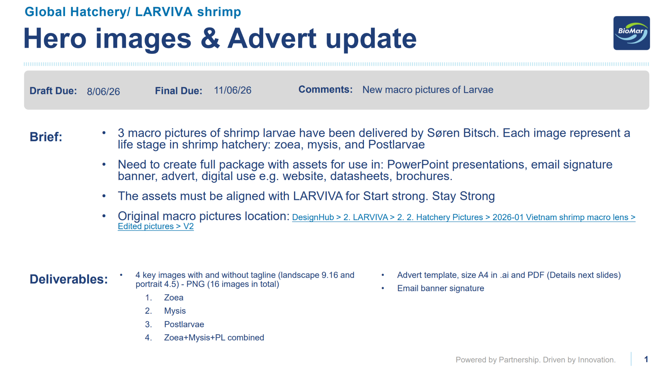
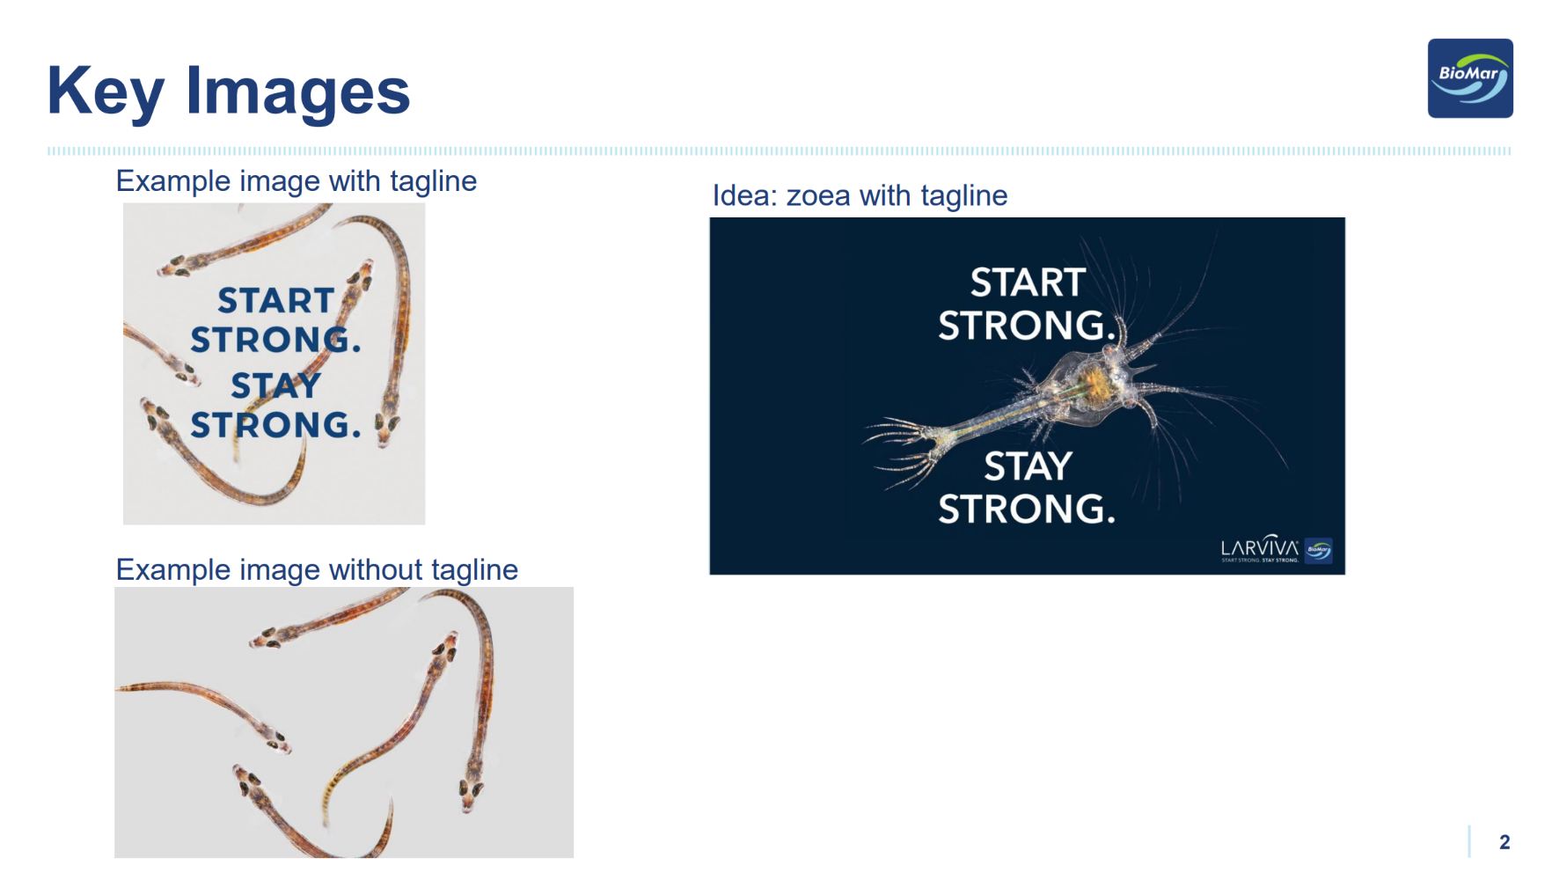
Everything starts with an email
Reviewing the Brief
Before starting any project, make sure the brief includes the minimum information required to proceed. This helps avoid unnecessary back-and-forth and ensures the project can be completed efficiently.
Minimum information required:
Purpose: What is the project for?
Timeline: Draft and final delivery dates.
Specifications: Format, dimensions, and any production requirements.
Content: Final copy/text and any supporting assets*.
*Assets are not always required. However, when applicable, request any materials that are specific to the project, such as third-party logos, certification logos, feed datasheets, event-related visuals, or market-specific images. BioMar brand assets can be sourced internally.

Slide 6
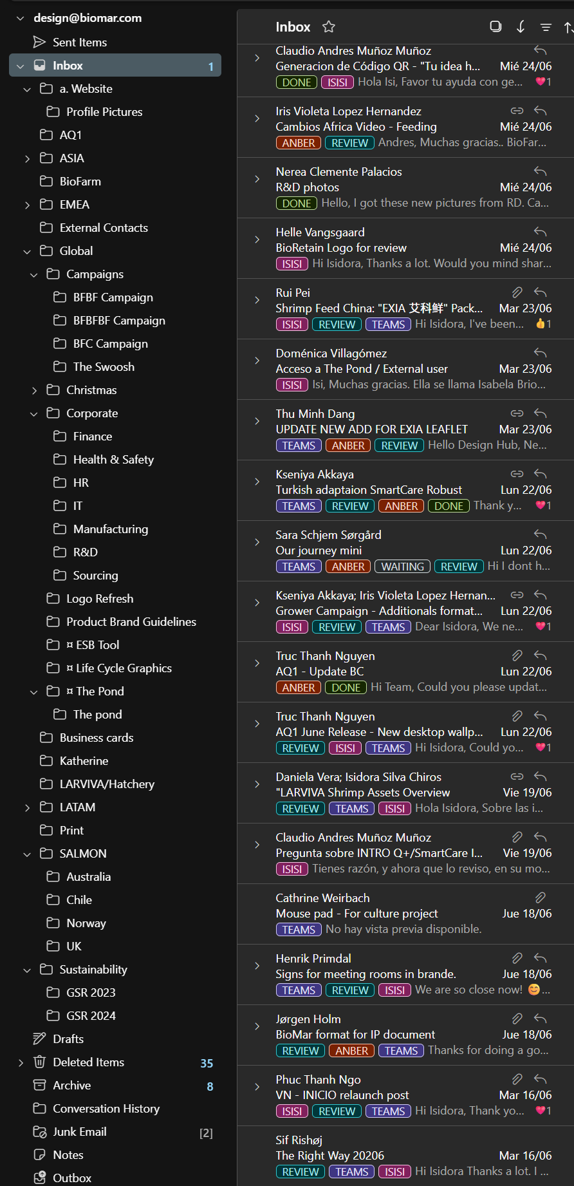
Everything starts with an email
Email Tags & Folder Structure
Teams: Used to indicate whether the request has been added to the task manager.
Teams – The request has been registered in the task manager.
No tag – Assume the request has not yet been added and needs to be reviewed.
Status: Used to track the progress of the project.
Waiting – The project is on hold while waiting for missing information, additional details, clarification, feedback, or confirmation from the requester.
Review – The proof version has been sent to the requester for feedback.
Done – The project has been completed and no further action is required.
Who: Used to identify who is responsible for the project.
Apply the tag with the designer's name once the task has been assigned.
This allows the team to quickly see who owns each project.
Folders: Once a project is completed, move the email to the corresponding folder to keep the inbox organized and make previous projects easy to find.
Emails are filed by market or business area (e.g. Global, Salmon, EMEA, ASIA, etc.).
This structure helps with future reference, project history, and retrieving previous files or conversations.
Tip: Keep tags updated throughout the project and archive completed requests in the appropriate folder. A well-maintained inbox makes collaboration, workload management, and handovers much more efficient.

Slide 7
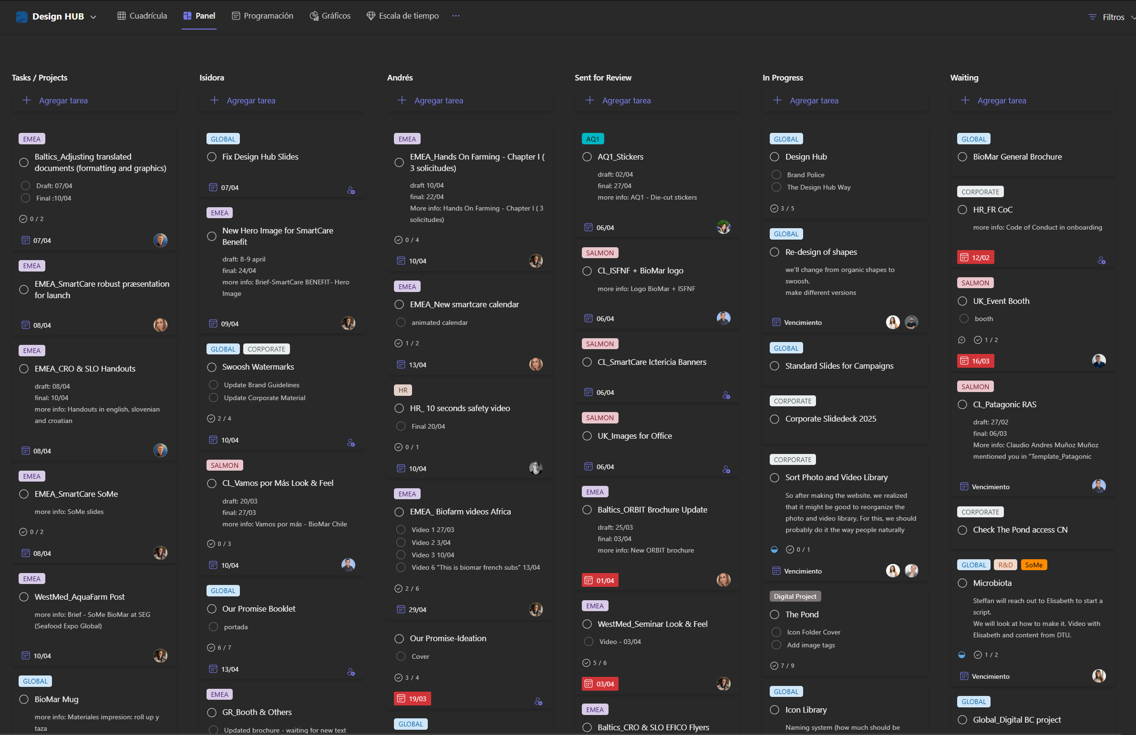
Design Hub Task Manager
Tasks / Projects Column
This is where all new requests are added when they enter the Design Hub. A task in this column means it is an active project, but it has not yet been assigned to a designer.

Slide 8
Design Hub Task Manager
Designer Columns
Once a designer starts working on a task, it should be moved to their personal column. This makes ownership clear and allows everyone in the Design Hub to quickly see who is responsible for each project.

Slide 9
Design Hub Task Manager
Status Columns
Status columns help track the progress of ongoing projects:
Sent for Review – The proof version has been shared with the requester and we are waiting for feedback or approval.
In Progress – Used for larger or longer-term projects that are actively being worked on by one or both designers.
Waiting – The task is temporarily on hold while waiting for missing information, additional details, clarification, feedback, or confirmation from the requester.

Slide 10
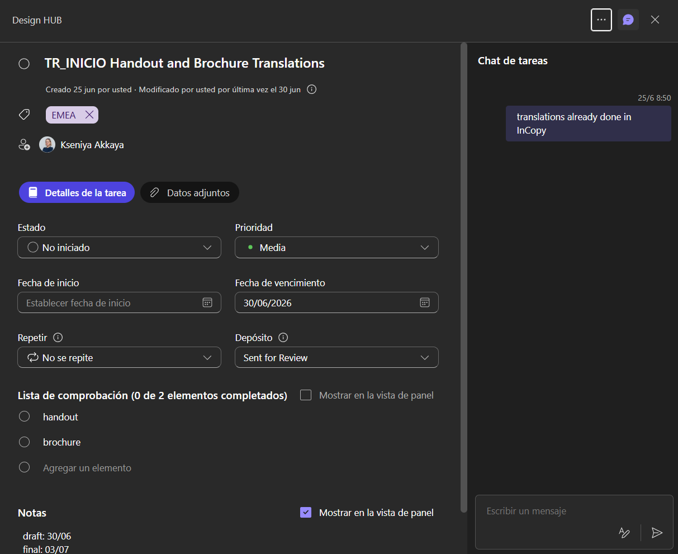
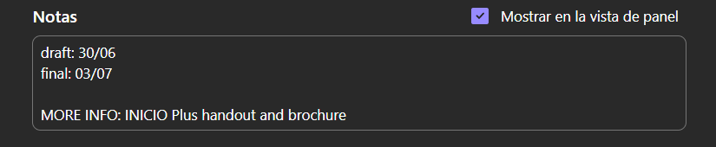
Design Hub Task Manager
Task Card Structure
Each task card contains all the relevant information needed to manage and track a project from start to finish.

Slide 11
Design Hub Task Manager
Title
The title should clearly identify the project. We use the market name at the beginning, followed by a short description of the request or deliverable.
Market Tags
Tags are added to identify which market the project belongs to. This helps with filtering, organization, and keeping track of workload across different areas.
People
Add the requester as a member of the task. Once added, they will receive an email notification and have access to the task, allowing them to follow updates and information related to the project.
Deadline
Deadlines should always be added and kept updated throughout the project lifecycle.
Initially, add the draft deadline provided by the requester.
Once the proof version has been sent, update it to the final deadline.
Additional dates can be added when needed (e.g., internal milestones or intermediate deliveries) to help organize the workflow and manage priorities.

Slide 12
Design Hub Task Manager
To-do
This section is not required for every task, but it is useful for projects with multiple deliverables or formats. It allows the different outputs to be listed and tracked individually.
Notes
Use this section to add any relevant project information.
At minimum, always include: Draft deadline; Final deadline; Email subject
Adding the email subject is especially important, as it makes it easier to find the original request, brief, and previous conversations when reviewing the project later.
Chat
The chat section is not frequently used, but it can be helpful for quick project updates or status notes, such as:
“Waiting for translation”
“InCopy setup completed”
“Feedback received from market”
It provides a simple way to keep track of small updates without changing the main task information.

Slide 13
Task Process Walkthrough

Slide 14
First, where to find things? WIP
https://www.figma.com/board/KRZiC0me29aOCJBrfaRYPk/Untitled?node-id=3-579&t=JFX3InyRx8QNRx1h-1

Slide 15
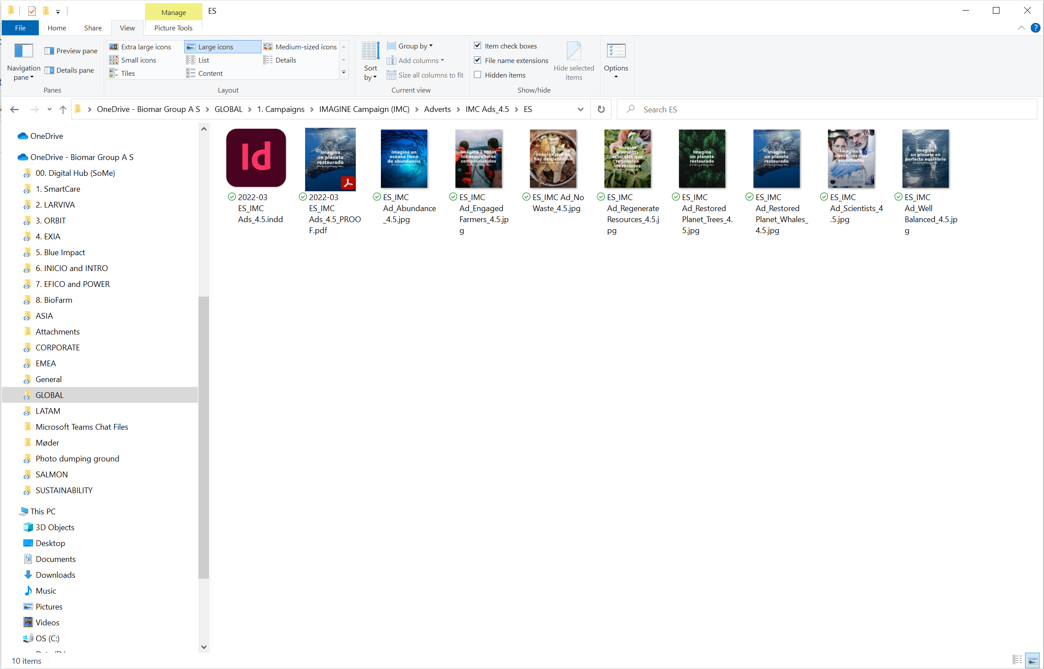
File Storage
You’ll always find:
Editable file (for Design Hub)
File for review (for Draft Date, ended in PROOF)
Final File (For Final Date, *ended in PRINT or DIGITAL)
*ONLY IF IT’S NEEDED TO MAKE THE DISTINCTION

Slide 16
File naming conventions
Design Files
Year-Month Language_Market
Brand/Product-FileType*
EXAMPLE:
2022-03 ES_Orbit_Brochure or DRAFT_2021-03 EN_EMEA SmartCare FOCUS (Marine) DM
*File Type:Brochure, Ad, Datasheet, Video, etc.
Images
Add on the name:
What it is (Species, Lifestage, Location, action, etc )
License/Shutterstock number/picture default name
EXAMPLE:
Trout_Smolt_Denmark_shutterstock_98966114
Videos
Add on the name:
What it is (Species, Lifestage, Location, action, etc )
License/Shutterstock number/picture default name
EXAMPLE:
Fish_Tilapia_Grower_shutterstock_25969904

Slide 17
Folders you can create for each project
To save files provided by who has made the request. Excel sheets, Word documents, images, videos, etc.
Files Provided
When you are starting a project, you can create folders that could be useful for an organized space
To save files useful that will be used and/on inserted on the project: Images, logos, datasheets, graphics, etc.
Assets
Once feedback has been received, the previous version can be saved here. This way the final version is first-reachable.
Previous Versions

Slide 18
Versioning
Add screenshot
We use different versions naming to know at what stage we are:
DRAFT: Started a concept or idea. It isnt ready to be shown to the counterpart
PROOF: Version ready for review. This one is sent to the counterpart. If there more than one round of review, it can go like this: PROOF, PROOF2, PROOF3...
FINAL: this is when the file has been aprooved and can move to the stage to be used. We don’t really use final at the end of the file. Instead we use these 2 options:
PRINT: to say this one is print ready, meaning it has the specifications(e.g. Cropmarks, bleed, etc)
DIGITAL: meaning this is for digital use, such as computer or phones. Exported as an interactive PDF.

Slide 19
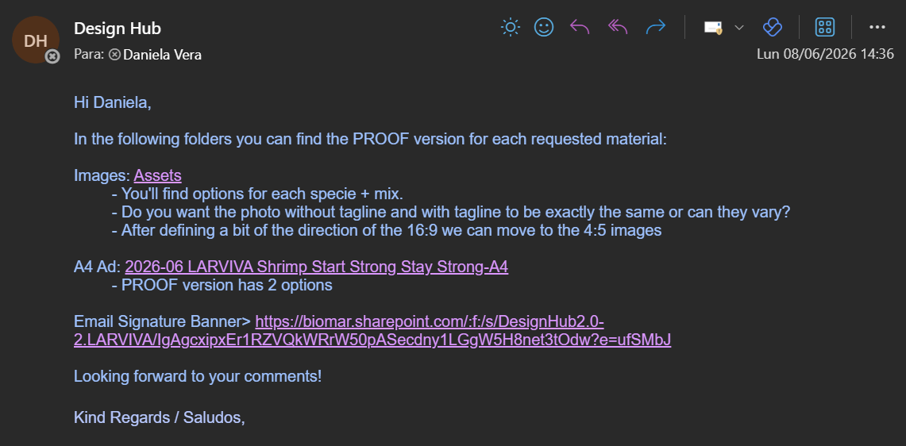
Sending a file to review
After you’ve exported the first version, you can send it to the counterpart via email. Instead of attaching the pdf, we usually send the link to the folder.

Slide 20
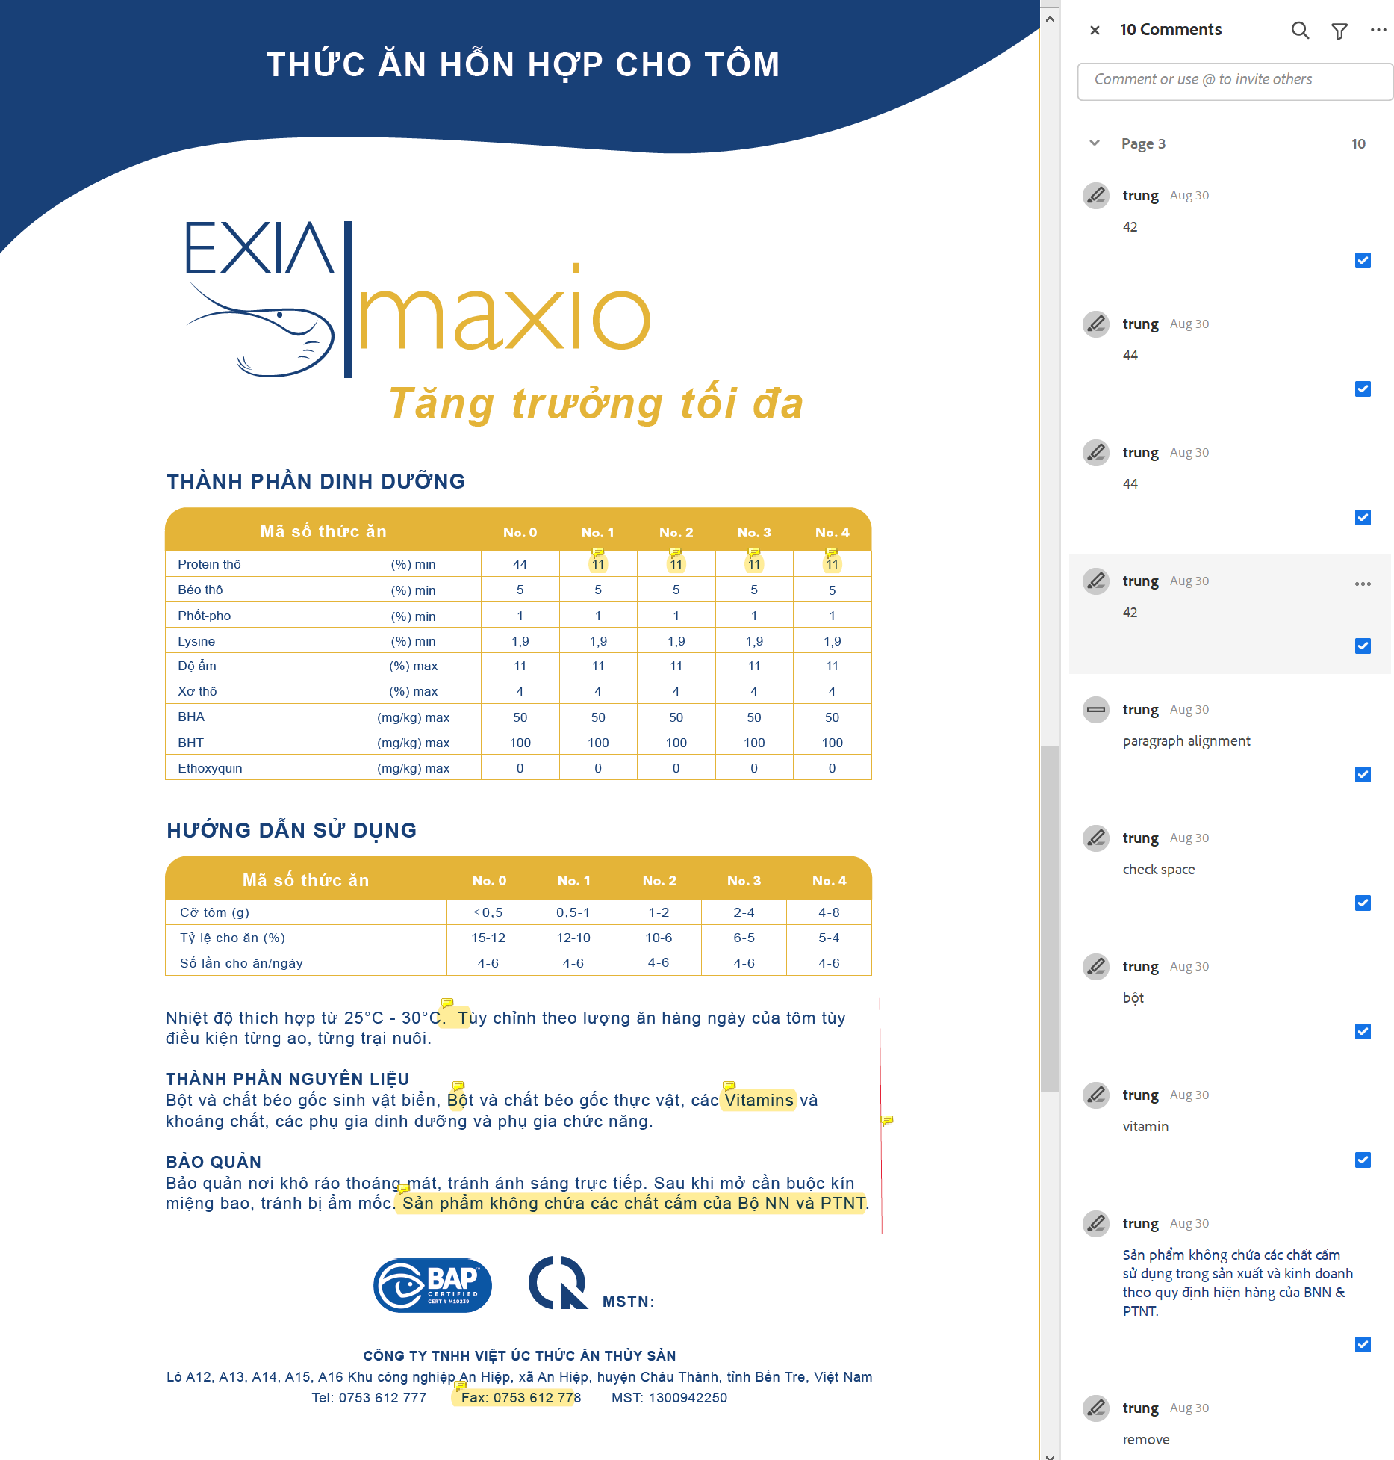
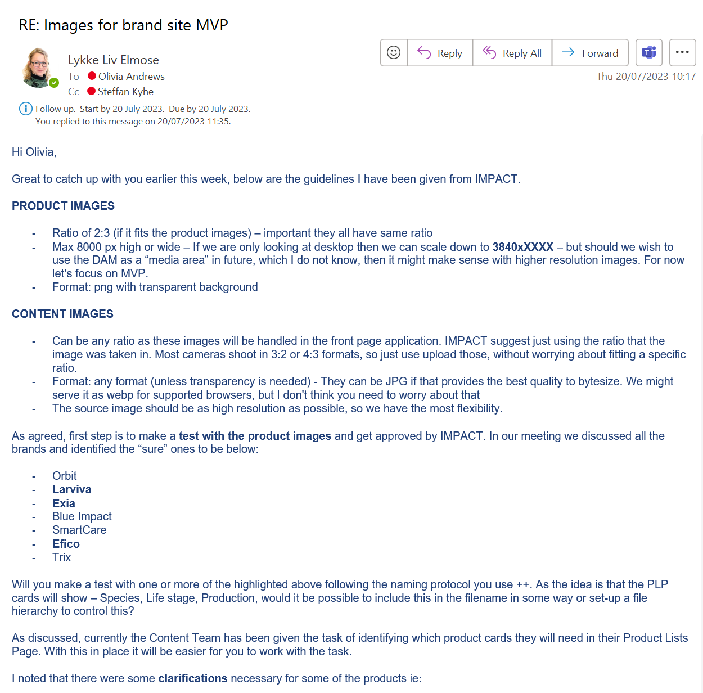
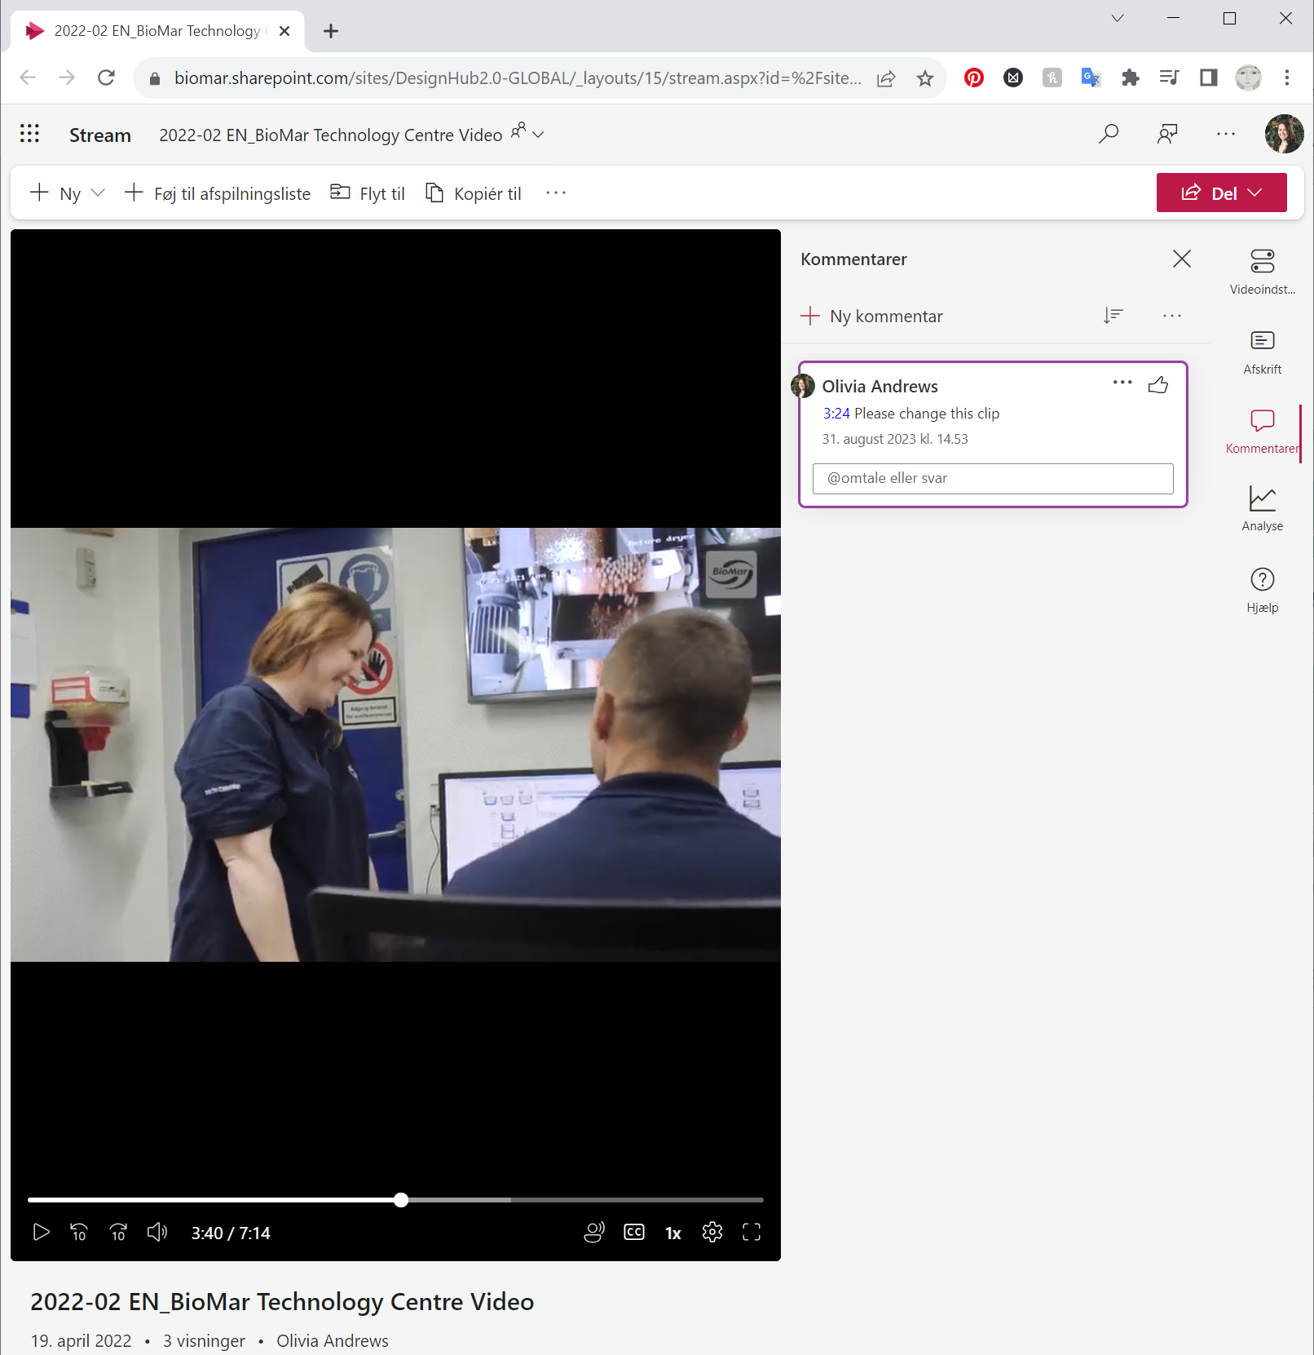
Receiving Feedback
PDF
JPG, PNG
Video
Must write timestamp as HH:MM:SS
Sent as link to folder
Sent as link to folder
Sent as link to Sharepoint
Notes:
Para PDFs por ejemplo, se les enviará el camino, o el link de la carpeta, para que puedan ver el archivo, y dejar sus comentarios en el pdf.
El proceso con las imágenes es similar.
En el caso de los videos, se les enviará el link del mismo via sharepoint, donde podrán dejar sus comentarios.

Slide 21
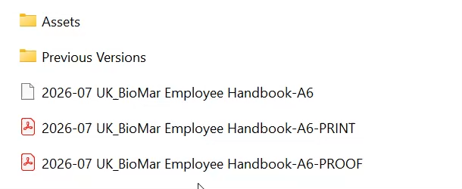
Previous Version Folder
After you’ve received feedback, you can move the PROOF version (and sometimes the editable file) into the Previous Version Folder. This way we can keep the last versions just in case they decide to go for a previous direction, or to check how things have evolved.

Slide 22
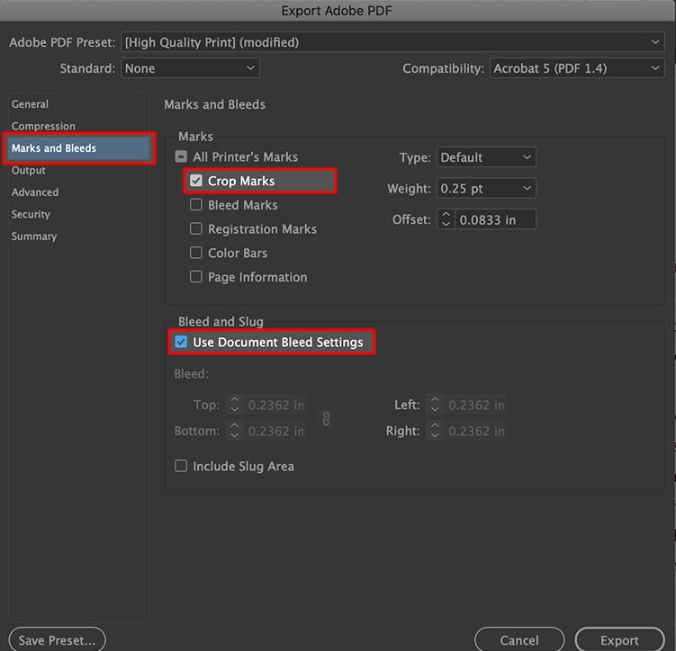
Exporting FINAL versions
PRINT: Usually print material will have bleed and/or crop-marks. Make sure ask what the supplier needs the document and to add them.
DIGITAL: Digital material is usually exported as Interactive PDF. Ask the requester where this will be displayed or used, to choose if the view should be 1 or 2 pages → or vertical or horizontal.

Slide 23
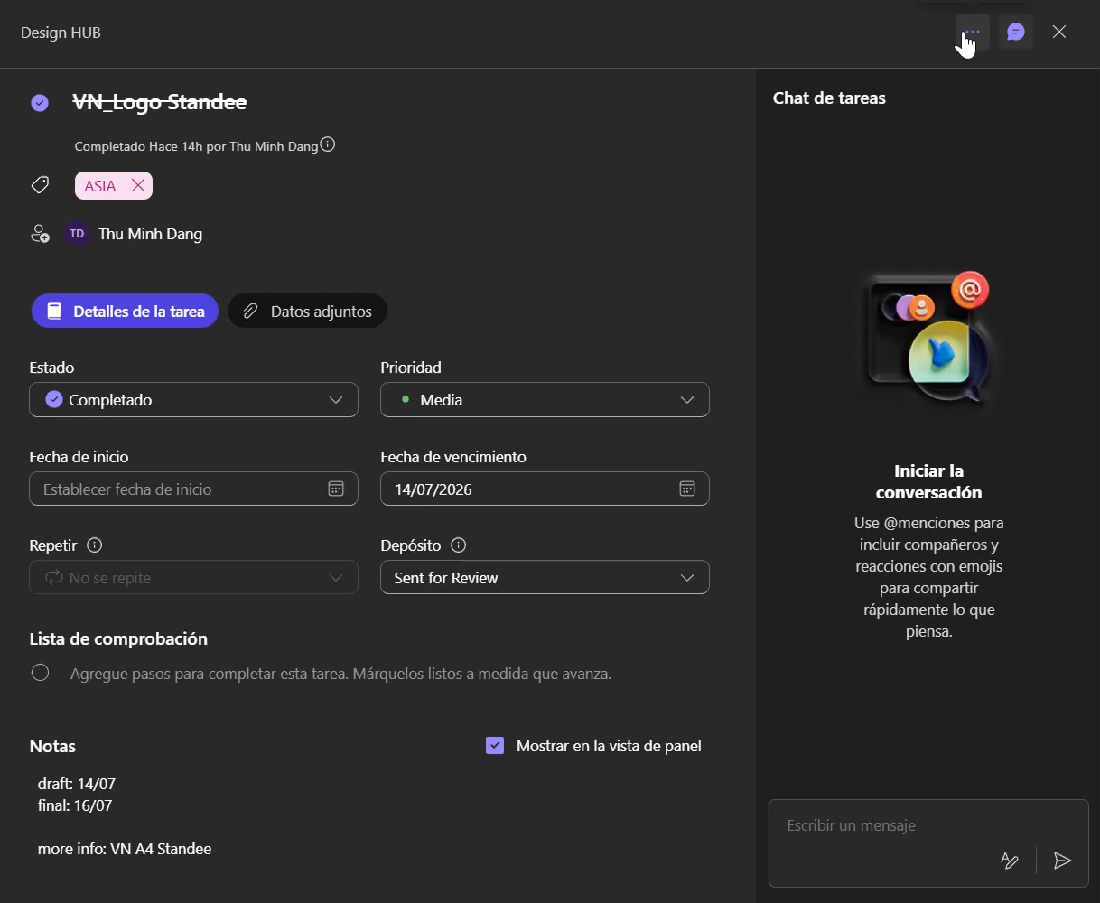
Closing tasks
Task manager
Once the task has been completed, it needs to be moved to the Completed section of the year, and categorized in the market it was made for.
In the case on the left, it is moved to “Completed 2026” and then categorized in “Vietnam”.

Slide 24
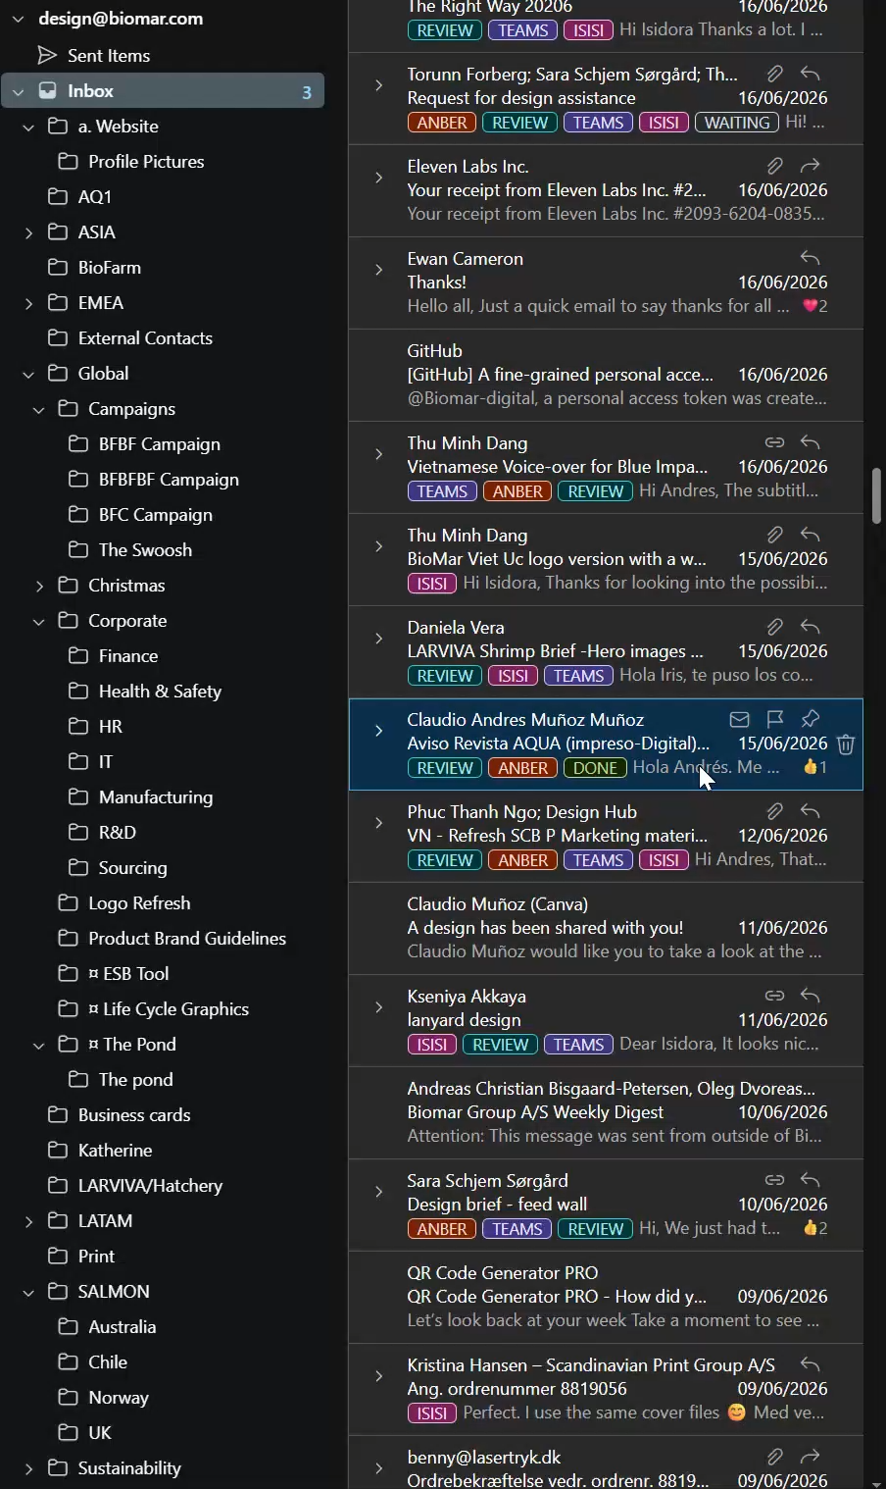
Closing tasks
Email Inbox
Once the task has been completed, it needs to be marked with the “done” tag and moved to the folder of the market that requested it.

Slide 25
Complementary Info

Slide 26
Stakeholder map
Datasheets related?
Write to Kat katmi@biomar.com
Who is in charge of what
Technical questions?
Write to Iannis, Andreina, Bruno or Ewan
R&D related?
Write to Elisabeth eliaa@biomar.com
If you have any questions related to specific themes, you can contact the following people
Have any questions about…?Write to…
SmartCare related?
Write to Torunn torfo@biomar.com
LARVIVA related?
Write to Daniela vdv@biomar.com

Slide 27
When to use what?
Ways of communicating
Email
Teams Chat
Verbal/Meetings
Submitting new task
Submitting new project
Submitting feedback
Follow up on tasks
Follow up on projects
To clarify/define projects
Clarify topics/themes
In-depth review of the artwork

