Slide 1
Design Hub: Who We Are, How We Work & How We Support the Business

Slide 2
What is the Design Hub?
Design Hub
Global
Marketing
Local
Markets
External
Agencies
Product and Technical Teams
Sustainability
Corporate & Internal Communications
AQ1
A Centralized Creative & Brand Support Function
Supports both global and local communication needs
Ensures brand consistency across markets and channels
Provides strategic and operational design support
Cross-functional collaboration with marketing, sustainability, corporate, product and technical teams, as well as external partners
Combines creative execution, brand governance and technical technology-based knowledge
Notes:
IS

Slide 3

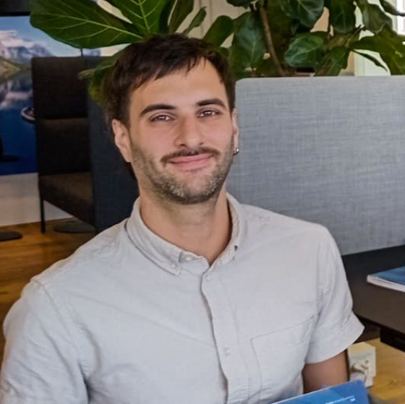
Who we are
Isidora Silva Ch.
Graphic Designer
Andres Bernadou
Multimedia Designer
3 Years at BioMar
Graphic & Print Design (External and Internal)
Supporting Brand Consistency Across Markets
Working with Campaigns & Corporate Communication
2 Years at BioMar
Video & digital Design (External and Internal)
Supporting storytelling and concept creation Across Markets
Working with Campaigns & Corporate Communication
Notes:
IS + AB

Slide 4
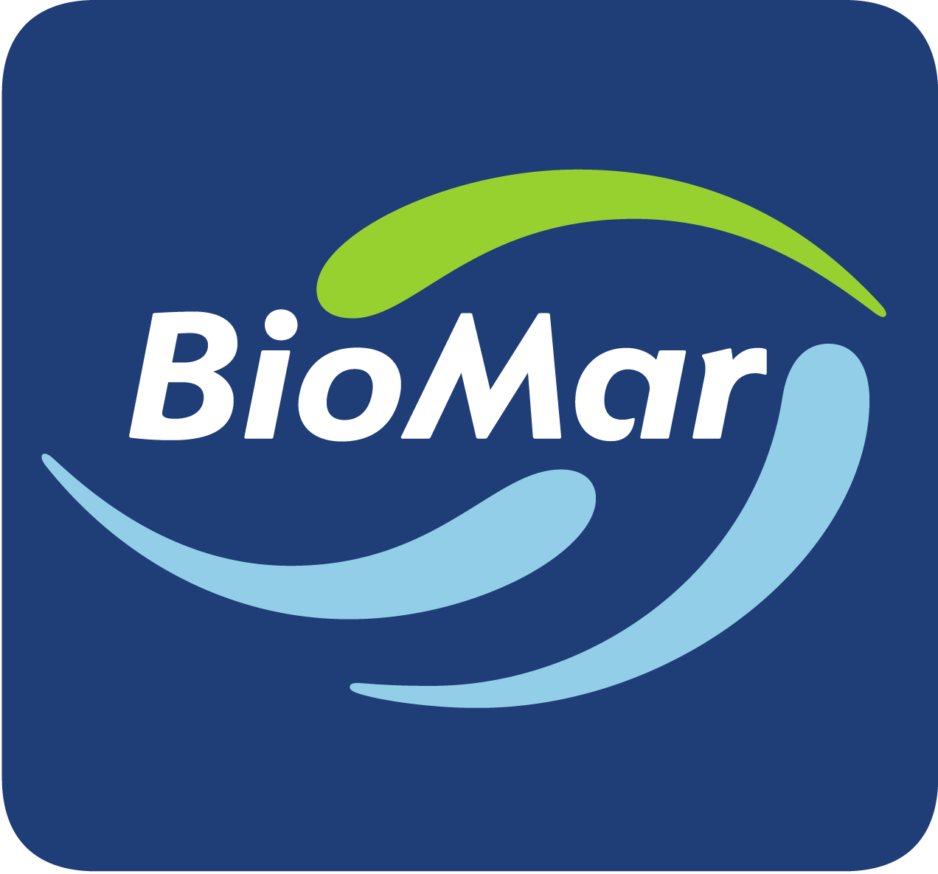

Marketing 2028 refined strategy house
2028 Refined Above & Beyond
Marketing
Driving our value propositions, products and services to meet market needs and deliver on the promise of fed aquaculture in the global food system inline with our strategy and purpose.
Functional services/Operations
New initiatives
Design Hub
Digital Hub
Products
BioMar Brand
Market Intelligence
Strategic Marketing
Customer Journey
Investor Category
Our centralised design and advertising agency providing shared services across the BioMar world. Offering services to our markets, 14 hours every weekday. The Design Hub does more then 1000 tasks annually ranging in complexity from a few hours to several months.
Management and execution of brand and product guidelines
Visual design creation
Our centralised digital marketing agency provides a global platform of digital tools and services for direct interaction with our customers, aligned with commercial and marketing teams across the BioMar world.
Management of the marketing and commercial digital strategy
Daily management and development of tools including brandsite, customer portal, marketing automation
Umbrella product and services strategy to ensure a One BioMar approach with species segment alignment and while addressing local adaptation needs
One product segment approach to product marketing management
Creation of all product and service concepts, value propositions and campaigns
BioMar brand positioning´, management and execution across the BioMar world aligned to our strategy and purpose.
Marketing strategy, value propositions and campaigns
Stakeholder relations
Risk management communications alignment
Content creation and alignment
Data-driven decision making: to deliver the right information/solution at the right time to address our customers.
Needbased Customer Segmentation: a ComEx project follow-up in which we identify customer drives that align with our strategy.
Product Segmentation: segmenting our sales data to enable product lifecycle management and product sales behaviour.
Use One BioMar marketing theory and tools to meet business and commercial needs.
One Budget & Reporting process
One Marketing & Product process and structure
Key strategic partnerships to leverage our position and enable a market pull.
Chefs Initiative
Strategic commercial partnerships
Identify strategic opportunities in the digital realm to enhance the customer journey and experience with BioMar
Strategic digital situation analysis and key opportunities
Marketing strategy for our new target segment of investors: Creating the value position for BioMar in the Feed Category setting our pathway towards IPO.
Investor Category Creation marketing strategy (2026+)
We are innovators dedicated to an efficient and sustainable aquaculture
4
Notes:
AB

Slide 5
Strategic role of the Design Hub
Five pillars hold the brand together.
05
Brand and Product Protection
01
02
03
04
Consistency
Efficiency
Quality
Scalability
A unified visual identity globally. Aligned with brand standards, adapted to local needs
Centralized expertise, less duplicated work, better workflows, smart prioritization based on business knowledge
Professional, strategic and creative. Every output earns its place.
Many markets, formats and campaigns: adaptations to specific needs
Correct logo, typography, imagery; applied consistently everywhere.
Notes:
AB

Slide 6
Our Areas of Responsibility and functions
One hub, Several functions
External communication
Internal communication
Campaigns
Advertisements
Social media assets
Internal campaigns
Office branding
Stationery
Videos & motion graphics
Brochures & flyers
Event material
Corporate templates
Corporate presentations
Trade show assets
Product communication
Presentations
HR / internal material
Employer branding
Signage
Website assets
Publications & reports
Legal documents
Onboarding assets
Merch
+ more
Packaging
Learning Material
Merch
+ more
Management and services
The Pond library
Business cards
Project management board
Internal Design Hub library
QR Code Generator
Umbraco Content Library
Canva Templates
Stock Photography and Video
Notes:
AB

Slide 7
Ownership
One team, Multiple support
Graphic Design
Motion & Video
Campaigns · marketing assets · layouts · digital & print material · packaging
Animations · video editing · motion graphics · storytelling
Brand & Creative Direction
Production & Coordination
Visual consistency · art direction · strategic guidance
Workflow management · printer/publisher coordination · file & asset organization
Notes:
AB

Slide 8
Beyond Daily Design Support
01
Brand Management
Brand consistency / Brand evolution /
Visual governance
02
Creative Development
Concepts and campaigns / Art direction / Visual storytelling
03
Production & Adaptation
Market Adaptation / Resizing and roll-outs / Print & digital production
04
Strategic Support
Cross-market coordination / Creative recommendations /
Design consultation
Notes:
Intangible part
Concepts meaning branding and look and feel of prodcuts and services

Slide 9
Design Hub Process
Marketing/User
Design Hub
Collaborative rather than transactional approach
Continuous communication with local stakeholders
Support adaptation for local market needs while maintaining brand consistency
Prioritization based on timelines and business impact
Fill out Brief form and send via email to design@biomar.com
(Template Provided)
Feedback submitted is relevant to the media type. Inform Design Hub via email that feedback has been given.
Approve final files and inform Design Hub that the task/project is closed.
Review Brief, input to Design Hub, tag contact person and inform via email. (Request any missing information or seek clarifications).
Submit drafts via email following the same thread. Paths for files or links for videos.
Adjust based on feedback and submit final files.
Close task and move card to Completed tab.
Notes:
Esto partiría con el usuario, o sea ustedes, rellenando formulario con la información necesaria, y enviarlo al correo de diseño. Para este formulario hay un template en power point, que les mostrare más adelante.
Luego, nosotros como Design Hub tomamos la solicitud, la revisamos, la agregamos a nuestras tareas, y de ser necesario, pedimos información faltante o aclarar alguna duda.
Posteriormente, enviamos el borrador dentro de la misma línea de correos. Y se recibirá retroalimentación dentro de la misma.
Así, se harán los ajustes basados en el feedback, y se enviará la versión final.
Al ser aprobado, es necesario informarle al Design Hub, para que luego la tarea pueda ser marcada como completada.

Slide 10
Different Workflows Depending on Scope
Tasks vs Projects
 | Task | Project
What is it? | Small requests | Larger strategic initiatives. Multiple deliverables.
Timeline | Faster turnaround ( 2 to 6 days) | Longer turnaround (2 to 24 weeks)
Number of reviews | Limited reviews (1 to 3) | Several stakeholders/review rounds
Examples | Update existing document / Social media assets / Small edits / One-page documents / Internal banners | Campaigns / Publications / Rebranding initiatives / Product launches / Video productions
Notes:
IS

Slide 11


Design Hub through the years
2010
Fragmented design and communication in the markets
2020
Incorporation of full-time
in-house Designer for Global Marketing needs.
2019
BioMar rebranding.
New Brand Guidelines.
2021
Because of need of brand consistency through-out all markets, Design Hub starts working with local markets
2023
Incorporation of
a second in-house graphic designer, as marketing needs are broader and more complex.
2026
Based on the product logo rebrand, new swoosh watermarks were created. First major BioMar Brand Guidelines update
IPO launch support.
2025
A total of 489 task completed by Design Hub. +71% more than the previous year.
Product Logos Rebrand. Launch of Product Brand Guidelines v1.
2024
Incorporation of a multimedia designer to answer new needs for storytelling and format.
A total of 286 task completed by Design Hub.
Notes:
IS
11

Slide 12
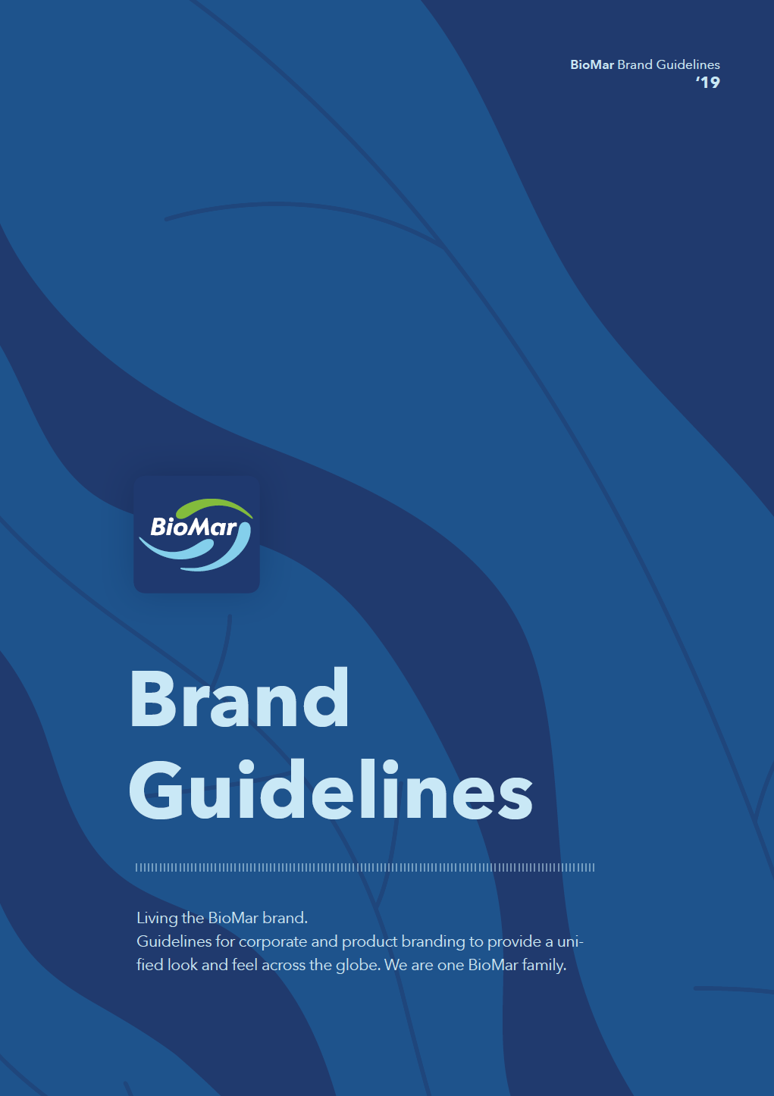
Brand Guidelines
Visual Branding & Design Governance
Key elements:
Logo usage
Typography
Color palette
Layout principles
Imagery style
Tone and consistency
Digital vs print applications
Guidelines are tools to support consistency while allowing flexibility for communication needs.
Notes:
IS

Slide 13
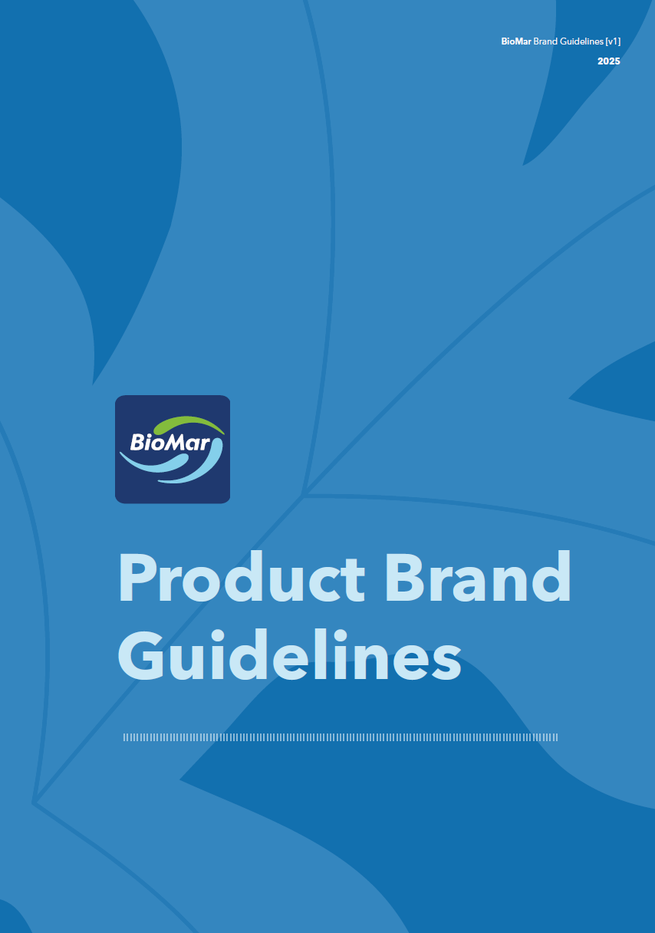
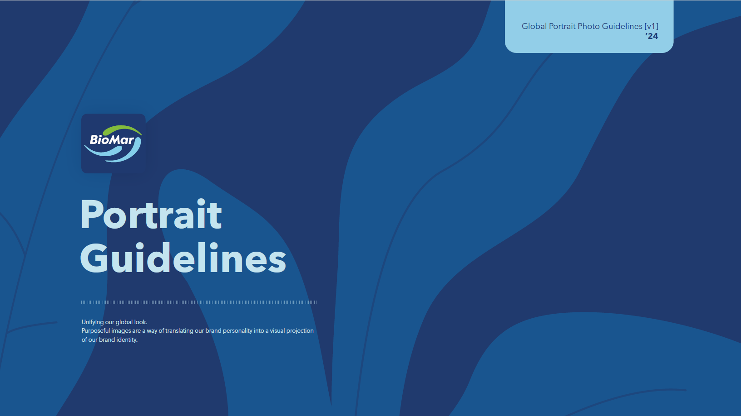

Additional Guidelines
All available on The Pond
Product communication standards
Packaging/product visual alignment
Art direction
Styling
Lighting & framing references
Image selection principles
Employee/profile photography consistency
Notes:
IS

Slide 14
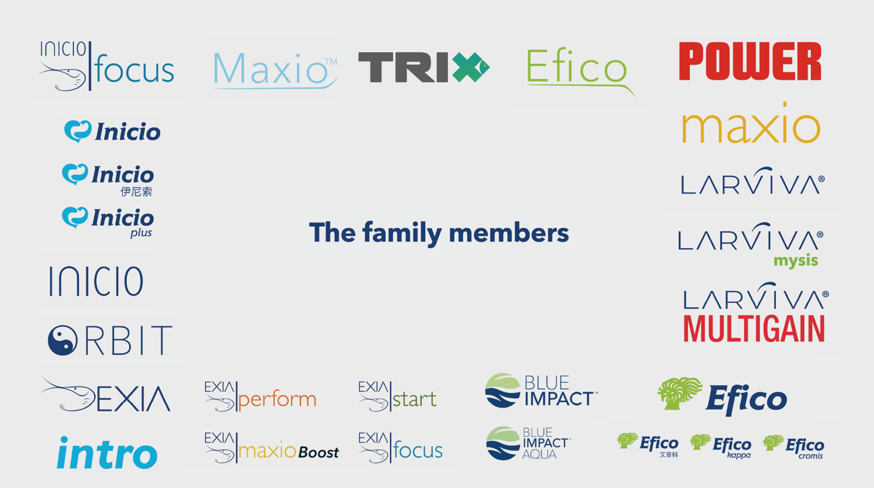














Recent Logo Rebranding
Before
All brands were treated independently from eachother. No alignment between them. Seem to be from different parents.
Now
All brands follow the same framework. Seem from the same parents. Have the swoosh.
Notes:
IS
Managing Brand Evolution
Talking points:
Recent logo update/rebranding initiative
Importance of maintaining consistency during transition
Roll-out across markets and materials
Updating templates, assets, documents, presentations, videos, and platforms
Coordination across departments and external suppliers
Design logistics behind implementation

Slide 15
Ways of Working
WEEKLY
DAILY
ALWAYS-ON
Weekly meetings
Daily collaboration
File & asset management
Ongoing project alignment
Prioritization
Capacity overview
Cross-functional coordination
Feedback loops
Stakeholder communication
Iterative review process
Shared systems & organization
Version control
Accessibility across teams
Notes:
AB

Slide 16

Current Challenges & Opportunities
Looking ahead
TODAY – hub 2.0
Hub 3.0
Current challenges
Opportunities
Volume of requests is increasing
Swift on necessities + Campaigns, storytelling and events
Global consistency vs local flexibility
Enhance collaboration, scale the hub resources
Scaling processes efficiently
High-value vs low-value tasks. Commercial vs Internal balance
Quality across channels, local scalling
Automation, improved workflows and transparency
Product ownership
Notes:
AB

