Slide 1
Global and Group Marketing
The team, practicalities and how we work.

Slide 2
What is Global Marketing and Branding

Slide 3
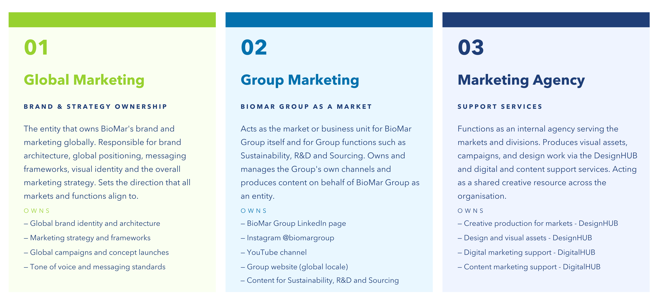
Our 3 working areas

Slide 4
Marketing Organisation

Slide 5
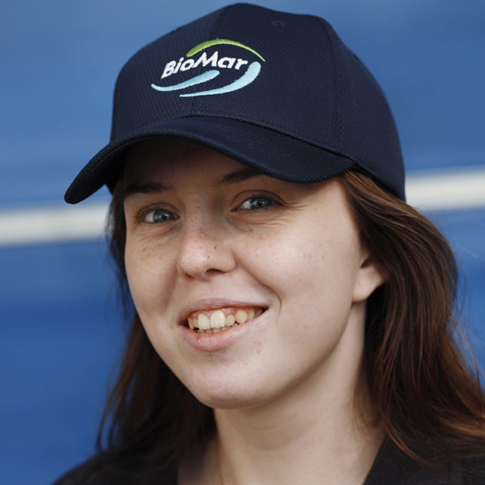
Global Marketing
Global Marketing Director
Helle Vansgaard
DESIGN HUB
DIGITAL MARKETING
Multimedia Designer
Andres Bernadou
Digital Marketing Platforms Specialist
Matt Evans
Content Creator
Nerea Palacios
Graphic Designer
Isidora Silva Chiros
Notes:
5

Slide 6




Manager Kseniya
Akkaya
Manager
Cathrine
Weirbach
Assistant Christina
Kravariti
Manager
Iris Hernandez
BioMar Marketing
Global Marketing manages the BioMar brand creates the positioning for all product concepts and services and runs a centralised Design and Digital Shared Services agency.
Product Marketing Management manages their segment and develops the product range in their product portfolio
Local Marketing launches its product range and runs marketing initiatives to support its businesses
EMEA
Marketing Manager
Valeria Triviño Alvarez
Marketing Assistant
Thu Minh Dang
Global Marketing
Daniela Vera
Xinru Wang
LATAM
Asia
Marketing Responsible
Steven Leon Ulloa
Marketing Manager
Ma Teng
Joana Silva
Salmon
Manager
Thomas
Hansen
Manager
Victoria
Valdenegro
= Location
Responsible
Andrew
Richardson
Manager
Claudio
Muñoz

Slide 7
Marketing Stakeholders

Slide 8
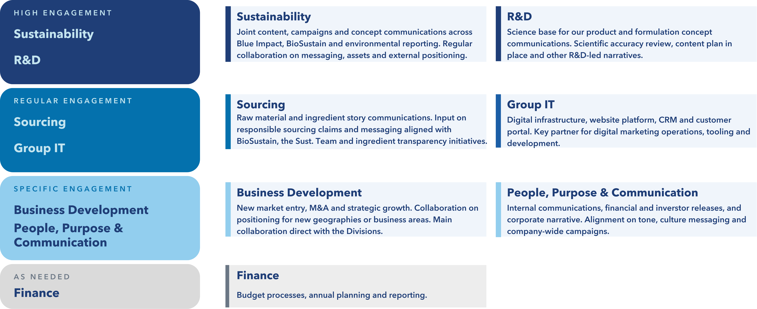
Our Group Function Stakeholders

Slide 9
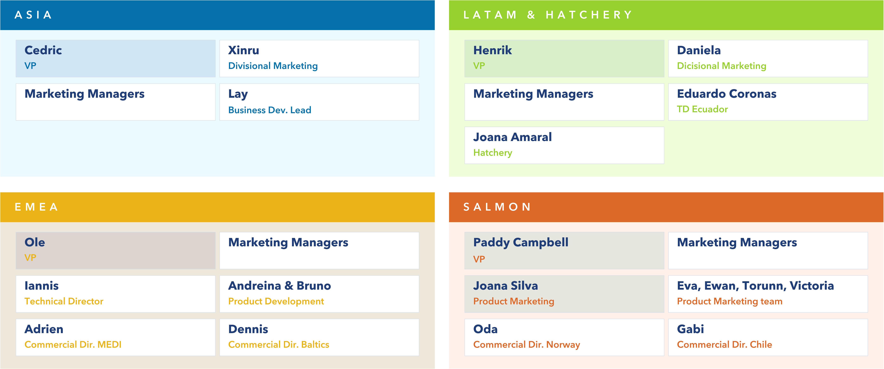
Some of our key stakeholders around the world

Slide 10
Marketing Meetings

Slide 11
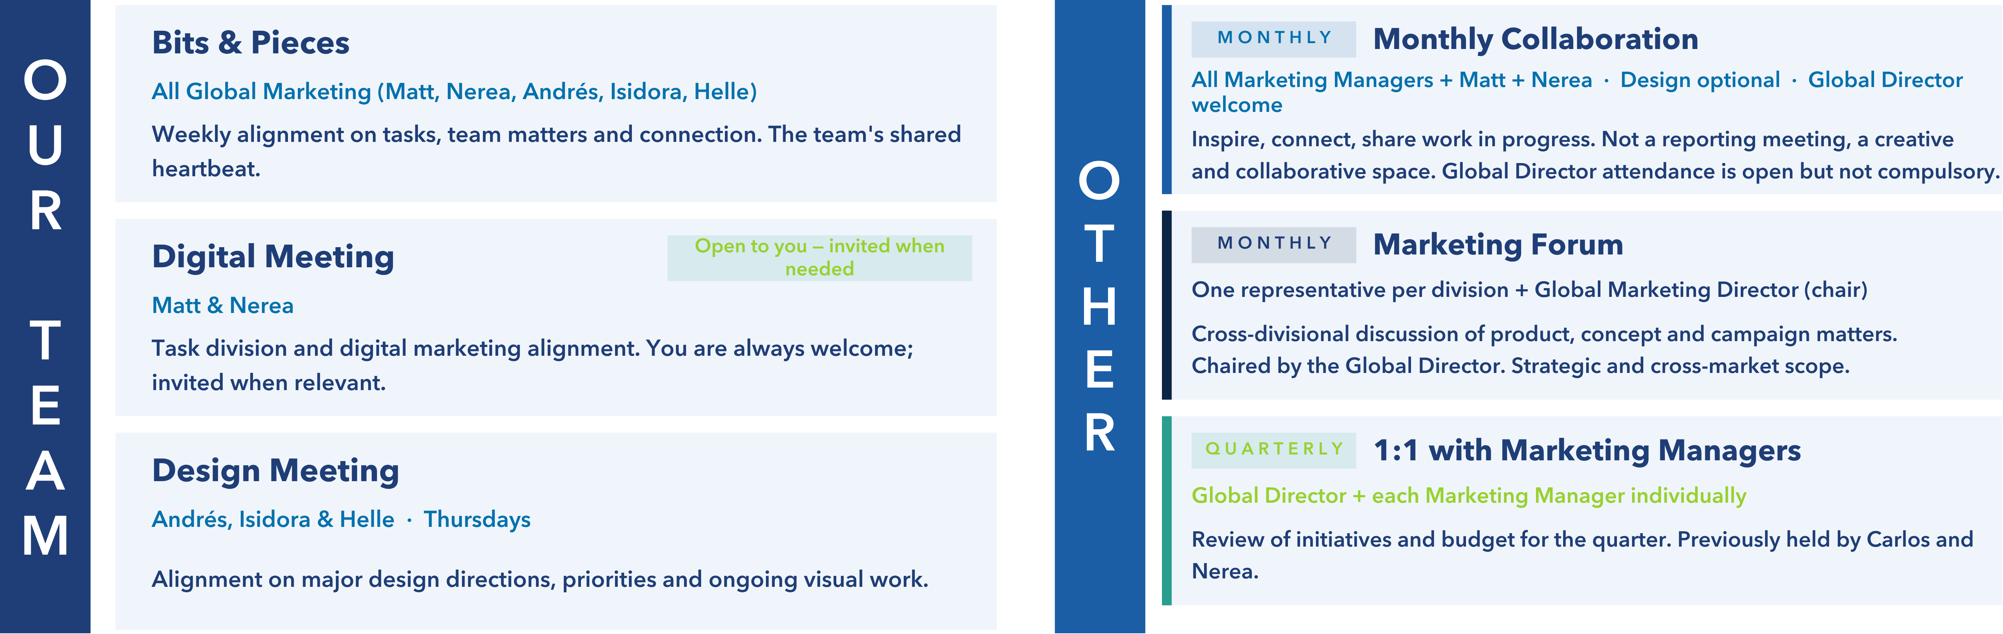
Regular meetings

Slide 12
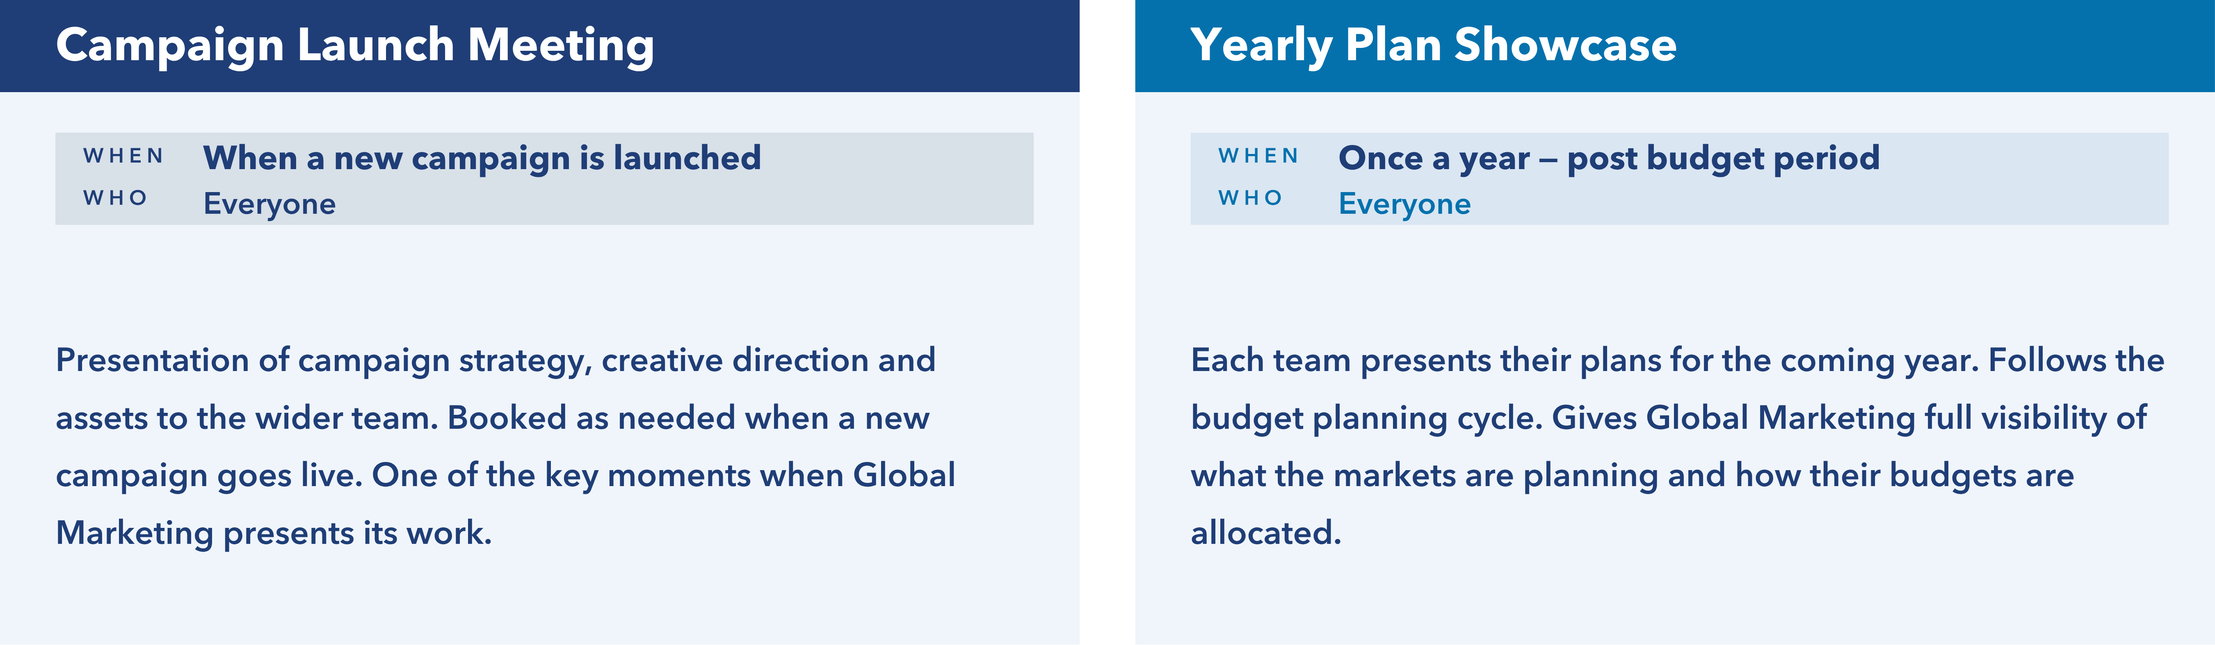
Special meetings

Slide 13
How we communicate

Slide 14
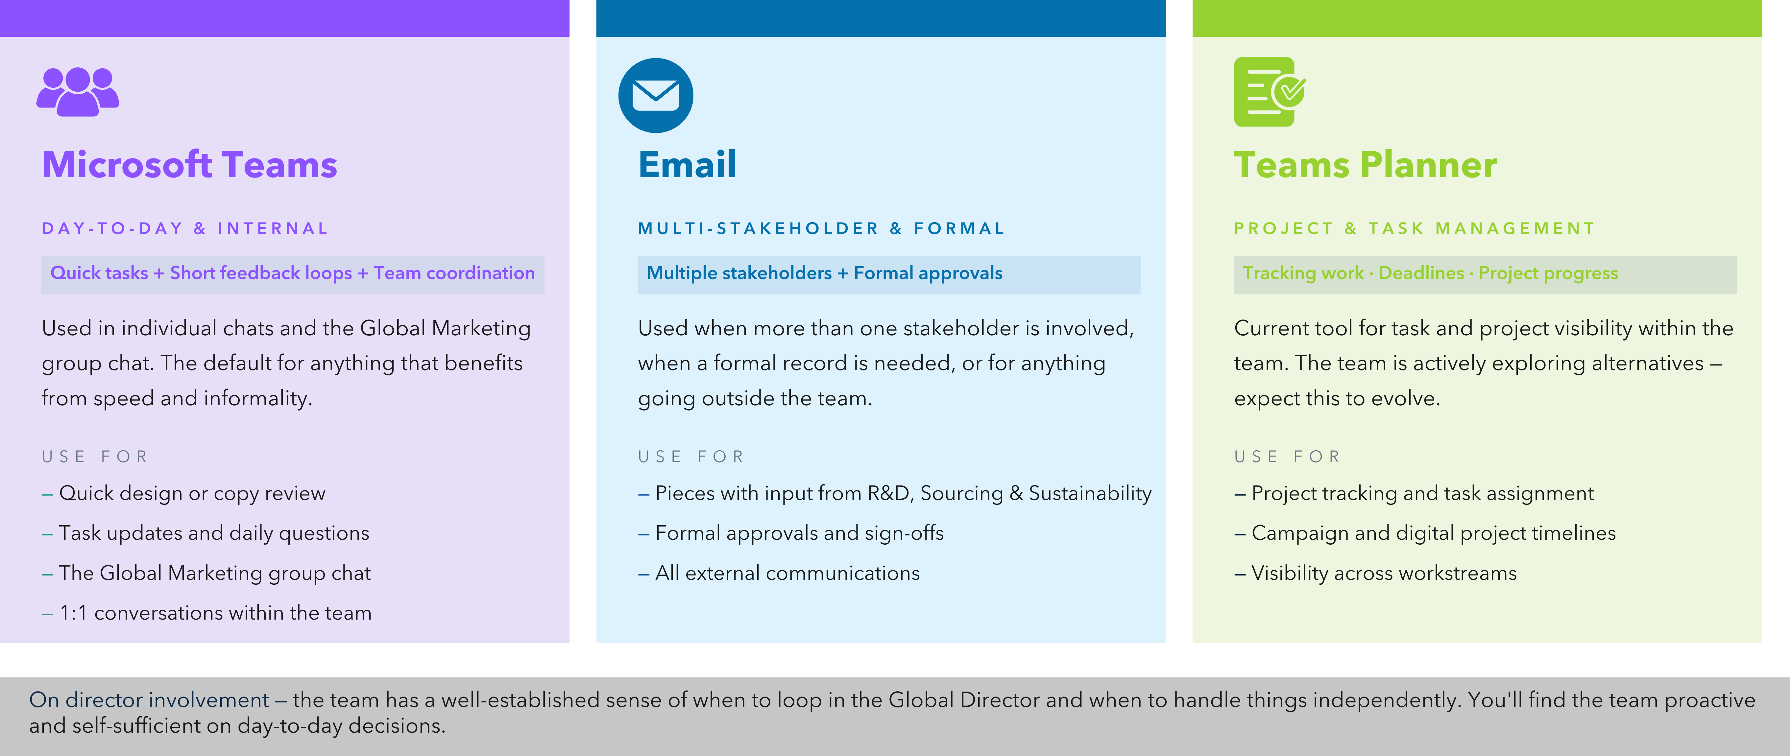
Channels

Slide 15
Global Marketing Plan
2026

Slide 16
Global
Group
 | January 2026 | February 2026 | March 2026 | April 2026 | May 2026 | June 2026 | July 2026 | August 2026 | September 2026 |  |  | October 2026 |  |  | November 2026 | December 2026
Events & Sponsorship
 |  |  | NASF | Blue Food Innovation Summit | Barcelona Show |  |  | TARS | GSF
Digital Marketing
Biomar.com |  | Gated Content |  |  | United Customer Journey
Customer Portal |  | Forecast |  |  |  |  | Data Exchange
Feeding Tool |  | Feeding Tool 1.5
Discover Seafood |  |  |  | Discover Seafood 1.5
Marketing Automation | WhatsApp Channel |  | Newsletter 1.5 |  |  | Market Roll-out Newsletter |  |  |  |  | Market Roll-out Newsletter |  |  |  | The Pond 3.0
Campaigns
Vision Elements |  |  |  |  | GSR | GSR | GSR |  |  |  |  |  |  |  | Manufactoring Excellence Award
Brand Image Elements | Health videos | Health videos |  | Swoosh |  |  | BFBFBF | BFBFBF
Commercial Elements | SmartCare | SmartCare |  |  |  | Grower Campaign |  |  | Formulation Concept |  |  | Formulation Concept
Social Media
Vision |  |  |  | Launch + CA | CA | CR | EP
Brand Image |  | BioFarm Campaign Round 2 | BioFarm Campaign Round 2 |  | ISFNF (Driven by Innovation) |  |  | Community | Behind the Feed |  |  | Behind the Feed |  |  | Sustainable Nutrition Campaign | Sustainable Nutrition Campaign
Commercial |  |  | International Women Day |  |  |  |  |  |  |  |  |  |  |  | International Day of the Child

Slide 17
Budgets

