Slide 1

If every cell were a person…
A visual story about PseudoEmbed
A snapshot
We meet different infants, children, teenagers, and adults.
The question
Can their measurements reveal a developmental progression?
IN PSEUDOEMBED
Each person represents one cell. The photographs represent a single-cell dataset.
01
Notes:
This analogy starts from cross-sectional observations: different individuals, not repeated pictures of one person. Infants suggest an early state, but stem cells can already be heterogeneous. The developmental ordering is specific to the biological process under study, not a universal ranking of people or cells.
Illustrations are conceptual cartoons, not experimental data.
Method sources:
https://github.com/BiomedSciAI/PseudoEmbed/blob/main/README.md
https://github.com/BiomedSciAI/PseudoEmbed/blob/main/pseudoembed/core/views.py
https://github.com/BiomedSciAI/PseudoEmbed/blob/main/examples/richard2018_tcell_tutorial.ipynb

Slide 2

One person, several views
Different measurements describe the same individuals
Physical traits
Height or body proportions are direct measurements.
Academic ability
Reasoning ability is inferred from performance across tasks.
Athletic ability
Endurance and coordination describe another pattern.
IN PSEUDOEMBED
Gene expression is measured. TF and pathway activity are inferred from patterns across genes.
02
Notes:
The academic and athletic examples are intuitive analogues for inferred activities, not literal biological equivalences. CollecTRI TF scores and PROGENy pathway scores use prior gene networks and decoupler ULM. All these views ultimately derive from the same RNA measurements, unlike truly independent human test modalities. Physical traits, including eye color, are not universally useful developmental signals. No trait or ability is linked to ethnicity or sex.
Illustrations are conceptual cartoons, not experimental data.
Method sources:
https://github.com/BiomedSciAI/PseudoEmbed/blob/main/README.md
https://github.com/BiomedSciAI/PseudoEmbed/blob/main/pseudoembed/core/views.py
https://github.com/BiomedSciAI/PseudoEmbed/blob/main/examples/richard2018_tcell_tutorial.ipynb

Slide 3
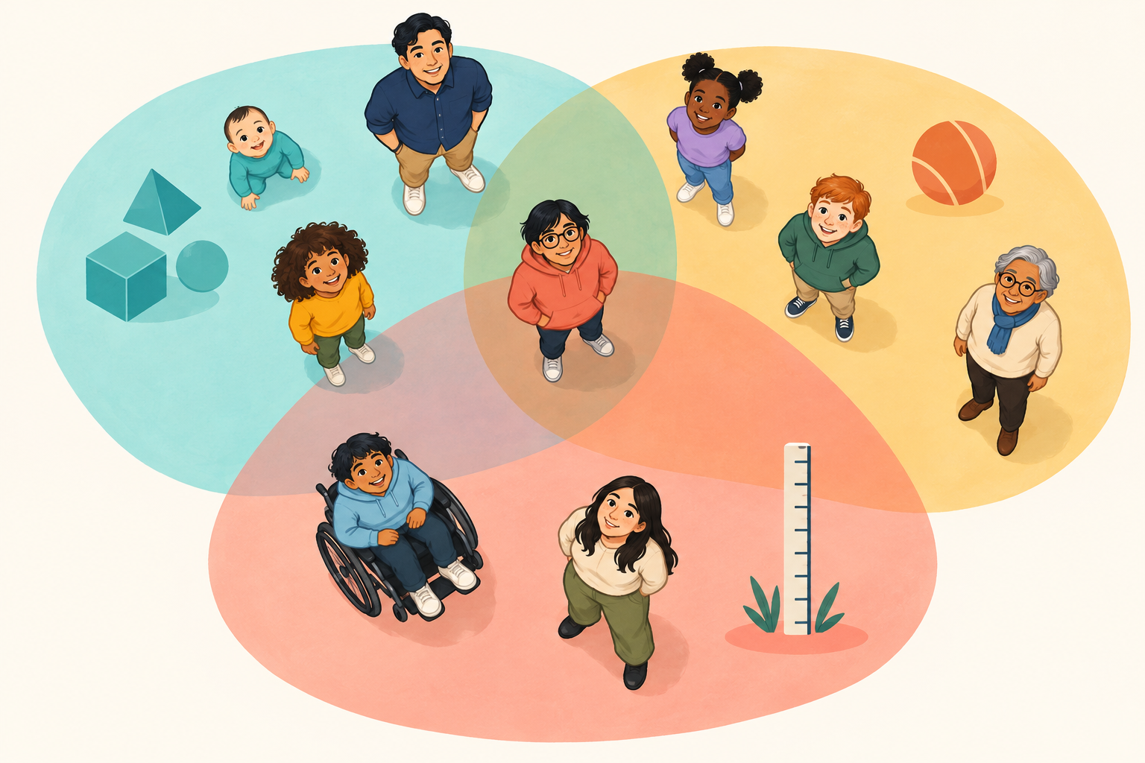
Groups can overlap
One named group connects many people at once
A named group
“Strong at math” can include several people of different ages.
Shared memberships
Someone can also belong to “strong endurance” and a height group.
A hyperedge
The whole group is one connection, rather than a set of pairs.
IN PSEUDOEMBED
A hyperedge groups cells by a gene, regulon, or pathway activity bin. Cells can join many edges.
03
Notes:
The colored groupings in the illustration are conceptual. Actual gene hyperedges select cells above an expression threshold after candidate and size filtering. TF edges group cells with activity of a regulon, and pathway edges group cells within an activity bin. A single pathway can define several hyperedges. A group need not correspond to a mutually exclusive cell type.
Illustrations are conceptual cartoons, not experimental data.
Method sources:
https://github.com/BiomedSciAI/PseudoEmbed/blob/main/README.md
https://github.com/BiomedSciAI/PseudoEmbed/blob/main/pseudoembed/core/views.py
https://github.com/BiomedSciAI/PseudoEmbed/blob/main/examples/richard2018_tcell_tutorial.ipynb

Slide 4
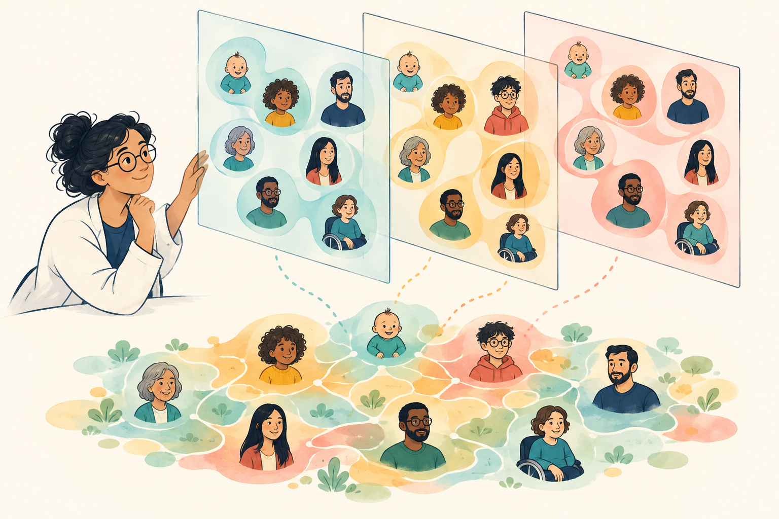
Several views form a shared map
Similarity depends on more than one characteristic
Different evidence
Two people may be physically similar but differ in their skills.
Combined structure
Overlapping groups help organize people into a common map.
Adjustable influence
We can change the weight assigned to each view.
IN PSEUDOEMBED
PseudoEmbed normalizes hypergraph operators and combines them. The result defines cell similarity.
04
Notes:
Operator fusion averages normalized per-view operators using specified view weights. Edge fusion instead combines edges before normalization and can produce different geometry. Hyperedge-size and cell-degree normalization influence connections. More views do not automatically improve a result. The current tutorial uses TF, pathway, and gene-expression views, not a foundation-model embedding. The illustration is not a measured graph or literal computation.
Illustrations are conceptual cartoons, not experimental data.
Method sources:
https://github.com/BiomedSciAI/PseudoEmbed/blob/main/README.md
https://github.com/BiomedSciAI/PseudoEmbed/blob/main/pseudoembed/core/views.py
https://github.com/BiomedSciAI/PseudoEmbed/blob/main/examples/richard2018_tcell_tutorial.ipynb

Slide 5

Pseudotime follows a path from a root
Relative developmental position, not age in years
Choose a starting point
An infant-like profile represents an early state.
Follow the map
Distance follows connections through similar people.
Read the ordering
A larger score means farther along this inferred progression.
IN PSEUDOEMBED
PseudoEmbed uses a spectral embedding and root-to-cell distance, usually along a neighborhood graph.
05
Notes:
The winding park path is a metaphor for geodesic distance through a kNN graph in the spectral embedding. A spectral embedding represents connectivity patterns, not a pretrained foundation-model representation. Pseudotime is typically normalized to [0,1], without units of hours or years. It does not measure intelligence, worth, or general maturity. Root selection can use a marker panel or earliest sampling time. Current code also uses time labels during fitting; this is not an entirely time-blind ordering. Different people at positions on the path are not proven ancestors or descendants.
Illustrations are conceptual cartoons, not experimental data.
Method sources:
https://github.com/BiomedSciAI/PseudoEmbed/blob/main/README.md
https://github.com/BiomedSciAI/PseudoEmbed/blob/main/pseudoembed/core/views.py
https://github.com/BiomedSciAI/PseudoEmbed/blob/main/examples/richard2018_tcell_tutorial.ipynb

Slide 6

Development can branch into specializations
A shared early path can lead toward different job functions
Jobs resemble cell types
Some people become doctors. Others become engineers.
Traits cross career paths
Strong math performance can occur on both branches.
Distance and destination
People on different paths can be equally far from the starting point.
IN PSEUDOEMBED
Cell lineages can branch. Pseudotime measures root distance; identifying a branch needs additional information.
06
Notes:
Career paths are a metaphor for branching differentiation across a population. Different individuals specialize into different functions; a person does not physically split. Doctors and engineers illustrate differentiated cell types, not ranked outcomes. Shared math performance illustrates a programme that can occur on several branches and need not uniquely specify cell type. Hyperedges can span branches. A scalar root-distance pseudotime cannot by itself identify branch membership, reconstruct ancestry, or predict fate. The cartoon does not claim that PseudoEmbed automatically assigns lineages. Careers are influenced by social opportunity and choice, so this is an analogy rather than a literal biological model.
Illustrations are conceptual cartoons, not experimental data.
Method sources:
https://github.com/BiomedSciAI/PseudoEmbed/blob/main/README.md
https://github.com/BiomedSciAI/PseudoEmbed/blob/main/pseudoembed/core/views.py
https://github.com/BiomedSciAI/PseudoEmbed/blob/main/examples/richard2018_tcell_tutorial.ipynb

Slide 7

Named groups explain the progression
Traits define groups. Group positions help interpret the map.
A trait and a group
Math performance is a trait. People strong at math form a hyperedge.
Contribution
How strongly does that group align with a fitted spectral axis?
“Onset” in the tutorial
The group’s mean pseudotime describes its typical position.
IN PSEUDOEMBED
“Onset” averages member-cell positions. It does not identify the first moment a programme turns on.
07
Notes:
Contribution is nonnegative and sign-blind. Direction requires an oriented signed projection; per-member means help compare different edge sizes. Edge onset is average member-cell position, not the moment the trait first appears. Contribution describes axis alignment and is not proof of a causal driver. Exact quadratic-form decomposition refers to the operator supplied to the attribution routine, not automatically to the entire fused, temporally biased, geodesic pipeline. The art is schematic and carries no numerical result.
Illustrations are conceptual cartoons, not experimental data.
Method sources:
https://github.com/BiomedSciAI/PseudoEmbed/blob/main/README.md
https://github.com/BiomedSciAI/PseudoEmbed/blob/main/pseudoembed/core/views.py
https://github.com/BiomedSciAI/PseudoEmbed/blob/main/examples/richard2018_tcell_tutorial.ipynb

Slide 8

A convincing story needs independent checks
Some traits describe development; others describe something else
Useful signal?
Height can track growth. Eye color generally does not.
Independent evidence
Check the map against a measurement excluded from fitting.
Limits of inference
An association does not prove what caused the progression.
IN PSEUDOEMBED
Use held-out measurements and sensitivity checks. Time correlation is not independent if time helped fit the map.
08
Notes:
The Richard tutorial uses held-out surface-protein measurements as biological validation. They are a held-out modality, not an independent cohort. Sampling time and condition are confounded in that dataset, so an effect of stimulation cannot be separated from elapsed time. Explore root, view, edge-size, and candidate-pool sensitivity. Biological differentiation may branch; career paths illustrate branching, but root distance alone does not identify branch membership or fate. The README documents a missing spectral degree back-transform, which limits interpretation of current pseudotime. The sensor/clipboard illustration is a metaphor, not a real validation assay.
Illustrations are conceptual cartoons, not experimental data.
Method sources:
https://github.com/BiomedSciAI/PseudoEmbed/blob/main/README.md
https://github.com/BiomedSciAI/PseudoEmbed/blob/main/pseudoembed/core/views.py
https://github.com/BiomedSciAI/PseudoEmbed/blob/main/examples/richard2018_tcell_tutorial.ipynb

Slide 9
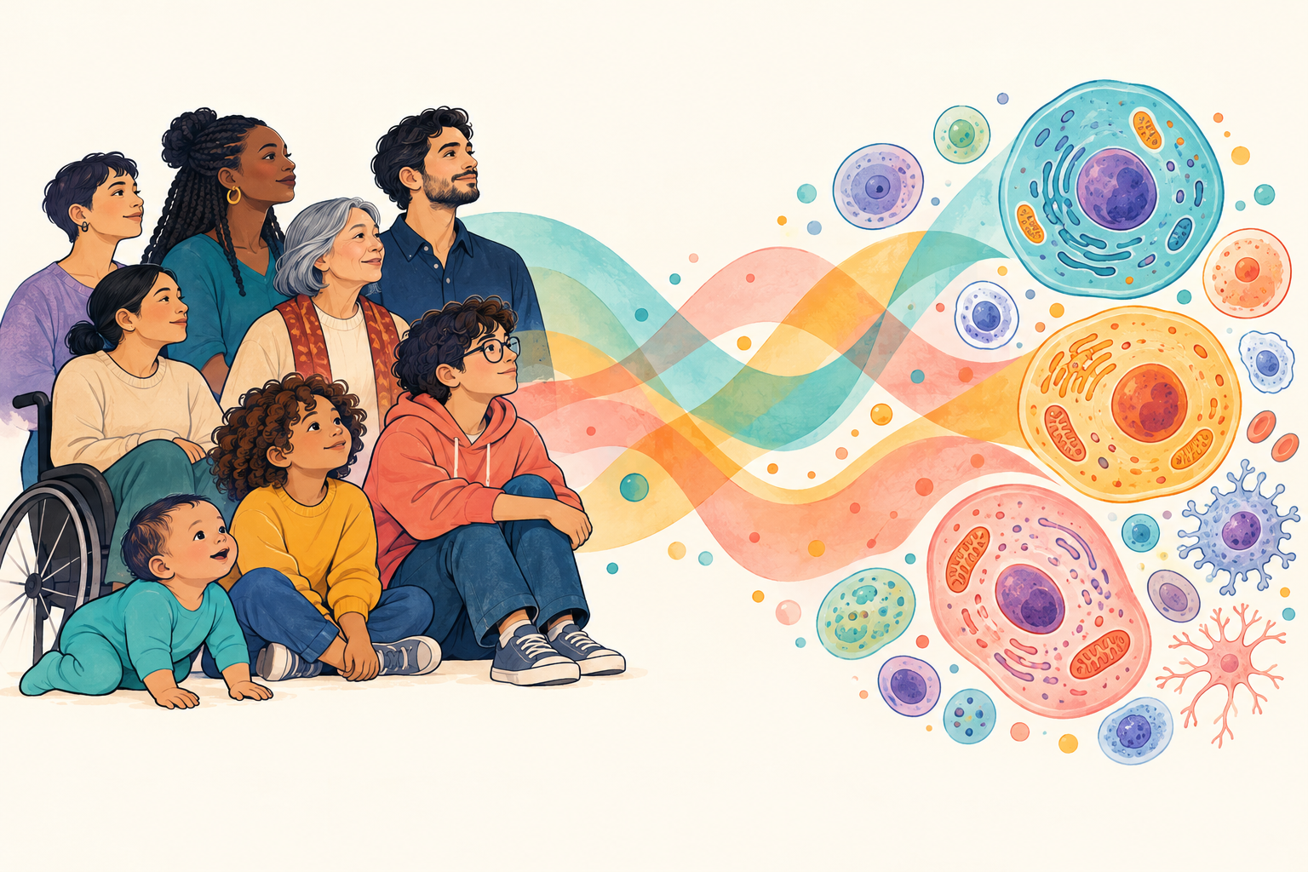
Back to cells: the PseudoEmbed idea
Shared traits can span different developmental branches
People become cells
Each cell has an expression profile.
Groups become hyperedges
Named genes and programmes define overlapping cell sets.
Paths and specializations
Career paths resemble lineages. Job functions resemble cell types.
IN PSEUDOEMBED
PseudoEmbed links a trajectory to named biological programmes. The result is a set of hypotheses to investigate.
09
Notes:
The analogy translates: people = cells; measurements = gene expression; inferred abilities = inferred TF/pathway activity; overlapping named groups = hyperedges; shared map = fused operator and spectral embedding; relative position = pseudotime. The optional PCA view groups cells by expression-space neighborhoods. No foundation-model cell embedding is used in the reviewed tutorial. Condition-specific gene attribution is an optional extension requiring valid contrast and donor structure. Biological root populations can be heterogeneous, and lineage branching can require additional analysis. Do not claim universal superiority over DPT or causal validation. Career is a metaphor for specialized function. Population trajectories branch as different individuals take different routes. Root distance is a scalar and cannot by itself distinguish two branches at similar distance.
Illustrations are conceptual cartoons, not experimental data.
Method sources:
https://github.com/BiomedSciAI/PseudoEmbed/blob/main/README.md
https://github.com/BiomedSciAI/PseudoEmbed/blob/main/pseudoembed/core/views.py
https://github.com/BiomedSciAI/PseudoEmbed/blob/main/examples/richard2018_tcell_tutorial.ipynb

