Slide 1
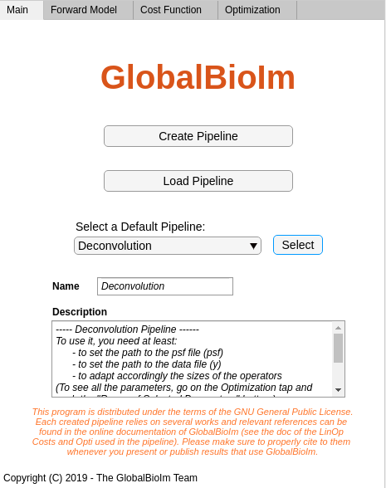
Create a new pipeline
Load a pipeline that has been previously saved on your computer
Select a default pipeline distributed along with GlobalBioIm
Editable field to set the name of the pipeline
Editable field to describe the pipeline and to provide any useful information on it

Slide 2
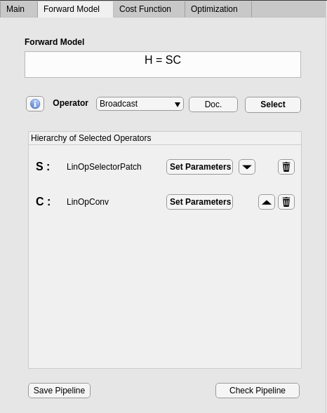
Open the doc of the operator (here Broadcast)
Display the built operator
Select the operator to be added to the composition
List of available operators
Delete the operator
Selected operators
Exchange the order of the operators
Open a new window to set the parameters of the operator (see below)
Save the current pipeline. Can then be reopened with the button « Load Pipeline » in the Main panel.
Check the validity of the pipeline (see below)

Slide 3
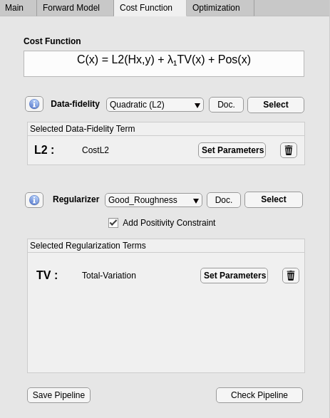
Open the doc of the data-fidelity (here L2)
Select the data-fidelity to be added to the cost
Display the built cost
Open a new window to set the parameters of the data-fidelity (see below)
List of available data-fidelity
Selected data-fidelity
Delete the data-fidelity
List of available regularizers
Select the regularizer to be added to the cost
Add a positivity constraint
Open the doc of the regularizer (here Good Roughness)
Selected regularizer(s)
Delete the regularizer
Open a new window to set the parameters of the regularizer (see below)
Save the current pipeline. Can then be reopened with the button « Load Pipeline » in the Main panel.
Check the validity of the pipeline (see below)

Slide 4
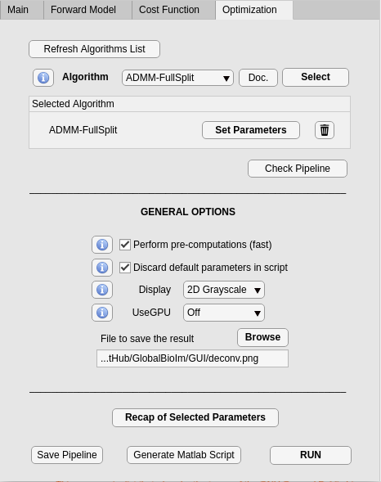
Open the doc of the algorithm (here ADMM)
Update the algorithm list according to the built cost function
Select the algorithm
List of usuable algorithms
Selected algorithm
Delete the algorithm
Pre-computation option (see the « Important Informations » section of the online Doc)
Open a new window to set the parameters of the algorithm (see below)
Discard (in the generated script and in the recap parameters window) the parameters that have been let to the default value
Check the validity of the pipeline (see below)
Set a file to save the result
Choose how to display the result
Select the GPU mode (see the « Speedup with GPU » section)
Open a new window to modify the parameters of the selected Operators / Data-fidelity / Regul / Algo
Save the current pipeline. Can then be reopened with the button « Load Pipeline » in the Main panel.
Run the algorithm
Automatic script generation (see below)

Slide 5
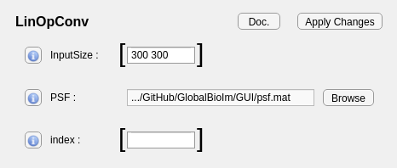
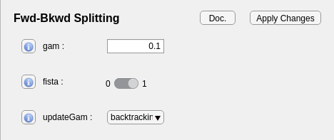
Example with convolution operator
Editable fields for parameters of type « vector of integers »
Browse button to select a file to be read and set to the corresponding parameter (here PSF)
Example with the FBS algorithm
Open the corresponding doc (here OptiFBS)
Editable field for parameters of type « numerical-value »
Button to save the changes and check the validity of the syntax
Dropdown menu for parameters with specific « options »
Toggle button for parameters of type « boolean »

Slide 6
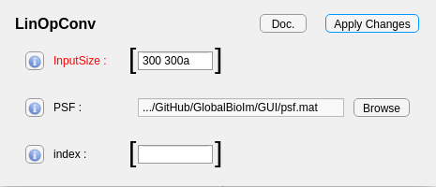
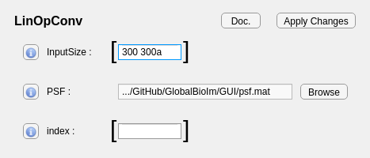
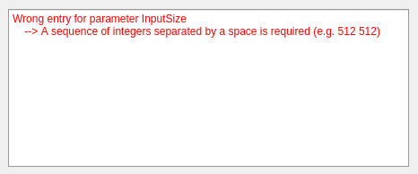
Wrong parameter in red
Wrong syntax
Push
« Apply Changes »
Log window specifying the problem

Slide 7
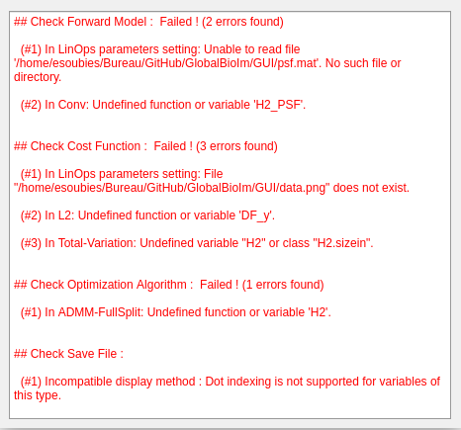
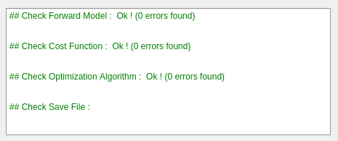
Example of Log window when check failed :
Example of Log window when check passed :

Slide 8
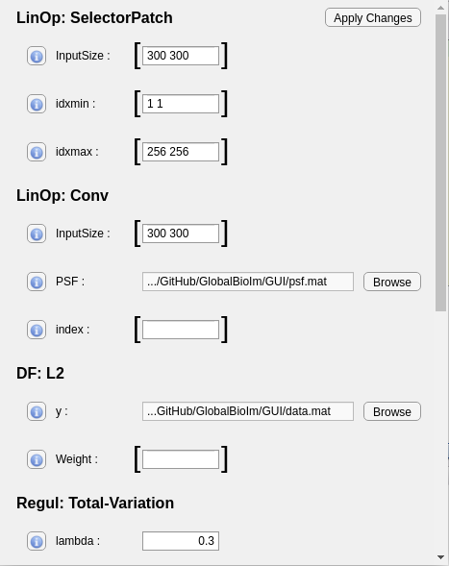
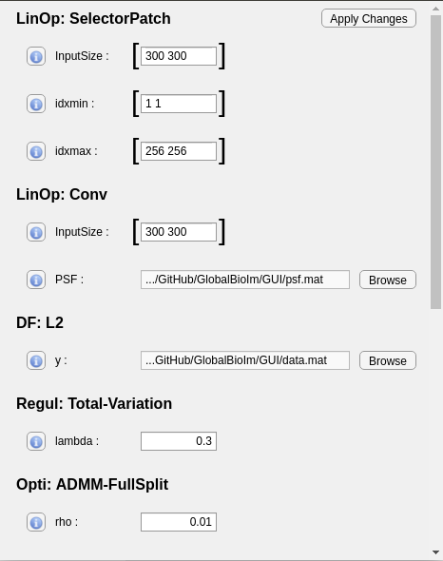
Without discarding default parameters
Discarding default parameters

