Slide 1






25th European Conference on Computational Biology (ECCB)
Tutorial session T13: 13:45 -17:30
Democratizing multi-omics data analysis with BiomiX and Nextflow: from single-omics to advanced integration
Presenters:
Cristian IPERI, PhD Jessica GLIOZZO, PhD
USZ: Center for Experimental Rheumatology, Zurich Switzerland
cristian.iperi@uzh.ch
Fondazione IRCCS
Istituto Nazionale dei Tumori, Milan, Italy
jessica.gliozzo@istitutotumori.mi.it
03-09-2026

Slide 2



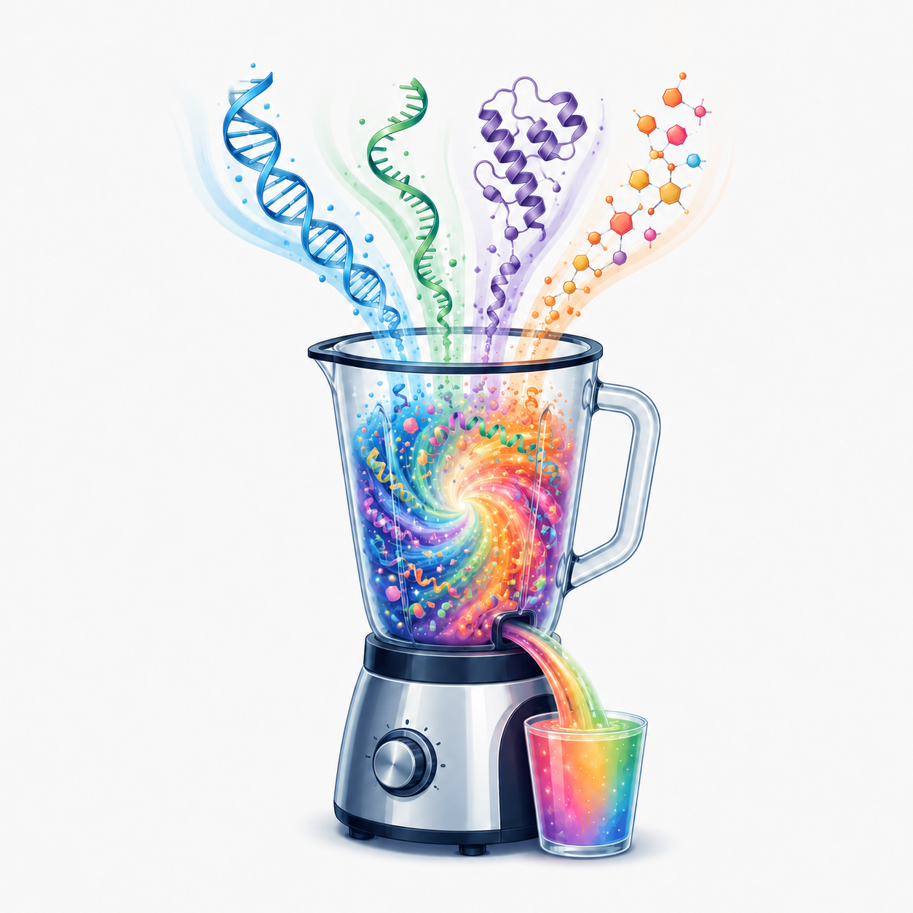

Part 2 – Multi-Omics Integration
15:30 – 16:00 | Integration strategies – Jessica Gliozzo
Early, intermediate and late integration
Overview of MOFA, DIABLO, SNF and NEMO
16:00 – 16:30 – MOFA & DIABLO Tutorials – Cristian Iperi
Parameter selection
Application to the CLL dataset
Interpretation of results
16:30 – 17:00 – SNF & NEMO Tutorials – Jessica Gliozzo
Parameter selection
Application to the CLL dataset
Interpretation of results
17:00 – 17:30 – Final discussion and Q&A
2026 Cristian Iperi, Jessica Gliozzo — CC BY 4.0

Slide 3
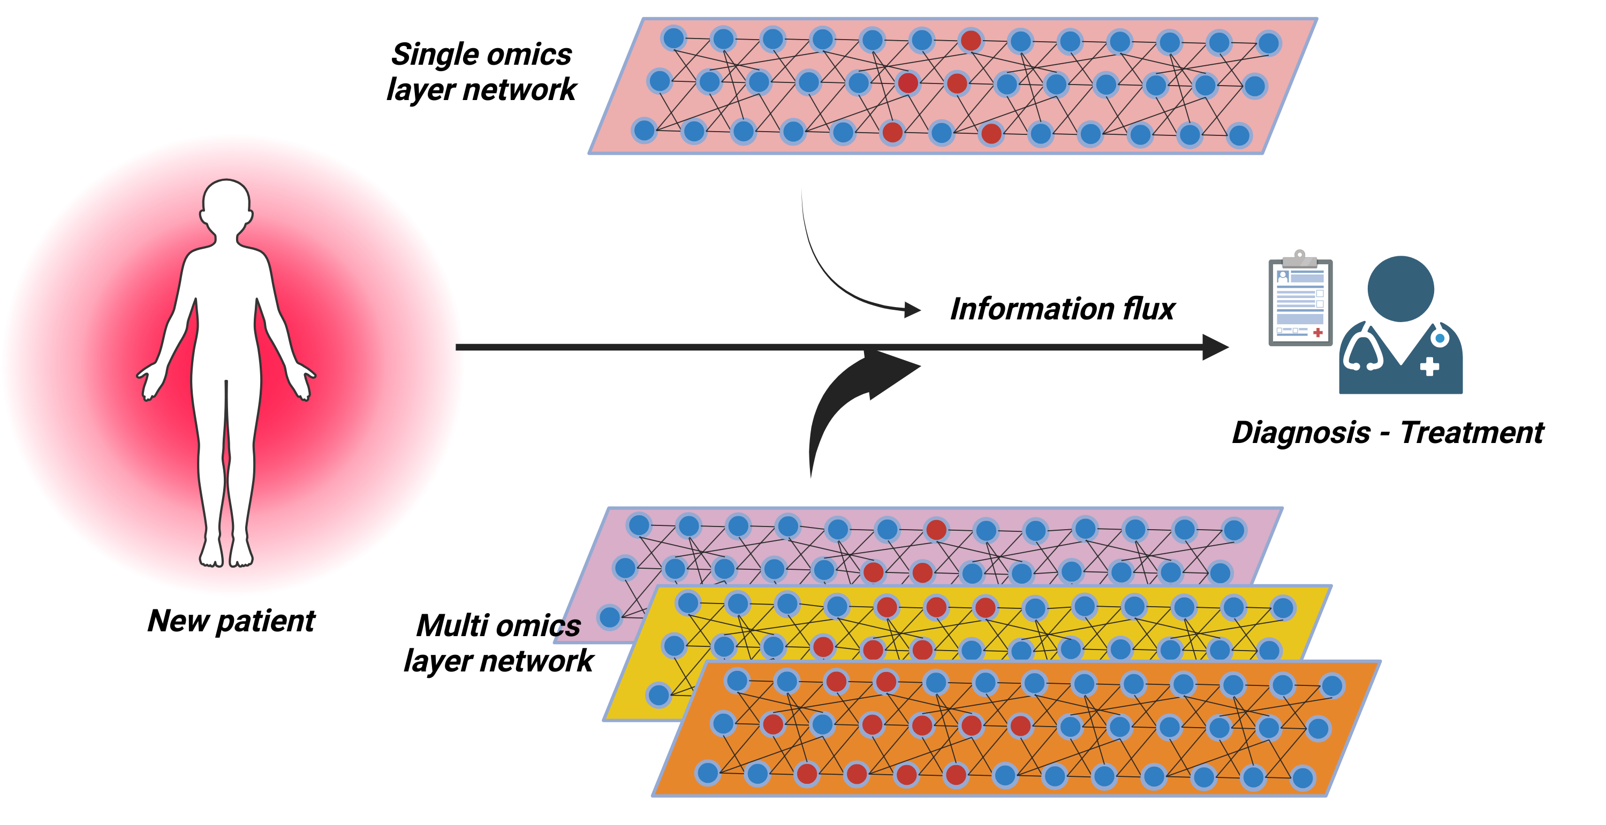
Multi-omics data integration, the grail of biology understanding ?
Pros
Observations strengthened
Holistic interpretation
Detailed characterization
Prevention, prognosis, diagnosis, treatment
Cons
Precision Medicine
Different distribution
Curse of dimensionality
Missing data
2026 Cristian Iperi, Jessica Gliozzo — CC BY 4.0

Slide 4





Multi-omics data integration, the grail of biology understanding?
Task specific methods
Disease molecular pattern
Drug response prediction
Patients stratification
Identification regulatory networks
Prognosis-Severity prediction
2026 Cristian Iperi, Jessica Gliozzo — CC BY 4.0

Slide 5
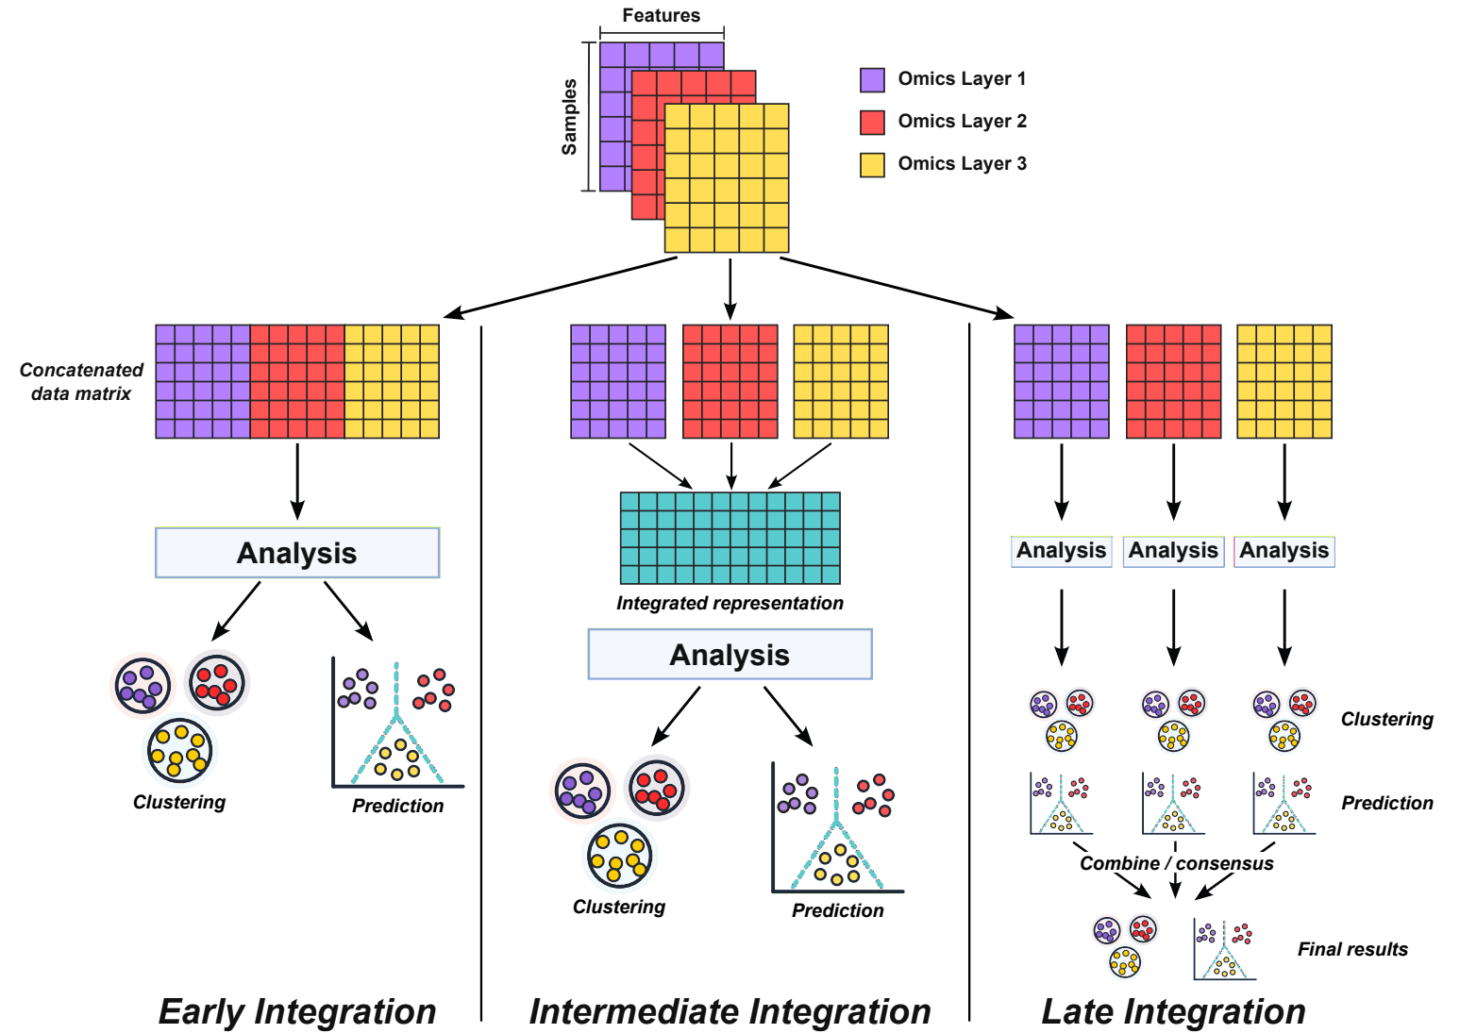
Families of integration methods
Key distinction is the stage at which
information from different omics is integrated:
Early - omics are merged into a single input
feature space before joint analysis
Intermediate - omic-specific representations
are integrated to construct a joint
representation
Late - results from separate analyses/models
are combined
Ritchie MD et al., Nat Rev Genet, 2015; Zitnik M et al., Inf Fusion, 2019
2026 Cristian Iperi, Jessica Gliozzo — CC BY 4.0

Slide 6
Early integration:
Different omics measured on the same samples
Features from the omics are concatenated into a single matrix
A joint downstream analysis is performed on the integrated matrix
Integration occurs at the input level
Families of integration methods
Pros
Simple and intuitive
Compatible with many standard
ML/statistical methods
Allows joint analysis of
features across omics
Cons
Very high dimensionality
No explicit modeling of cross-omic structure by
concatenation
Sensitive to differences in scale/distribution across omics
Often requires matched samples
2026 Cristian Iperi, Jessica Gliozzo — CC BY 4.0

Slide 7
Intermediate integration:
Omics are retained as separate data layers
Information across layers is integrated while learning or constructing a joint representation
The resulting integrated representation is used for downstream analysis
Integration occurs at the reprentation level
Families of integration methods
Pros
Can capture relationships across omics
Can accommodate different data types and distributions
May reduce the influence of very high-dimensional feature spaces
Some approaches handle missing samples
Cons
More complex than simple concatenation
Results depend on how omic-specific representations are constructed
Parameter selection can strongly affect the integrated representation
Interpretation may be less direct
2026 Cristian Iperi, Jessica Gliozzo — CC BY 4.0

Slide 8
Late integration:
Each omic layer is analyzed separately
Each analysis produces an omic-specific output (e.g. predictions or clustering solutions)
The separate outputs are then combined and used to derive a consensus
The combined output provides the final result
Integration occurs at the output level
Families of integration methods
Pros
Allows omic-specific preprocessing and models
Can accommodate heterogeneous data types and distributions
Individual omic contributions can remain relatively interpretable
Some approaches can more easily handle missing modalities
Separate analyses can be performed independently or in parallel
Cons
Cross-omic relationships are not modeled directly
Information may be lost when each omic is reduced to an output
Results depend on the strategy used to combine or weight outputs
Signals that are weak within individual omics but strong jointly may be missed
2026 Cristian Iperi, Jessica Gliozzo — CC BY 4.0

Slide 9
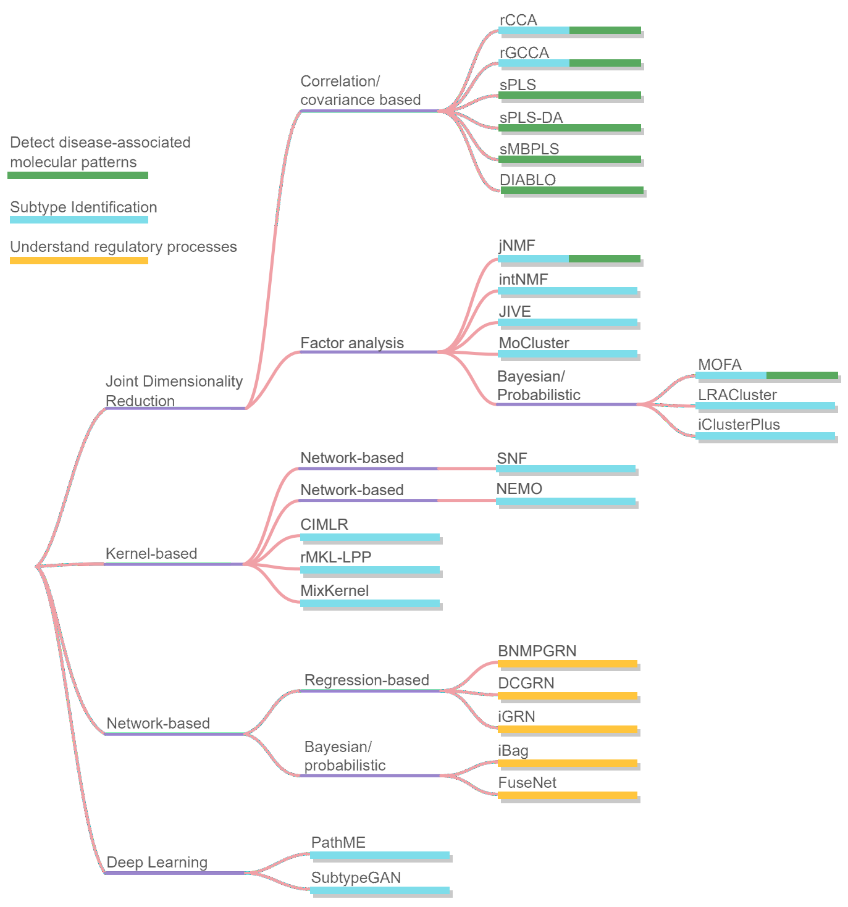
Classification based on computational methods
Most newly developed tools specifically adopt the intermediate integration approach.
Methods can be classified based on the employed computational approach.
In BiomiX, the following intermediate approaches are implemented:
MOFA (Multi-Omics Factor Analysis)
DIABLO (Data Integration Analysis for Biomarker discovery using Latent cOmponents)
SNF (Similarity Network Fusions)
NEMO (NEighborhood based Multi-Omics clustering)
Image adapted from Athieniti E, Spyrou GM, Comput. Struct. Biotechnol. J, 2023
2026 Cristian Iperi, Jessica Gliozzo — CC BY 4.0

Slide 10
MOFA (Argelaguet R, et al. Mol. Syst. Biol., 2018)
MOFA is an unsupervised Bayesian factor-analysis framework
that learns a low-dimensional representation of multi-omics data
through latent factors capturing shared and modality-specific sources of variation.
Data integration suited for Gaussian, Bernoulli and Poisson distributions
Missing omics data handled
Easy MOFA factor interpretation enabled by sparse weights
Low performance on strongly non-linear data
Factor selection depends on user-defined training criteria
2026 Cristian Iperi, Jessica Gliozzo — CC BY 4.0

Slide 11
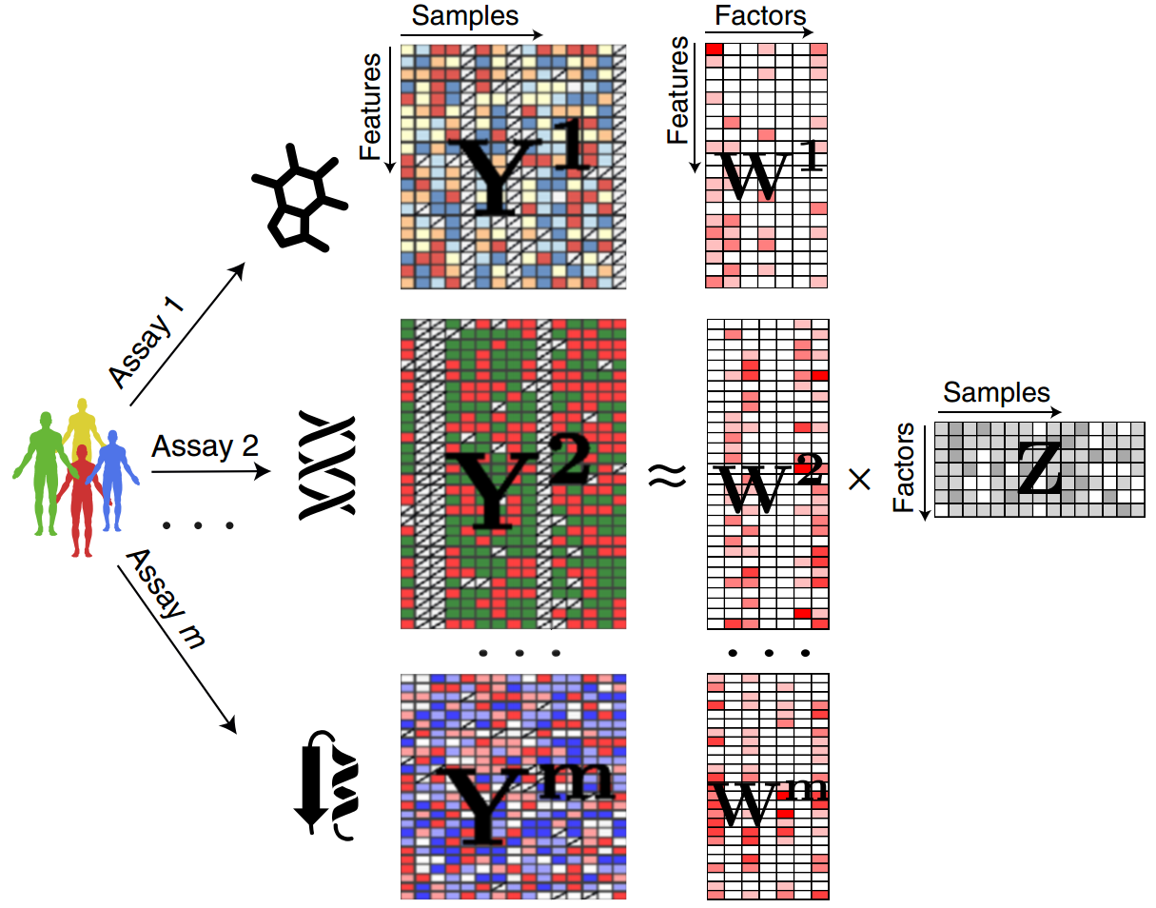
Multiple omics matrices Y^{m} are approximated using a common
sample-factor matrix Z, but each omic has its own
feature-weight matrix W^{(m)}.
Y^{(m)} ≈ ZW^{(m)T} m = 1, …, M
Y^{(m)}: one data matrix for each omic m
Z: one common factor matrix for the samples
W^{(m)}: one loading/weight matrix for each omic m
Factor-wise and feature-wise sparsity lead to more interpretable solutions!
Each factor can capture variation shared across multiple omics or specific to a single omic.
Image from Argelaguet R, et al. Mol. Syst. Biol. 2018
2026 Cristian Iperi, Jessica Gliozzo — CC BY 4.0

Slide 12
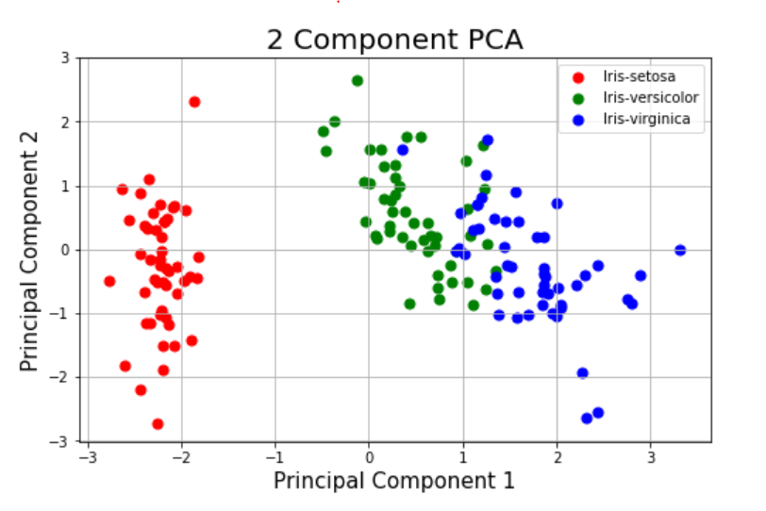
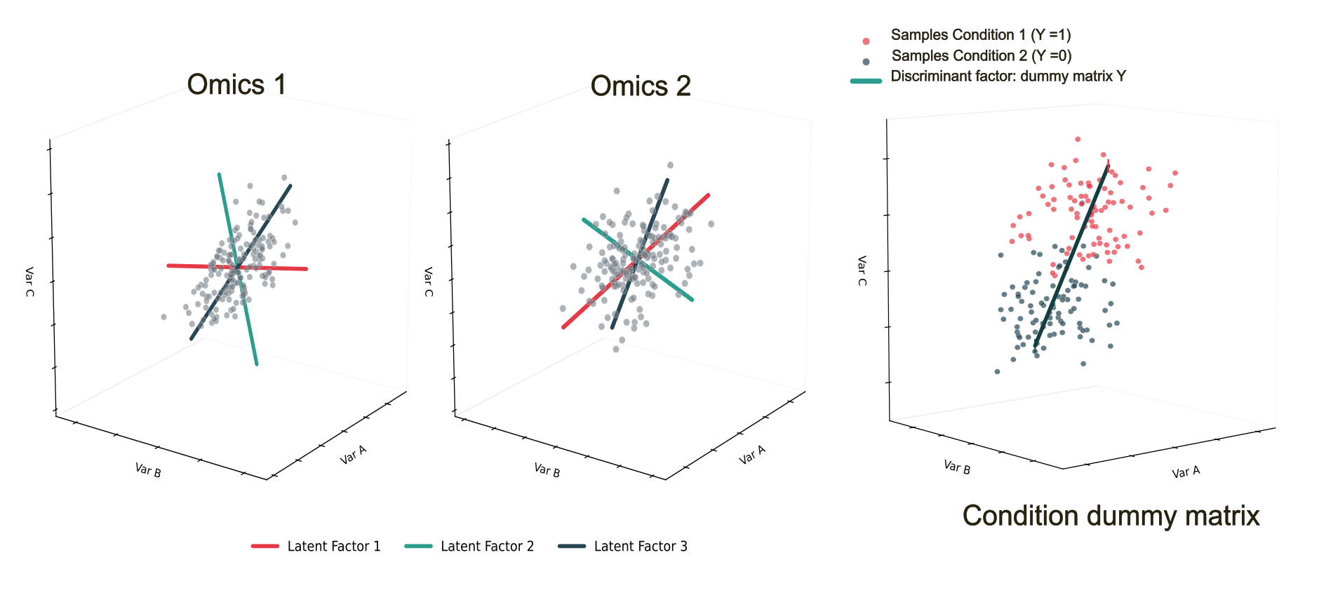
Making it simple: Intuition behind MOFA
MOFA can be viewed as a multi-omics generalization of PCA !
It extends this idea using a Bayesian factor model for multiple omics.
PCA → Y ≈ ZW^{T}
1 omic → few latent components + weights
MOFA → Y⁽¹⁾ ≈ ZW^{(1)T}
Y⁽²⁾ ≈ ZW^{(2)T}
Y⁽³⁾ ≈ ZW^{(3)T}
multiple omics → few common latent components + omic-specific weights
Multi-omics latent space
2026 Cristian Iperi, Jessica Gliozzo — CC BY 4.0

Slide 13
DIABLO (Singh A, et al. Bioinformatics, 2019)
DIABLO is a supervised extension of sGCCA (sparse Generalized
Canonical Correlation Analysis), that identifies variables while
discriminating phenotypic groups.
Objectives:
1) maximize the covariance between linear combinations of
variables (latent components)
2) maximize groups discrimination
Joint integration and supervised feature selection (LASSO-like)
Identifies correlated multi-omics signatures associated with phenotype
Sparse weights facilitate interpretation
Low performance on non-linear data
Training requires matched samples across omics
Some hyperparametes need tuning (n components, n variable to select)
2026 Cristian Iperi, Jessica Gliozzo — CC BY 4.0

Slide 14
For each omic, DIABLO learns a latent component as a weighted combination of features.
For sample i and omic q, we obtain the component score ti^{(q)} as:
ti^{(q)}​=a1​^{(q)}xi1^{(q)}​+a2^{(q)}​xi2^{(q)}​+⋯+ap^{(q)}​xip^{(q)}​
Sparsity is imposed on the weights, so many coefficients can become zero (i.e. feature selection)
Components are learned jointly to maximize association across connected omics while discriminating the phenotype.
Each omic has its own components!
Component 1
Component 2
Component 3
2026 Cristian Iperi, Jessica Gliozzo — CC BY 4.0

Slide 15
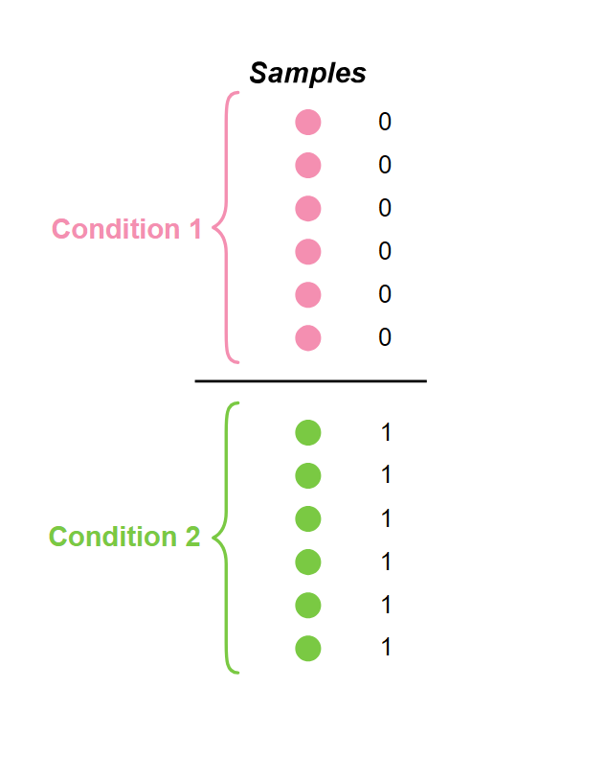
Dummy matrix → provides the supervised frame to select the components discriminating the two conditions
Design matrix → defines how strongly we expect pairs of omics to be related (high assoc. = 1, low assoc. = 0)
Dummy matrix
Samples | Cond. 1 | Cond. 2
S1 | 1 | 0
S2 | 0 | 1
... | ... | ...
SN | 1 | 0
Design matrix
 | RNA | Methylome
RNA | 0 | 0.8
Methylome | 0.8 | 0
Component 1
Component 2
Component 3
2026 Cristian Iperi, Jessica Gliozzo — CC BY 4.0

Slide 16
Similarity Network Fusion (SNF) (Wang B, et al., Nature Methods, 2014)
SNF is an unsupervised multi-omics integration method that builds one
sample similarity network per omic and iteratively fuses them
into a single integrated network for subtype discovery, exploiting a
message-passing process.
Unsupervised subtype discovery
High-dimensional features into an integrated sample-sample network
Capture local/nonlinear relationships
Network interpretation
Limited biomarker interpretation
Arbitrary choice of hyperparameters
No missing-data handling
Poor scaling with number of samples
2026 Cristian Iperi, Jessica Gliozzo — CC BY 4.0

Slide 17
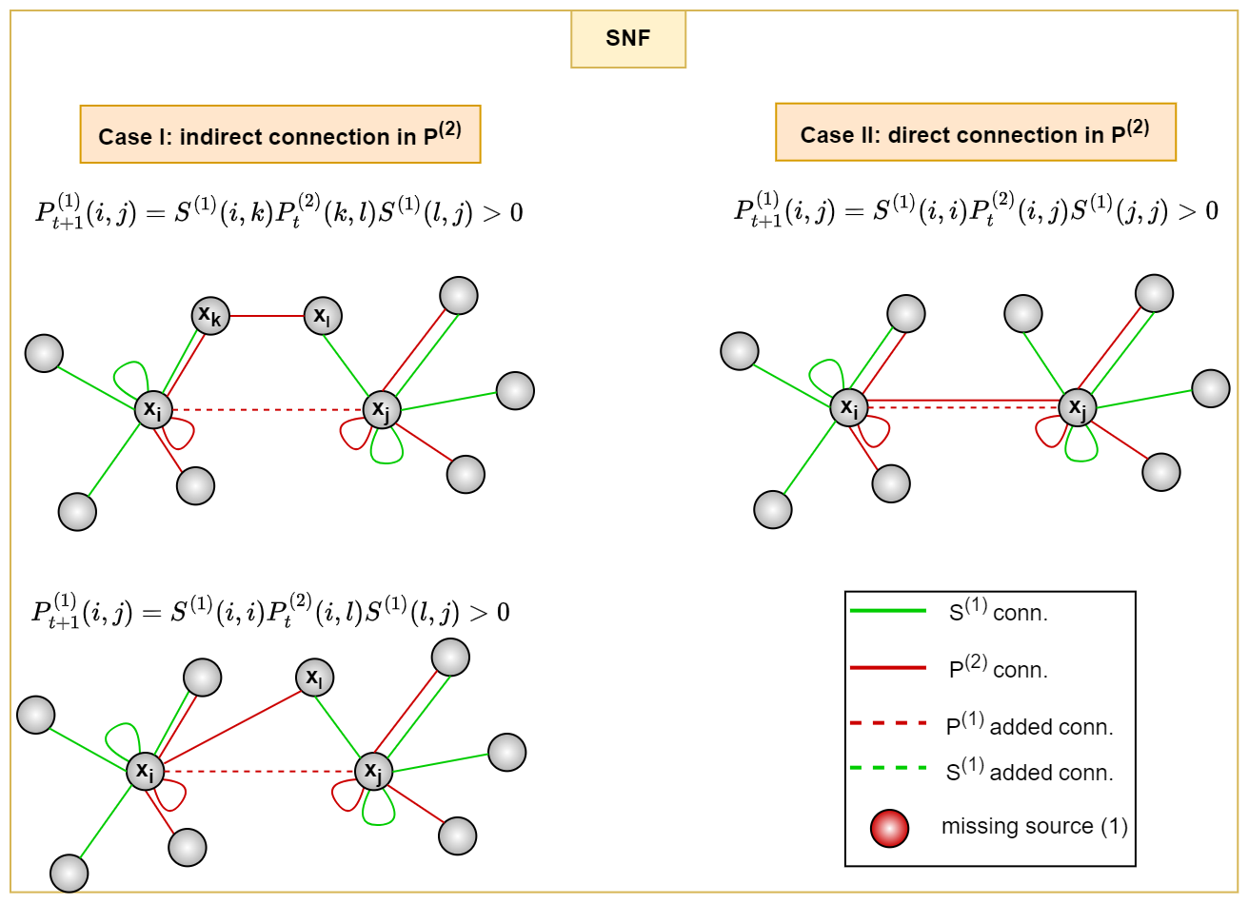
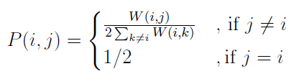
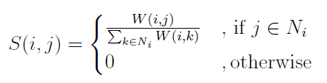

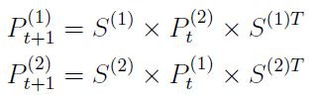

How SNF works
1) Omic-specific similarity matrix W is computed.
2) Computation of omic-specific global similarity matrix P:
3) Computation of the omic-specific local similarity matrix S, retaining only k-nearest neighbours:
where
4) Integration through an iterative parallel diffusion process and final average
(two views s={1,2}):
Image adapted from Gliozzo J, et al Bioinformatics, 2025
5) Spectral clustering for subgroup discovery.
2026 Cristian Iperi, Jessica Gliozzo — CC BY 4.0

Slide 18
NEighborhood based Multi-Omics clustering (NEMO) (Rappoport and Shamir, Bioinformatics, 2019)
NEMO is an unsupervised network-based integration approach
that fuses local sample-neighbourhood similarities across omic-specific
networks for subtype discovery.
Unsupervised subtype discovery
High-dimensional features into an integrated sample-sample network
Capture local/nonlinear relationships
Sample-sample network interpretation
Handles partial multi-omics datasets
Limited biomarker interpretation
Choice of hyperparameters
Assumes each pair of samples shares at least one measured omic
Poor scaling with number of samples
2026 Cristian Iperi, Jessica Gliozzo — CC BY 4.0

Slide 19
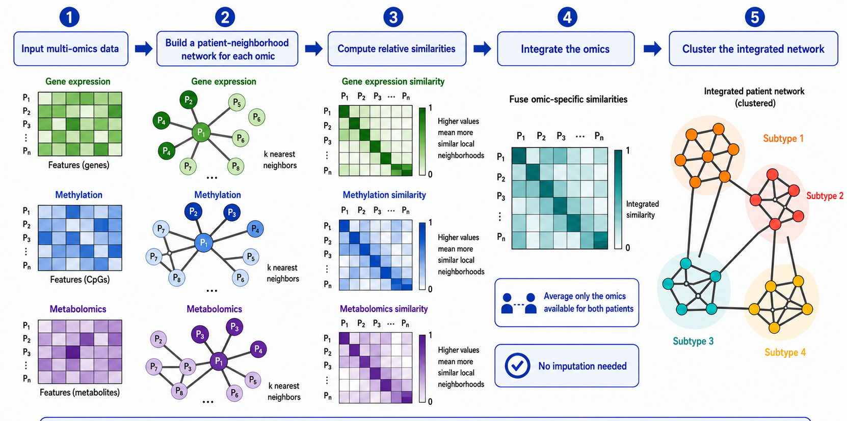
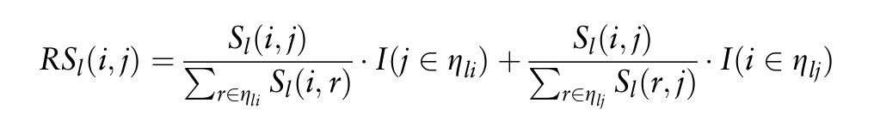
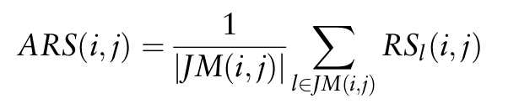
How NEMO works
Unlike SNF: no iterative network diffusion.
Handles missing omics
Each pair of samples must share ≥1 measured omic
1) Omic-specific similarity matrix using “scaled exponential Euclidean kernel” (same as SNF).
2) Define a relative similarity matrix for each
omic l:
Similarity is evaluated relative to the local
neighborhoods of both samples (i,j).
3) Integration by average considering omics types available for both samples JM(i,j):
4) Spectral clustering for subgroup discovery.
2026 Cristian Iperi, Jessica Gliozzo — CC BY 4.0

Slide 20
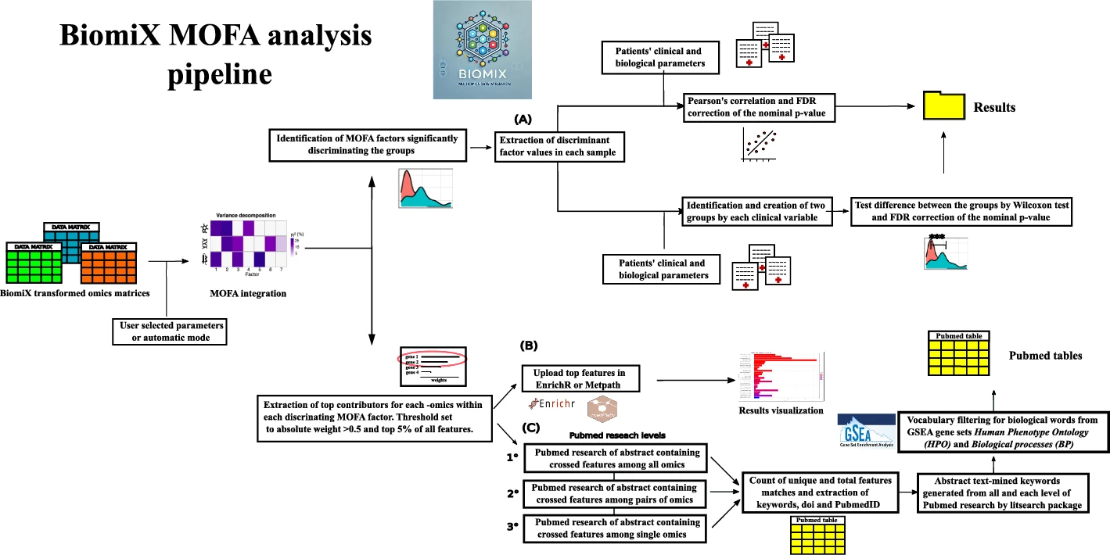
What’s new with BiomiX?
Automatic selection MOFA/ DIABLO factors
(stopping when new variance capture < 1%)
Selection of factors separating the two conditions (semi-supervised)
Automatic annotation of the latent factors
- Correlation by clinical data
- Pathway analysis
- Bibliographic research
Iperi et al BMC bioinformatics (2025)
2026 Cristian Iperi, Jessica Gliozzo — CC BY 4.0

Slide 21

MOFA tutorial
https://sagarsajeev.medium.com/business-logic-vulnerability-via-idor-6d510f1caea9
2026 Cristian Iperi, Jessica Gliozzo — CC BY 4.0

Slide 22
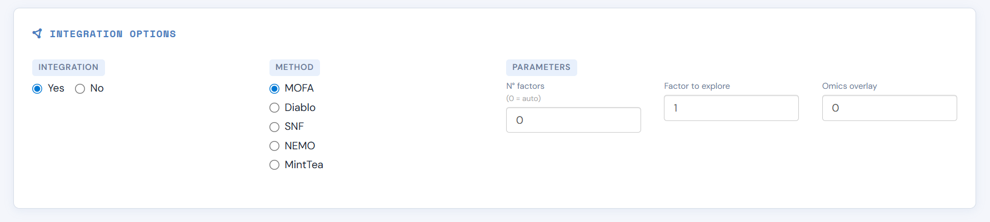
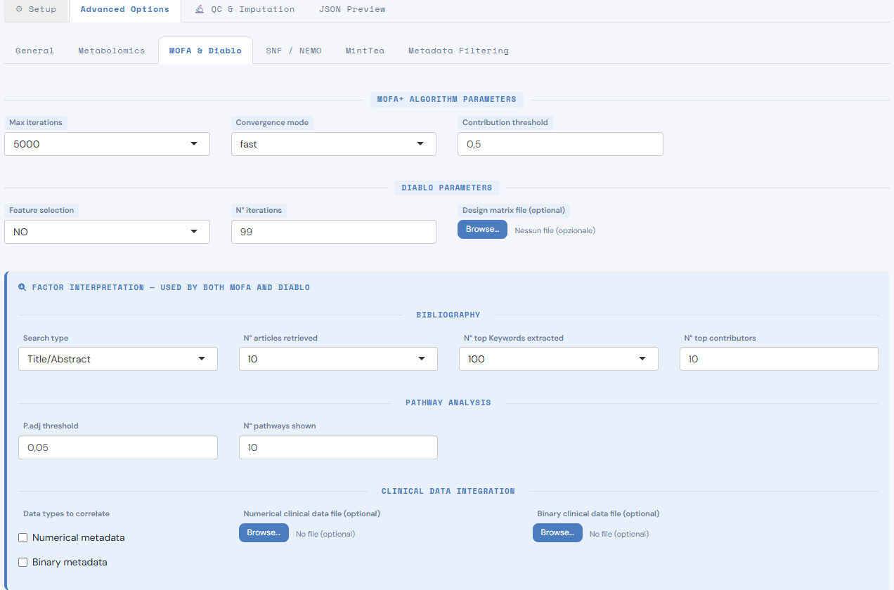
Main interface
Advance option MOFA
2026 Cristian Iperi, Jessica Gliozzo — CC BY 4.0
2026 Cristian Iperi, Jessica Gliozzo — CC BY 4.0

Slide 23
Number of factors to calculate. When 0 activates the automatic selection
Exclude samples with less than “” Omics shared
Converning speed, the slower the more accurate
All features contribution to a factor are ranked from 0 to 1. Score threshold to filter features for interpretation analysis
Advance option MOFA
2026 Cristian Iperi, Jessica Gliozzo — CC BY 4.0

Slide 24
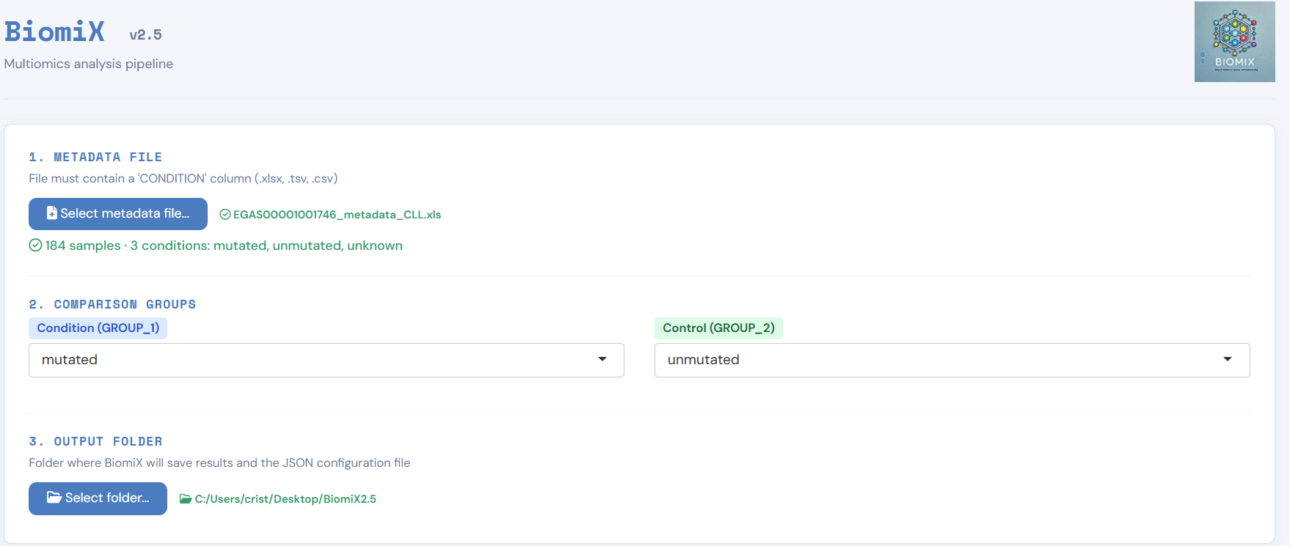
1) Load EGAS00001001746_metadata_CLL.xls from Metadata folder.
2) Set the mutated vs unmutated comparison
3) Output folder in BiomiX 3.0 folder
2026 Cristian Iperi, Jessica Gliozzo — CC BY 4.0

Slide 25
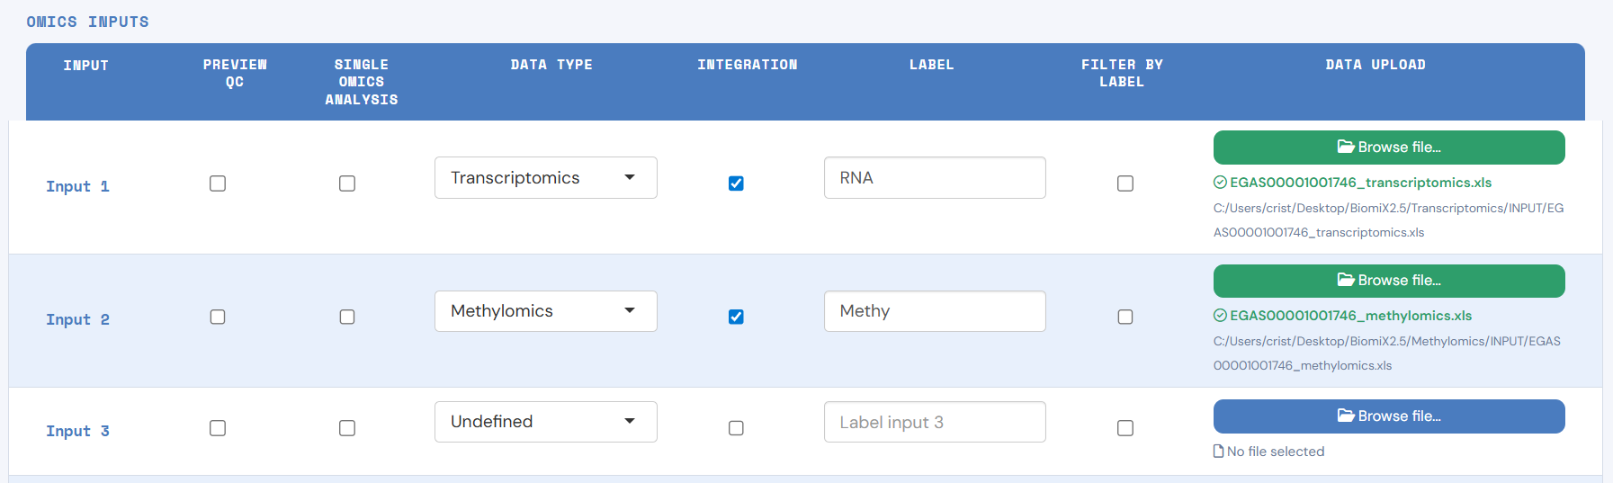
4) Load EGAS00001001746_transcriptomics.xls from Transcriptomics folder.
5) Load EGAS00001001746_methylomics.xls from Methylomics folder.
6) Click on integration to select the slot to integrate.
2026 Cristian Iperi, Jessica Gliozzo — CC BY 4.0

Slide 26
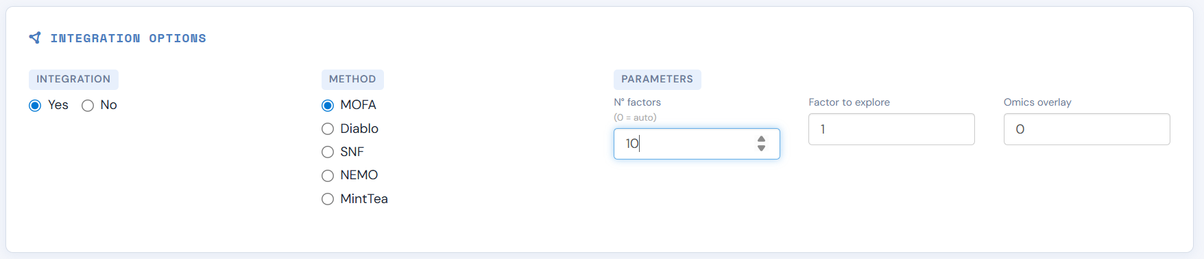
Select 10 factors
2026 Cristian Iperi, Jessica Gliozzo — CC BY 4.0
2026 Cristian Iperi, Jessica Gliozzo — CC BY 4.0

Slide 27
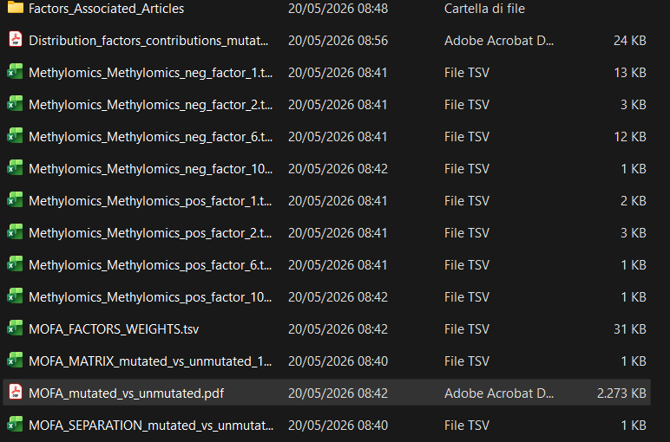
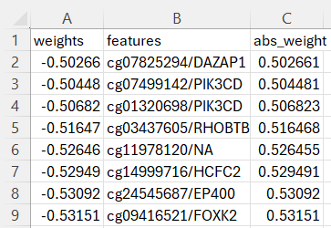
1) Open output folder: Integration\OUTPUT\MOFA_mutated_vs_unmutated_10_factors
Each omics has the positive and negative contributors for the “discriminating” factors
Example:
2026 Cristian Iperi, Jessica Gliozzo — CC BY 4.0

Slide 28
1) Open output folder: Integration\OUTPUT\MOFA_mutated_vs_unmutated_10_factors
Latent factor value (10 factors) per each sample. Dimensional reduction-like.
Variance explained by each factor within each omics
P.adjusted value of the “discriminantion” power of each factor among the two conditions
2026 Cristian Iperi, Jessica Gliozzo — CC BY 4.0

Slide 29
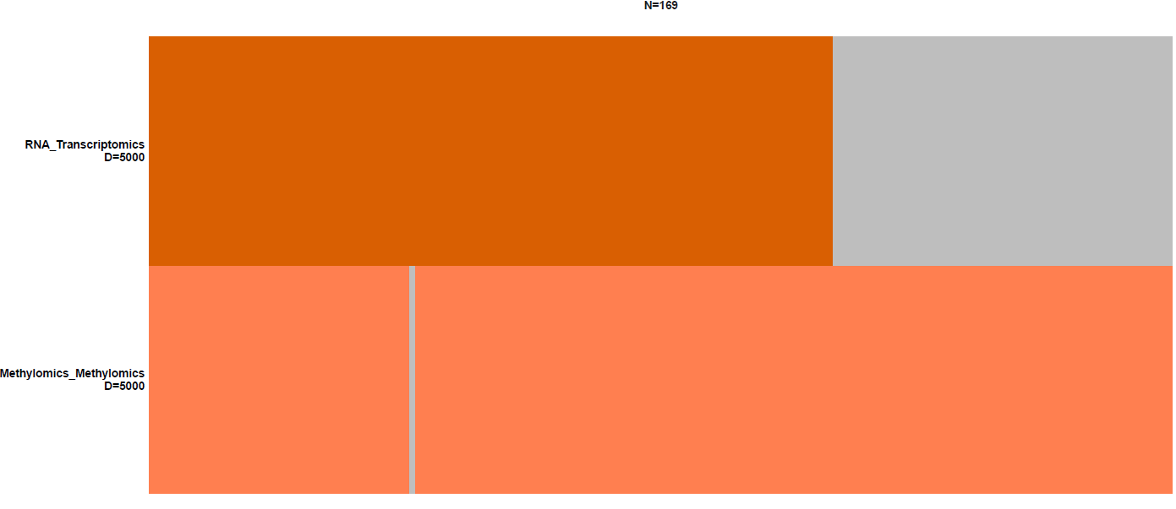
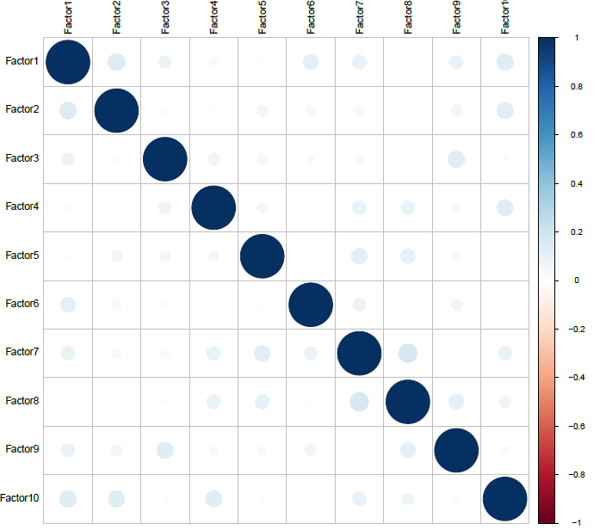
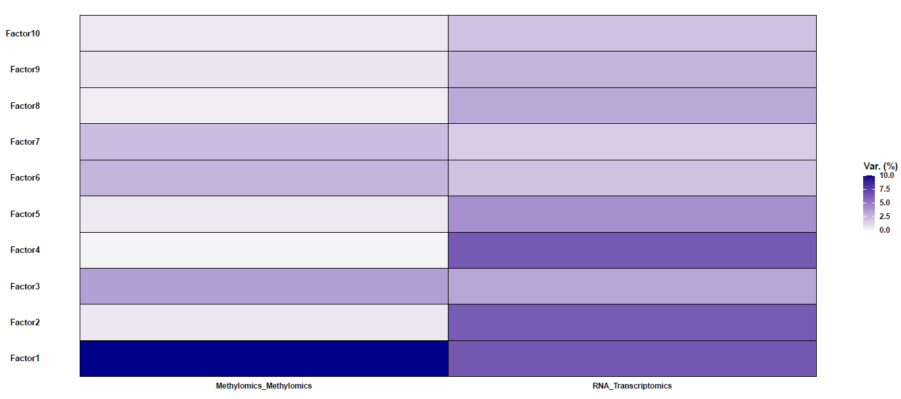
1) Open output folder: Integration\OUTPUT\MOFA_mutated_vs_unmutated_10_factors
Sample distribution per omics
Factor co-correlation test
Variance explained per omics and factor
Main pdf results including
2026 Cristian Iperi, Jessica Gliozzo — CC BY 4.0

Slide 30
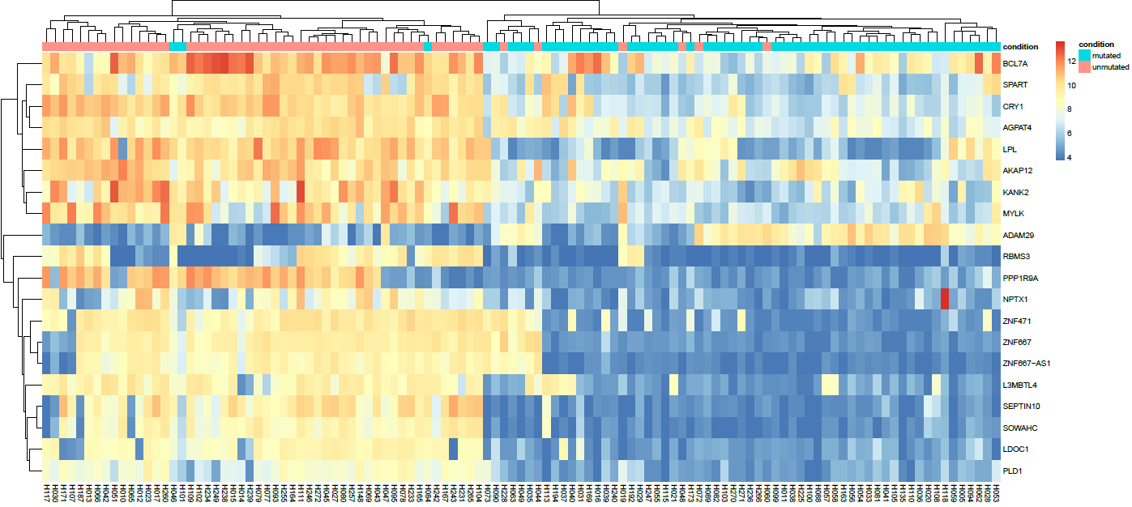
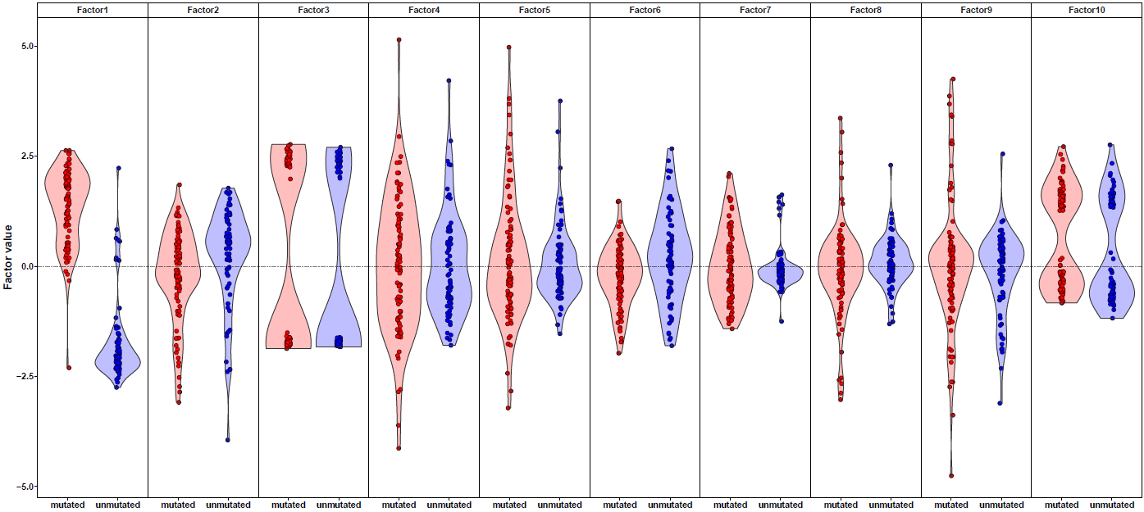
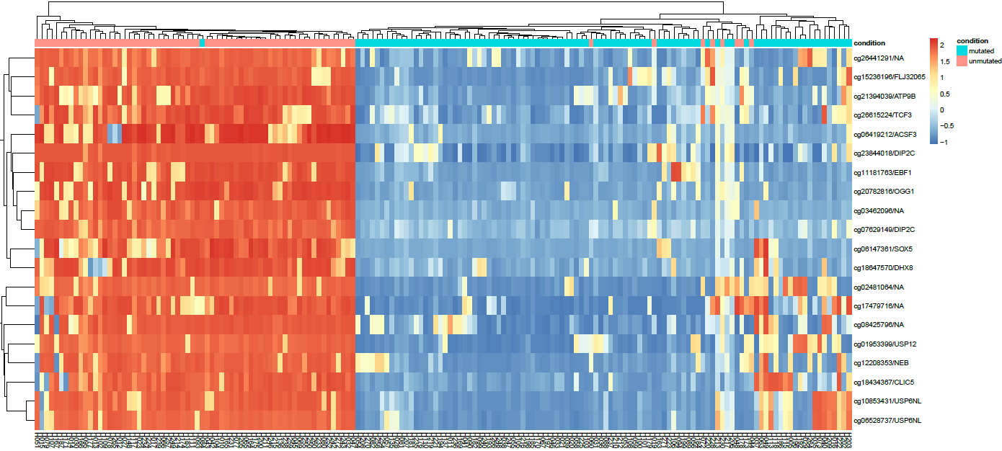
Violin plot factor separation per condition
Heatmap to features factor per omics
2026 Cristian Iperi, Jessica Gliozzo — CC BY 4.0

Slide 31
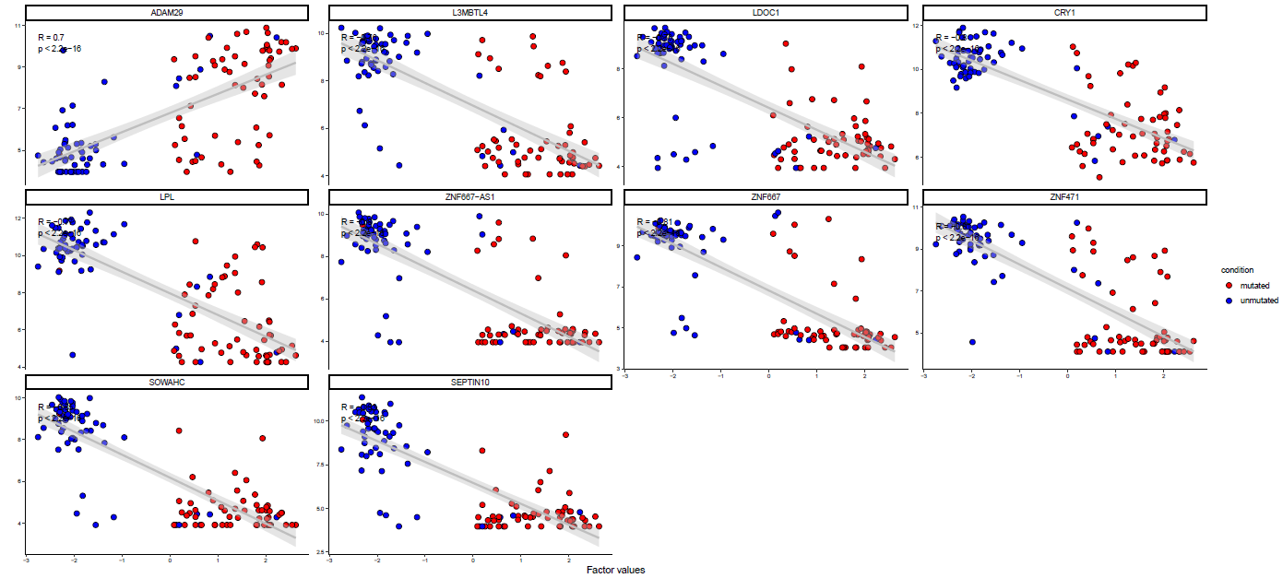
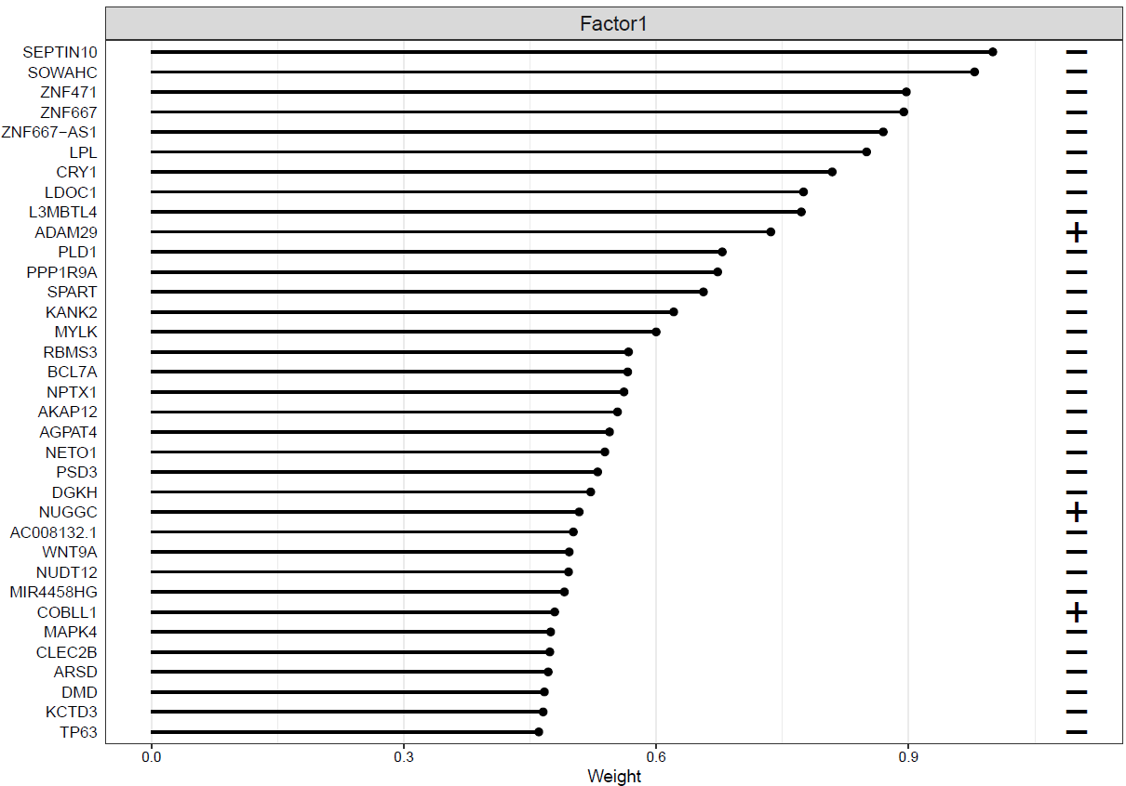
1) Open output folder: Integration\OUTPUT\MOFA_mutated_vs_unmutated_10_factors
Top contributor weights.
Top contributor discriminatory power per condition
2026 Cristian Iperi, Jessica Gliozzo — CC BY 4.0

Slide 32
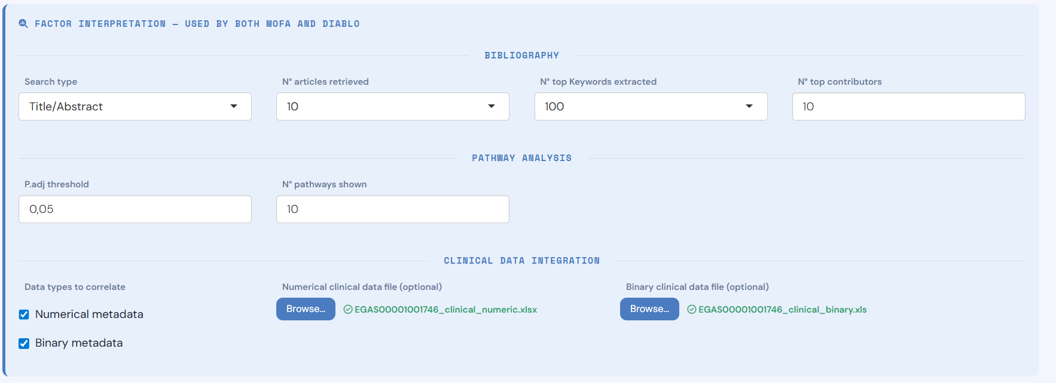
3 Level of interpretation
-Pubmed research
-Pathway analysis
-Clinical correlation
Nice, but what is behind factor 1?
2026 Cristian Iperi, Jessica Gliozzo — CC BY 4.0

Slide 33
3 Level of interpretation
-Pubmed research
-Pathway analysis
-Clinical correlation
Nice, but what is behind factor 1?
1) Re-run including Numeric and binary clinical data. These will be correlated and tested with the MOFA factors calculated.
Are they associated?
2026 Cristian Iperi, Jessica Gliozzo — CC BY 4.0

Slide 34
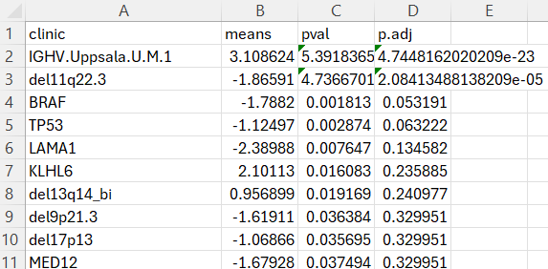
Open:BiomiX2.5\Clinical_data\OUTPUT\Clinical_mutated_vs_unmutated_10_factors
1) Conclusion:
Factor 1 is directly associated to the IGHV mutation measurement
2026 Cristian Iperi, Jessica Gliozzo — CC BY 4.0

Slide 35
DIABLO tutorial
https://sagarsajeev.medium.com/business-logic-vulnerability-via-idor-6d510f1caea9
2026 Cristian Iperi, Jessica Gliozzo — CC BY 4.0

Slide 36
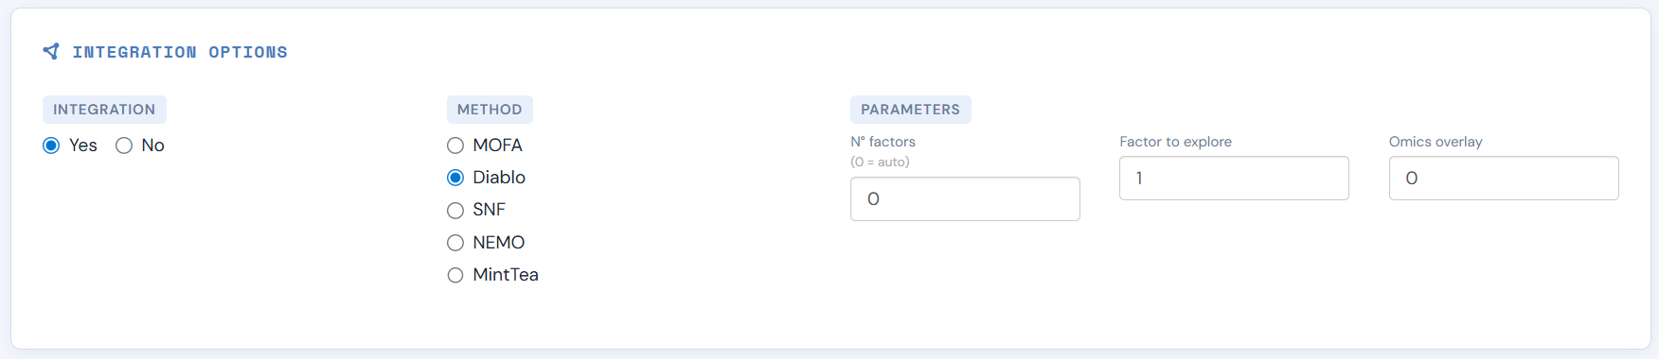
Number of factors to calculate. When 0 activates the automatic selection
Exclude samples with less than “” Omics shared
Main interface DIABLO
Advance option DIABLO
2026 Cristian Iperi, Jessica Gliozzo — CC BY 4.0

Slide 37
Don’t forget the Clinical data for the interpretation!
2026 Cristian Iperi, Jessica Gliozzo — CC BY 4.0

Slide 38
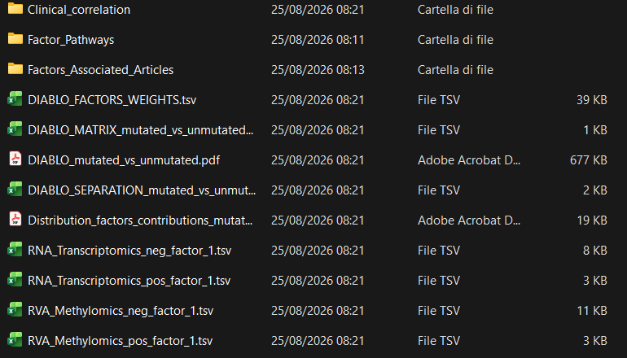
1) Open output folder: Integration\OUTPUT\DIABLO_mutated_vs_unmutated_10_factors
Example:
Each omics has the positive and negative contributors for the “discriminating” factors
2026 Cristian Iperi, Jessica Gliozzo — CC BY 4.0

Slide 39
1) Open output folder: Integration\OUTPUT\DIABLO_mutated_vs_unmutated_10_factors
Latent factor value (10 factors) per each sample. Dimensional reduction-like.
Variance explained by each factor within each omics
P.adjusted value of the “discriminantion” power of each factor among the two conditions
2026 Cristian Iperi, Jessica Gliozzo — CC BY 4.0

Slide 40
1) Open output folder: Integration\OUTPUT\DIABLO_mutated_vs_unmutated_10_factors
Main pdf results including
Sample distribution per omics
Factor co-correlation test
Variance explained per omics and factor
2026 Cristian Iperi, Jessica Gliozzo — CC BY 4.0

Slide 41
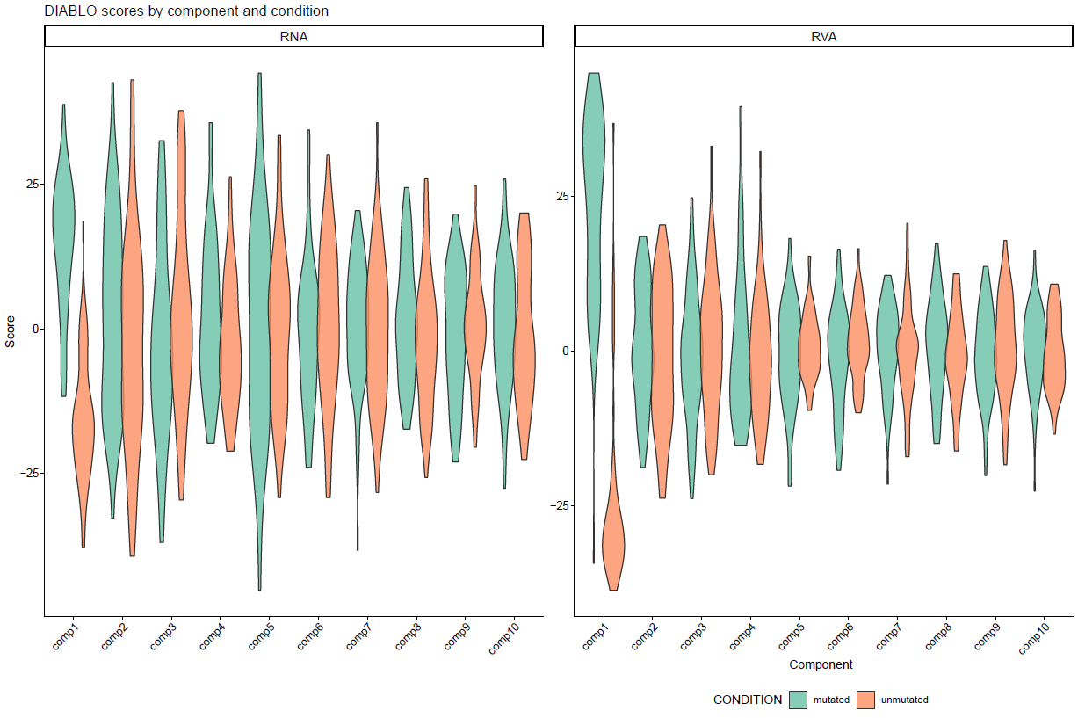
1) Factor 1 is discriminating patients by IGHV mutation measurement.
Which biological processes are behind it?
2026 Cristian Iperi, Jessica Gliozzo — CC BY 4.0

Slide 42
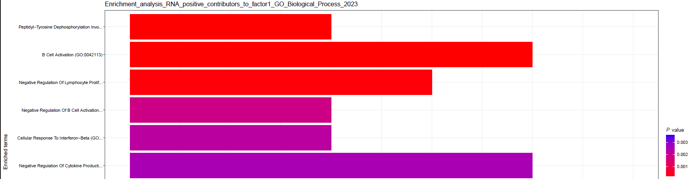
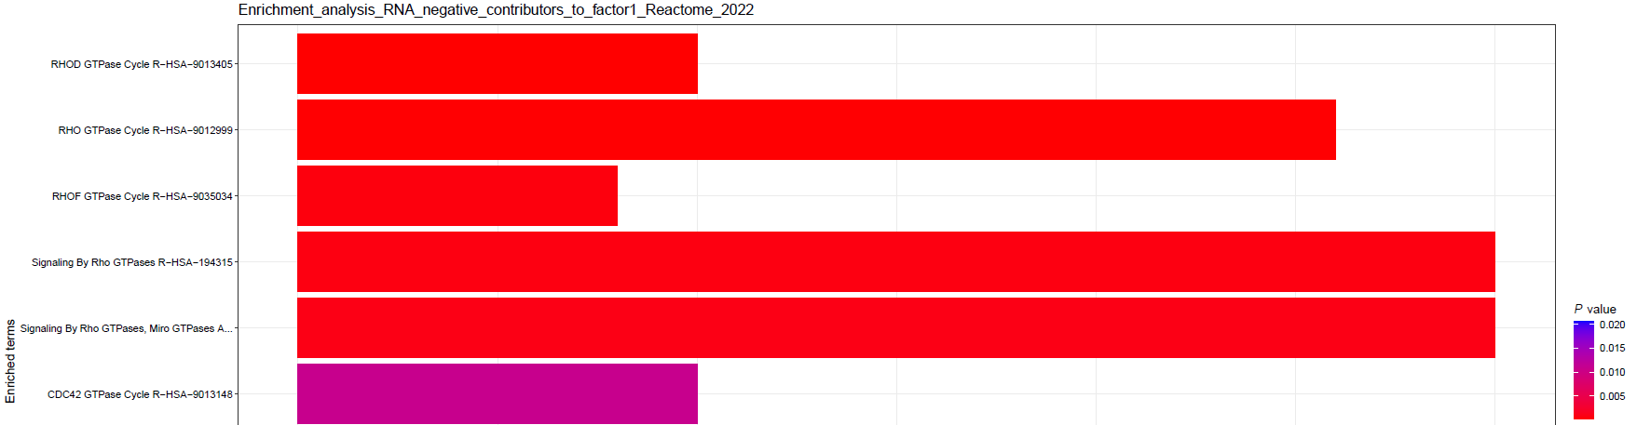
1) Open output folder: Integration\OUTPUT\DIABLO_mutated_vs_unmutated_10_factors\Factor_Pathways
1) Mutated patients are associated to higher values in factor 1 → Positive contributors
1) Unmutated patients are associated to Lower values in factor 1 → Negative contributors
2026 Cristian Iperi, Jessica Gliozzo — CC BY 4.0

Slide 43
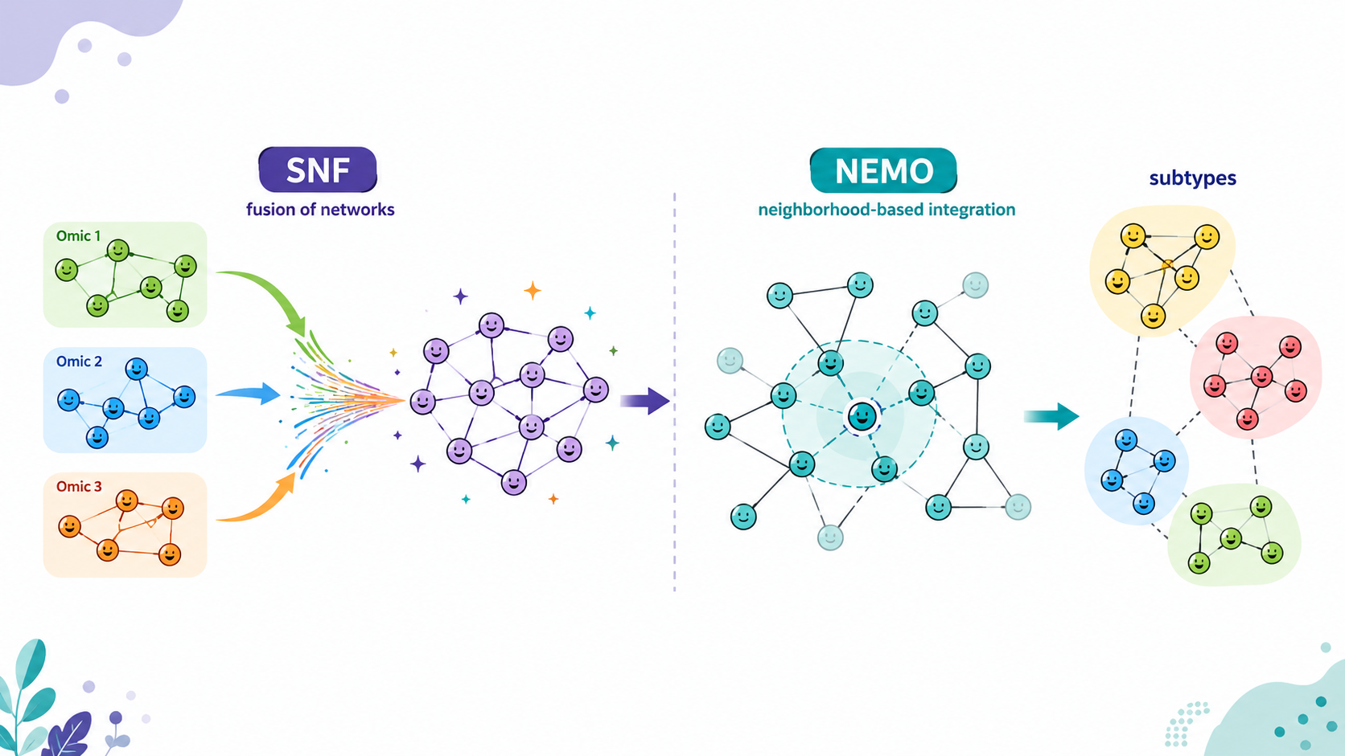
SNF & NEMO Tutorials
Network-based multi-omics approaches
2026 Cristian Iperi, Jessica Gliozzo — CC BY 4.0

Slide 44
DATASET
Tutorial will use the Chronic Lymphocytic Leukemia (CLL) cohort (ID EGAS00001001746):
EGAS00001001746_metadata_CLL.tsv:
metadata table having ID, DISEASE, AGE, GENDER, CONDITION, Treated, Alive
EGAS00001001746_methylomics.tsv:
methylomic CpG sites (Illumina 450K array) profiles of the top-5000 most variant sites
EGAS00001001746_transcriptomics_VST.tsv:
transcriptomic (RNA-seq) profiles of ≈ 54500 transcripts after VST (variance-stabilizing transformation)
CONDITION: IGHV-mutated (M-CLL) and IGHV-unmutated (U-CLL) chronic lymphocytic leukemia.
2026 Cristian Iperi, Jessica Gliozzo — CC BY 4.0

Slide 45
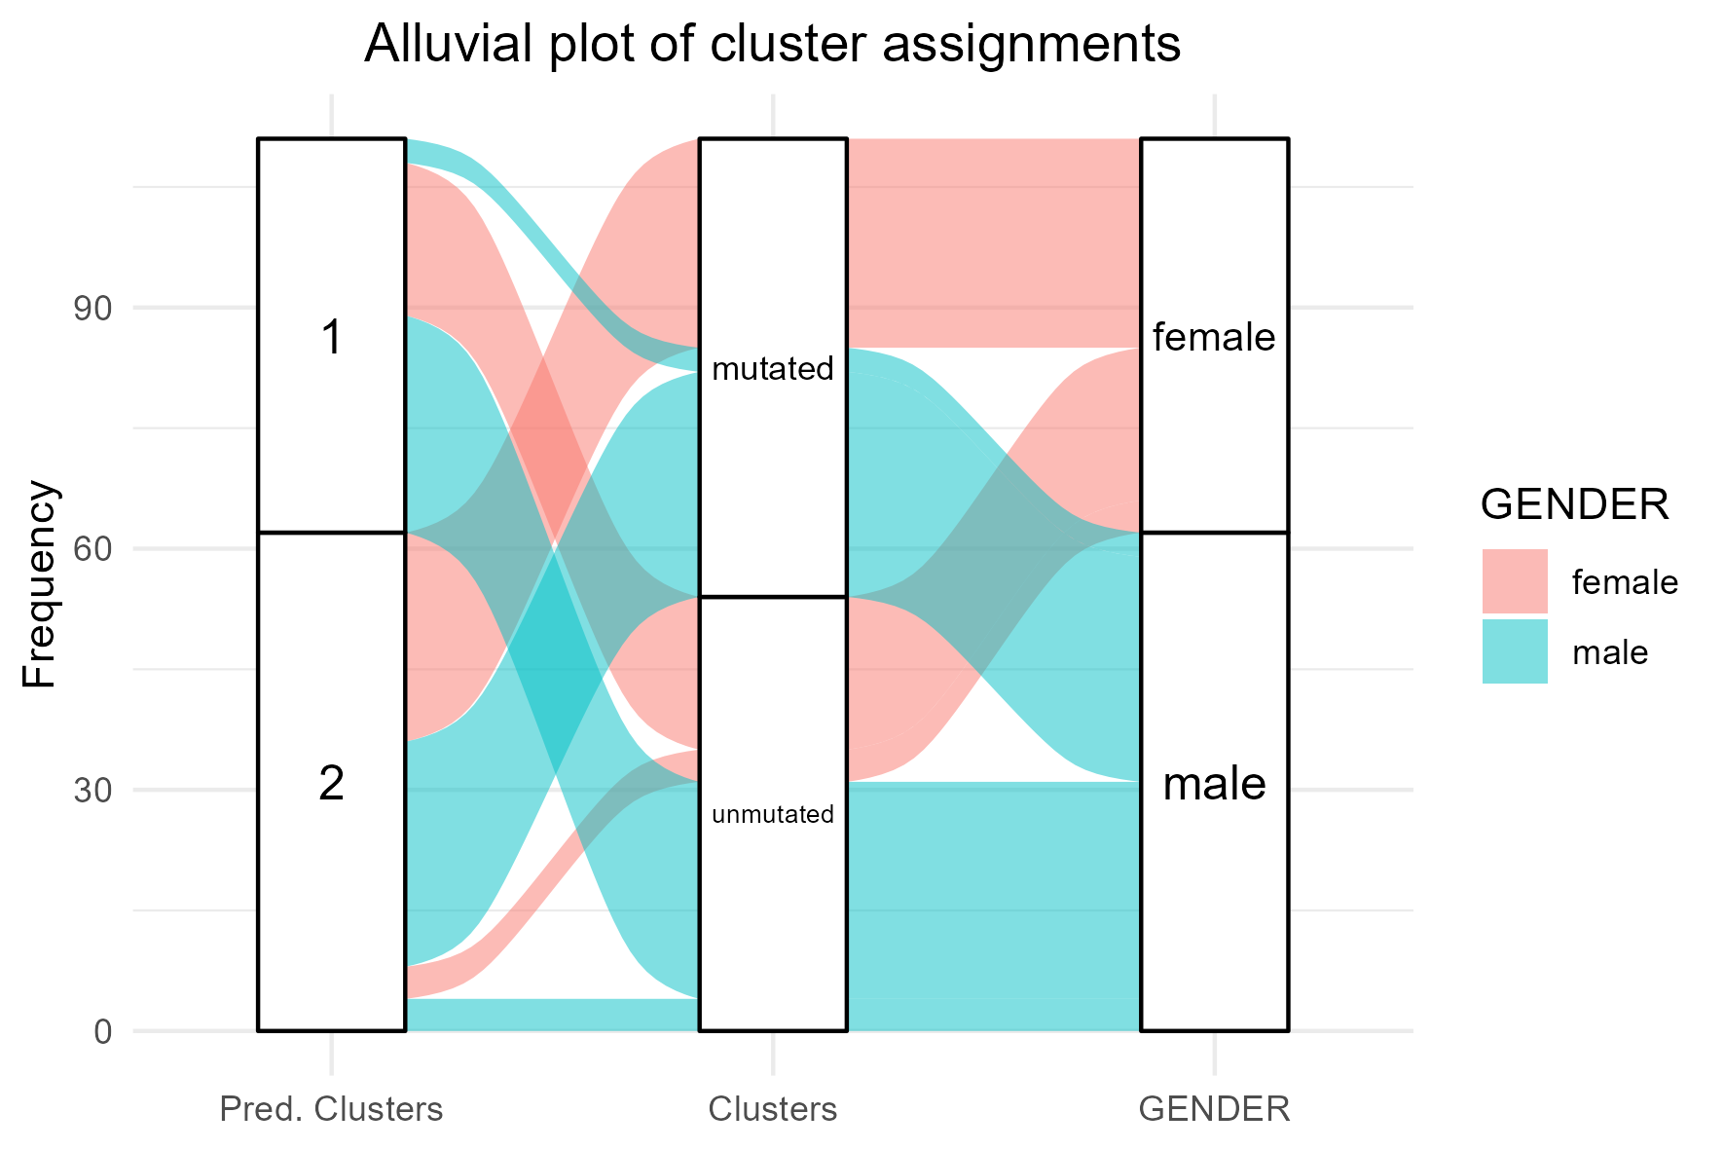
Number of clusters optimization SNF/NEMO
- Optimal number of clusters estimation: eigengap/modified eigegap method
- Internal clustering validation metrics (i.e. "Mean Silhouette Coefficient", "Dunn Index", "Entropy" and “Calinski and Harabasz Index”)
Implemented interpretation methods SNF/NEMO
- Similarities heatmap for single omics and integrated matrix
- Network (graph) for single omics and integrated network - External quality indices (i.e. ARI, AMI, NMI, NVI) if CONDITION (ground truth available)
- Post-hoc feature prioritization based on NMI
- Variables enrichment (chi-squared test for categorical, Kruskal-Wallis for continuous variables)
- Survival analysis (log-rank test and Kaplan-Meier plots)
- Alluvial plot comparing clustering, CONDITION (if any), variables of interest
2026 Cristian Iperi, Jessica Gliozzo — CC BY 4.0

Slide 46
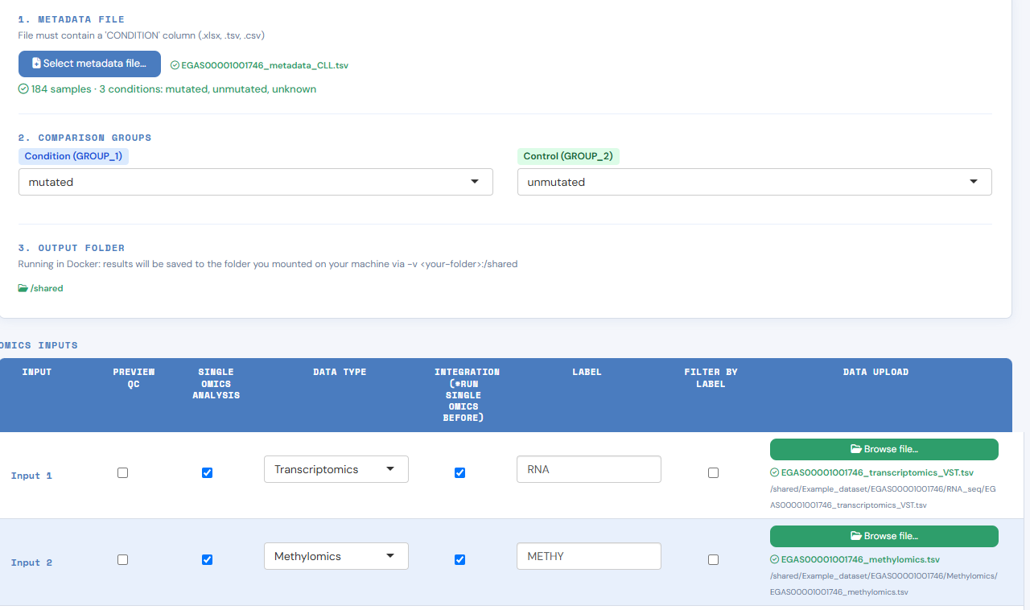
2026 Cristian Iperi, Jessica Gliozzo — CC BY 4.0

Slide 47
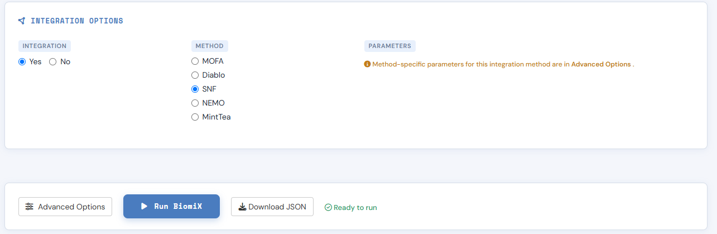
2026 Cristian Iperi, Jessica Gliozzo — CC BY 4.0

Slide 48
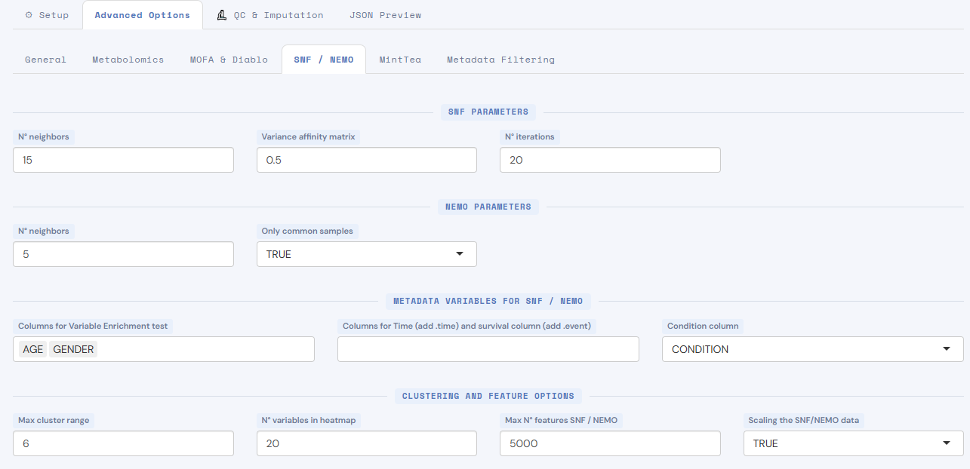
Advanced Options SNF
Model:
- Number of nearest neighbours
- Variance (controls decay of similarity with distance)
- Number of message-passing iterations
Interpretation:
- Column names for enrichment analysis - Column names for survival analysis - Condition column name (ground truth) Clustering and features:
- Number cluster 2:X to test
- Number of variables to show in the heatmap
- Number features selected by variance
- Scaling (z-score)
2026 Cristian Iperi, Jessica Gliozzo — CC BY 4.0

Slide 49

Let’s explore the results!
2026 Cristian Iperi, Jessica Gliozzo — CC BY 4.0

Slide 50
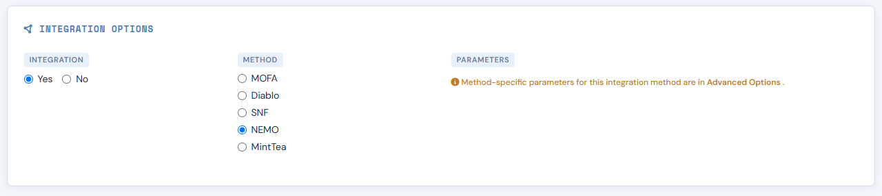
Switch in the main interface to NEMO in the “Integration Options”
(we can avoid single-omics analysis since already run for SNF)
2026 Cristian Iperi, Jessica Gliozzo — CC BY 4.0

Slide 51
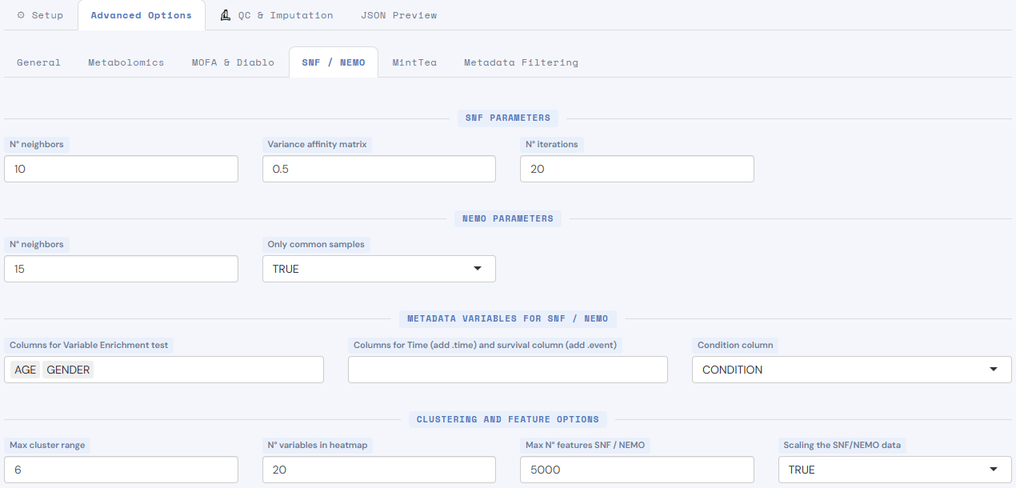
Advanced Options NEMO
Model:
- Number of nearest neighbours
- Consider only samples having all omics available
Interpretation:
- Column names for enrichment analysis - Column names for survival analysis - Condition column name (ground truth) Clustering and features:
- Number cluster 2:X to test
- Number of variables to show in the heatmap
- Number features selected by variance
- Scaling (z-score)
2026 Cristian Iperi, Jessica Gliozzo — CC BY 4.0

Slide 52
Let’s explore the results!
2026 Cristian Iperi, Jessica Gliozzo — CC BY 4.0

Slide 53
Issues & suggestions
BiomiX is an actively developed research project; if you encounter any problem or have suggestions, please open an issue on GitHub or contact the authors.
GitHub issues page link: https://github.com/BiomiX-consortium/BiomiX2.5/issues
Authors contacts:
Cristian Iperi for issues with single-omics pipelines, MOFA, DIABLO, others: cristian.iperi@uzh.ch
Jessica Gliozzo for issues with SNF and NEMO integration: jessica.gliozzo@istitutotumori.mi.it
Álvaro Fernández-Ochoa for issues with metabolomics pipeline: alvaroferochoa@ugr.es
This presentation is licensed under the Creative Commons Attribution 4.0 International License (CC BY 4.0), except where otherwise noted.
Third-party material remains subject to its original copyright or license.
2026 Cristian Iperi, Jessica Gliozzo — CC BY 4.0

