Slide 1
ASP.NET Core 3.0
QConSF 2019

Slide 2
What’s New in ASP.NET Core 3.0

Slide 3


Totally Modular
Faster Development Cycle
Seamless transition from on-premises to cloud
Choose your Editors
and Tools
Open Source with Contributions
OSS
Cross-Platform
Fast

Slide 4
Blazor
Create rich interactive UIs using C# instead of JavaScript.
Share server-side and client-side app logic written in .NET.
Render the UI as HTML and CSS for wide browser support, including mobile browsers.

Slide 5
Blazor
Scenarios:
Reusable UI components (Razor components)
Client-side routing
Component layouts
Support for dependency injection
Forms and validation
Build component libraries with Razor class libraries
JavaScript interop

Slide 6
gRPC
Is a popular, high-performance RPC (remote procedure call) framework.
Offers an opinionated contract-first approach to API development.
Uses modern technologies such as:
HTTP/2 for transport.
Protocol Buffers as the interface description language.
Binary serialization format.
Provides features such as:
Authentication
Bidirectional streaming and flow control.
Cancellation and timeouts.

Slide 7
SignalR

Slide 8
JSON Serialization
Reads and writes JSON asynchronously.
Is optimized for UTF-8 text.
Typically higher performance than Newtonsoft.Json.

Slide 9
New Razor Directives
The following list contains new Razor directives:
@attribute – The @attribute directive applies the given attribute to the class of the generated page or view. For example, @attribute [Authorize].
@implements – The @implements directive implements an interface for the generated class. For example, @implements IDisposable.

Slide 10
HTTP/2
HTTP/2 is enabled by default in Kestrel for HTTPS endpoints.
HTTP/2 support for IIS or HTTP.sys is enabled when supported by the operating system.

Slide 11
EventCounters
requests-per-second
total-requests
current-requests
failed-requests
We can report on the following:
requests-per-second
total-requests
current-requests
failed-requests

Slide 12
Health Checks
Health checks are exposed by an app as HTTP endpoints. Health check endpoints can be configured for a variety of real-time monitoring scenarios:
Health probes can be used by container orchestrators and load balancers to check an app's status.
Use of memory, disk, and other physical server resources can be monitored for healthy status.
Health checks can test an app's dependencies, such as databases and external service endpoints, to confirm availability and normal functioning.
Notes:
For example, a container orchestrator may respond to a failing health check by halting a rolling deployment or restarting a container. A load balancer might react to an unhealthy app by routing traffic away from the failing instance to a healthy instance.

Slide 13
Health Checks
app.UseEndpoints(endpoints =>
{
endpoints.MapHealthChecks("/health");
});

Slide 14
Pipes on HttpContext
It's now possible to read the request body and write the response body using the System.IO.Pipelines API.
The HttpRequest.BodyReader property provides a PipeReader that can be used to read the request body.
The HttpResponse.BodyWriter property provides a PipeWriter that can be used to write the response body.
HttpRequest.BodyReader is an analogue of the HttpRequest.Body stream.
HttpResponse.BodyWriter is an analogue of the HttpResponse.Body stream.

Slide 15
Performance Improvements
Reduction in memory usage when using the built-in dependency injection container for scoped services.
Reduction in allocations across the framework, including middleware scenarios and routing.
Reduction in memory usage for WebSocket connections.
Memory reduction and throughput improvements for HTTPS connections.
New optimized and fully asynchronous JSON serializer.
Reduction in memory usage and throughput improvements in form parsing.

Slide 16
Middleware

Slide 17
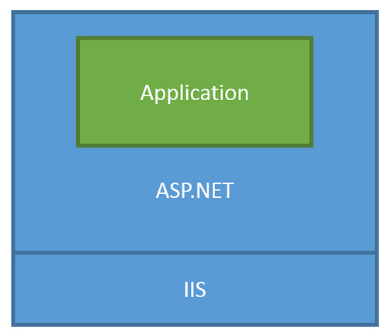
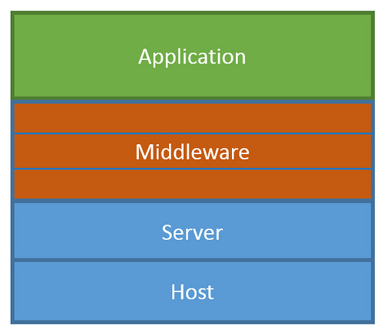
ASP.NET Core Middleware
Traditional ASP.NET Application Model
ASP.NET Core Middleware

Slide 18
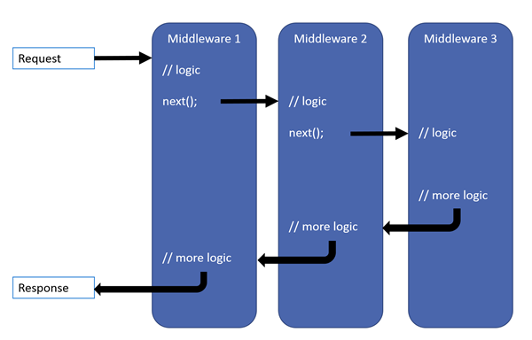
Middleware

Slide 19

Middleware

Slide 20
Routing

Slide 21
Types of Routing
The Link Generator can link to MVC/Razor Pages actions and pages via the following extension methods:
GetPathByAction
GetUriByAction
GetPathByPage
GetUriByPage

Slide 22
Routing to Actions
app.UseMvc(routes =>
{
routes.MapRoute("default",
"{controller=Home}/{action=Index}/{id?}");
});
var link = Url.Action("ReadPost", "blog", new { id = 17, });

Slide 23
Routing to Pages
@page
@model RazorPages.Pages.Albums.IndexModel
<a asp-page="./Albums/Index">Albums</a>

Slide 24
Routing

Slide 25
Razor Pages

Slide 26
Scaffolding
Scaffold-DbContext
'Server=.;Database=Chinook;Trusted_Connection=True;Application Name=Chinook;’
Microsoft.EntityFrameworkCore.SqlServer
-OutputDir Models

Slide 27
Razor Pages

Slide 28
Single Page Apps

Slide 29
Install Webpack
npm install -g webpack
Single Page Apps

Slide 30
Single Page Apps

Slide 31
Additional Information
Documentation
https://docs.microsoft.com/en-us/aspnet
What’s New in ASP.NET Core 3.0
https://docs.microsoft.com/en-us/aspnet/core/release-notes/aspnetcore-3.0
Source on GitHub
https://github.com/aspnet/AspNetCore

