Slide 1
Blazor
QConSF 2019

Slide 2
Agenda
What is Blazor?
How Blazor Works
WebAssembly Crash Course
Why?
Features
Roadmap
FAQ
Code Examples
Questions

Slide 3
What is Blazor?
A .NET web framework that runs in the browser
Use C#/Razor to author
Runs on a .NET runtime implemented in WebAssembly
Browser + Razor = Blazor

Slide 4
How Blazor Works
C# and Razor code files are compiled into .NET assemblies
Assemblies and .NET runtime are downloaded on the browser
Blazor uses JavaScript to bootstrap the .NET runtime (Mono) loading the required assembly references
Blazor allows DOM manipulation/browser API calls from the .NET runtime via JavaScript interoperability

Slide 5
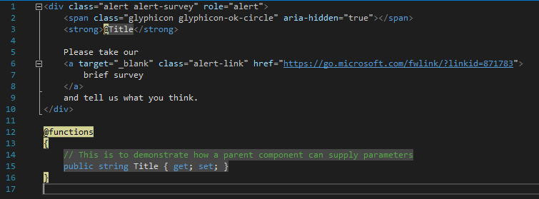
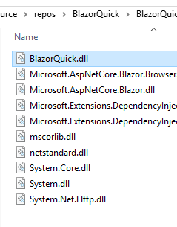
How Blazor Works
C# and Razor code files are compiled into .NET assemblies

Slide 6
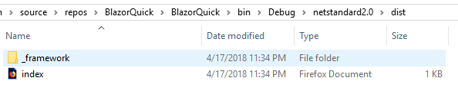
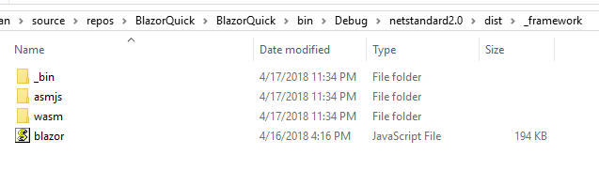
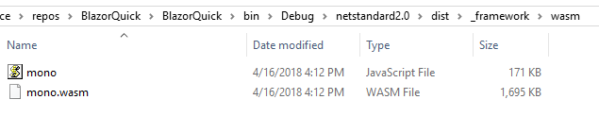
How Blazor Works
Assemblies and .NET runtime are downloaded on the browser

Slide 7
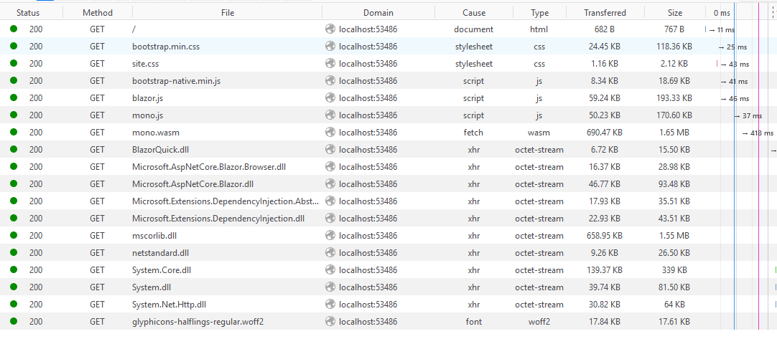
How Blazor Works
Blazor uses JavaScript to bootstrap the .NET runtime loading the required assembly references

Slide 8
How Blazor Works
Blazor allows DOM manipulation/browser API calls from the .NET runtime via JavaScript interoperability
C#
Render Dropdown
Blazor JavaScript
Change DOM
DOM
C#
Event Trigger
Process Event
Blazor JavaScript
Change DOM
DOM
UI Differences

Slide 9
What is WebAssembly?
WebAssembly (wasm) is a binary instruction format for a stack-based virtual machine
New type of code that can be run in a browser
Developed out of performance problems from JavaScript

Slide 10
What is WebAssembly?
WebAssembly Goals:
Fast, efficient, and portable
Wasm code can be executed at near-native speed in the browser
Readable and debuggable
Wasm code is a low-level assembly language but is in a human-readable text format
Secure
Designed to run in a safe, sandboxed execution environment like JavaScript in the browser

Slide 11
What is WebAssembly?
The web platform consists of two parts:
A virtual machine to run code
Set of APIs to control the browser
Traditionally, the browser’s VM has only been able to load JavaScript
WebAssembly adds an additional VM to run a compact binary format

Slide 12
What is WebAssembly?
WebAssembly is not meant to replace JavaScript
Intended to be a compilation target of source languages
WebAssembly can’t directly access the DOM
C/C++/C# source code
wasm module
HTML
Wasm compiler
JavaScript “glue” code

Slide 13
Why?
Full Stack development using C# and .NET
.NET advantages:
High Performance
Scalability
Maintainability
Cross Platform
Visual Studio

Slide 14
Features
Component model for building composable UI
Routing
Layouts
Forms and validation
Dependency injection
JavaScript interop
Live reloading in the browser during development
Server-side rendering

Slide 15
Features
Full .NET debugging both in browsers and in the IDE
Rich IntelliSense and tooling
Ability to run on older (non-WebAssembly) browsers via asm.js
Publishing and app size trimming

Slide 16
FAQ
Does Blazor compile my entire .NET assembly into WebAssembly?
No.
Only .NET runtime is compiled into WebAssembly.
Could be support for full static ahead-of-time compilation into WebAssembly in the future.

Slide 17
FAQ
Won’t the app size huge for the .NET runtime?
Not really.
Runs on full Mono Desktop profile right now.
Plans to reduce size by using custom profile.

Slide 18
FAQ
Can I use Blazor without .NET backend?
Yup.
Can be deployed as set of static files.

Slide 19
Components
Fundamental building block of web apps
Components are self-contained UI
Includes HTML and logic to inject data or respond to events
They can be nested, reused, and shared between projects
Written using C#/Razor and HTML

Slide 20
Layouts
Layouts are really just components
Defined in a Razor template
Inherits from LayoutComponentBase
Adds a Body property that contains the content to be rendered
Allows for nested layouts

Slide 21
Routes
Handles internal routing of pages
Router is configured in App.razor
Uses the @Page directive defined in the Pages
Can have multiple routes
Can contain parameters

Slide 22
Data Binding
Supports one-way and two-way data binding
Binding using the bind= attribute
Support for binding data types:
Int
String
DateTime
Enums
Bool
If you need another type, you must provide a getter/setter.

Slide 23
JavaScript Interop
Supports calling JavaScript from inside Blazor
Blazor uses registered functions
Supports calling C# from JavaScript

Slide 24
Additional Information
Blazor GitHub
https://github.com/aspnet/Blazor/
Blazor.net
https://dotnet.microsoft.com/apps/aspnet/web-apps/blazor
Steve Sanderson’s Intro to Blazor
https://blog.stevensanderson.com/2018/02/06/blazor-intro/
Steve Sanderson’s Demo Video
https://www.youtube.com/watch?v=uW-Kk7Qpv5U
Blazor Pizza App
https://github.com/dotnet-presentations/blazor-workshop

