Slide 1

Azure Media Services
Abhimanyu Kumar Vatsa
Microsoft MVP (4 Times), Author, Speaker, Blogger
Blogs at: http://www.itorian.com

Slide 2

Agenda
Introduction to Azure Media Services
Azure Media Service workflow
Packaging - traditional vs dynamic
Development options
Building console client
Building MVC client
Q&A

Slide 3
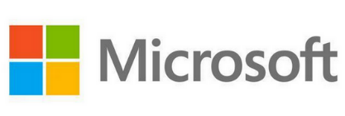
Azure Media Services (AMS)
Content uploading, encoding, encryption and streaming services by

Slide 4

Who can use?
Maybe you have a bunch of training videos you want to share with your global audience.

Slide 5

Who can use?
Or maybe you are hosting the Olympic Games and need to live stream to hundreds of millions of consumer.

Slide 6

Who can use?
Or maybe you’re a TV network, a radio station, ad agency and you want to stop worrying about infrastructure and embrace cloud scale.

Slide 7
Advantages of AMS?
An extensible cloud-based platform to build scalable media management and delivery applications
Securely upload, store, encode and package video or audio content
Delivers media on-demand and live streaming
Delivery to various clients for example, TV, PC, and mobile devices
Automatic adaptive video playback
Highly scalable using reserve streaming and encoding units
Encrypted video content delivery using AES or DRM (PlayReady) technologies
and much more..

Slide 8
How different it is from others?
Features | Azure Media Services | YouTube | Vimeo
REST API | Yes | Yes | Yes
Native SDK | Yes | Not Applicable/No | Not Applicable/No
Dynamic Packaging | Yes | Yes | Yes
Scaling Streaming and Encoding | Yes | Not Applicable/No | Not Applicable/No
Live Encoding and Streaming | Yes | Hangout | No
Content Protection | Yes | No | No
Content Delivery UI | No/we build it | Yes | Yes
Indexing | Yes | Subtitles as alt | No
Note: We should not compare AMS with YouTube or Vimeo because somehow both solves different purpose. This table is only meant to provide knowledge on what AMS can do today.

Slide 9
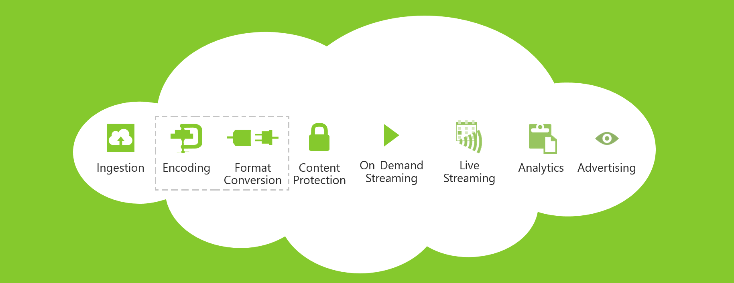
AMS Overview
compress video into different format
something like expression encoder
secure content delivery with AES or DRM (PlayReady)
stream live video data through camera
upload content into the cloud
stream video when needed using locators

Slide 10
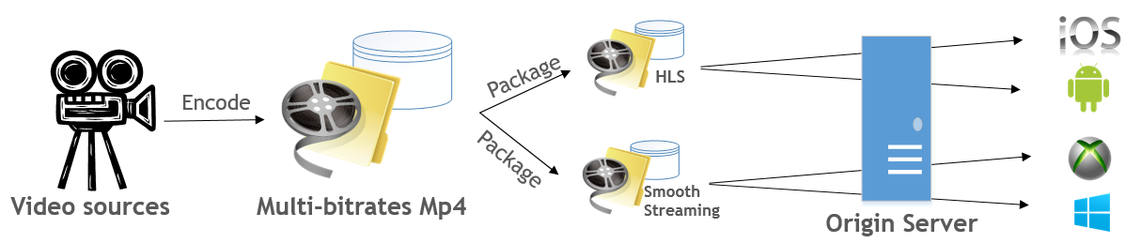
Packaging - Traditional vs Dynamic
Traditional Packaging
Dynamic Packaging

Slide 11

AMS Development Options
Azure Portal - demo today
SDK (Java & .NET) - .NET demo today in console and MVC client
REST API

Slide 12
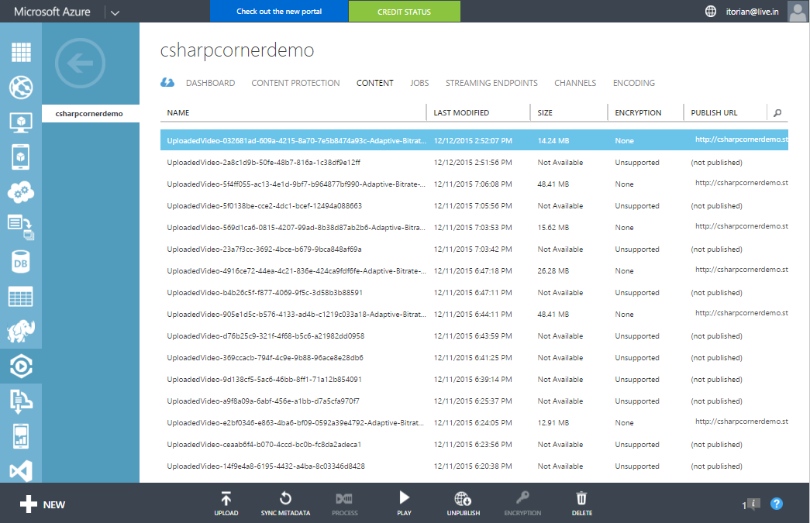
Demo – Azure Portal
Upload video file
Encode video asset i.e. create encoding job
Play using azure media player

Slide 13
Media Service Asset Storage
Media Services uses the concept of Assets to manage your media content. The media files for an Asset are stored in your storage account but entity metadata for the Asset is stored by Media Services in its internal repository.
When you create a Media Services account, you are also asked to create or select an existing Storage account.
Media Services
Storage Account
Asset
reference some
Media File
.
reference some
.
.
reference some
.
.
reference some
.

Slide 14
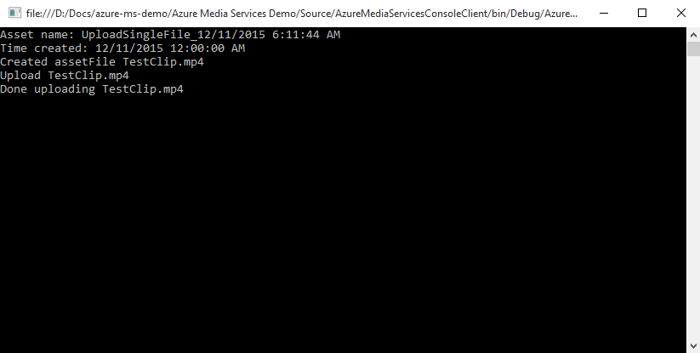
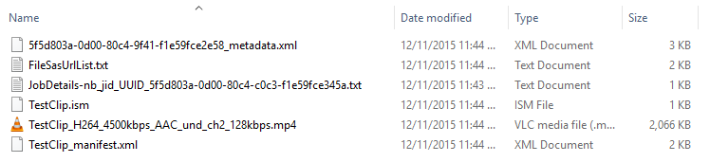
Demo – Console client using .NET SDK

Slide 15
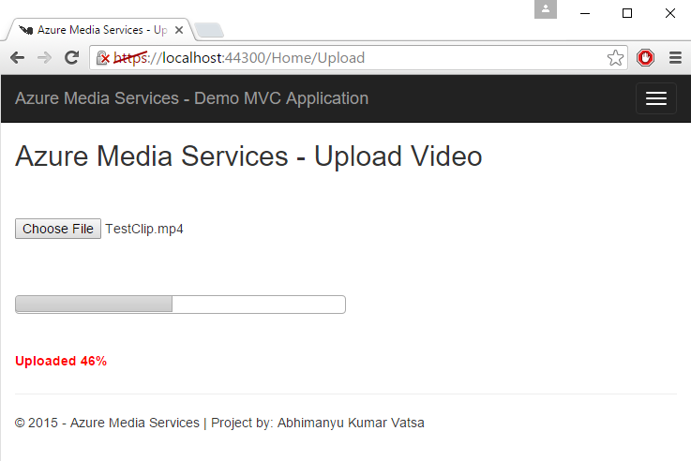
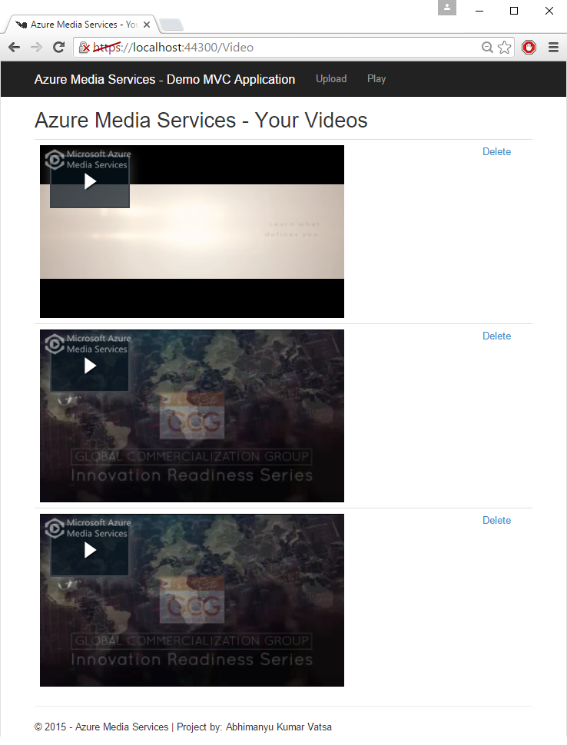
Demo – MVC App Client using .NET SDK

Slide 16
Q & A

Slide 17
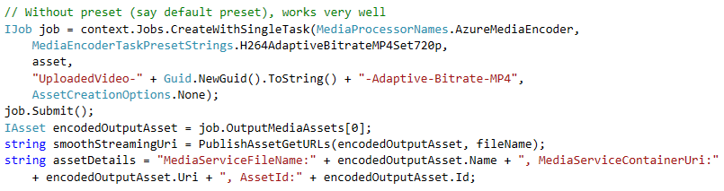
Update – Default Encoding Preset

Slide 18
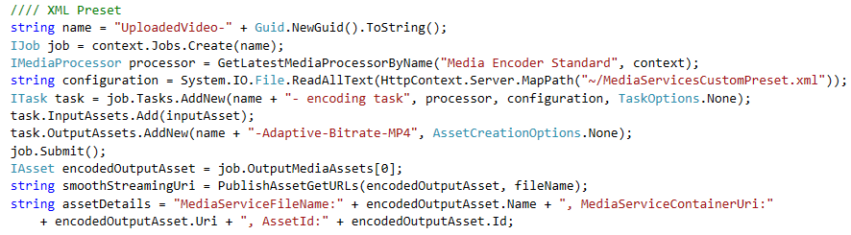
Update – Custom Encoding Preset

