Slide 1
Entity Framework Core

Slide 2
Naming history
Entity Framework Everywhere
Entity Framework 7 (EF7)
Entity Framework Core (EF Core) 1.0

Slide 3
Agenda
Introducing EF Core
EF Core and EF6.x
Demos
Next steps

Slide 4
Introducing EF Core

Slide 5
Entity Framework project status
Entity Framework 6.2
Runtime on NuGet
Tooling on Microsoft Download Center
Latest version included in Visual Studio
Entity Framework Core 1.0
Entity Framework 6.x
Entity Framework 5
New runtime components on NuGet
Core runtime components in .NET
Tooling in Visual Studio
Entity Framework 4.x
Entity Framework 4
Runtime in .NET Framework
Tooling in Visual Studio
Entity Framework 3.5 SP1

Slide 6
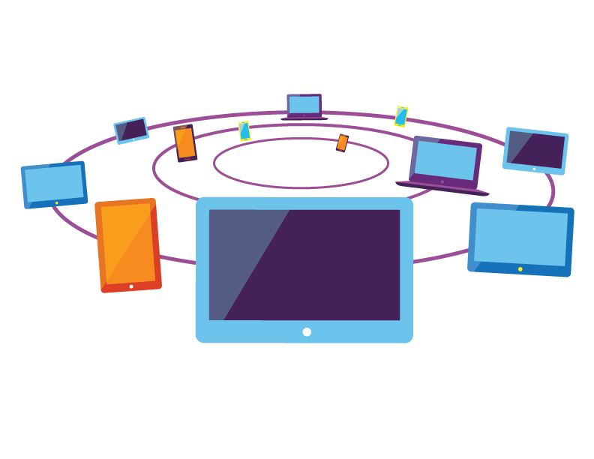
New platforms

Slide 7
New platforms
.NET FRAMEWORK
.NET CORE
XAMARIN
APP
MODELS
WPF
Windows Forms
UWP
iOS
Android
ASP.NET
ASP.NET Core
OS X
*
BASE
LIBRARIES
Base Class Library
Core Library
Mono Class Library
COMMON INFRASTRUCTURE
Compilers
Languages
Runtime components
EF6.x
EF Core
Notes:
Notes: Even if we are reusing a lot across components (especially with the open sourcing last year), the reality is that each platform has its own implementation of the base libraries.
Note: .NET Framework BCL and Mono BCL are the same APIs, different implementation. .NET Core “Core Library” is a similar set of APIs, but different.

Slide 8
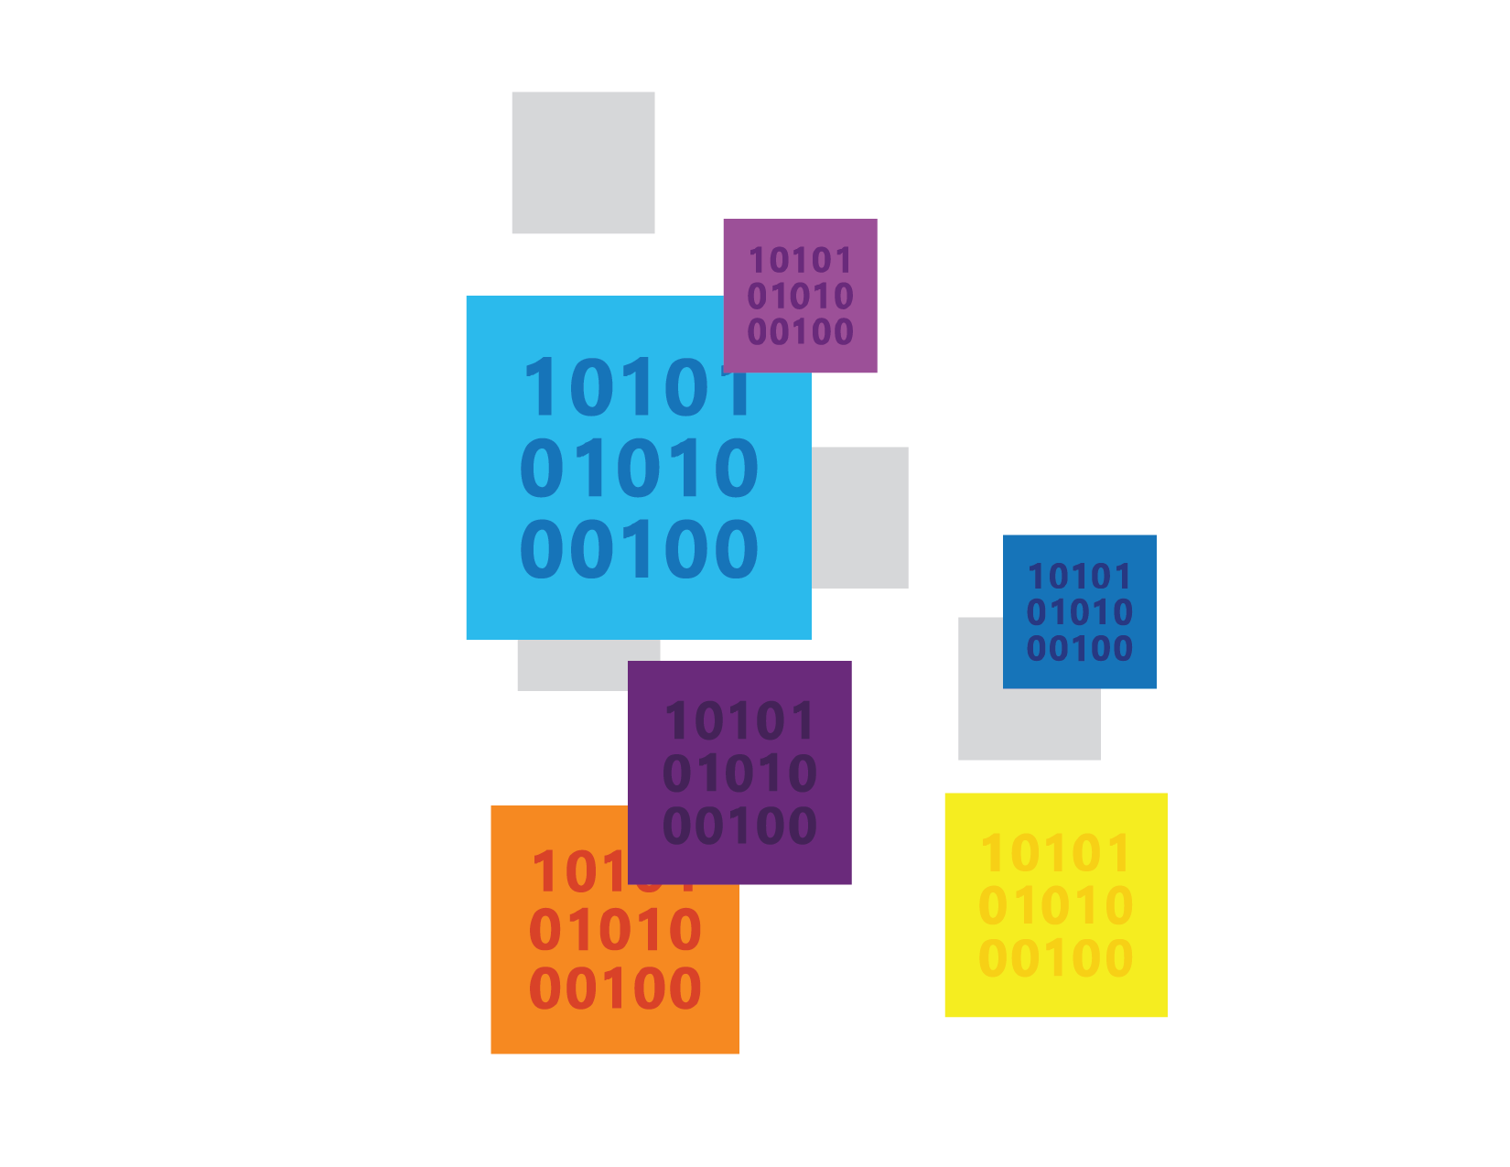
New data stores

Slide 9
New data stores
Relational & non-relational
Not a magic abstraction
High level services that are useful on all/most stores
Non-common concerns handled by provider extensions
Example providers
Relational (SQL Server, SQLite, Postgres, SQL Compact etc.)
Azure Table Storage
Redis
In Memory (for testing)
Just relational providers for v1.0.0

Slide 10



New features

Slide 11
New features
Batching during SaveChanges
Client eval in LINQ queries
Shadow state properties
SQL Server sequences
Alternate keys

Slide 12
Lightweight & extensible core

Slide 13
Lightweight & extensible core
Top level API built over a modular core
Core = metadata, SQL generation, change tracking, etc.
Built as a collection of services
Follows dependency injection principles
Easy to use/replace/extend individual services
Optimized for memory and CPU usage
Pay-per-play components

Slide 14
EF Core & EF6.x

Slide 15
EF Core
Mindful of our past…
Same top level experience as EF6.x
Not changing things just for the sake of it
…but not constrained by it
New code base
Completely different core
Not all features from EF6.x will be implemented

Slide 16
EF Core & EF6.x
EF6.x is the mature data stack
8 years of RTM releases = features and stability
Rich ecosystem of database providers
Patch and minor releases will continue
EF Core is a true v1
Basic feature set shipping in v1
Limited set of early adopter database providers

Slide 17
EF Core & EF6.x
EF6.x will be the right choice for many applications
Carefully evaluate requirements if considering EF Core
Many features not implemented in 1.0.0 (e.g. lazy loading, stored procedure mapping, etc.)
Less mature code base (e.g. LINQ translator has limitations)
EF6.x to EF Core is “port” not “upgrade”
Very basic code will port easily
Many APIs have changed drastically
Beware of behavior differences in similarly named APIs

Slide 18
Demos

Slide 19

Demo EF Core 101

Slide 20

Demo Performance improvements

Slide 21

Demo Simplified metadata API

Slide 22

Demo Extensible core

Slide 23
Extensible core
Top Level API DbContext, DbSet, ChangeTracker, Database, etc.
Core Services StateManager, CompiledQueryCache, etc.
Database Provider Services SqlServerTypeMapper, SqlServerSqlGenerationHelper, etc.

Slide 24
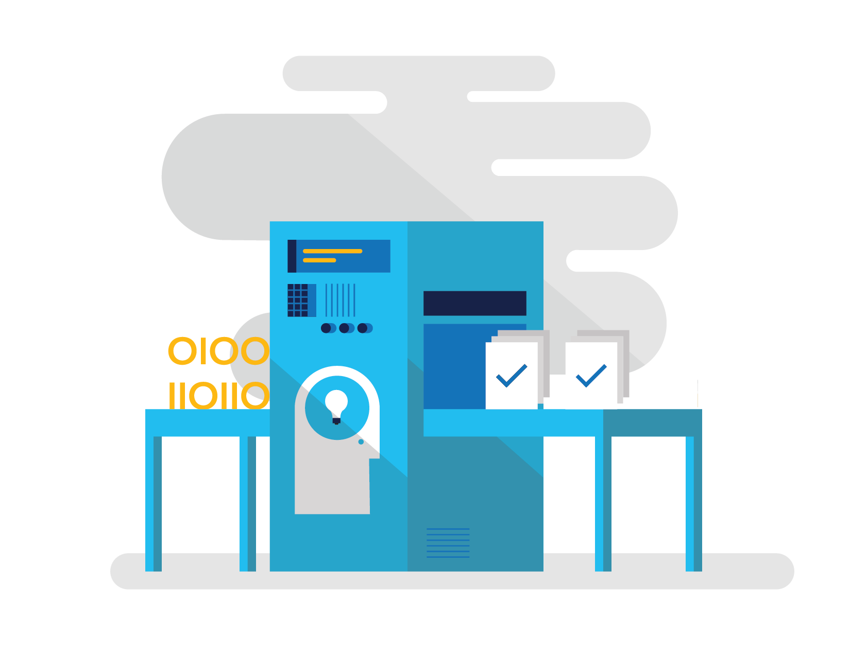
Demo Model building pipeline

Slide 25
EF6.x model building pipeline
Entity Classes
Conventions
Context
DbSet properties
DbSet Discovery
Model
OnModelCreating
Configuration

Slide 26
EF Core model building pipeline
Entity Classes
Conventions
Context
DbSet properties
DbSet Discovery
Model
OnModelCreating

Slide 27

Demo Same model, multiple platforms

Slide 28
Demo Same model, multiple databases

Slide 29
Demo SQL generation improvements

Slide 30
Next steps

Slide 31
Next steps
docs.efproject.net
github.com/aspnet/EntityFramework
github.com/rowanmiller/Demo-EFCore

