Slide 1
Secrets of Multi-Tenant Applications
With ASP.NET Core

Slide 2
What We’ll Cover
Some definitions
Multi-Tenancy Patterns
ASP.NET Core
Authentication and Authorizations
Generic patterns
EF Core Global Query Filters
Distributed Caching
Load balancing

Slide 3
Definitions
Tenant
Scaling
Vertical (Scale up)
Horizontal (Scale out)

Slide 4
Multi-Tenancy Patterns

Slide 5
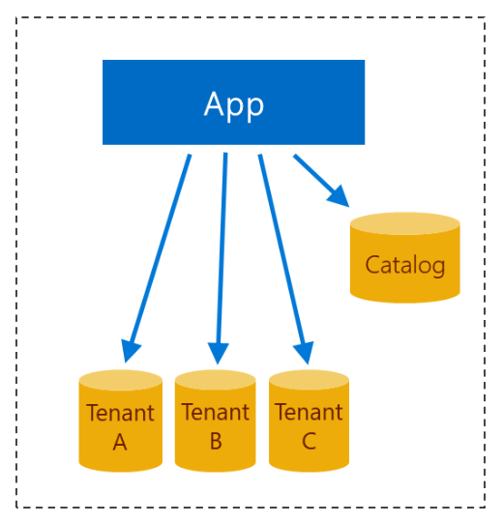
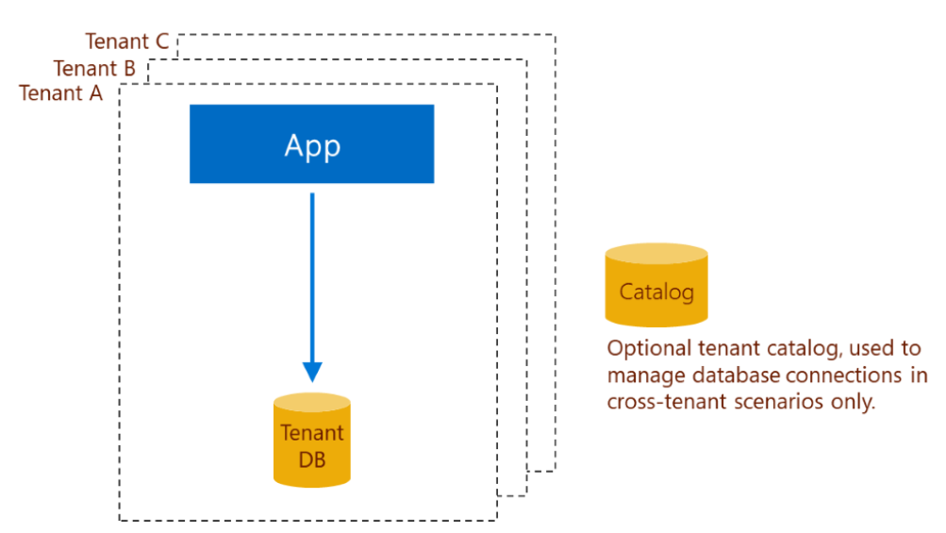
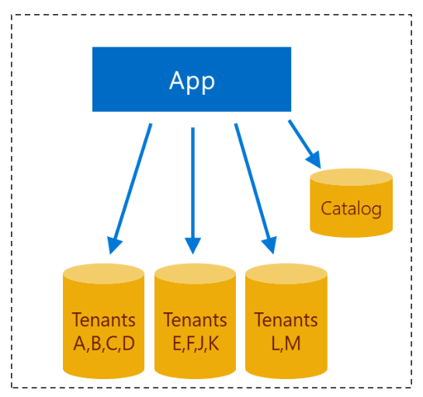
Multi-Tenant App; Multi-Tenant Database

Slide 6
Single-Tenant App; Single-Tenant Database

Slide 7
Multi-Tenancy Patterns

Slide 8
Multi-Tenant App; Multi-Tenant Database

Slide 9
Single-Tenant App; Single-Tenant Database

Slide 10
Multi-Tenant App; Database-Per-Tenant

Slide 11
Multi-Tenant App; Multi-Tenant Databases

Slide 12
Multi-tenant App; Sharded Multi-Tenant Databases

Slide 13
Some Scaling Tools in Azure

Slide 14
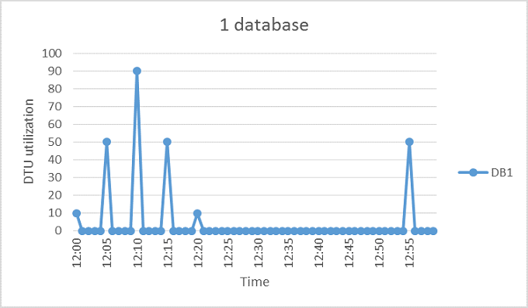
SQL Azure Elastic Database Pools

Slide 15
SQL Azure Sharding

Slide 16
Database Scaling
Clusters
Vertical Scaling
Horizontal Scaling
Vertical Sharding
Horizontal Sharding
Central database server lookup

Slide 17
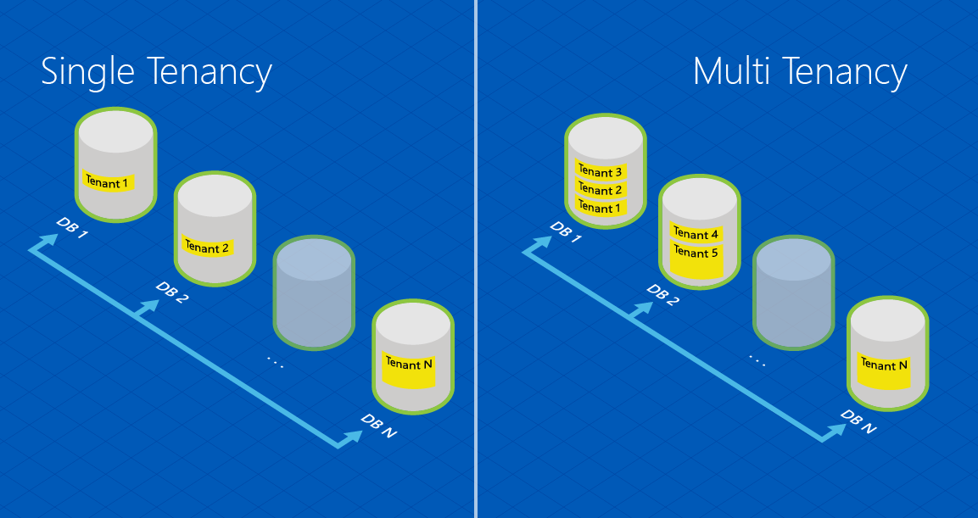
https://docs.microsoft.com/en-us/azure/sql-database/sql-database-elastic-scale-introduction#sharding

Slide 18
Using Generic Classes

Slide 19
Filter Queries to Prevent Leaks

Slide 20
Auto-set Properties to Avoid Cross-Updates

Slide 21
Load Balancing

Slide 22
Distributed Caching

Slide 23
Using Filters

Slide 24
Authentication
JWT

Slide 25
Authentication
JWT from querystring

Slide 26
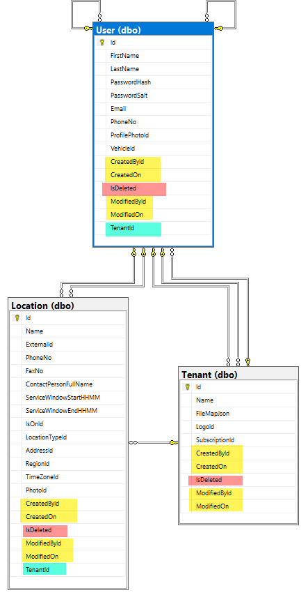
EF Boiler Plate
Audit
Soft delete
Multi-Tenant

Slide 27
EF
Shadow properties

Slide 28
EF
Global filters

