Slide 1
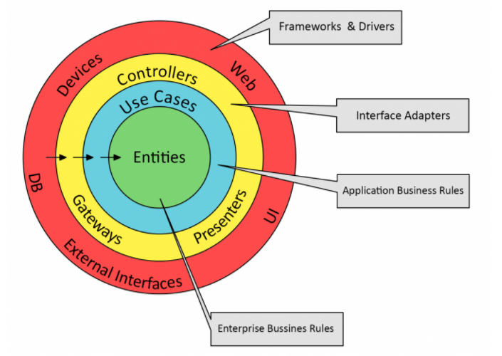

Slide 2
.NET Reactive Clean Web Application
RequestDto
IObservable<RequestDto>
Controller
(Interface Adapter)
Web API
(Framework)
Interactor / Use Case
Task<ActionResult>
IObservable<ResponseDto>
IObservable<ResponseDto>.Subscribe(res => {
ActionResult return = res.Select(x=>…);
});
IObservable<Entity>
Domain Entities
IObservable<Entity>
Reactive Store
-DB, FS, Cache…
(Drivers)
IObservable<Entity>
IObservable<Entity>
Repository / Gateway
(Interface Adapter)
IObservable<Entity>
Network Services
(External Source)

