Slide 1

Globalization & Localization in ASP.NET Core
Rachel Appel
Microsoft
rachel@rachelappel.com
rachelap@microsoft.com
http://rachelappel.com

Slide 2

Always design with the world in mind

Slide 3
Areas of Globalization
Internationalization
World-Readiness
Localization
Globalization
Localizability
Notes:
Internationalization involves Globalization and Localization. Globalization is the process of designing apps that support different cultures. Globalization adds support for input, display, and output of a defined set of language scripts that relate to specific geographic areas.
Localization is the process of adapting a globalized app, which you have already processed for localizability, to a particular culture/locale.

Slide 4
Internationalization
Planning and implementing products and services so that they can easily be adapted to specific local languages and cultures through a process called localization.
Notes:
Globalization (G11N): The process of making an app support different languages and regions.
Localization (L10N): The process of customizing an app for a given language and region.
Internationalization (I18N): Describes both globalization and localization.
Culture: It's a language and, optionally, a region.
Neutral culture: A culture that has a specified language, but not a region. (for example "en", "es")
Specific culture: A culture that has a specified language and region. (for example "en-US", "en-GB", "es-CL")
Parent culture: The neutral culture that contains a specific culture. (for example, "en" is the parent culture of "en-US" and "en-GB")
Locale: A locale is the same as a culture.

Slide 5
Internationalization
World-Readiness
Localization
Globalization
Localizability
Notes:
Internationalization involves Globalization and Localization. Globalization is the process of designing apps that support different cultures. Globalization adds support for input, display, and output of a defined set of language scripts that relate to specific geographic areas.
Localization is the process of adapting a globalized app, which you have already processed for localizability, to a particular culture/locale.

Slide 6
World-readiness
You want as many people around the world as possible to use your software
World-readiness is about two general principles:
Globalization: The process to develop a program core whose features and code design are not solely based on a single language or locale.
Localizability: The process to enable a program to be localized into different.

Slide 7
World-Ready: requirements
Address globalization early in development process:
Ship dates
Staffing
Milestones
Sprints
Coding, translating, and testing of content and software

Slide 8
World-Ready: Legal Considerations
Security & Privacy
Encryption Declarations
Intellectual Property, Copyright, and Piracy
Language Laws (France)
EULA
Laws or Standards Particular to Your Program
Notes:
https://docs.microsoft.com/en-us/globalization/design/international-laws-and-standards

Slide 9
World-Ready legal examples
In France, software and documentation must be in French
Many countries restrict encryption algorithms
In some countries, user time-tracking features may conflict with labor laws
Privacy laws vary wildly between countries
In Brazil, software must run on Brazillian made hardware
Source: Developing International Software 2e

Slide 10
Customization
Process of making modules for foreign markets

Slide 11
Internationalization
World-Readiness
Localization
Globalization
Localizability
Globalization is the process of designing apps that support different cultures
Notes:
Internationalization involves Globalization and Localization. Globalization is the process of designing apps that support different cultures. Globalization adds support for input, display, and output of a defined set of language scripts that relate to specific geographic areas.
Localization is the process of adapting a globalized app, which you have already processed for localizability, to a particular culture/locale.

Slide 12
Globalization
Culture-independent binaries
Code uses culture setting from OS for input from and output for the user
Code uses canonical date, time and number formats
Text (Date/time, numbers, sort order)
Code uses canonical date, time and number formats when
Storing and retrieving data
Serialization/deserialization
Calling APIs

Slide 13
Globalization | Text
String processing
Code pages
Unicode
Encodings (e.g. UTF-8, UTF-16, GB 18030)
Normalization
Text rendering and editing
Right-to-left (RTL) scripts (e.g. Arabic, Hebrew)
Bi-directional text (i.e. text containing LTR and RTL sections)
Support for scripts like Chinese, Japanese and Korean
Vertical writing (top-to-bottom and right-to-left)
Ruby characters
Maximum length of text input fields (e.g. a name can be as short as a single character in Japan or several dozen characters long in Germany)
Notes:
Unicode is a standardised character encoding that allows all characters in all languages of the world to be represented in one character set. It makes it much easier to work with characters and to allow different characters into the same document eg Chinese, Arabic and Roman.

Slide 14
Language, Culture, and Region
A culture is a general geographical area in which the majority of people speak the same language and maintain the same customs
A culture is not:
A language
A country
A political boundary
Cultures are determined from OS, cookie, or user choice.

Slide 15
Internationalization
World-Readiness
Localization
Globalization
Localizability
Notes:
Internationalization involves Globalization and Localization. Globalization is the process of designing apps that support different cultures. Globalization adds support for input, display, and output of a defined set of language scripts that relate to specific geographic areas.
Localization is the process of adapting a globalized app, which you have already processed for localizability, to a particular culture/locale.

Slide 16
Localizability
The design of software so that it can be localized
Resource duplication
May require more strings in original language
Pluralization
Locale identifiers (en, en-US)
Notes:
May require more strings than necessary in original language to accommodate e.g. different pluralization rules in other languages

Slide 17
Internationalization
World-Readiness
Localization
Globalization
Localizability
Notes:
Internationalization involves Globalization and Localization. Globalization is the process of designing apps that support different cultures. Globalization adds support for input, display, and output of a defined set of language scripts that relate to specific geographic areas.
Localization is the process of adapting a globalized app, which you have already processed for localizability, to a particular culture/locale.

Slide 18
Localization
Make the app's content localizable
Provide localized resources for the languages and cultures you support
Implement a strategy to select the culture for each request

Slide 19
Make Content Localizable
The translating and customizing a product for a specific market.
Part of requirements
Translation of strings
Translation and re-recording of audio files
Captioning, dubbing or replacing of video files
Replacement of graphics not understood or misleading in the respective target culture
Translation of place-names on maps or replacement of maps

Slide 20
A localization-friendly design
Features code, content, and structure that helps to prevent:
Replication of source bugs in target files
Translation errors
Common software localization errors, such as functional, display, and abbreviations
The right amount of localization. Over-localization or under-localization.

Slide 21
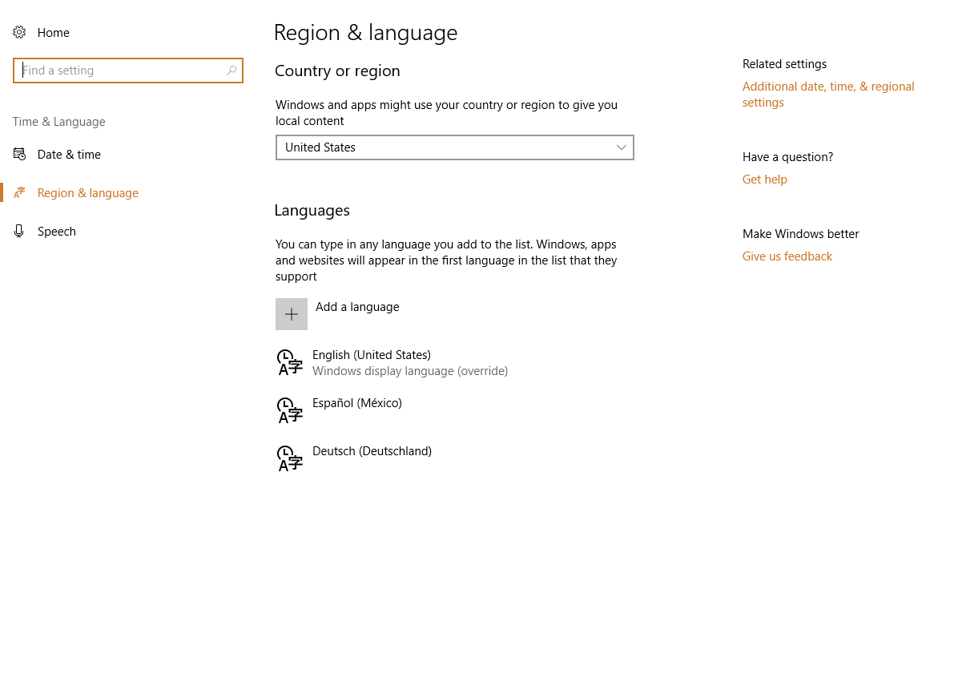
Regional
Settings

Slide 22
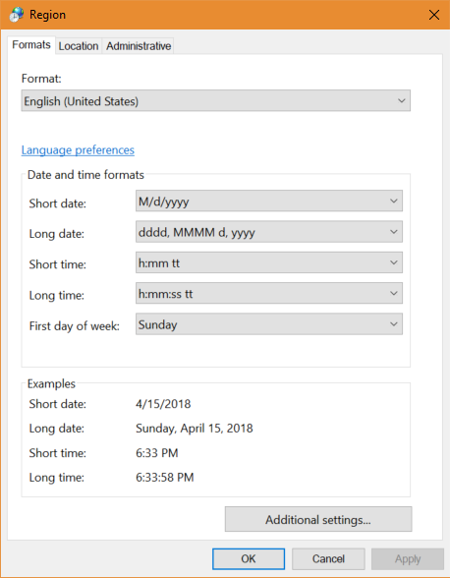
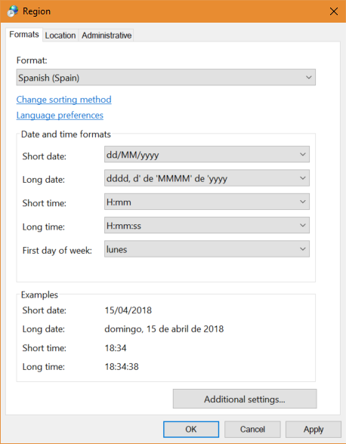

Slide 23
App localization involves the following
Prerequisite: App has to be localizable
Provide localized resources for the languages and cultures you support
Implement a strategy to select the language/culture for each request
Should work out of box
May need custom code for allowing end user to switch language in app
Localization testing

Slide 24
What to localize
Localize content
Text, not HTML
Titles, names, descriptions, dates, times, videos, images, graphics
Links
Localize MVC views, Razor Pages
Localize Data Annotations

Slide 25
Localize media
Not all symbols are universal or neutral.
Avoid images of hands or feet, animals, and other symbols which can have unexpected or unwelcome meanings.
You will have to research this
Use icons are likely to be understood globally
Don’t misuse icons
Notes:
For example, a U.S.-style mailbox doesn’t translate to many other cultures. Do your research and avoid images of hands or feet, animals, and other symbols which can have unexpected or unwelcome meanings.

Slide 26







Samples of icons
Avoid these
Ok
Use
these
Notes:
Rather than using the hand to represent the action of stopping, use the internationally-accepted stop sign.

Slide 27
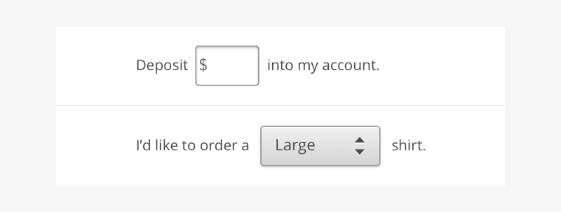
Don’t embed UI elements into text

Slide 28
35% Rule
English
BUY NOW
French
ACHETER MAINTENANT
German
JETZT KAUFEN
Spanish
COMPRAR AHORA

Slide 29
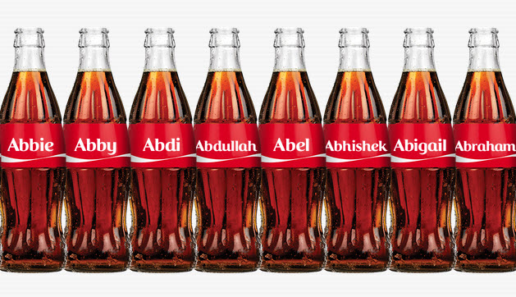
http://www.coca-colajourney.com.au/stories/local-idea-goes-global-share-a-coke

Slide 30
What to localize: data
English
Id: 1
Name: Bicycle
Description: A sturdy, blue bike.
Price: 1,000.00 Dollars***
Warranty: No
Purchase Date:
Español
Id: 1
Name: Bicicleta
Description : una bicicleta azul robusta
Price : 1.000,00 Euros***
Warranty : No
Purchase Date:
Fields; local
Data;translated
Not numerical or data
Notes:
Español
Id: 1
Nombre: Bicicleta
Descripción: una bicicleta azul robusta
Precio: 1.000,00
Garantía: No

Slide 31
Localizability
Replace strings in loc effort as you go (use keys)
Resource duplication
May require more strings
Pluralization
Notes:
May require more strings than necessary in original language to accommodate e.g. different pluralization rules in other languages

Slide 32
Localization
Develop with default locale
Translators
Resource strings
Graphics
Don’t localize the UI before UI freeze
Do prep for localization through dev process
Change tracking is necessary

Slide 33
Localization To-do’s
Static UI and report layouts must provide enough space for longer, localized strings
Dynamic UI and report layouts must scale correctly for longer and shorter strings

Slide 34
URL structure
Top level domain example.com, example.es and example.de.
Sub level domain. en.example.com, es.example.com, de.example.com
File system structure
example.com/en-us/products/sports/bicycle/
example.com/es-es/products/sports/bicycle/
example.com/de-de/products/sports/bicycle/
http://bit.ly/lang-codes
Notes:
https://webmasters.stackexchange.com/questions/403/how-should-i-structure-my-urls-for-both-seo-and-localization

Slide 35
Localizing ASP.NET Core Apps

Slide 36
Project Structure
\Resources
\Controllers
\ViewModels
\Account
\Views
\About
\Home

Slide 37
Resource Files
Contains localized strings for the app
Not a database
Resources are named for the full type name of their class minus the assembly name
.resx extension

Slide 38
ASP.NET Core Localization Middleware
services.AddLocalization(options => options.ResourcesPath = "Resources");
services.AddMvc() .AddViewLocalization(LanguageViewLocationExpanderFormat.Suffix)
.AddDataAnnotationsLocalization();
Notes:
services.Configure<RequestLocalizationOptions>(options =>
{
var supportedCultures = new[]
{
new CultureInfo(enUSCulture),
new CultureInfo("fr")
};
// State what the default culture for your application is. This is used if no specific culture
// can be determined for a given request.
options.DefaultRequestCulture = new RequestCulture(culture: enUSCulture, uiCulture: enUSCulture);
// You must explicitly state which cultures your application supports.
// These are the cultures the app supports for formatting numbers, dates, etc.
options.SupportedCultures = supportedCultures;
// These are the cultures the app supports for UI strings (that we have localized resources for).
options.SupportedUICultures = supportedCultures;
// You can change which providers are configured to determine the culture for requests, or even add a custom
// provider with your own logic. The providers will be asked in order to provide a culture for each request,
// and the first to provide a non-null result that is in the configured supported cultures list will be used.
// By default, the following built-in providers are configured:
// - QueryStringRequestCultureProvider, sets culture via "culture" and "ui-culture" query string values, useful for testing
// - CookieRequestCultureProvider, sets culture via "ASPNET_CULTURE" cookie
// - AcceptLanguageHeaderRequestCultureProvider, sets culture via the "Accept-Language" request header
//
//options.RequestCultureProviders.Insert(0, new CustomRequestCultureProvider(async context =>
//{
// // My custom request culture logic
// return new ProviderCultureResult("en");
//}));
});

Slide 39
var supportedCultures = new[] {
new CultureInfo(enUSCulture), new CultureInfo("en-AU"), new CultureInfo("en-GB"), new CultureInfo("en"),
new CultureInfo("es-ES"), new CultureInfo("es-MX"), new CultureInfo("es"),
new CultureInfo("fr-FR"), new CultureInfo("fr"),};
app.UseRequestLocalization(new RequestLocalizationOptions {
DefaultRequestCulture = new RequestCulture(enUSCulture),
// Formatting numbers, dates, etc
SupportedCultures = supportedCultures,.
// UI strings that we have localized
SupportedUICultures = supportedCultures });

Slide 40
ASP.NET Localization implementation
CultureInfo
CultureInfo.CurrentCulture
CultureInfo.CurrentUICulture
Resource Files
Culture Fallback
Select a language

Slide 41
Controllers/Areas localization
You can partition your localized strings by controller, area, or have just one container.

Slide 42
IStringLocalizer and IStringLocalizer<T>
[Route("api/[controller]")]
public class AboutController : Controller {
private readonly IStringLocalizer<AboutController> _localizer;
public AboutController
(IStringLocalizer<AboutController> localizer)
{_localizer = localizer; }
[HttpGet]
public string Get() {
return _localizer["About Title"];
}
}

Slide 43
IHtmlLocalizer and IHtmlLocalizer<T>
public class BookController : Controller {
private readonly IHtmlLocalizer<BookController> _localizer;
public BookController(IHtmlLocalizer<BookController> localizer) { _localizer = localizer;
}
public IActionResult Hello(string name) {
ViewData["Message"] = _localizer["<b>Hello</b><i> {0}</i>", name];
return View();
}
}

Slide 44
IViewLocalizer
ViewLocalizer is a class that can be used in Razor views to get access to translations for the specific view.
Razor generates a class but you can't reference the class name. ViewLocalizer exists because of this reason.
@inject IViewLocalizer Localizer
@{
ViewData["Title"] = Localizer["Home Page"];
}
@Localizer["Learn how to build ASP.NET apps that can run anywhere."]
Notes:
(https://joonasw.net/view/aspnet-core-localization-deep-dive)
The IViewLocalizer service provides localized strings for a view. The ViewLocalizer class implements this interface and finds the resource location from the view file path. The following code shows how to use the default implementation of IViewLocalizer

Slide 45
Data Annotations
DataAnnotations error messages are localized with IStringLocalizer<T>.
Using the option ResourcesPath = "Resources", the error messages in RegisterViewModel can be stored in either of the following paths:
Resources/ViewModels.Account.RegisterViewModel.fr.resx
Resources/ViewModels/Account/RegisterViewModel.fr.resx

Slide 46
Implement Language Selection
Partial View
ViewComponent

Slide 47
ASP.NET Localization implementation
Graphics (icons, photos)
Audio and video files
Maps
Place-names
May need to be replaced entirely when doing business in countries involved in territorial disputes

Slide 48
Considerations

Slide 49
Culture Fallback
Code must fallback when resources for requested culture are unavailable
Fallback to more general culture (e.g. loading English [en] resources when American-English [en-US] is requested but unavailable)
Fallback to default culture when fallback to a more general culture is not possible

Slide 50
Testing Localization
UI can be translated without re-engineering or code modifications.
Check for
Truncations and other layout issues
All resources requiring localization have been localized and are used at runtime
OS culture settings are used correctly for UI, reports, and input/output
Culture-independence of date, time and number processing for storage, API calls, etc.
Track localization issues like regular issues
Tools: Selenium, PhantomJS
Notes:
The purpose of localizability testing is to verify that the UI of the program being tested can be easily translated to any target language without re-engineering or making code modifications. Since localizability bugs must be fixed in the code of the application, they must be looked for at the earliest stage of development possible. By doing so, you can circumvent having to fix bugs for every language version at a later point. (See Designing for Internationalization.)

Slide 51
Resources
Microsoft Language Portal https://www.microsoft.com/en-us/Language
Globalization tools downloads https://docs.microsoft.com/en-us/globalization/downloads

Slide 52
Thank You!
Rachel Appel
Microsoft
rachel@rachelappel.com
rachelap@microsoft.com
http://rachelappel.com

