Slide 1
Building Apps with TypeScript
Rachel Appel
Microsoft
rachelap@microsoft.com
http://rachelappel.com

Slide 2
Agenda
TypeScript Overview
Features
Using TypeScript in VS Code
Type Acquisition
The TypeScript Compiler
Project Configuration
Build Tasks
Create an Object Model

Slide 3
TypeScript Overview

Slide 4
Features
Non-nullable types
Control flow analysis
Discriminated Union types
Never types
Read-only properties
This types for functions
Glob support in tsconfig
New module resolution
Quick ambient modules
@types .d.ts acquisition
UMD module definitions
Optional class properties
Private constructors
More…

Slide 5
The TypeScript Transpiler
tsc.exe
https://www.typescriptlang.org/docs/handbook/compiler-options.html
Notes:
https://code.visualstudio.com/Docs/languages/typescript#_transpiling-typescript-into-javascript
a transpiler is a source to source compiler

Slide 6
Program organization
A TypeScript Program
Module
Module
Class
Class
Method
Members
Class
Property
Members
Class
Class
Members
Members
Notes:
Program
Module (namespace)
Class | Interface
Compilation
when you are writing TypeScript code, you are participating in the design time stage along with any development tools you are
using. The compiler represents the second stage, converting TypeScript into JavaScript, and
raising errors and warnings it discovers. The final stage involves the runtime executing the
generated JavaScript.

Slide 7
VS Code

Slide 8
Using TypeScript in VS Code
https://blogs.msdn.microsoft.com/typescript/2015/04/30/using-typescript-in-visual-studio-code/
Ctrl+Shift+P Command Pallet
Type in “task”
Set tasks.json
Tsconfig.json

Slide 9
Configure the Task Runner
https://cmatskas.com/typescript-and-vs-code/
tsconfig.
Tasks.

Slide 10
Project Configuration
Individual file scope
Explicit projects [recommended]
tsconfig.json
Notes:
Tip: We recommend that you use explicit projects over file scope projects. Since explicit projects list the files belonging to a project language, features like Find All ReferencesShift+F12 consider the project scope and not the file scope only.
https://code.visualstudio.com/Docs/languages/typescript
File Scope: in this mode TypeScript files opened in Visual Studio Code are treated as independent units. As long as a file a.ts doesn't reference a file b.ts explicitly (either using /// reference directives or external modules) there is no common project context between the two files.
Explicit Project: a TypeScript project is defined via a tsconfig.json file. The presence of such a file in a directory indicates that the directory is the root of a TypeScript project. The file itself lists the files belonging to the project as well as compiler options. Details about the tsconfig.json file can be found here.

Slide 11
Build Tasks
tasks.json
{
"version": "0.1.0",
"command": "echo",
"isShellCommand": true,
"args": ["Hello World"],
"showOutput": "always"
}
Version
echo shell command
Input arguments
Output Window behavior
[always; never; silent]

Slide 12
Build Tasks
https://code.visualstudio.com/docs/editor/tasks#_command-and-tasks

Slide 13
Type Acquisition
Definitely Typed
TSD
Typings (.d.ts registry)
@types
Async/await

Slide 14
The TypeScript Language

Slide 15
TypeScript Types
Primitive and Object
Any
Number
Boolean
String
Null *
Undefined *
Object
Void *
HTMLElement
Functions
Enum
Notes:
the primitive types are the Number, Boolean, String, Void, Null, and Undefined types along with user
defined enum types. The number, boolean, string, and void keywords reference the Number, Boolean,
String, and Void primitive types respectively. The Void type exists purely to indicate the absence of a
value, such as in a function with no return value. It is not possible to explicitly reference the Null and
Undefined types—only values of those types can be referenced, using the null and undefined literals.

Slide 16
Type annotations
Argument types
Return types
Type inference

Slide 17
Create an Object Model
Object Orientation
Classes
Getters/setters
Methods
Types
Interfaces
Abstraction
Encapsulation
Inheritance

Slide 18

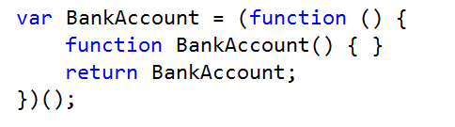
Classes
TS
JS
Notes:
Classes
Interfaces
Ambient declarations
ES6

Slide 19
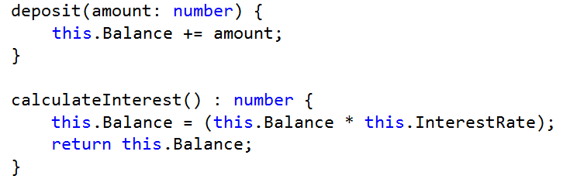
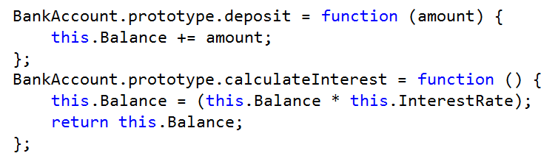
Classes: Members
TS
JS

Slide 20

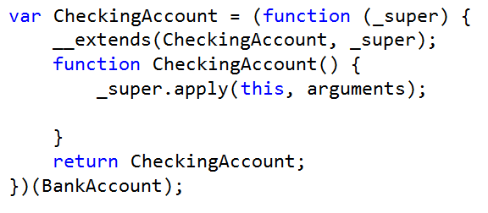
Inheritance
TS
JS

Slide 21
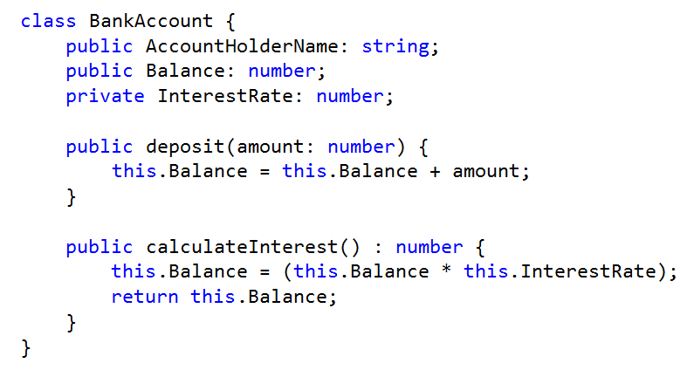
Classes: Access modifiers

Slide 22
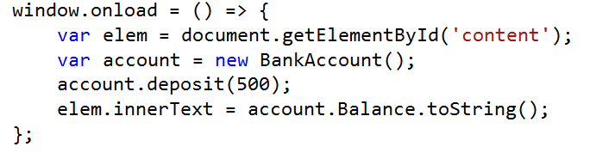
Accessing a Class and its members

