Slide 1
Write OO JavaScript with TypeScript
Rachel Appel
Microsoft
rachel@rachelappel.com
rachelap@microsoft.com
http://rachelappel.com

Slide 2
Agenda
TypeScript Overview
Features
Using TypeScript in VS Code
Type Acquisition
The TypeScript Compiler
Project Configuration
Build Tasks
Create an Object Model

Slide 3
TypeScript Overview

Slide 4
Overview: Why TypeScript?
Compile time type safety for JavaScript
Object oriented features
ES6 now
Use existing JavaScript
Syntactic Sugar
Add things missing from JavaScript
Cross platform

Slide 5
Overview: What is it?
Superset of JavaScript
Valid JS code is valid TS code
Transpiles to JavaScript
Commitment to existing ECMA standards
Written in JavaScript

Slide 6
typescriptlang.org https://github.com/Microsoft/TypeScript

Slide 7
New features
Non-nullable types
Control flow analysis
Discriminated union types
Literal types
Definition files as NPM packages (@types)
Downlevel async/await
Generator support for ES3/ES5
Asynchronous iterators
Type parameter defaults
Object spread and rest
Mixin classes
Mapped types
Lookup types and ‘keyof’ type operator
Type checking for plain JavaScript
Infer types from JSDoc in JavaScript files
Language service extensibility
Configuration inheritance
Transformation based emitter
Quick fixes
Untyped imports
New ‘object’ type
Explicitly typed ‘this’ in functions
Readonly properties and index signatures
Path mappings in module resolution
Glob support in tsconfig.json
UMD module definitions

Slide 8
The feature gap
ES2015
ES2016
ES2017
ES2018
ES3
ES5
JavaScript Evolution
State of web JS
State of server JS
State of the art JS
Target
Productivity
JavaScript feature gap
May 2015
May 2017

Slide 9
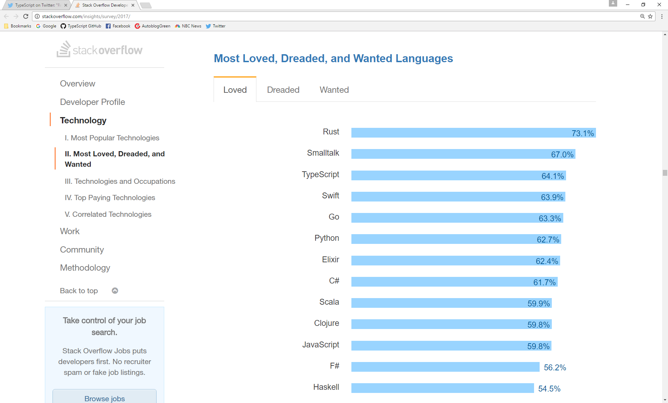

Slide 10
Developers
Understand Code
Reading code, tracing code, docs
Maintain Code
Bug fixes, enhancements, refactor
New Code
Writing new modules

Slide 11
Installation
Source:
https://github.com/Microsoft/TypeScript/releases
Npm package, latest stable build:
npm install -g typescript
To install locally, per project
npm install --save-dev typescript

Slide 12
How TypeScript works
TypeScript
code
tsc.exe
JavaScript
output

Slide 13
Program organization
A TypeScript Program
Module
Module
Class
Class
Method
Members
Class
Property
Members
Class
Class
Members
Members
Notes:
Program
Module (namespace)
Class | Interface
Compilation
when you are writing TypeScript code, you are participating in the design time stage along with any development tools you are
using. The compiler represents the second stage, converting TypeScript into JavaScript, and
raising errors and warnings it discovers. The final stage involves the runtime executing the
generated JavaScript.

Slide 14

Type Acquisition
Historical Acquisition
https://github.com/typings/typings
https://github.com/DefinitelyTyped/tsd
@types

Slide 15
Type Acquisition
Install lodash:
npm install --save lodash
Install type definitions for lodash:
type-acquisition npm install –save @types/lodash
Install folder
node_modules\@types\lodash\index.dts

Slide 16
TypeScript transpiler

Slide 17
The TypeScript Transpiler
tsc.exe
tsc -p ./path-to-project-directory
tsc --version
tsc --help
https://www.typescriptlang.org/docs/handbook/compiler-options.html
Notes:
https://code.visualstudio.com/Docs/languages/typescript#_transpiling-typescript-into-javascript
a transpiler is a source to source compiler

Slide 18
Compilation
.tsconfig to set compiler configurations
https://basarat.gitbooks.io/typescript/docs/project/tsconfig.html

Slide 19
Compiler Options
Basic
Type Checking
General Compilation
Paths & Modules
Source map optiopns

Slide 20
Basic options
"target": "es5", /* Specify ECMAScript target version: 'ES3' (default), 'ES5', 'ES2015', 'ES2016', 'ES2017', or 'ESNEXT'. */
"module": "commonjs", /* Specify module code generation: 'commonjs', 'amd', 'system', 'umd' or 'es2015'. */
"allowJs": true, /* Allow javascript files to be compiled. */
"checkJs": true, /* Report errors in .js files. */
"sourceMap": true, /* Generates corresponding '.map' file. */
"outFile": "./", /* Concatenate and emit output to single file. */
"outDir": "./", /* Redirect output structure to the directory. */
"rootDir": "./", /* Specify the root directory of input files. Use to control the output directory structure with --outDir. */
"removeComments": true, /* Do not emit comments to output. */
"noEmit": true, /* Do not emit outputs. */
"isolatedModules": true, /* Transpile each file as a separate module (similar to 'ts.transpileModule'). */

Slide 21
Strict Type-Checking Options
"strict": true, /* Enable all strict type-checking options. */
"noImplicitAny": true, /* Raise error on expressions and declarations with an implied 'any' type. */
"strictNullChecks": true, /* Enable strict null checks. */
"noImplicitThis": true, /* Raise error on 'this' expressions with an implied 'any' type. */
"alwaysStrict": true, /* Parse in strict mode and emit "use strict" for each source file. */

Slide 22
How TypeScript Works

Slide 23
How it works
Transpiles TS to JS
TS file as source, JS as output
Browser or host runs JS file
Use .map files for debugging & tools

Slide 24
Visual Studio

Slide 25
TypeScript in Visual Studio
TypeScript SDK for Visual Studio 2017
http://bit.ly/TSVS2017

Slide 26
VS Code

Slide 27
Using TypeScript in VS Code
Ctrl + Shift + P command pallet
Type in “task”
Set tasks.json
Tsconfig.json

Slide 28
Configure the Task Runner
tsconfig
Tasks
Notes:
https://cmatskas.com/typescript-and-vs-code/

Slide 29
Project Configuration
Individual file scope
Explicit projects [recommended]
tsconfig.json
Compile .ts files to working folder(s) and .js to output folder
Minify .js files
Notes:
Tip: We recommend that you use explicit projects over file scope projects. Since explicit projects list the files belonging to a project language, features like Find All ReferencesShift+F12 consider the project scope and not the file scope only.
https://code.visualstudio.com/Docs/languages/typescript
File Scope: in this mode TypeScript files opened in Visual Studio Code are treated as independent units. As long as a file a.ts doesn't reference a file b.ts explicitly (either using /// reference directives or external modules) there is no common project context between the two files.
Explicit Project: a TypeScript project is defined via a tsconfig.json file. The presence of such a file in a directory indicates that the directory is the root of a TypeScript project. The file itself lists the files belonging to the project as well as compiler options. Details about the tsconfig.json file can be found here.

Slide 30
Build Tasks
tasks.json
{
"version": "0.1.0",
"command": "echo",
"isShellCommand": true,
"args": ["Hello World"],
"showOutput": "always"
}
Version
echo shell command
Input arguments
Output Window behavior
[always; never; silent]

Slide 31
Build Tasks
https://code.visualstudio.com/docs/editor/tasks#_command-and-tasks

Slide 32
The TypeScript Language

Slide 33
Types

Slide 34
TypeScript Types
Primitive and Object
Any
Number
Boolean
String
Null
Undefined
Object
Void
HTMLElement
Functions
Enum
Never
Notes:
the primitive types are the Number, Boolean, String, Void, Null, and Undefined types along with user
defined enum types. The number, boolean, string, and void keywords reference the Number, Boolean,
String, and Void primitive types respectively. The Void type exists purely to indicate the absence of a
value, such as in a function with no return value. It is not possible to explicitly reference the Null and
Undefined types—only values of those types can be referenced, using the null and undefined literals.

Slide 35
Any type
let notSure: any = 4;
notSure = "maybe a string instead";
notSure = false; // okay, definitely a boolean

Slide 36
Any
Built-in
User defined

Slide 37
Declaring types
var x = 10;
let message = “hello world”;
Let has block scoping, where var does not.

Slide 38
Type annotations
Argument types
Return types
Type inference

Slide 39
Enums
enum Color {Red, Green, Blue}
let c: Color = Color.Green;

Slide 40
Interfaces
interface Name {
first: string;
second: string;
}
var name: Name;
name = {
first: 'John',
second: 'Doe'
};

Slide 41
Null, undefined, void
Null: value is unknown.
Undefined: value has not been set yet.
Void

Slide 42
Never
The never type is a subtype of, and assignable to, every type; however, no type is a subtype of, or assignable to, never (except never itself). Even any isn’t assignable to never.
Wut?
Notes:
// Function returning must not have unreachable end point
function error(message: string): never {
throw new Error(message);
} // Inferred return type is never
function fail() {
return error("Something failed");
}
// Function returning never must have unreachable end point
function infiniteLoop(): never { while (true) { } }

Slide 43
type Shape = Square | Rectangle | Circle;
function area(s: Shape) {
switch (s.kind) {
case "square": return s.size * s.size;
case "rectangle": return s.height * s.width;
case "circle": return Math.PI * s.radius ** 2;
default: return assertNever(s);
}
}
function assertNeverShape(x: never): never {
throw new Error("Unexpected object: " + x);
}

Slide 44
Type Assertions
<> or “as”
let anotherType: any = "this is a string";
let strLength: number = (<string> anotherType).length;
let anotherType : any = "this is a string";
let strLength: number = (anotherType as string).length;

Slide 45
Type Alias
Not a new type
Just a new name for an existing type
Like an interface

Slide 46
Type Alias
type Name = string;
type NameResolver = () => string;
type NameOrResolver = Name | NameResolver;
function getName(n: NameOrResolver): Name {
if (typeof n === "string") {
return n;
}
else {
return n();
}
}
Notes:
Type aliases create a new name for a type. Type aliases are sometimes similar to interfaces, but can name primitives, unions, tuples, and any other types that you’d otherwise have to write by hand.

Slide 47
String Literal Types
type Color = “Red” | “Blue” | “Green”
function ChooseColor(whichColor: Color) {
if (whichColor === “Red”) { }
else if (whichColor === “Green”) { }
else if (whichColor === “Blue”) { }
else { }
}
Notes:
type Easing = "ease-in" | "ease-out" | "ease-in-out"; class UIElement { animate(dx: number, dy: number, easing: Easing) { if (easing === "ease-in") { // ... } else if (easing === "ease-out") { } else if (easing === "ease-in-out") { } else { // error! should not pass null or undefined. } } } let button = new UIElement(); button.animate(0, 0, "ease-in"); button.animate(0, 0, "uneasy"); // error: "uneasy" is not allowed here You can pass any of the three allowed strings, but any other string will give the error
Argument of type '"uneasy"' is not assignable to parameter of type '"ease-in" | "ease-out" | "ease-in-out"'

Slide 48
Read only
function foo(config: {
readonly bar: number,
readonly bas: number
}
let config = { bar: 123, bas: 123 };
foo(config);

Slide 49
Generics
http://www.typescriptlang.org/docs/handbook/generics.html

Slide 50
Type Inference
http://www.typescriptlang.org/docs/handbook/type-inference.html

Slide 51
Type Declarations

Slide 52
Declaration file
.ds or .dts
Publish to npm
A file filled with declarations/descriptions for types
Make and publish your own

Slide 53
OOP TypeScript

Slide 54
Create an Object Model
Object Orientation
Classes
Getters/setters
Methods
Types
Interfaces
Abstraction
Encapsulation
Inheritance

Slide 55
Namespaces and Modules
Namespaces are simply named JavaScript objects in the global namespace.
Notes:
This makes namespaces a very simple construct to use. They can span multiple files, and can be concatenated using --outFile. Namespaces can be a good way to structure your code in a Web Application, with all dependencies included as <script> tags in your HTML page.
Just like all global namespace pollution, it can be hard to identify component dependencies, especially in a large application.
Using Modules
Just like namespaces, modules can contain both code and declarations. The main difference is that modules declare their dependencies.
Modules also have a dependency on a module loader (such as CommonJs/Require.js). For a small JS application this might not be optimal, but for larger applications, the cost comes with long term modularity and maintainability benefits. Modules provide for better code reuse, stronger isolation and better tooling support for bundling.
It is also worth noting that, for Node.js applications, modules are the default and the recommended approach to structure your code.
Starting with ECMAScript 2015, modules are native part of the language, and should be supported by all compliant engine implementations. Thus, for new projects modules would be the recommended code organization mechanism
------
Modules are executed within their own scope, not in the global scope; this means that variables, functions, classes, etc. declared in a module are not visible outside the module unless they are explicitly exported using one of the export forms. Conversely, to consume a variable, function, class, interface, etc. exported from a different module, it has to be imported using one of the import forms.

Slide 56
Classes
export module BankOfTypeScript {
export class BankAccount { }
}
(function (BankOfTypeScript) {
var BankAccount = /** @class */ (function () {
function BankAccount() {
}
return BankAccount;
}());
BankOfTypeScript.BankAccount = BankAccount;
})

Slide 57
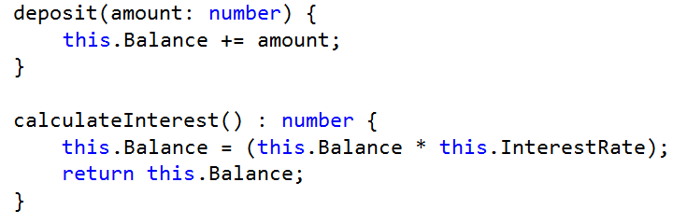
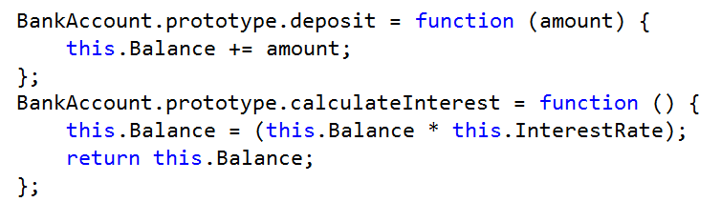
Classes: Members
TS
JS

Slide 58
Inheritance
Banking Account
Accountholder Information
Balance
Etc…
Savings Account
Accountholder Information
Balance
Etc…
Interest Rate
Interest Paid
Money Market Account
Accountholder Information
Balance
Etc…
Interest Rate
Interest Paid
Minimum Deposit

Slide 59

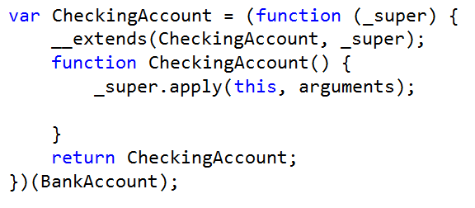
Inheritance
TS
JS

Slide 60
Reference Base Class
super() method

Slide 61
Interfaces
export interface Fee {
ChargeFee(amount: number): number;
}

Slide 62
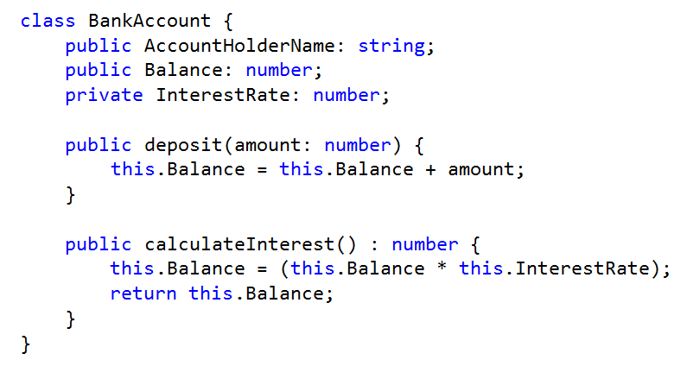
Access modifiers

Slide 63
Overloads
declare function fn(x: HTMLDivElement): string;
declare function fn(x: HTMLElement): number;
declare function fn(x: any): any;
var myElem: HTMLDivElement;
var x = fn(myElem); // x: string,

Slide 64
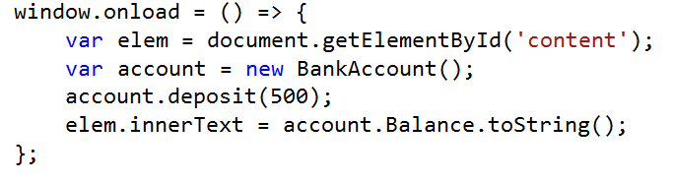
Accessing a Class and its members

Slide 65
Migrate from JavaScript

Slide 66
Migration
Good news! It’s JavaScript
Directory and project structures
External libraries
Build processes
Bundling and minification
Config files
http://www.typescriptlang.org/docs/handbook/migrating-from-javascript.html
Notes:
http://www.typescriptlang.org/docs/handbook/migrating-from-javascript.html

Slide 67
Thank You!
Rachel Appel
Microsoft
rachel@rachelappel.com
rachelap@microsoft.com
http://rachelappel.com

