Slide 1

Designing & Creating Accessible Web Pages
Rachel Appel
http://rachelappel.com
rachel@rachelappel.com
Notes:
A and 11 letters and Y is the #A11Y hash tag on twitter to talk about AccessibiliY.

Slide 2
Agenda
Creating Accessible Content
Designing Accessible Site Layouts
Coding Accessible Webpages
Tools for Accessible Development

Slide 3
Your website can't reach 1.4 billion users worldwide.
Notes:
A and 11 letters and Y is the #A11Y hash tag on twitter to talk about AccessibiliY.

Slide 4
1.4 Billion Users
About 20% of the world population have accessibility needs
Yet accessibility is almost always overlooked by developers/authors
62.8 million Americans and 1.4 billion people worldwide require assistive technology.
Many simply cannot use popular webpages at all as they are not accessible
You must design for accessibility to really reach ALL of your customers
Notes:
stats
A study in 2009 by Cass Business School found that around 20% of UK entrepreneurs and 35% of US entrepreneurs are dyslexic
8% of males in the US suffer from some form of color blindness
7% of working age adults have a severe dexterity difficulty
4%-5% of people in the US, UK and Canada suffer from difficulty hearing. Incidence increases sharply in over-60s, with more than 20% of over-75s affected.

Slide 5
In the USA...
Among adult computer users in the United States:
1 in 4 has a vision difficulty
1 in 4 has a dexterity difficulty
1 in 5 has a hearing difficulty
35% of US entrepreneurs are dyslexic (20% in the UK)
Notes:
http://www.microsoft.com/enable/research/de
http://webaim.org/articles/userperspective/fault.aspx

Slide 6
Research by Forrester
"Among US computer users in 2003 ranging from 18 to 64, 57% (74.2 million) are likely to directly or indirectly benefit from the use of accessible technology due to difficulties and impairments that may impact computer use."
Notes:
FROM the W3C
The Market for Accessible Technology - Research by Forrester, commissioned by Microsoft. Example: Among US computer users in 2003 ranging from 18 to 64, 57% (74.2 million) are likely to directly or indirectly benefit from the use of accessible technology due to difficulties and impairments that may impact computer use.
Industry sector case studies: ecommerce - a round up of data from a number of sources by the UK Employers Forum on Disability. Example: 71% of people with disabilities in the UK use the Web to find information on goods and services.
Web Accessibility for Older Users Presentation and Web Accessibility for Older Users: A Literature Review - includes statistics on older users online. Example: number of people over 65 is increasing rapidly; in 2020 (just 10 years away) it is expected to be nearly 30% in Japan, 20% in Europe, and 16% in U.S.

Slide 7
Why Accessibility?
Human ability, traits, and perceptions run across a spectrum.
That effects how people interact with technology
Visual
Auditory
Motor/Dexterity
Cognitive

Slide 8
What can we do?
Make Better Websites and Apps
Make Better Assistive Technology

Slide 9
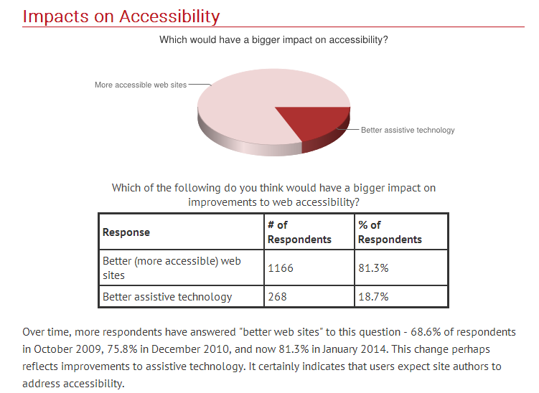
source: http://webaim.org/projects/screenreadersurvey5/#demographics
Notes:
http://webaim.org/projects/screenreadersurvey5/#demographics

Slide 10
Visual Differences
Low Vision
Blindness
Color blindness
Color Contrast Sensitivity

Slide 11
DEMO
Color Oracle

Slide 12
Auditory Differences
Low Hearing
Deafness
Background noise interference

Slide 13
Motor/Dexterity Differences
Traumatic Injuries
Spinal cord injury
Loss or damage of limb(s)
Diseases and Congenital Conditions
Cerebral palsy
Muscular dystrophy
Multiple sclerosis
ALS (Lou Gehrig's Disease)
Arthritis
Parkinson's disease
Essential tremor

Slide 14
Cognitive Differences
Dyslexia
ADHD, ADD
Autism spectrum
Injuries
Visual Comprehension
Learning disabilities
Seizures

Slide 15
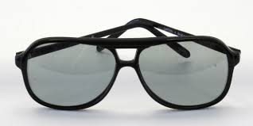
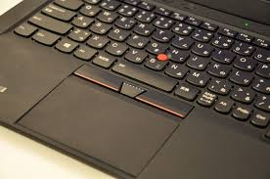
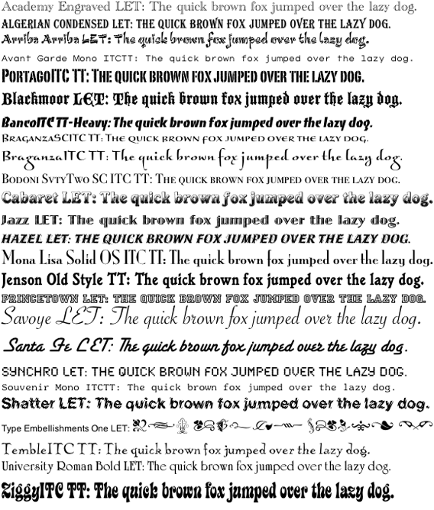

Assistive Technology
You're already using it

Slide 16
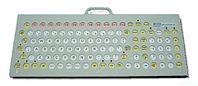
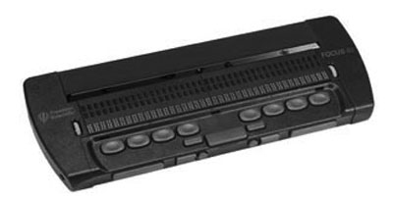
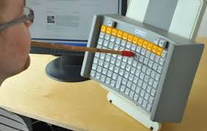
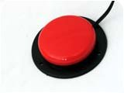
Assistive Technology
Screen Narrators
Braille Readers
Mouth stick
Head wand
Single-switch access
Sip and puff switch
Oversized trackball mouse
Adaptive keyboard
Eye tracking glasses
Voice recognition software
Notes:
https://encrypted-tbn3.gstatic.com/images?q=tbn:ANd9GcS2iWsJ4AhXGLXfN07M_mZ8mwgF2ALwiI2dWoLwkP7iNrAx2Os_Bg
http://webaim.org/articles/motor/assistive/

Slide 17
Screen Narrators
NVDA
Web Anywhere
Browser Specific Narrators
Spoken Web [IE]
ChromeVis [Chrome]
ChromeVox [Chrome]
Apple VoiceOver
MIT Finger Reader Experimental Technology
Notes:
NVDA
http://www.nvaccess.org/
Webanywhere
http://webanywhere.cs.washington.edu/wa.php

Slide 18
Creating Accessible Content
Fonts should be large, clear, and without unnecessary décor
Organize content into distinct sections with clear headings
Colors should have high contrast
Label fields and elements clearly
Movies and animations should provide captions or transcripts
http://rachelappel.com/designing-and-programming-accessible-websites-and-apps
Notes:
http://rachelappel.com/designing-and-programming-accessible-websites-and-apps

Slide 19
Contrast Sensitivity
Contrast Sensitivity
Contrast Sensitivity
Contrast Sensitivity
Contrast Sensitivity
Contrast Sensitivity
Contrast Sensitivity
Contrast Sensitivity
Contrast Sensitivity
Contrast Sensitivity

Slide 20
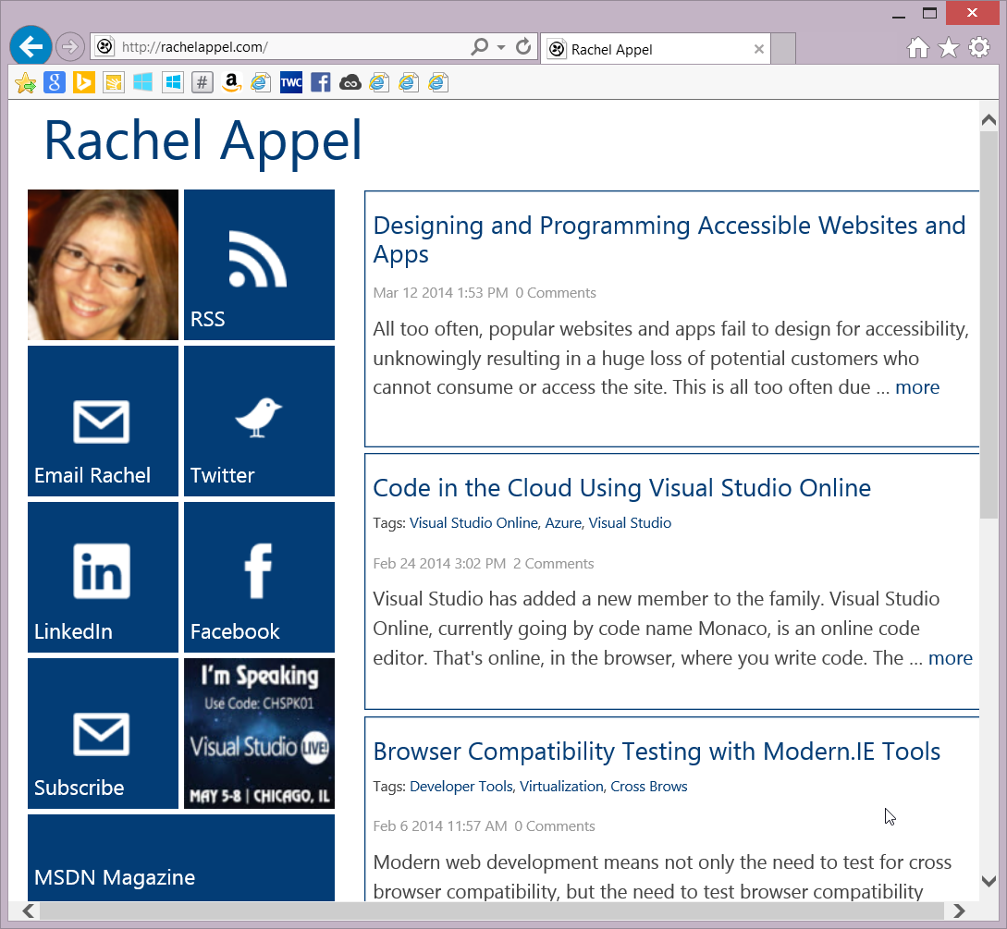
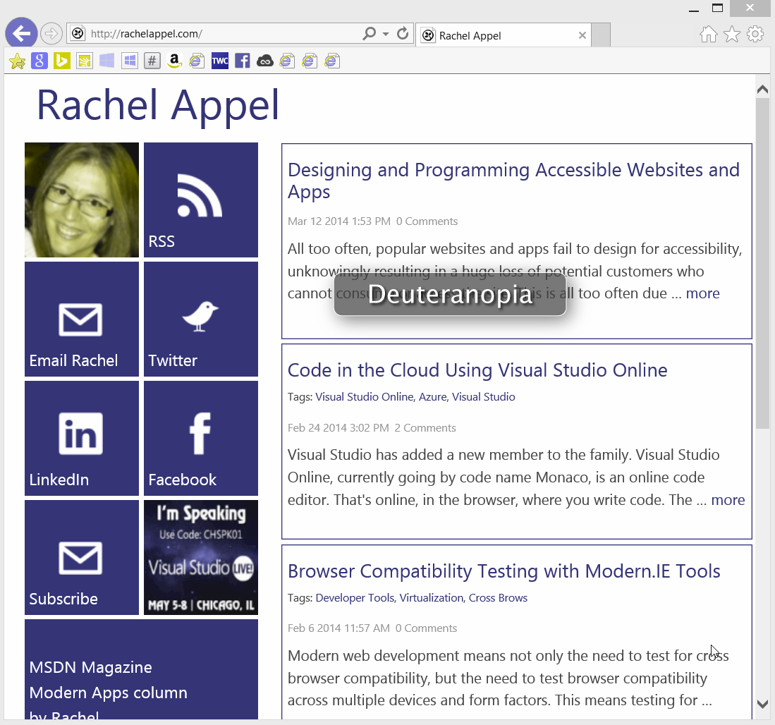
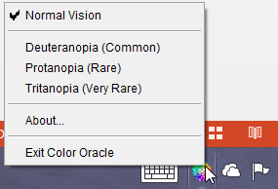
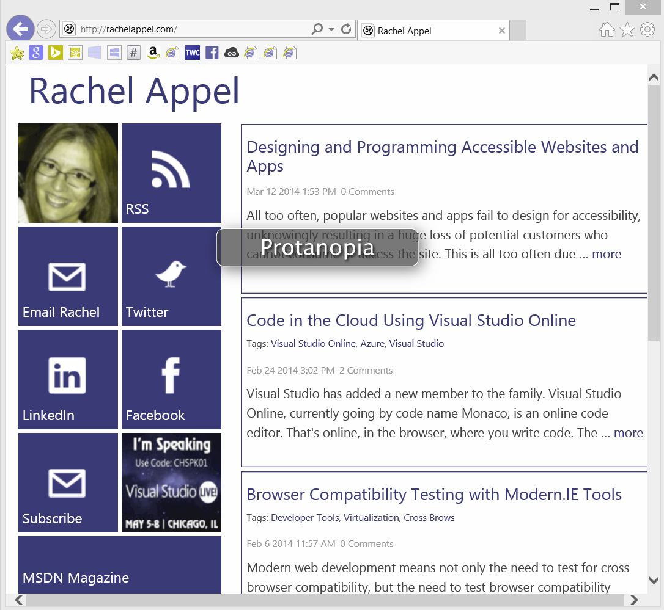
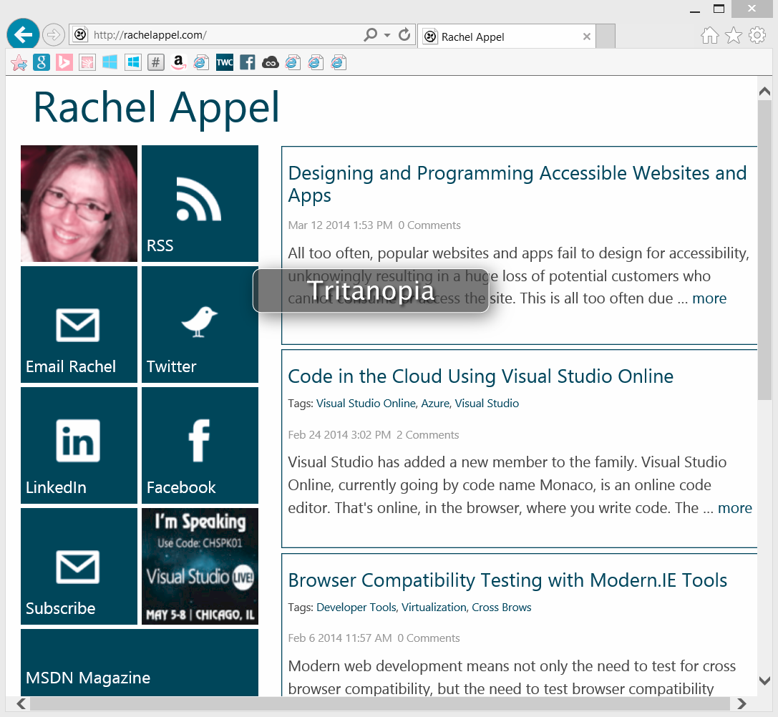
Accessibility Color Wheel Tool
http://gmazzocato.altervista.org/colorwheel/wheel.php
Color Oracle
http://colororacle.org/
MSDN Designing with Color
http://msdn.microsoft.com/en-us/library/aa511283.aspx
Notes:
http://www.youtube.com/watch?v=6RuOt28orRI
http://www.youtube.com/watch?v=wZLABgekBfI
http://www.youtube.com/watch?v=xGNDXM5DLPo

Slide 21
Designing Accessible Web Pages
Use a consistent and clear navigation scheme
Use a consistent and clear page layout and structure
Organize content into distinct sections with clear headings
JUST SAY NO to advertising popups!
They make it impossible for screen readers to work correctly
Users immediately leave your site. They cannot use it.
They’re annoying to able bodied users

Slide 22
Coding Accessible Web Pages
The Section 508 Checklist at WebAIM
http://webaim.org/standards/508/checklist
WebAIM WAVE Tool
http://wave.webaim.org

Slide 23
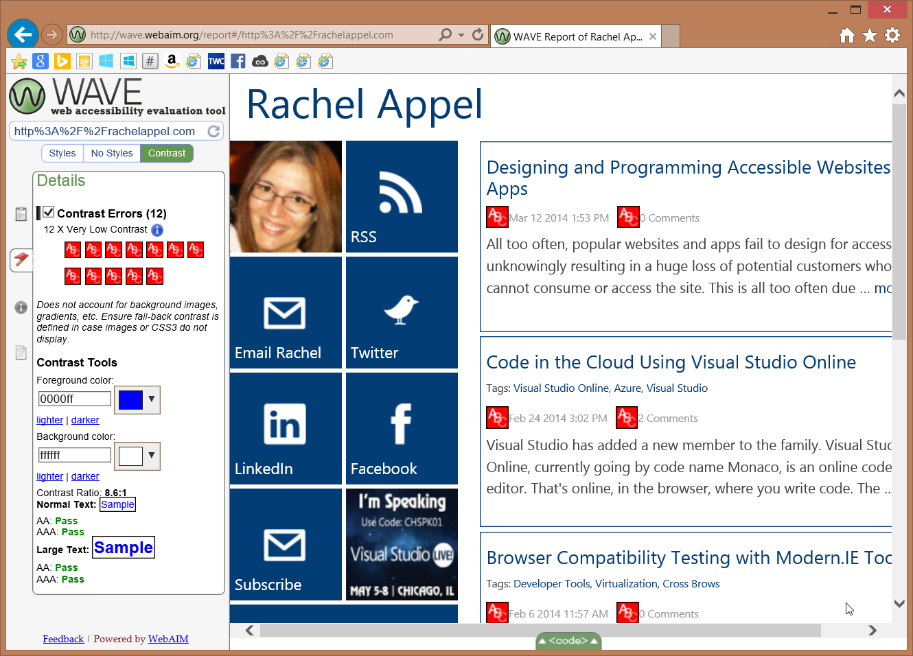

Slide 24
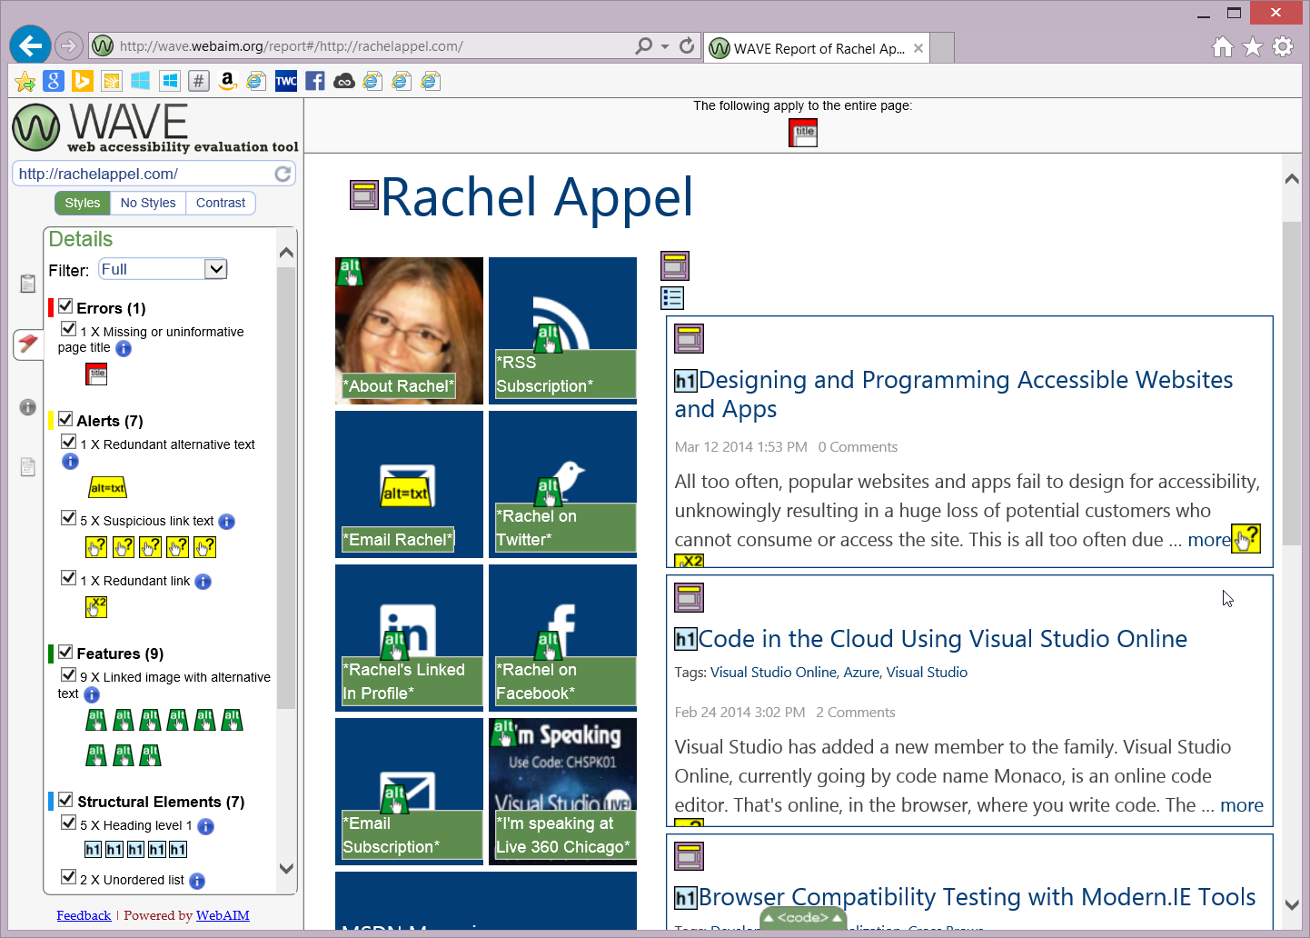

Slide 25
DEMO
WebAIM Wave tool

Slide 26
Coding Accessible Webpages
Microsoft Accessibility Engineering Center
Notes:
http://msdn.microsoft.com/en-us/library/windows/desktop/dd936223.aspx

Slide 27
Coding Accessible Web Pages
Design & code with a "Mobile First" mission.
HTML & ARIA
Use skip links
Must be keyboard and alternative input friendly
Avoid strobing, flickering, or flashing effects and images
Avoid crazy JavaScript popups
Notes:
Because the default taborder is sufficient, tabindex should almost always be avoided.
A commonly used method of implementing skip links uses the CSS display: none; rule. A skip link is a normal HTML <a> tag providing a link to a section of content or navigation within your web page (but this doesn't work well, as readers can't do the visibility thing.)
http://www.jimthatcher.com/skipnav.htm ← great piece on skip links

Slide 28
Skip Links
.offscreen {
position:absolute;
left:-10000px;
top:auto;
width:1px;
height:1px;
overflow:hidden;
}

Slide 29
DMEO
Skip links
http://webaim.org/techniques/skipnav/
Notes:
.offscreen { position:absolute; left:-10000px; top:auto; width:1px; height:1px; overflow:hidden; }

Slide 30
Coding Accessible Web Pages
Use semantic tags over aria if one exists

Slide 31
WAI-ARIA
Web Accessibility Initiative Accessible Rich Internet Applications
W3C protocol
Addresses missing semantics in dynamic apps
Notes:
Addresses semantics in dynamic apps
-readers/asst tech is great at reading html
-not so great at reading dynamically created content or SPA style apps. for obvious hopefully reasons. (such as tree menus, drag and drop, sliders, sort controls, etc.),
http://www.w3.org/WAI/intro/aria

Slide 32
ARIA
Roles
What an element does (its function or purpose)
States
What condition an element is in (e.g., enabled/disabled, on/off)
Properties
Characteristics of element (e.g., required)
All these enable assistive technologies to work better
Notes:
Aria has roles, states, and properties. Roles describe widgets that aren't otherwise available in HTML 4, such as sliders, menu bars, tabs, and dialogs.
Properties describe characteristics of these widgets, such as if they are draggable, have a required element, or have a popup associated with them.
States describe the current interaction state of an element, informing the assistive technology if it is busy, disabled, selected, or hidden.

Slide 33
ARIA Roles
application
banner
complementary
contentinfo
form
main
navigation (nav)
search
Notes:
landmark roles
application
banner
complementary
contentinfo
form
main
navigation
search

Slide 34
ARIA States & Properties
aria-checked
aria-disabled
aria-atomic
aria-busy (state)
aria-controls
aria-describedby
aria-disabled (state)
aria-dropeffect
aria-flowto
aria-grabbed (state)
aria-haspopup
aria-hidden (state)
aria-invalid (state)
aria-label
aria-labelledby
aria-live
aria-owns
aria-relevant
Notes:
The attributes in red have a corresponding HTML element or attribute, and their values need to stay in sync. For example, there is already an HTML "checked" property of a checkbox. When the user clicks on the checkbox then the value of the checked attribute toggles between true or false. While the checked attribute's value changes, the aria attribute does not. This means that you must use JavaScript to synchronize the values of the aria attributes and the HTML elements and attributes. In addition, specific screen readers may show some quirks depending on whether they deal with HTML or ARIA better.

Slide 35
DEMO
ARIA

Slide 36
Coding Accessible HTML Forms
Accessible Forms
Labels
Tab Order
No Focus
Required
Buttons, Links
ARIA

Slide 37
Coding Accessible HTML Forms
<fieldset>
<!-- fields -->
<legend>
<!-- group checkboxes, radios -->
</legend>
<!-- fields -->
</fieldset>

Slide 38
Coding Accessible HTML Forms
<label for="fullName">Full Name</label>
<input id="fullName" type="text" />
<span class="required">[Required]</span>
Notes:
You can hide form labels if necessary to fit in with visual design, yet still have them work with screen readers
http://webaim.org/techniques/css/invisiblecontent/

Slide 39
Coding Accessible HTML Forms
<label for="fullName">Full Name</label>
<input id="fullName" aria-required="true" type="text" />
<span class="required">[Required]</span>

Slide 40
DEMO
Accessible Forms

Slide 41
WebAIM Developer Tools
WebAIM WAVE scanner
[http://wave.webaim.org]
Web Content Accessibility Guidelines [http://webaim.org/standards/wcag/checklist]
Section 508 Checklist
[http://webaim.org/standards/508/checklist]
Color Contrast Tool
[http://webaim.org/resources/contrastchecker]
Notes:
http://wave.webaim.org/
http://webaim.org/standards/wcag/checklist
http://webaim.org/standards/508/checklist
http://webaim.org/resources/contrastchecker/

Slide 42
Resources
http://apodder.org/blog/NVDA-quick-start.html
http://usabilitygeek.com/10-free-screen-reader-blind-visually-impaired-users/
Notes:
http://apodder.org/blog/NVDA-quick-start.html
http://usabilitygeek.com/10-free-screen-reader-blind-visually-impaired-users/

