Slide 1
Building Real Time Applications with ASP.NET SignalR 2.0
Rachel Appel
Appel Consulting
http://rachelappel.com
rachel@rachelappel.com

Slide 2
Agenda
Overview of SignalR
Configure SignalR and Visual Studio
Hubs
Connections
Deployment

Slide 3
Overview: What is SignlaR?
Simplifies real time web development
ASP.NET Server and JavaScript Client Libraries
Real-time persistent connection abstraction over HTTP
Simplicity
Reach
Performance
"Incredibly simply real-time web for .NET"
– Damian Edwards, SignalR team
Notes:
Long polling is itself not a true push; long polling is a variation of the traditional polling technique, but it allows emulating a push mechanism under circumstances where a real push is not possible, such as sites with security policies that require rejection of incoming HTTP/S Requests.
With long polling, the client requests information from the server exactly as in normal polling, except it issues its HTTP/S requests (polls) at a much slower frequency. If the server does not have any information available for the client when the poll is received, instead of sending an empty response, the server holds the request open and waits for response information to become available. Once it does, the server immediately sends an HTTP/S response to the client, completing the open HTTP/S Request. In this way the usual response latency (the time between when the information first becomes available and the next client request) otherwise associated with polling clients is eliminated.
For example, BOSH is a popular, long-lived HTTP technique used as a long-polling alternative to TCP when TCP is difficult or impossible to employ directly (e.g., in a web browser);[9] it is also an underlying technology in the XMPP, which Apple uses for its iCloud push support.

Slide 4
Overview: What is SignalR?
OWIN http://owin.org/
Katana https://katanaproject.codeplex.com/

Slide 5
Overview: Why Use SignalR?
Types of Apps
Games, leaderboards
Social Applications
Business Collaboration
Stocks
Chat, messaging
Dashboards
Real time forms
Auctions
Anything that needs live data

Slide 6
Overview: Where you can use SignalR
HTML & ASP.NET apps
Windows Store & Phone
Any JavaScript client

Slide 7
Overview: SignalR in Action
http://shootr.signalr.net
http://JabbR.net

Slide 8
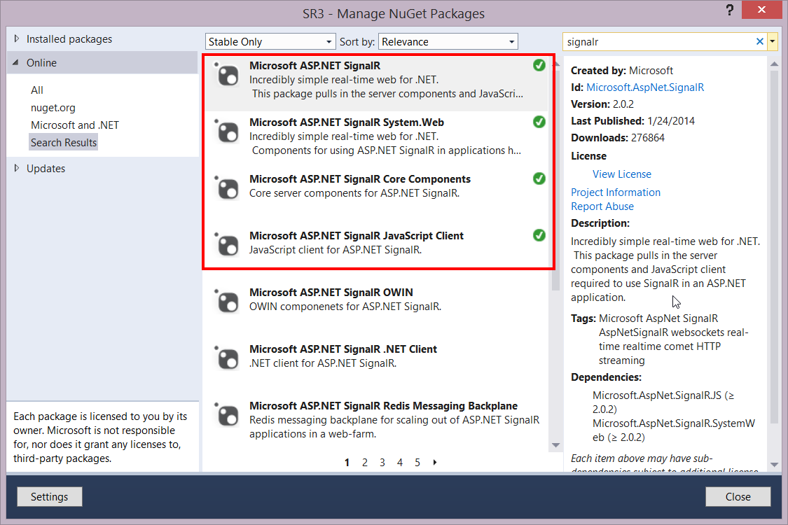
Configure SignalR & Visual Studio
http://www.asp.net/signalr
NuGet package
OWIN References
Scripts
GitHub download
Notes:
Each SignalR app is an OWIN app (open web interface for .net). http://owin.org

Slide 9
SignalR Startup
using Owin;
using Microsoft.Owin;
[assembly: OwinStartup(typeof(SR3.Startup))]
namespace SR3
{
public class Startup
{
public void Configuration(IAppBuilder app)
{
app.MapSignalR();
}
}
}
Notes:
Every OWIN Application has a startup class where you specify components for the application pipeline. There are different ways you can connect your startup class with the runtime, depending on the hosting model you choose (OwinHost, IIS, and IIS-Express). The startup class shown in this tutorial can be used in every hosting application. You connect the startup class with the hosting runtime using one of the these approaches: Naming Convention: Katana looks for a class named Startup in namespace matching the assembly name or the global namespace.
OwinStartup Attribute: This is the approach most developers will take to specify the startup class. The following attribute will set the startup class to the TestStartup class in the StartupDemo namespace.[assembly: OwinStartup(typeof(StartupDemo.TestStartup))]The OwinStartup attribute overrides the naming convention. You can also specify a friendly name with this attribute, however, using a friendly name requires you to also use the appSetting element in the configuration file.

Slide 10
DEMO
SignalR setup
Notes:
Use NuGet to install SignalR references
IN the startup, the code maps SignalR hubs to the app builder pipeline at "/signalr".

Slide 11
Overview: SignalR Namespaces
Microsoft.AspNet.SignalR.Hub
http://msdn.microsoft.com/en-us/library/dn440565(v=vs.118).aspx
Notes:
$.connection.hub.logging = true; // to verify the transport (websockets or a fallback like comet or forever frame
connection.start({ transport: 'longPolling' });You can specify a fallback order if you want a client to try specific transports in order. The following code snippet demonstrates trying WebSocket, and failing that, going directly to Long Polling.
connection.start({ transport: ['webSockets','longPolling'] });

Slide 12
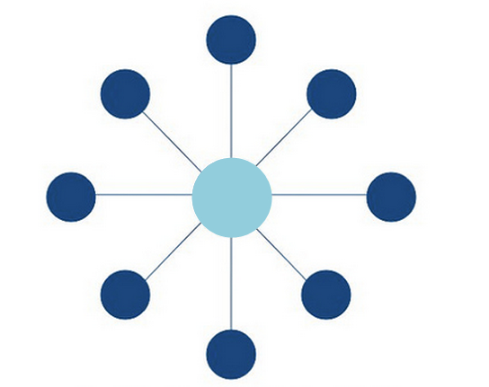
Hubs
Microsoft.AspNet.SignalR.Hub class
Server Side Library
Allows for duplex connectivity
Notes:
A Hub is a more high-level pipeline built upon the Connection API that allows your client and server to call methods on each other directly
When server-side code calls a method on the client, a packet is sent across the active transport that contains the name and parameters of the method to be called (when an object is sent as a method parameter, it is serialized using JSON). The client then matches the method name to methods defined in client-side code. If there is a match, the client method will be executed using the deserialized parameter data.
The method call can be monitored using tools like Fiddler. The following image shows a method call sent from a SignalR server to a web browser client in the Logs pane of Fiddler.

Slide 13
Hubs
Declare public methods on a hub so that clients can call them.
Use the Microsoft.AspNet.SignalR.Hub.Clients property to access all clients connected to this hub.
Call a function on the client
HubName attribute
Notes:
http://www.asp.net/signalr/overview/signalr-20/hubs-api/hubs-api-guide-javascript-client
Note: In JavaScript the reference to the server class and its members is in camel case. The code sample references the C# ChatHub class in JavaScript as chatHub

Slide 14
Hub Events
public override Task OnConnected()
{
var id = Context.ConnectionId;
return base.OnConnected();
}

Slide 15
Hubs: Transports
A full duplex, TCP based protocol
Is not HTTP
Standardized RFC in 2011
Notes:
From WikiPedia: WebSocket is a protocol providing full-duplex communications channels over a single TCP connection. The WebSocket protocol was standardized by the IETF as RFC 6455in 2011, and the WebSocket API in Web IDL is being standardized by the W3C.
WebSocket is designed to be implemented in web browsers and web servers, but it can be used by any client or server application. The WebSocket Protocol is an independent TCP-based protocol. Its only relationship to HTTP is that its handshake is interpreted by HTTP servers as an Upgrade request.^{[1]} The WebSocket protocol makes possible more interaction between a browser and a web site, facilitating live content and the creation of real-time games.
A full-duplex (FDX) system, or sometimes called double-duplex, allows communication in both directions, and, unlike half-duplex, allows this to happen simultaneously. Land-line telephone networks are full-duplex, since they allow both callers to speak and be heard at the same time.
HTTP is a half duplex system, meaning that it has two way communication but only one way at a time. Like a single elevator in a small building.

Slide 16
Hubs: Transports
Transports
WebSockets is the only transport that establishes a true persistent, two-way connection between client and server.
SSE/Events
AJAX Long Polling
Forever Frame (IE only)
Transport selection process
$.connection.hub.logging = true; // to determine transport
Notes:
Transport selection process
The following list shows the steps that SignalR uses to decide which transport to use.
If the browser is Internet Explorer 8 or earlier, Long Polling is used.
If JSONP is configured (that is, the jsonp parameter is set to true when the connection is started), Long Polling is used.
If a cross-domain connection is being made (that is, if the SignalR endpoint is not in the same domain as the hosting page), then WebSocket will be used if the following criteria are met:
The client supports CORS (Cross-Origin Resource Sharing). For details on which clients support CORS, see CORS at caniuse.com.
The client supports WebSocket
The server supports WebSocket
If any of these criteria are not met, Long Polling will be used. For more information on cross-domain connections, see How to establish a cross-domain connection.
If JSONP is not configured and the connection is not cross-domain, WebSocket will be used if both the client and server support it.
If either the client or server do not support WebSocket, Server Sent Events is used if it is available.
If Server Sent Events is not available, Forever Frame is attempted.
If Forever Frame fails, Long Polling is used.
You can determine what transport your application is using by enabling logging on your hub, and opening the console window in your browser.
To enable logging for your hub's events in a browser, add the following command to your client application:
$.connection.hub.logging = true;

Slide 17
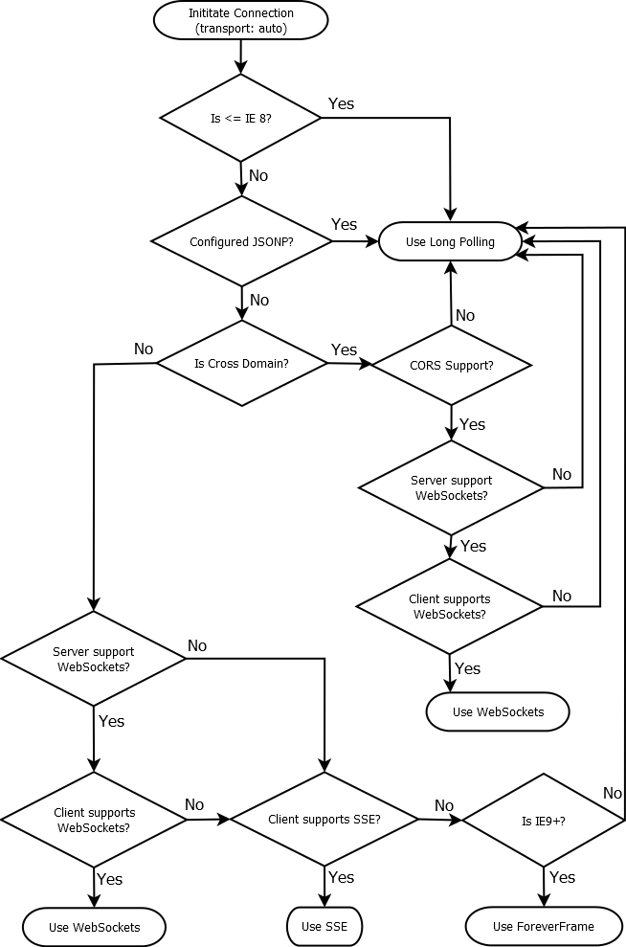
From this SO thread
http://stackoverflow.com/questions/16983630/how-does-signalr-decide-which-transport-method-to-be-used
From this SO user, thomaswr
http://stackoverflow.com/users/2207506/thomaswr

Slide 18

Start
IE 8 or earlier?
Y
N
Is JSONP configured?
Use Long Polling
Y
N
N
CORS Support?
Is Cross Domain?
Y
N
Y
N
N
Web Sockets (S/C)
Server Web Sockets Support?
Y
Y
Y
Client Web Sockets Support?
N
Use WebSockets
IE 9 or later?
SSE Support?
N
N
Y
Y
Use ForeverFrame
Use SSE

Slide 19
DEMO
Hubs

Slide 20
SignalR Client Script Libraries
SignalR depends on jQuery
@Scripts.Render("~/bundles/jquery")
SignalR script references
<script src="~/Scripts/jquery.signalR-2.0.2.min.js"></script>
<script src="~/signalr/hubs"></script>

Slide 21
Connections
Client Side
PersistentConnection
$.connection
Notes:
A Connection represents a simple endpoint for sending single-recipient, grouped, or broadcast messages
When OnConnected, OnDisconnected, and OnReconnected are called
Each time a browser navigates to a new page, a new connection has to be established, which means SignalR will execute the OnDisconnected method followed by the OnConnected method. SignalR always creates a new connection ID when a new connection is established.
The OnReconnected method is called when there has been a temporary break in connectivity that SignalR can automatically recover from, such as when a cable is temporarily disconnected and reconnected before the connection times out. The OnDisconnected method is called when the client is disconnected and SignalR can't automatically reconnect, such as when a browser navigates to a new page. Therefore, a possible sequence of events for a given client is OnConnected, OnReconnected, OnDisconnected; or OnConnected,OnDisconnected. You won't see the sequence OnConnected, OnDisconnected, OnReconnected for a given connection.
The OnDisconnected method doesn't get called in some scenarios, such as when a server goes down or the App Domain gets recycled. When another server comes on line or the App Domain completes its recycle, some clients may be able to reconnect and fire the OnReconnected event.
For more information, see Understanding and Handling Connection Lifetime Events in SignalR.
$.connection.hub.logging = true; // to verify the transport (websockets or a fallback like comet or forever frame
connection.start({ transport: 'longPolling' });You can specify a fallback order if you want a client to try specific transports in order. The following code snippet demonstrates trying WebSocket, and failing that, going directly to Long Polling.
connection.start({ transport: ['webSockets','longPolling'] });

Slide 22
Connections: Communications
Hub to Connection
Connection to Hub
Connection to Connection
Specific Connections

Slide 23
DEMO
Connecting to Hubs

Slide 24
public class ChatHub : Hub
{
public void Send(string name, string message)
{
// send to all
Clients.All.sendMessage(name, message);
// send to specific client
Clients.Client(Context.ConnectionId).sendMessage(message);
// send only to caller
Clients.Caller.sendMessage(name, message);
// send to all but caller
Clients.Others.sendMessage(name, message);
// excluding some
Clients.AllExcept(connectionId1, connectionId2).sendMessage(name, message);
// send to a group
Clients.Group(groupName). sendMessage(name, message);
}
}

Slide 25
DEMO
Connecting to specific Hubs

Slide 26
Send data via QueryString
Context.Request
Headers
QueryString
// .NET client
var connection = new HubConnection("http://localhost:8080/", "data=12345");
// JavaScript client
$.connection.hub.qs = "data=12345";
// Hub server code
var qs = Context.Request.QueryString["myInfo"].ToString();
Notes:
var connection = new HubConnection("http://localhost:8080/", "myInfo=12345"); // .NET client
$.connection.hub.qs = "myInfo=12345"; // the js client
Context.Request.QueryString["myInfo"].ToString(); // in hub code on server

Slide 27
DEMO
Using QueryStrings

Slide 28
Connection Status
Notify the client of slow or unavailable connectivity
$.connection.hub.connectionSlow(function () {
notifyUserOfConnectionProblem();
})
$.connection.hub.reconnecting(function () {
notifyUserOfReconnection();
});
Notes:
How to notify the user about disconnections
In some applications you might want to display a message to the user when there are connectivity problems. You have several options for how and when to do this. The following code samples are for a JavaScript client using the generated proxy.
Handle the connectionSlow event to display a message as soon as SignalR is aware of connection problems, before it goes into reconnecting mode.
$.connection.hub.connectionSlow(function() { notifyUserOfConnectionProblem(); // Your function to notify user. });
Handle the reconnecting event to display a message when SignalR is aware of a disconnection and is going into reconnecting mode.
$.connection.hub.reconnecting(function() { notifyUserOfTryingToReconnect(); // Your function to notify user. });

Slide 29
SignalR Deployment
Azure SDK
Deployment To-Do's
Enable WebSockets
Enable V 4.5
Multiple Azure instances
http://www.asp.net/signalr/overview/signalr-20/getting-started-with-signalr-20/using-signalr-with-windows-azure-web-sites
Notes:
You can use the Windows Azure Service Bus Backplane for multiple instances of Azure
http://www.asp.net/signalr/overview/signalr-20/getting-started-with-signalr-20/using-signalr-with-windows-azure-web-sites

Slide 30
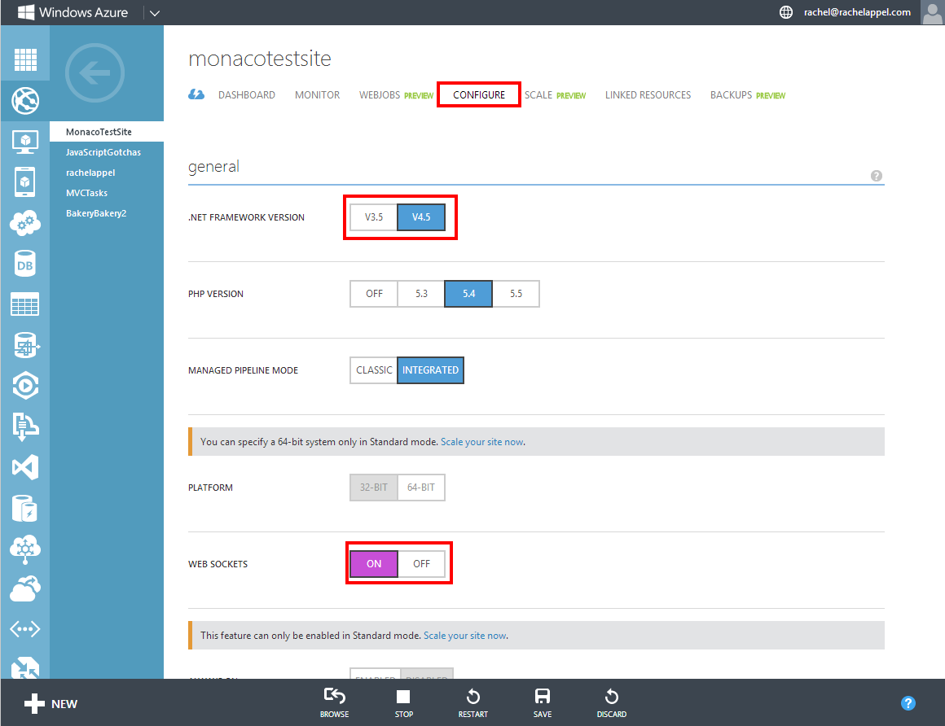

Slide 31
Thank You!
Rachel's Website
http://rachelappel.com
MSDN Modern Apps Column
http://msdn.microsoft.com/en-us/magazine/ee532098.aspx?sdmr=RachelAppel&sdmi=authors
WintellectNOW training videos
http://bit.ly/RachelNOW

