Slide 1
Can genetic diversity increase climate tracking?
Bioshifts working group
“Evolutionary potential” project

Slide 2
Expected effect of genetic diversity on range shift lags
Genetic variation underpins population fitness and adaptive potential.
Increase species inability to adapt to changes in environmental conditions.
Two processes: stay or move

Slide 3
Expected effect of genetic diversity on range shift lags
Genetic variation underpins population fitness and adaptive potential.
Increase species inability to adapt to changes in environmental conditions.
Two contrasting mechanisms: stay or move

Slide 4
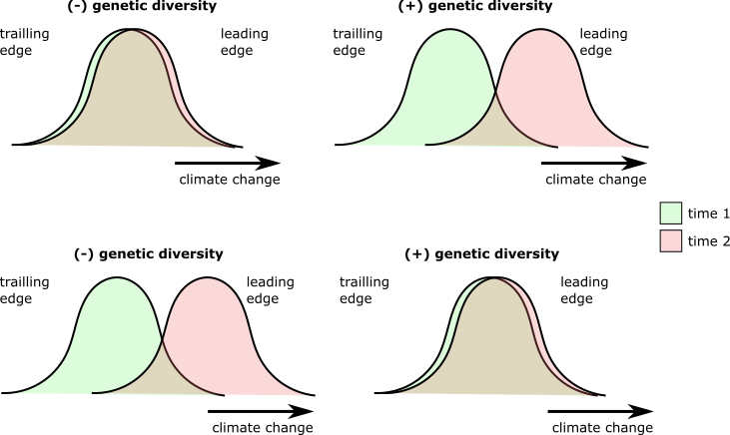
Expected effect of genetic diversity on range shift lags
Genetic variation underpins population fitness and adaptive potential.
Increase species inability to adapt to changes in environmental conditions.
Two processes: stay or move
Move to track climate change: higher potential to colonize new areas and adapt to the new community composition in newly colonized places
Lag
genetic diversity
Stay in place: higher plasticity or development of adaptations to tolerate new conditions
Lag
genetic diversity

Slide 5
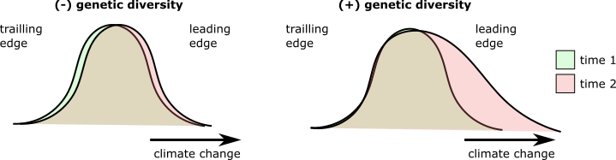
Expected effect of genetic diversity on range shift lags
Different processes may play out at difference range positions
Leading edge
Move to track climate change : higher potential to colonize new areas and adapt to the new community composition in newly colonized places
Lag (Clim. Vel. – Shift. Vel.)
Genetic diversity
Notes:
If there is selection for better dispersers at the leading edge

Slide 6
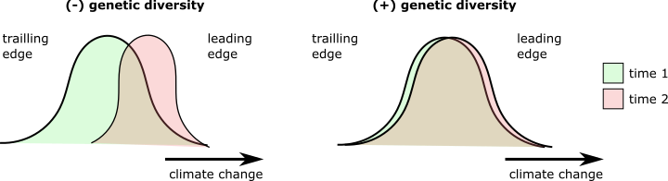
Expected effect of genetic diversity on range shift lags
Different processes may play out at difference range positions
Trailing edge
Stay in place: higher plasticity or development of adaptations to tolerate new conditions
Lag (Clim. Vel. – Shift. Vel.)
Genetic diversity

Slide 7
Expected effect of genetic diversity on range shift lags
Different processes may play out at difference range positions
Centroid
Both stay and move are possible
?
Lag (Clim. Vel. – Shift. Vel.)
Genetic diversity

Slide 8
Estimating lags in range shift
Lag = Climate change velocity – Range shift velocity
A given range shift northwards

Slide 9
Estimating lags in range shift
Lag = Climate change velocity – Range shift velocity
Species track temperature change
Lag = 0

Slide 10
Estimating lags in range shift
Lag = Climate change velocity – Range shift velocity
Species track temperature change
Lag = 0
Species lag behind temperature change
Lag > 0

Slide 11
Estimating lags in range shift
Lag = Climate change velocity – Range shift velocity
Species track temperature change
Lag = 0
Species lag behind temperature change
Lag > 0
Species overshoot temperature change
Lag < 0
Species tracks changes in temperature, but temperature is not the only limiting factor
Extinction of competitors from climate change can lead to competitor release and allow colonization of suitable areas not available in the original range.

Slide 12
Estimating lags in range shift
Lag = Climate change velocity – Range shift velocity
Species track climate change
Lag = 0
Species lag behind climate change
Lag > 0
Species overshoot climate change
Lag < 0
Species lag because they move against
climate change
Lag > 0
Species tracking changes in other climate axes (e.g., precipitation)
Rapid climate change can lead to extinctions at the LE, creating a contractions of the range due to local extirpations.
Here we test the ability of species to track climate change velocity. As we use a metric of temperature change velocity, we will only use shifts in the same direction of climate change velocity.

Slide 13
Estimating lags in range shift
Lag = Climate change velocity – Range shift velocity
Other cases…
Species lag because they move against temperature change
Lag >> 0
Species tracking changes in other climate axes (e.g., precipitation)
Rapid climate change can lead to extinctions at the LE, creating a contractions of the range due to local extirpations.

Slide 14
Expected effect of genetic diversity on range shift lags
Low GD
High GD
Low GD
High GD
Trailing edge
Leading edge
Lag (Clim. Vel. – Shift. Vel.)
Lag (Clim. Vel. – Shift. Vel.)
He
He

Slide 15
Estimating range shift lags
Lag = Temperature change velocity – Range shift velocity
Shifts in the same direction of climate change
Use fixed values
+ / +
- / -
++ / +
+ / ++
-- / -
- / --
Vel
Ran
Vel
Ran
Vel
Ran
Vel
Ran
5
3
3
5
-5
-3
-3
-5
Lag = 2
Lag = -2
Lag = -2
Fix sign
Lag = 2
Lag = 2
Fix sign
Lag = -2

Slide 16
Estimating range shift lags
Lag = Temperature change velocity – Range shift velocity
Shifts in the same direction of climate change
Use fixed values
Shifts in the opposite direction of climate change
Use absolute climate change velocity
+ / +
- / -
+ / -
- / +
++ / +
+ / ++
-- / -
- / --
++ / -
+ / --
-- / +
- / ++
Vel
Ran
Vel
Ran
Vel
Ran
Vel
Ran
Vel
Ran
Vel
Ran
Vel
Ran
Vel
Ran
5
3
3
5
-5
-3
-3
-5
5
-3
3
-5
-5
3
-3
5
Lag = 2
Lag = -2
Lag = -2
Fix sign
Lag = 2
Lag = 2
Fix sign
Lag = -2
Lag = 8
Lag = abs(velocity)
Lag = 5
Lag = 8
Lag = abs(velocity)
Lag = 3
Lag = -8
Lag = abs(velocity)
Lag = 5
Lag = -8
Lag = abs(velocity)
Lag = 3

Slide 17
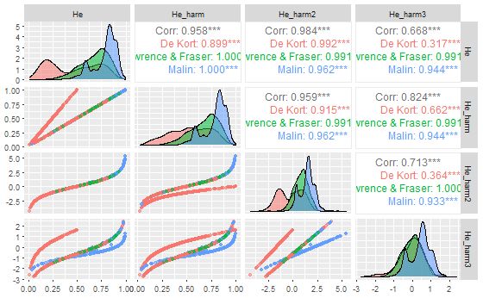
Harmonizing genetic diversity
We extracted He from 3 data sources:
De Kort et al. 2021 Nat Comm >> Microsatellites and AFPL
Lawrence et al. 2019 Sci Data >> Microsatellites
Pinsky, unpublished >> Microsatellites and mitochondrial
1) Harmonization methods
He_harm (De Kort et al 2021)
  Scale He by market type
  Standardize 0-1
He_harm2
  Logit transformation
He_harm3
  logit transformation (centered in zero)
2) Average by location

Slide 18
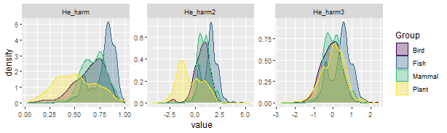
Harmonizing genetic diversity
We extracted He from 3 data sources:
De Kort et al. 2021 Nat Comm >> Microsatellites and AFPL
Lawrence et al. 2019 Sci Data >> Microsatellites
Pinsky, unpublished >> Microsatellites and mitochondrial
1) Harmonization methods
He_harm (De Kort et al 2021)
  Scale He by market type
  Standardize 0-1
He_harm2
  Logit transformation
He_harm3
  logit transformation (centered in zero)
2) Average by location

Slide 19
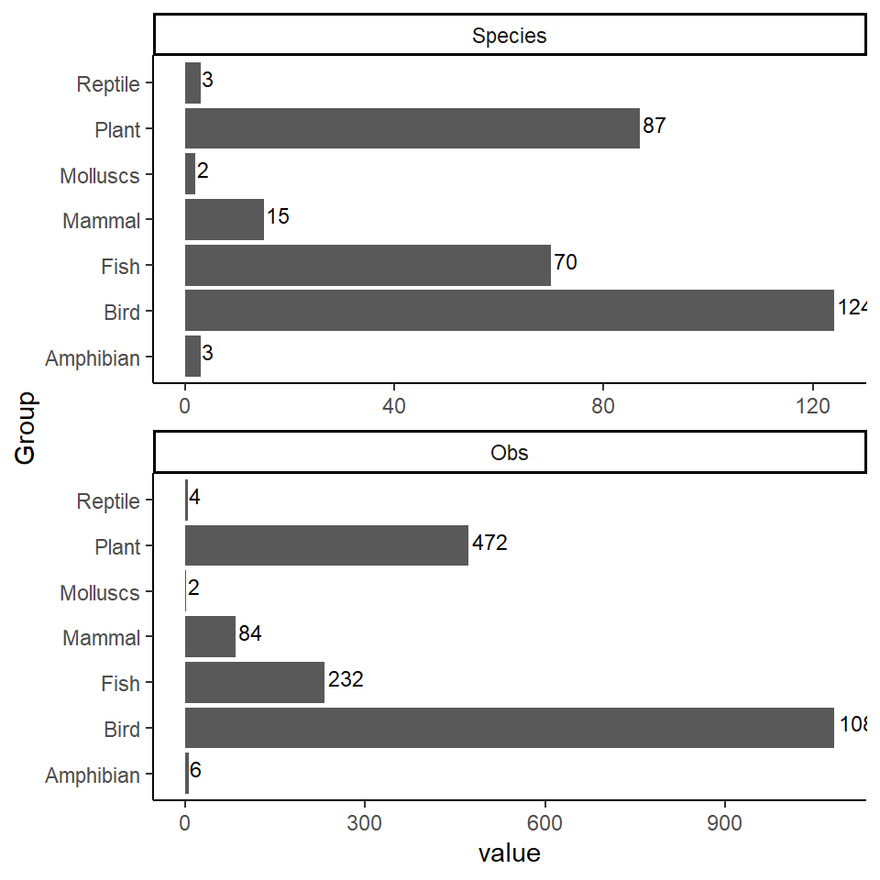
Pairing genetic data and range shifts
We extracted He from 3 data sources:
  De Kort et a. 2021 Nat Comm
  Lawrence et al. 2019 Sci Data
  Pinsky, unpublished.
304 species in common between Genetic and Bioshifts data
1.881 range shifts
7.847 He measurements (after averaging by location)

Slide 20
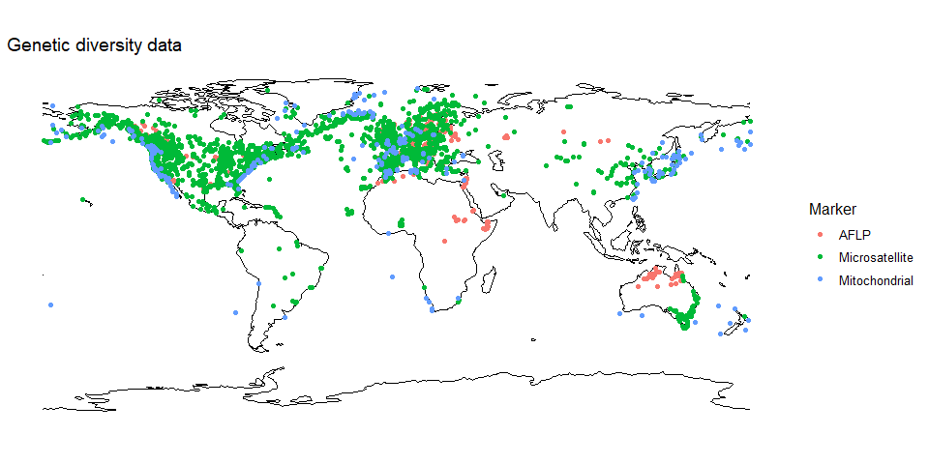
Merging genetic diversity with Bioshifts

Slide 21
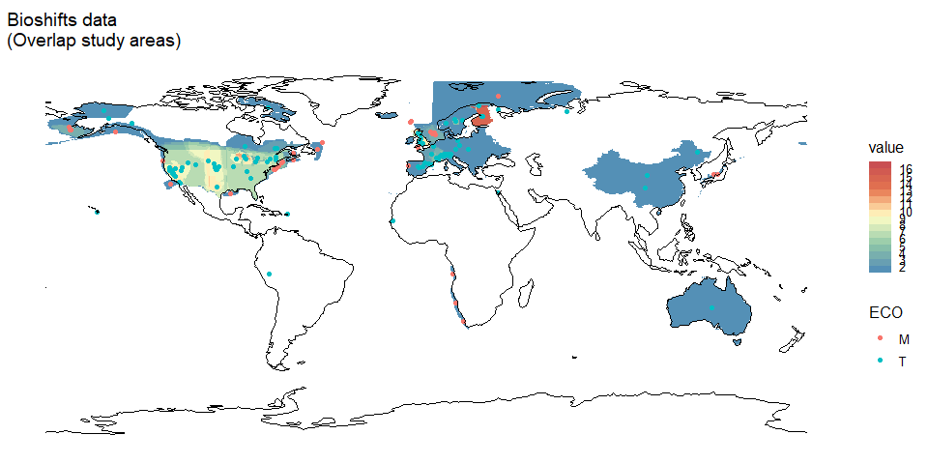
Merging genetic diversity with Bioshifts

Slide 22
Merging genetic diversity with Bioshifts
Notes:
Gen div in red
Blue is the study area

Slide 23
Merging genetic diversity with Bioshifts
Identify the edges of the study area
Max latitude (LE)
Mean latitude (O)
Min latitude (TE)
Notes:
Identify the edges of the study area

Slide 24
Merging genetic diversity with Bioshifts
Identify the edges of the study area
Select the He observation that is more closely located to each edge of the study area
Max latitude (LE)
Mean latitude (O)
Min latitude (TE)
Notes:
Identify the edges of the study area
2) Select the gen div obs that is more closely located to the edge of the study area

Slide 25
Merging genetic diversity with Bioshifts
Identify the edges of the study area
Select the He observation that is more closely located to each edge of the study area
Max latitude (LE)
Mean latitude (O)
Min latitude (TE)
Notes:
Identify the edges of the study area
2) Select the gen div obs that is more closely located to the edge of the study area

Slide 26
Merging genetic diversity with Bioshifts
Identify the edges of the study area
Select the He observation that is more closely located to each edge of the study area
Alternatively… average by distance (1/distance2)
Max latitude (LE)
Mean latitude (O)
Min latitude (TE)
Notes:
Identify the edges of the study area
2) Select the gen div obs that is more closely located to the edge of the study area

Slide 27
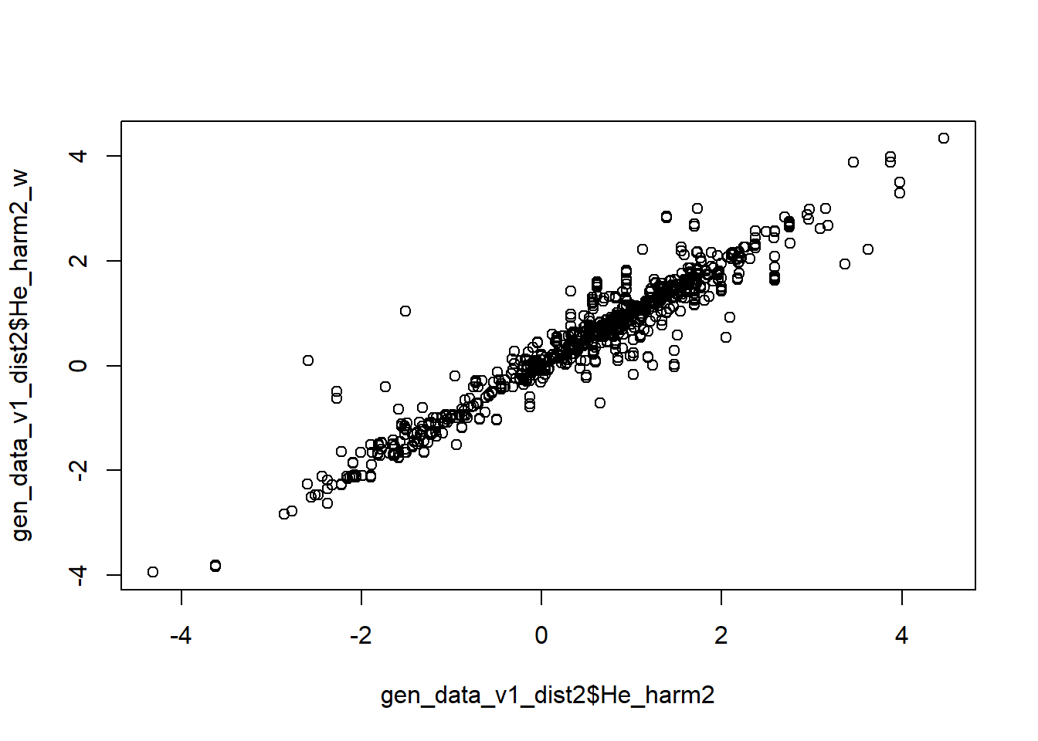

Slide 28
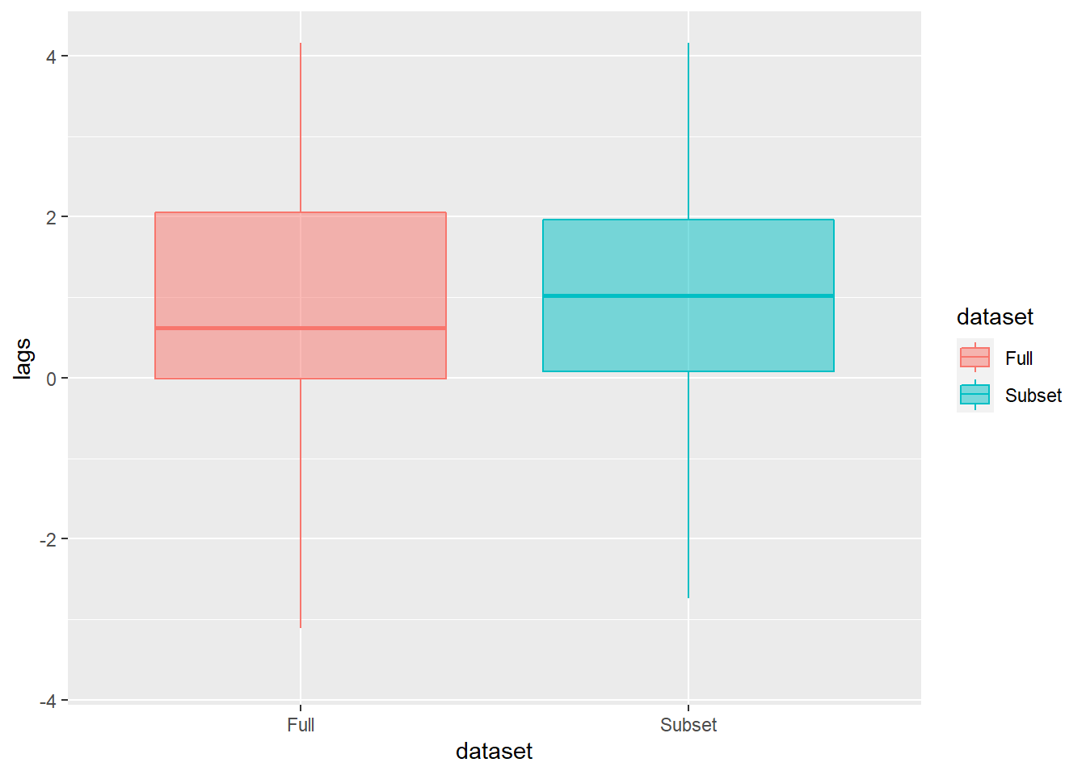
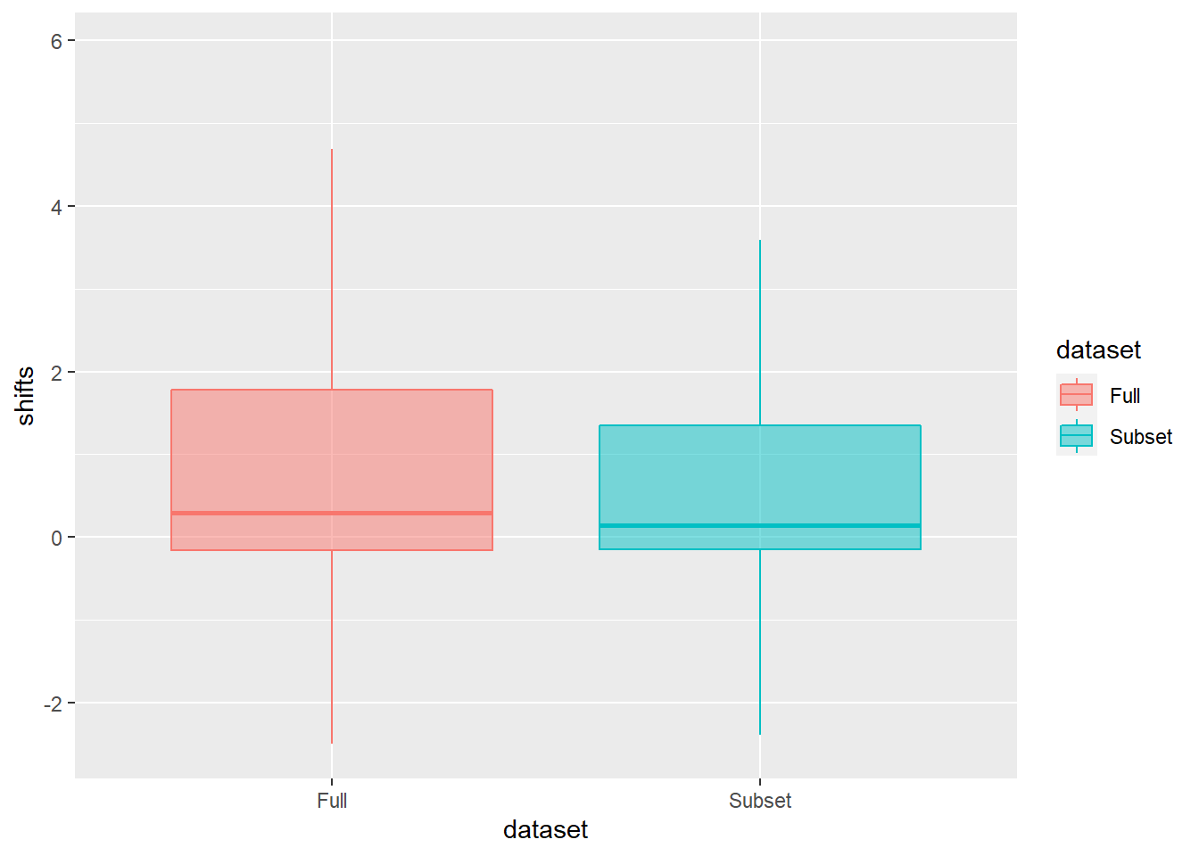
There is no difference in mean shift values between the full and subset data… but there is difference in lags…

Slide 29
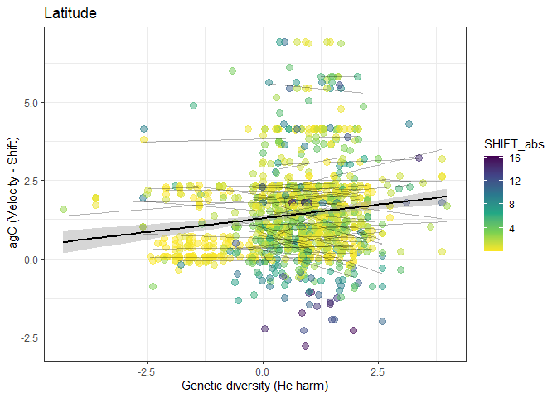
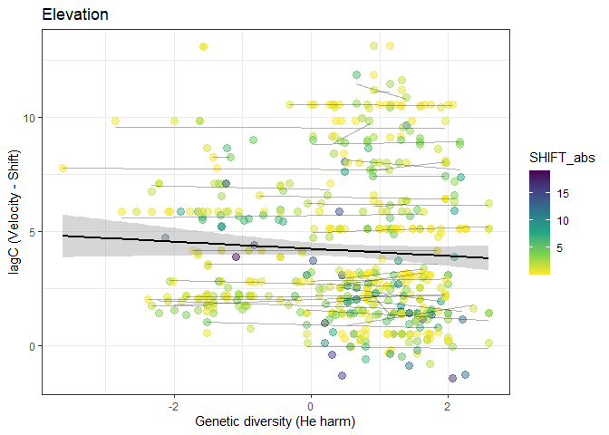
General pattern for lag

Slide 30
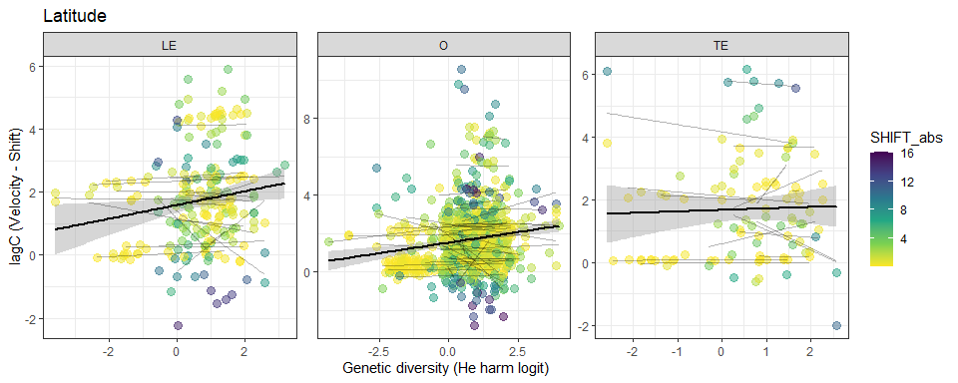
By range position

Slide 31
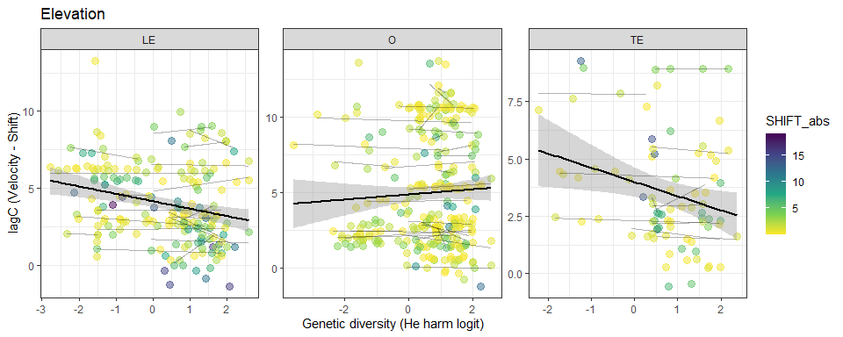
By range position

Slide 32
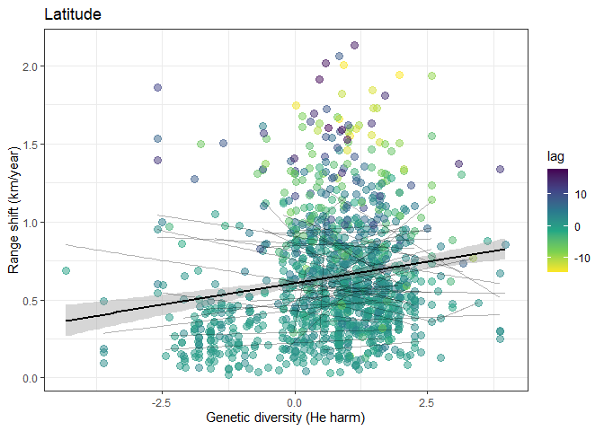
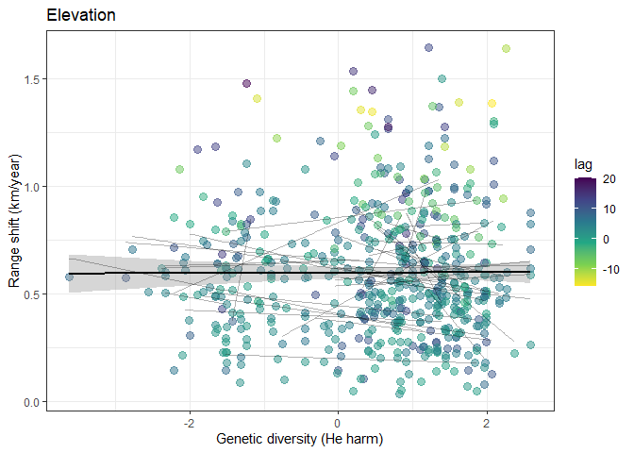
General pattern range shift

Slide 33
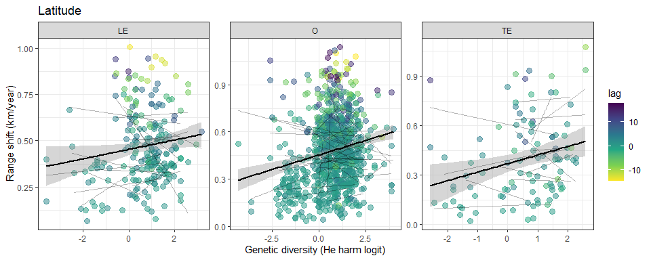
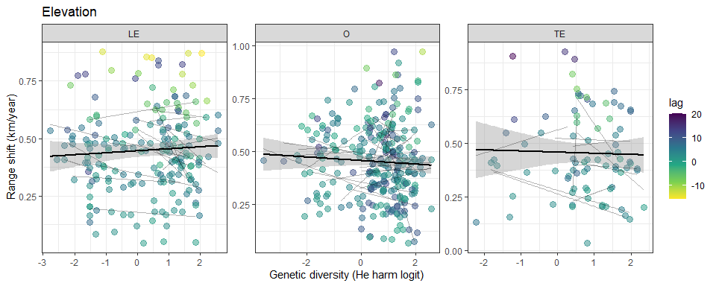
By range position

Slide 34
Playing with models – raw shift
Range shift models
lmer(SHIFT ~
    He*Group*Param + velocity + I(velocity^2)
START + ID.area + Sampling + Uncertainty_Parameter +
Uncertainty_Distribution + Grain_size + Data +
(1|Article_ID)+
(1|Marker)+
(1|Family/Genus),
weights = dist_weight,
  REML=TRUE,
data = model_data)
Ecology
Fixed effects
Methods
Random effects
Weighting uncertainty

Slide 35
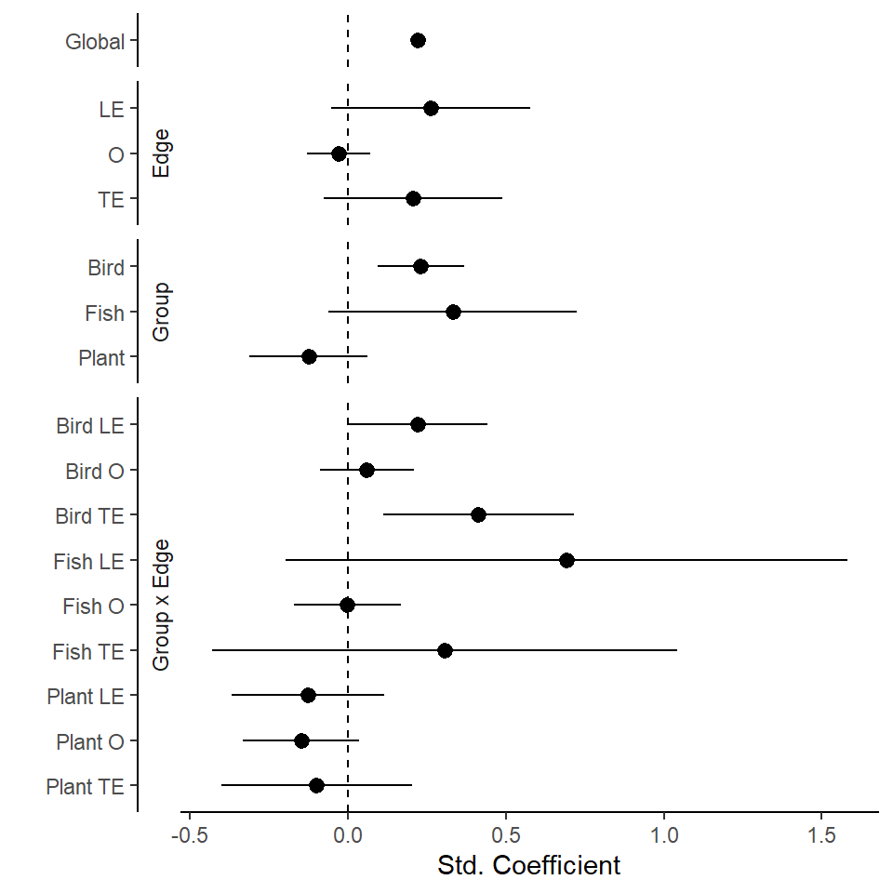
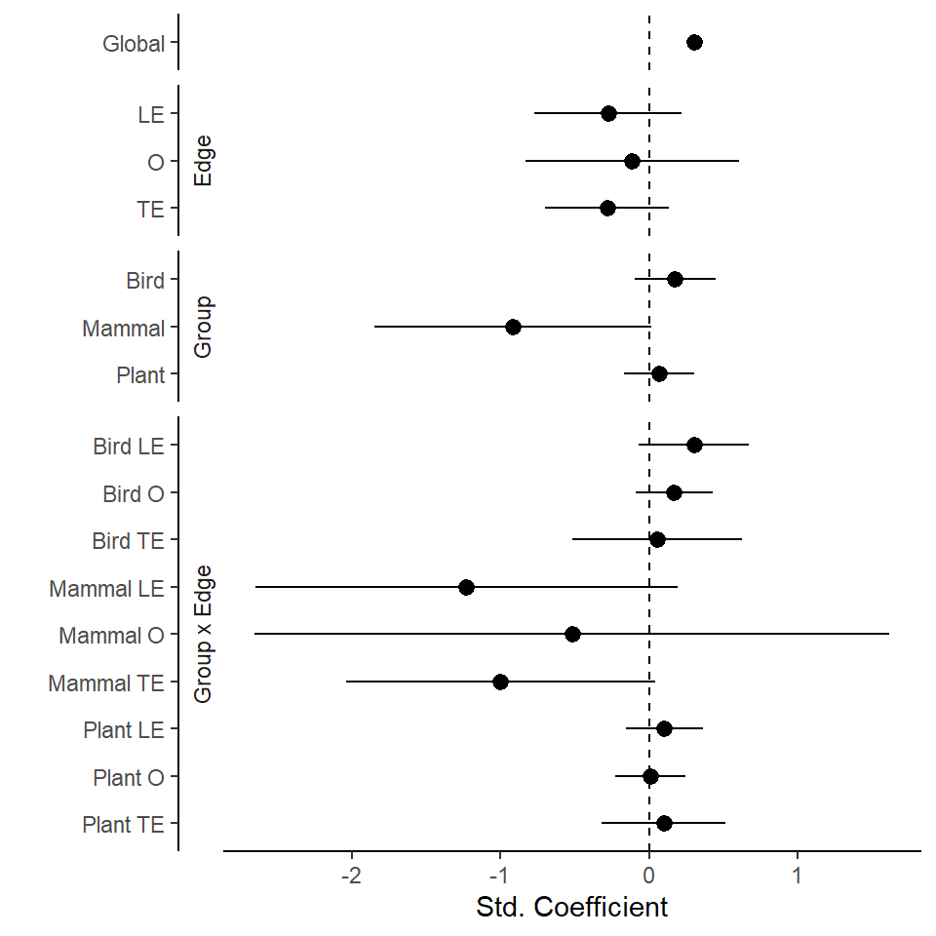
Raw shift model
Latitude
Elevation

Slide 36
Playing with models – corrected shift
Range shift models
lmer(SHIFT ~
    He*Group*Param + velocity + I(velocity^2)
(1|Article_ID)+
(1|Marker)+
(1|Family/Genus),
weights = dist_weight,
  REML=TRUE,
data = model_data)
Ecology (Fixed effect)
Random effects
Weighting uncertainty

Slide 37
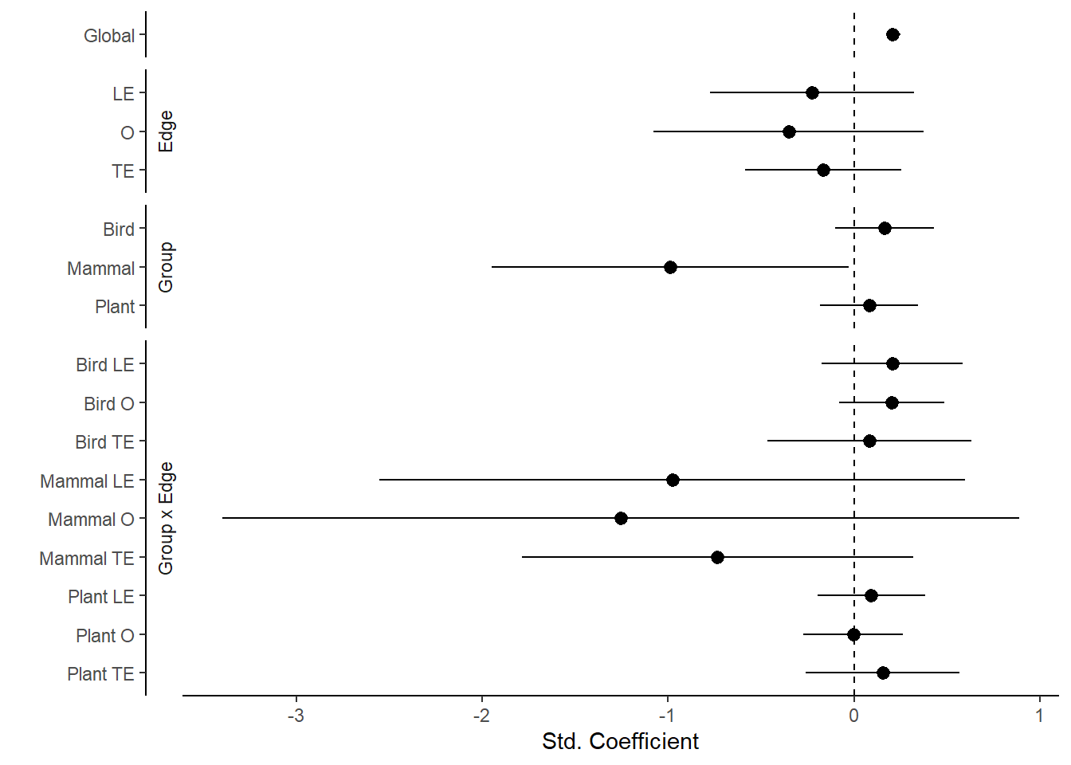
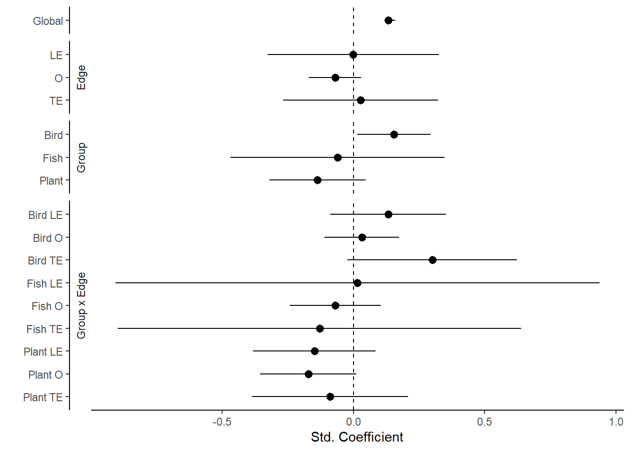
Corrected shift model
Latitude
Elevation

Slide 38
Playing with models – raw lag
Linear mixed effects
lmer(lag ~
    He*Group*Param +
START + ID.area + Sampling + Uncertainty_Parameter +
Uncertainty_Distribution + Grain_size + Data +
(1|Article_ID)+
(1|Marker)+
(1|Family/Genus),
weights = dist_weight,
  REML=TRUE,
data = model_data)
Ecology
Fixed effects
Methods
Random effects
Weighting uncertainty
Notes:
Uncertainty_Parameter = yes, no
Uncertainty_Distribution = "PROCESSED“, "OPPORTUNISTIC“
Grain_size = large, small, moderate
Data = abundance-based, occurrence-based

Slide 39
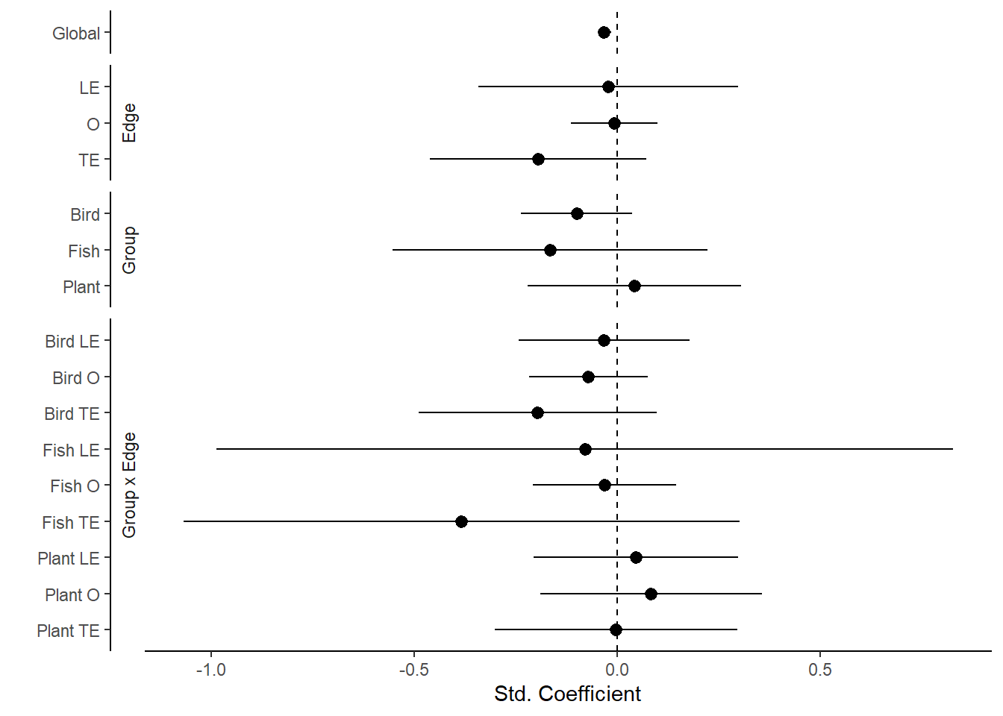
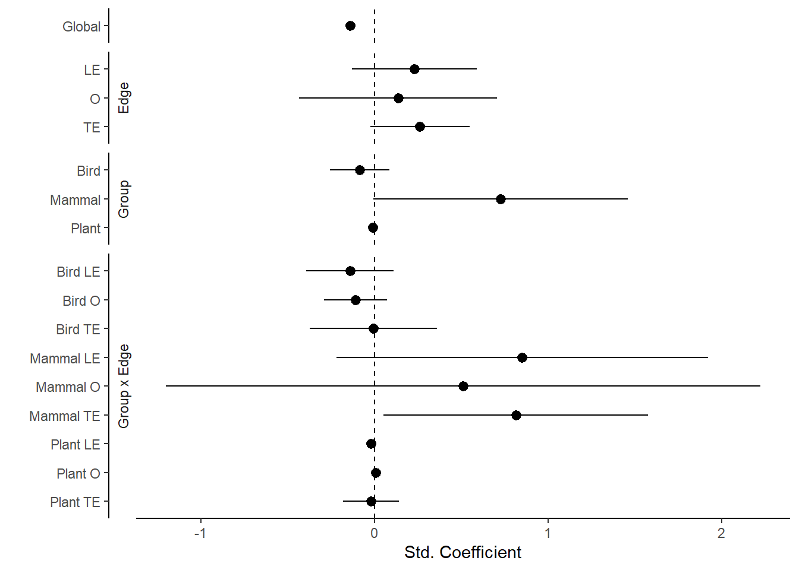
Raw lag model
Latitude
Elevation

Slide 40
Playing with models
Linear mixed effects
Lag corrected
lmer(lag ~
    He*Group*Param +
(1|Article_ID)+
(1|Marker)+
(1|Family/Genus),
weights = dist_weight,
  REML=TRUE,
data = model_data)
Ecology (Fixed effect)
Random effects
Weighting uncertainty
Notes:
Uncertainty_Parameter = yes, no
Uncertainty_Distribution = "PROCESSED“, "OPPORTUNISTIC“
Grain_size = large, small, moderate
Data = abundance-based, occurrence-based

Slide 41
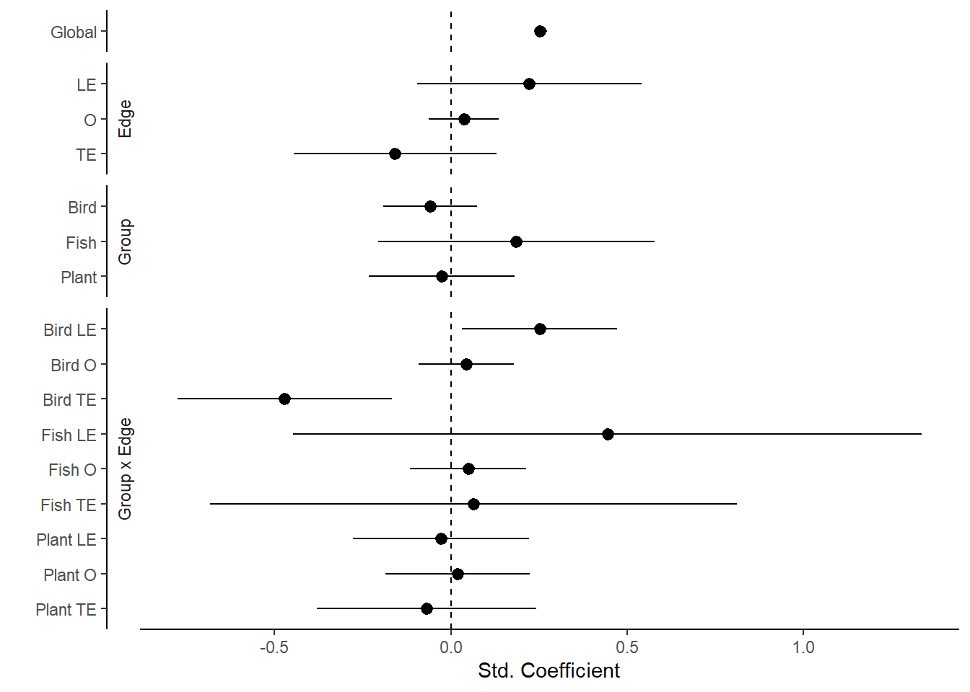
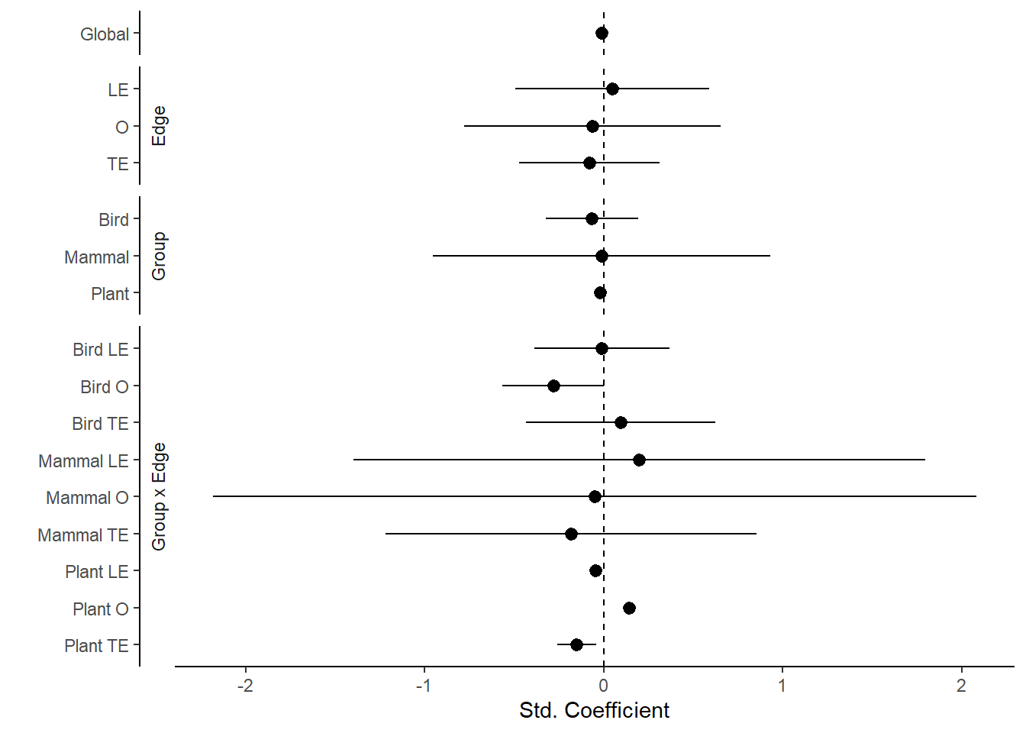
Corrected lag model
Latitude
Elevation

Slide 42
Position | Direction | Dynamic | Correction
Leading edge | + | Establishment
 | - | Extirpation | SHIFT/velocity * -1
Centroid | + | Centroid shift
 | - | Centroid shift | SHIFT/velocity * -1
Trailing edge | + | Extirpation
 | - | Establishment | SHIFT/velocity * -1

Slide 43
SHIFT ~ He * velocity * Ext/Est +
Methods +
(1|spp) +
(1|StudyID)

Slide 44
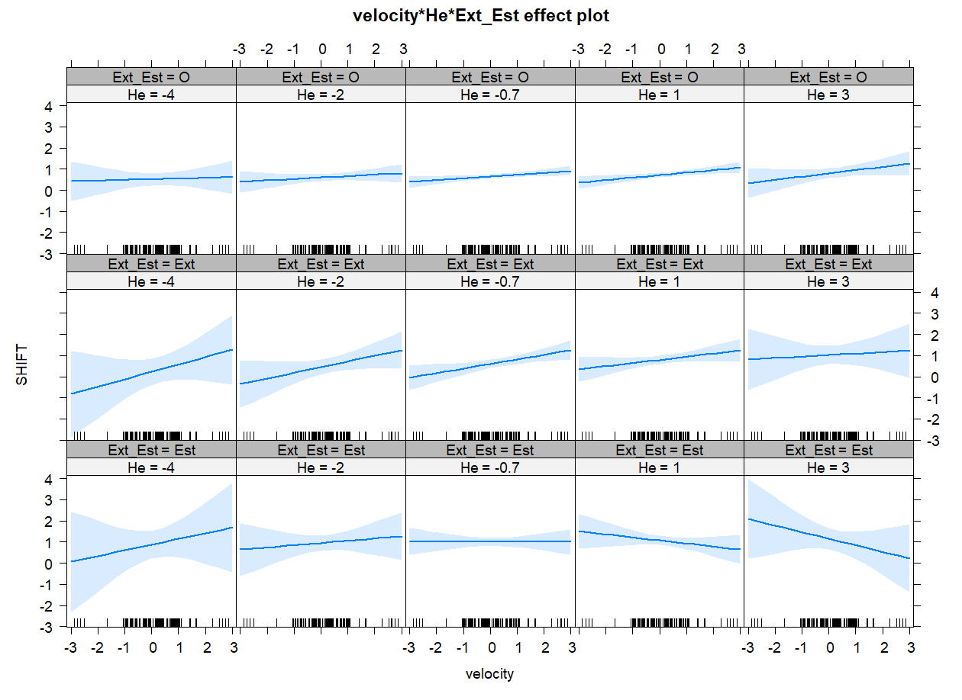
SHIFT ~ He * velocity * Ext/Est +
Methods +
(1|spp) +
(1|StudyID)

Slide 45
SHIFT ~ He * velocity * Ext/Est +
Methods +
(1|spp) +
(1|StudyID)
SHIFT ~ velocity * Ext/Est +
Methods +
(1|spp) +
(1|StudyID)
AIC = 1464.110
AIC = 1433.994

Slide 46
SHIFT ~ He * velocity * Ext/Est +
Methods +
(1|spp) +
(1|StudyID)
SHIFT ~ velocity * Ext/Est +
Methods +
(1|spp) +
(1|StudyID)
AIC = 143.8278
AIC = 136.5109
Extirpation only

Slide 47
SHIFT ~ He * velocity * Ext/Est +
Methods +
(1|spp) +
(1|StudyID)
SHIFT ~ velocity * Ext/Est +
Methods +
(1|spp) +
(1|StudyID)
AIC = 228.9960
AIC = 221.4346
Establishment only

Slide 48
SHIFT
VELOCITY
Position | SHIFT | Velocity | Correction | Process
Leading edge | + | + |  | Expansion
 | + | - | *-1 | Contraction
 | - | + |  | Expansion
 | - | - | *-1 | Contraction
Trailing edge | + | + |  | Contraction
 | + | - | *-1 | Expansion
 | - | + |  | Contraction
 | - | - | *-1 | Expansion
Centroid | + | + |  | Expansion
 | + | - | *-1 | Contraction
 | - | + |  | Contraction
 | - | - | *-1 | Expansion

Slide 49
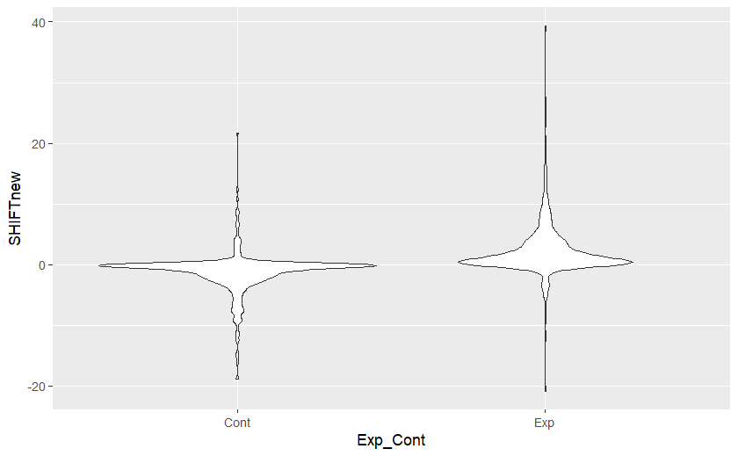


Slide 50
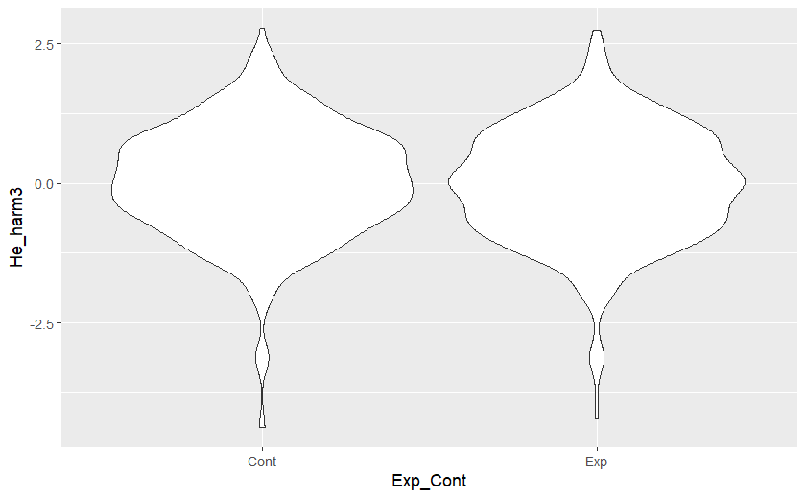

Slide 51
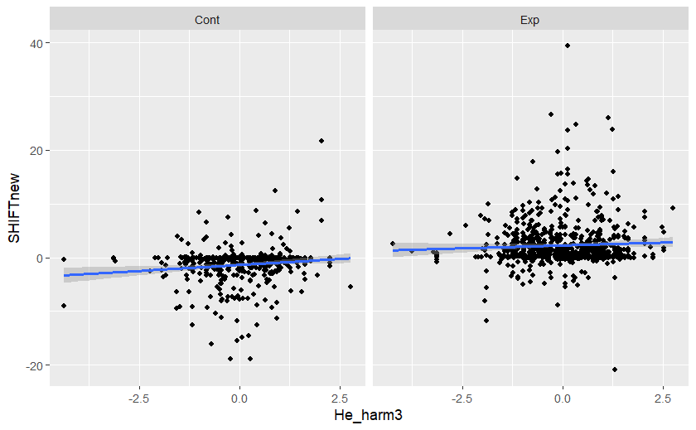

Slide 52
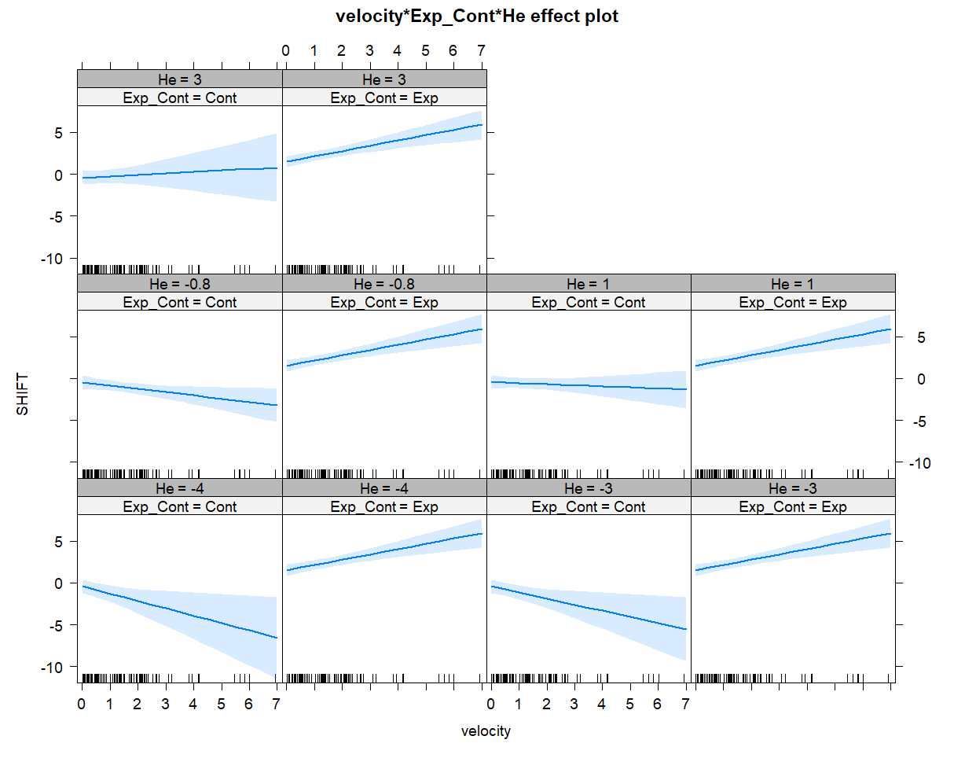
SHIFT ~ He * velocity * Expansion vs contraction +
Methods +
(1|spp) +
(1|StudyID)

