Slide 1
Comparative Genomics
5. Gene order analysis

Slide 2
Outline
Introduction
Analysing synteny with dotplots
Using gene order for phylogeny

Slide 3
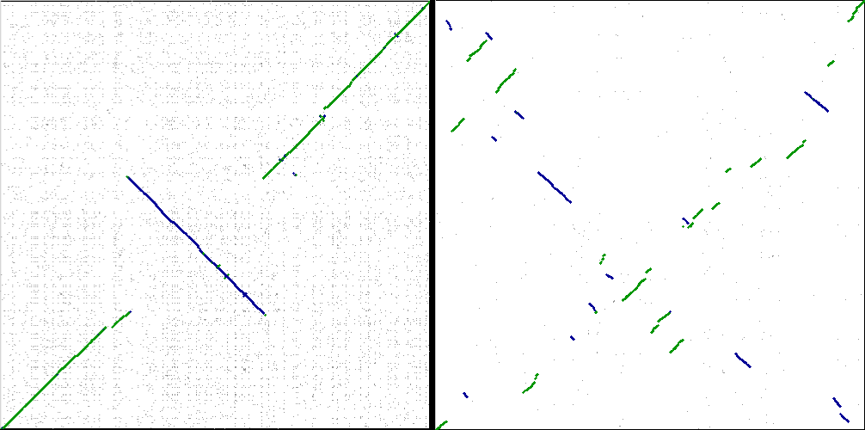
Gene order conservation = synteny
In closely related genomes, gene order may be preserved and can give functional insights.

Slide 4
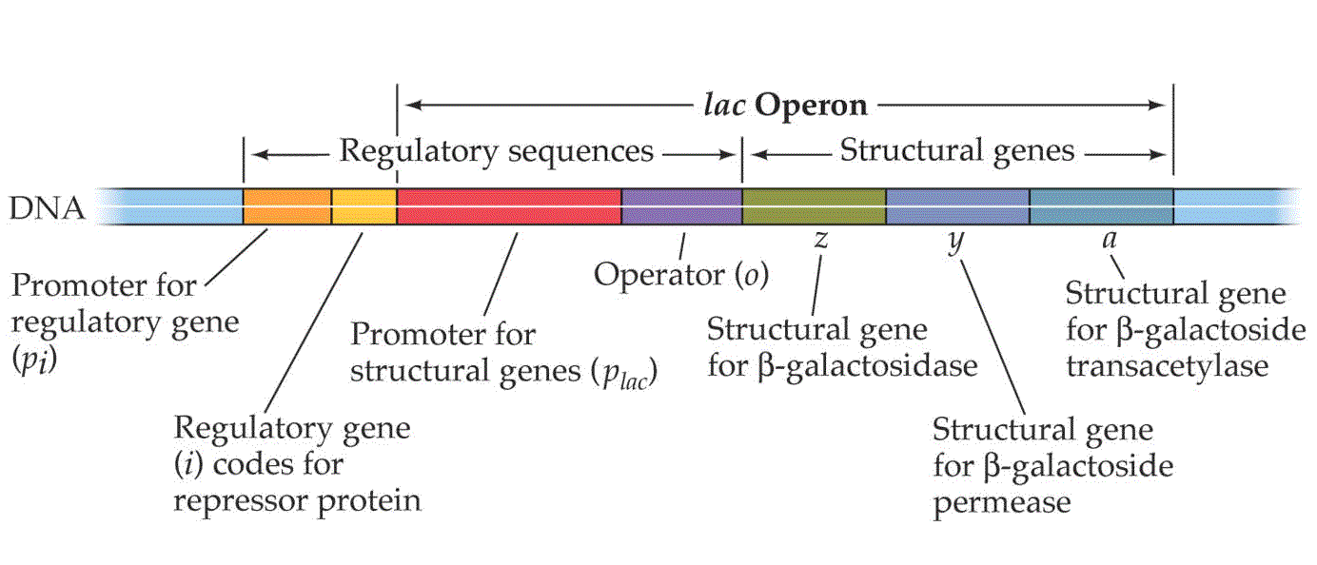
Synteny
Genes may remain in the same order during evolution because they share regulatory elements that require proximity.
In bacteria, this is relatively strong due to operons.
In eukaryotes, this is much weaker but still detectable.

Slide 5
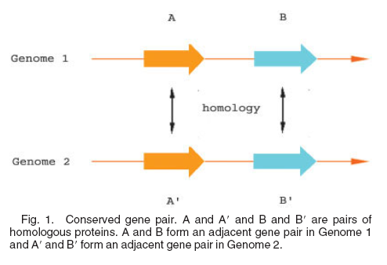
Operons
Genes in an operon may be detected via co-expression..
or via locally preserved gene order across species.
Even where gene order otherwise if lost, if species uses operons, those should remain intact

Slide 6
Dotplotting
Early tool to get an overview of sequence similarity.
Plot a matrix of sequence position vs sequence position
For “window” of positions centred on each position, plot a dot if it exceeds a cutoff.
More sophisticated software may have other criteria for deciding whether to plot a dot, and for rendering dots.

Slide 7
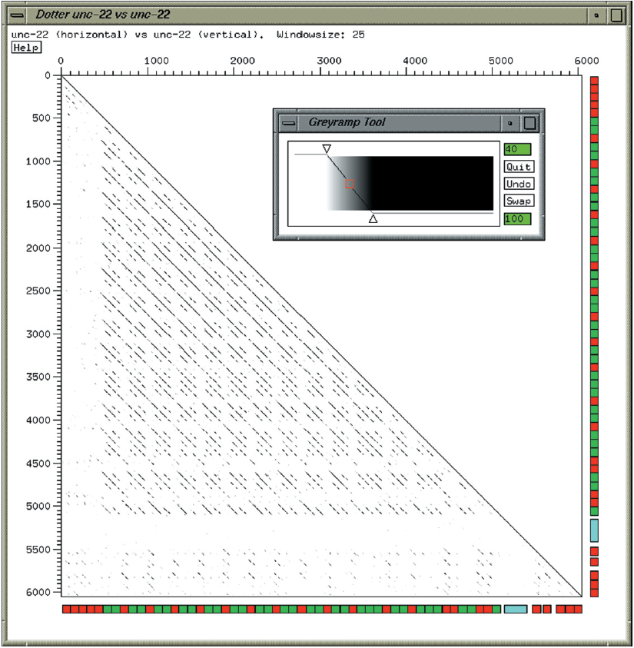
Dotplotting
Repeat regions will show up clearly
Inversion regions may be detected
Software: Dotter

Slide 8
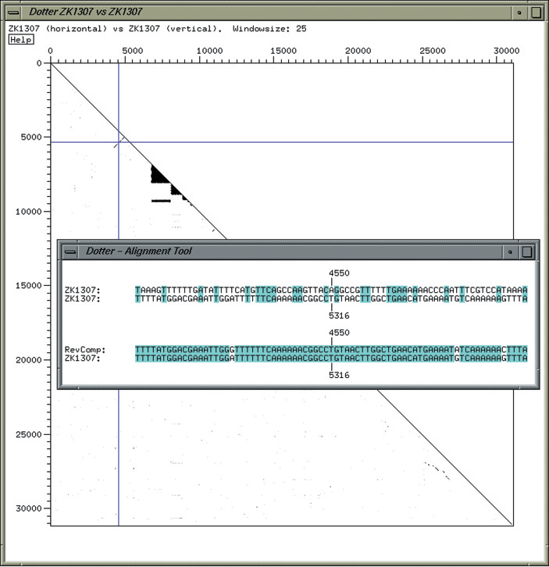
Dotplotting with Dotter

Slide 9
Dotplotting synteny
Genomic dotplotting – tool for visualizing synteny (preserved gene order)
One solution:
For each group of homologous genes, define a short (~20) unique pseudosequence of letters – its unique iconic sequence
Make pseudogenomes of the iconic sequences for their genes, in genomic order
Dotplot the resulting pseudogenomes against each other

Slide 10
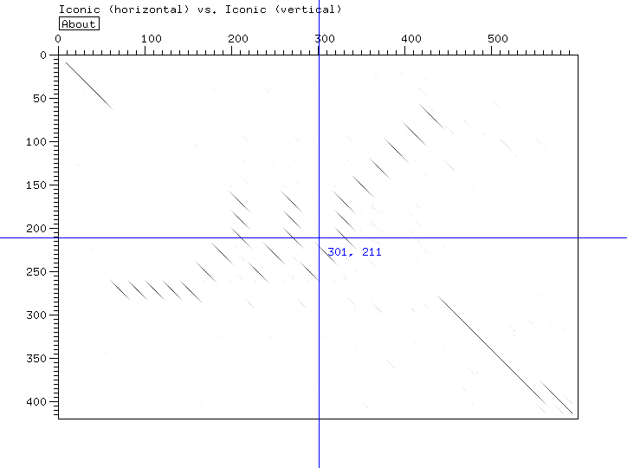
Dotplotting synteny
Example:
  G1: 1 2 3 4 4 4 4 4 5 6 7 5 6 7 5 6 7 8 9 10 11 12 13 14 15 16 17 18 18 19 20
  G2: 1 2 3 12 11 10 9 8 7 7 7 6 5 4 13 14 15 16 17 18 19 20

Slide 11
Gene order phylogeny
Genomes shuffle gene order as a function of time
Between closely enough related species, gene order is conserved
Gene order changes slower than the raw sequence but faster than gene content
This enables analysis of gene order changes to study evolution

Slide 12
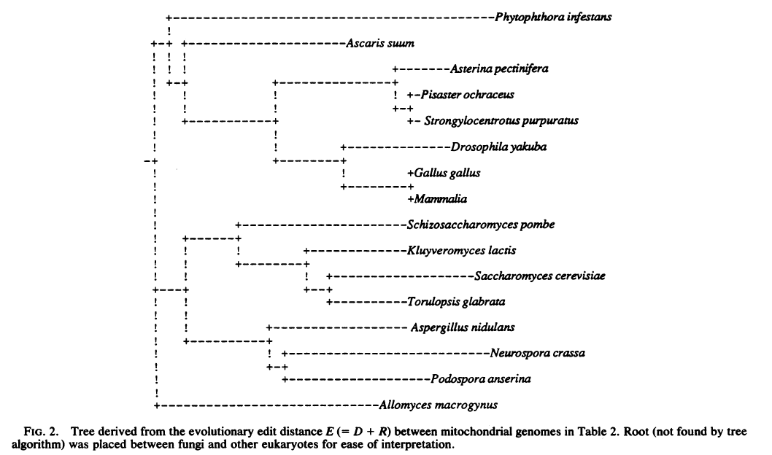
Gene order phylogeny
Sankoff et al., 1992. Mitochondrial phylogeny from gene order (PMID 1631158):

Slide 13
Gene order phylogeny
Consider two genomes represented as gene orderings
  <gene 1, genome 1> <gene 2, genome 1> <gene 3, genome 1>... <gene n, genome 1>
  <gene 1, genome 2> <gene 5, genome 2> <gene 4, genome 2>... <gene n, genome 2>
Define the edit distance E(a, b) as the number of elementary events necessary to change the gene order of genome a into that of genome b.
Elementary events: inversions, transpositions, and deletions/insertions.
Note that E(b, a) = E(a, b)
Example of inversion:
  1 2 3 4 5 6 7 8
  1 2 6 5 4 3 7 8

Slide 14
Gene order phylogeny
Practical approach:
Consider two genomes represented as gene orderings
  <gene 1, genome 1> <gene 2, genome 1> <gene 3, genome 1>... <gene n, genome 1>
  <gene 1, genome 2> <gene 5, genome 2> <gene 4, genome 2>... <gene m, genome 1>
Only include genes that have orthologs in the other genome
Label orthologs in the same way
  1 2 3 4 5 6 7 8 9 10 11 12 ...
  1 5 4 3 2 6 7 8 12 11 10 9 ...
Align these sequences and find the smallest number of elementary events needed to go from a to b.

Slide 15
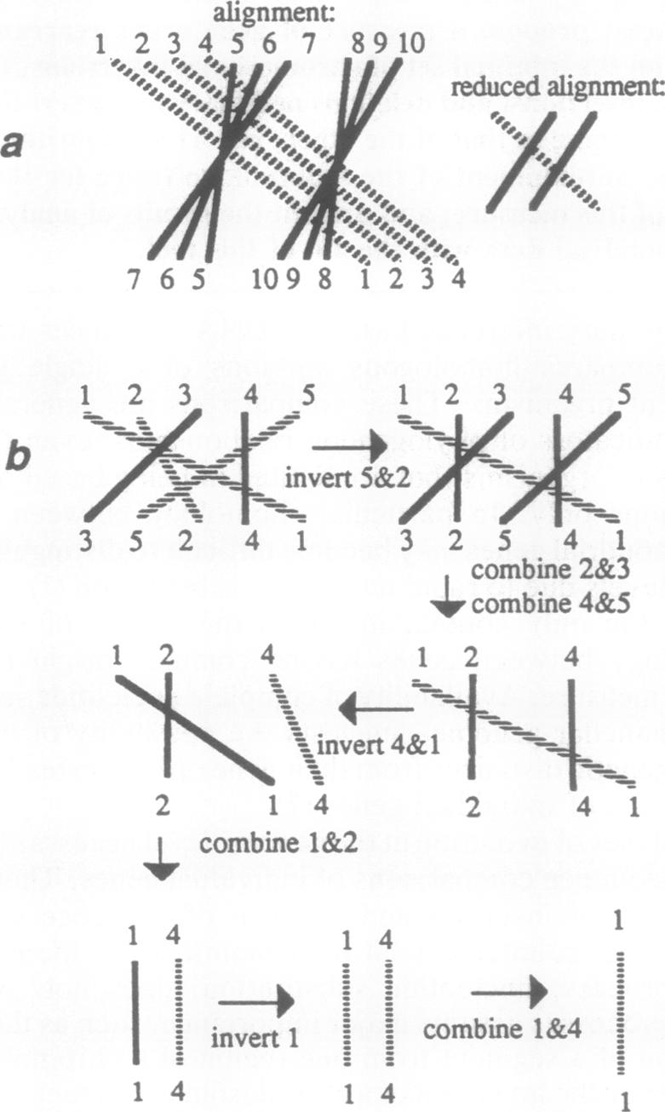
Sankoff et al., Fig. 1. Examples of alignment reduction. (a) Two or more homologous pairs of genes that are adjacent in both genomes and are either of the same orientation and order, such as the four pairs linked by dotted lines, or of opposing orientation and in reverse order, such as the two groups of three pairs linked by solid lines, may be combined and replaced by a single symbol representing a "conserved segment," since the minimum number of recombinatory events for the reduced (after this combination operation) problem is the same as the original (before combination) problem. (b) Reducing an alignment while finding a three-inversion solution for the minimal events distance.

Slide 16
Gene order phylogeny tools
GoTree, derange, GRAPPA, chromtree, GRIMM, (phylip).
To make a tree from distance data, e.g. Belvu or phylip can be used.

Slide 17
Conclusions
When synteny is partial, it can indicate functional association.
Dotplots are useful for detailed pairwise synteny analysis.
Large-scale usage of synteny can be done with minimum edit distance algorithms.

