Slide 1
Comparative Genomics
6.1 Orthology Concepts
Zvelebil Chapter 7.2

Slide 2
Outline
Definitions
Assumptions
Applications
How to identify orthologs

Slide 3
What do you know?
Homolog?
Ortholog?
Paralog?
Speciation?
Gene duplication?
Inparalog/Outparalog?

Slide 4
Homologs
Genes with a common origin
May be genes in the same or in different organisms
Does not say that function is identical
Homologs have the same 3D-structure layout
Can only be true or false, and not a percentage!

Slide 5
Homologs
Orthologs
Paralogs

Slide 6
Orthologs: separated by speciation
Gene X
in human
Orthologs
Gene X
in ancient mammal
Out-
Gene X
in rat
S
paralogs
Gene Y1
in human
D
In-paralogs
D
Gene Y2
in human
Orthologs
Gene X
in ancient animal
S
Gene Y
in rat
Gene Y
in ancient mammal
speciation
Time

Slide 7
In/Out-paralog definition
In-paralogs ~ co-orthologs
  paralogs that were duplicated after the speciation and hence are orthologs to a cluster in the other species
Out-paralogs = not co-orthologs
  paralogs that were duplicated before the speciation. Not necessarily in the same species.
Sonnhammer & Koonin, Trends Genet. 18:619-620 (2002)

Slide 8
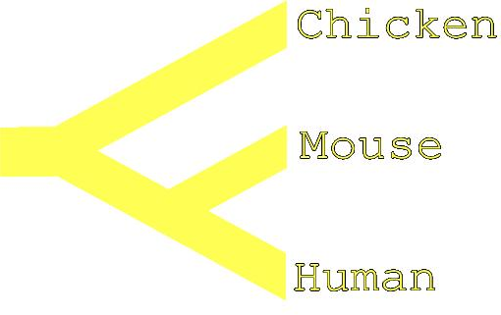
Gene trees and species trees
Evolution of gene != evolution of species
H1
H2
C
M
H3

Slide 9
Reconciliation of a gene tree with a species tree
H1
H2
C
M
H3
Gene tree
Species tree
Speciation
Duplication
Loss (deletion)

Slide 10
Outline
Definitions
Assumptions
Applications
How to identify orthologs

Slide 11
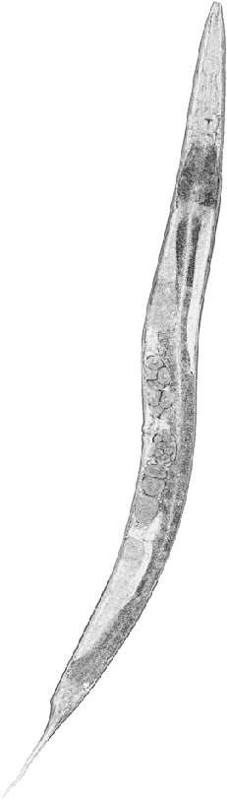
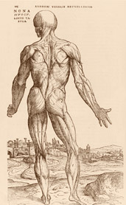
Orthologs for functional genomics
Orthologs (inparalogs /co-orthologs) are more likely than outparalogs to have identical biochemical functions and biological roles.
Orthologs can be used to discover human gene function via model organism experiments.
Orthologs are key to exploit functional genomics/proteomics data in in model organisms.

Slide 12
Orthology and function conservation
Orthology does not say anything about evolutionary distance.
Close orthologs, e.g. human-mouse are very likely to have the same biological role in the organism.
Distant orthologs, e.g. human-worm are less likely to have the same phenotypical role, but may have the same role in the corresponding pathway.

Slide 13

Orthology is not transitive!
Multiple species at different distances may give erroneous groups, that includes out-paralogs

Slide 14
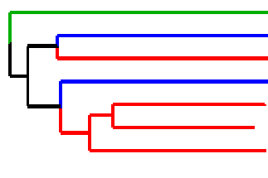
Orthology is not transitive!
Y
H1
D1
H2
D2
Y
D1
H2
-> Orthology strictly defined for only 2 species/clades
Combining species of different distances is dangerous
But OK to combine multiple equidistant ones

Slide 15
Outline
Definitions
Assumptions
Applications
How to identify orthologs

Slide 16
Applications
Applications of orthologs:
Functional transfer between organisms
  Genome and gene annotation
  Gene Ontology term assignment
  Model organism selection
Mapping evolution
  Tree of Life projects
  Calibration of phylogenetic inference methods

Slide 17
Applications
Orthology as a proxy to map disease genes
Human disease ortholog (cancer)
Mouse disease ortholog
Cancer-associated

Slide 18
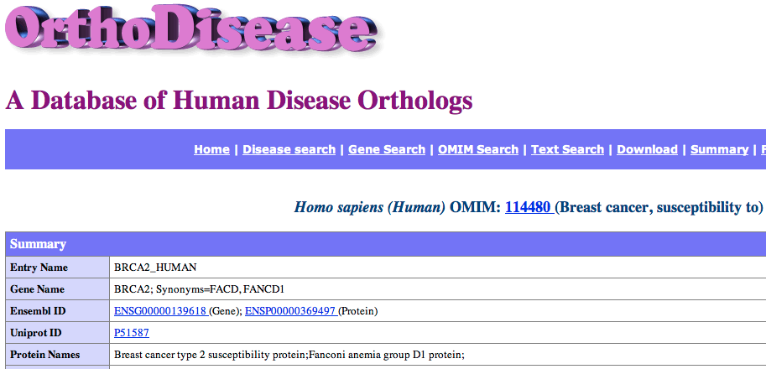
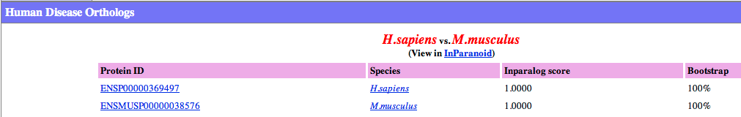
Applications
Orthology as a proxy to map disease genes
orthodisease.sbc.su.se

Slide 19
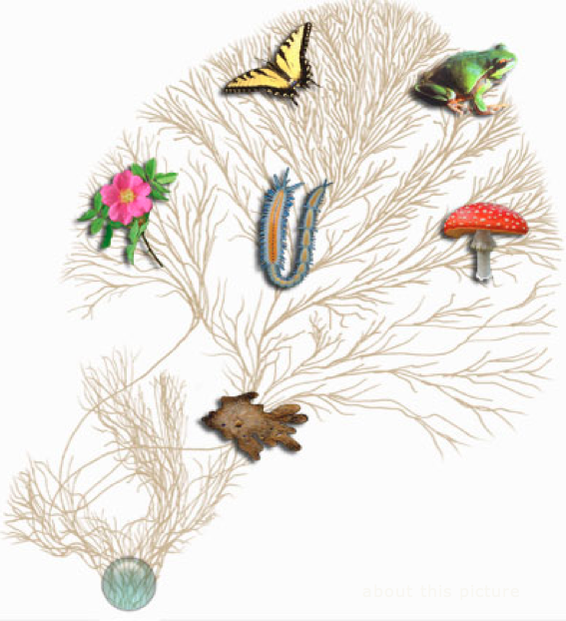
Applications
Study evolution of species
Gene A
Human
Mouse
Chicken
Tree

Slide 20
Applications
Study evolution of species
Goal: Species tree of
Human
Mouse
Chicken
Detect orthologs
Tree of Life
Tree

Slide 21
Outline
Definitions
Assumptions
Applications
How to identify orthologs

Slide 22


How to find orthologs?
Calculate phylogenetic tree, look for orthologs in the tree
Graph-based methods. Two-way best matches between two species can be used to find orthologs without trees.

Slide 23
Our ortholog predictions is always only as good as our data
Continue after break

