Slide 1
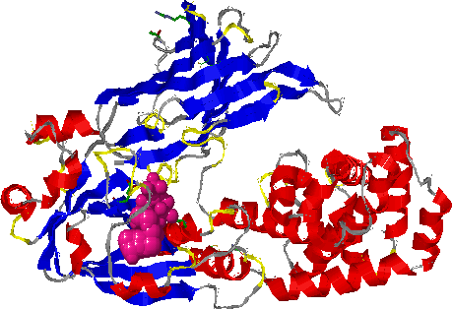
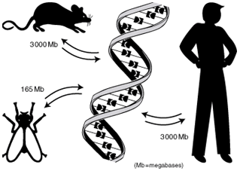
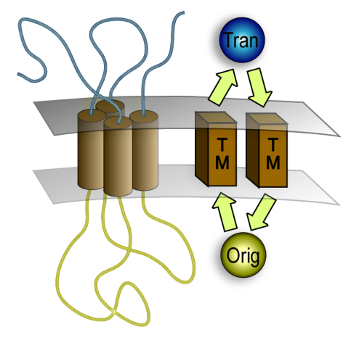
KB8007 Comparative Genomics
Function prediction

Slide 2
Outline
Protein domain annotation
Protein function annotation
Protein transmembrane prediction

Slide 3
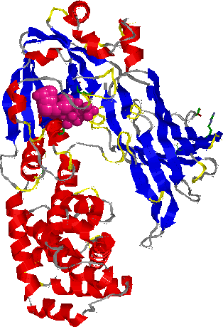
What is a Protein Domain?
Many proteins consist of discrete evolutionary units, domains
Domains:
  May exist alone or on the same protein chain as other domains.
  They can fold independently.
  Often correspond to a structural domain.

Slide 4
Multidomain proteins
30-60% of all proteins have been estimated to contain multiple domains.
Often one domain is repeated in the same protein.
Many regions between known domains have an unknown function.

Slide 5
The domain mapping problem
N
C
?
N
C
Why important: - Functional insights
- Improved database searching
- Fold recognition
- Localization
- Guide experiments

Slide 6
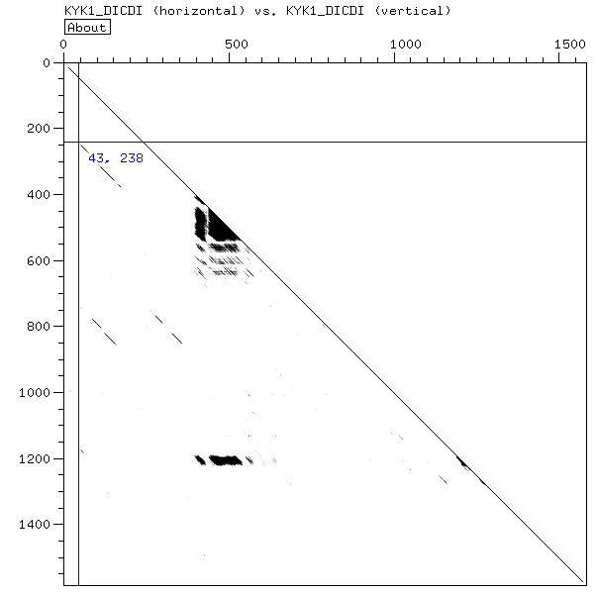
Internally repeated domains
Internal duplications with sequence similarity can be detected with a dot plot.
Run e.g. Dotter

Slide 7
How to find domains?
Single sequence database searching is very easy and can sometimes indicate domains.
The closest relatives may have annotated domains.

Slide 8
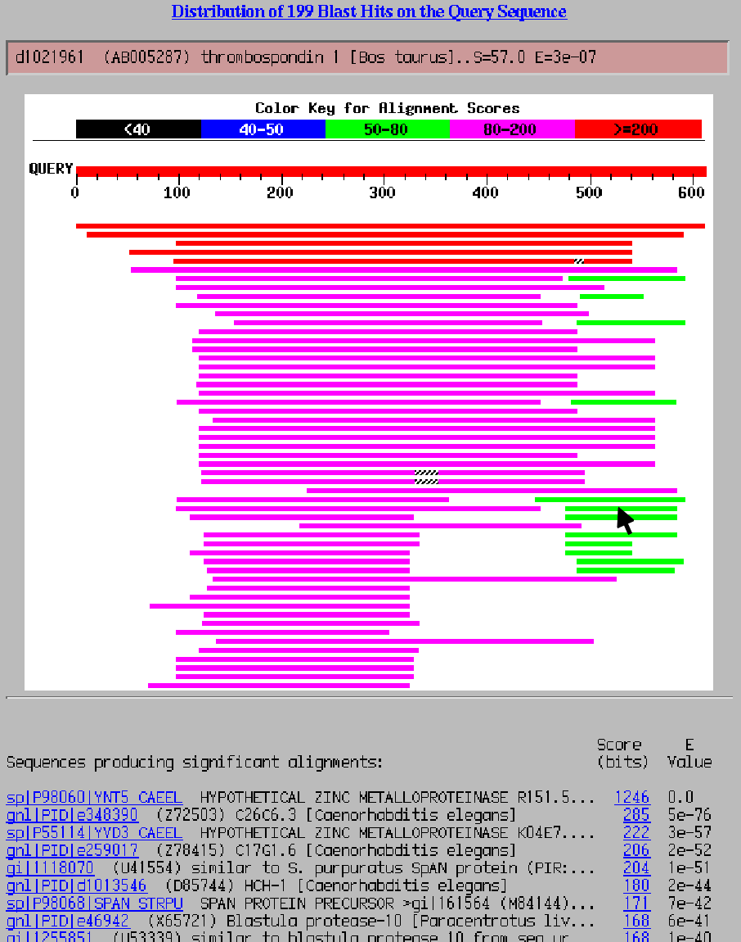
NCBI BLAST on the Web

Slide 9
Domain databases
Many of the common domains have already been defined in domain databases.
Advantages:
  Pre-annotated domains
  Easy interpretation of domain structure
  Sensitivity can be higher
Some databases:
  Pfam - CDD
  Superfamily - Gene3D
  Panther - TIGRfams
  Prosite - Blocks
  Smart - ProDom
  Prints
  Combined: Interpro

Slide 10
Protein domain family construction modes
Manual domain family construction
High quality
Labor-intensive to construct and maintain
ad-hoc, not comprehensive
Semi-automatic family construction (Pfam)
Manually verified quality
Semi-automatic
Comprehensive for common families
Stable seed alignments and annotation
Automatic extraction of conserved motifs
High quality in short segments (<30)
Computation and labor inexpensive
No explicit domain boundaries
Automatic domain family construction (Domainer)
Low quality
Computation-intensive to construct and maintain
Comprehensive
Clusters and annotation: automatic and unstable

Slide 11
Pfam family definitions
‘Domain’ definition:
  usually corresponds to “full length domains”
Clustering level:
  as diverse as possible, provided a good multiple alignment and HMM are obtained
No overlap is allowed between families.
Priority for incorporation is based on family size and prior knowledge.

Slide 12
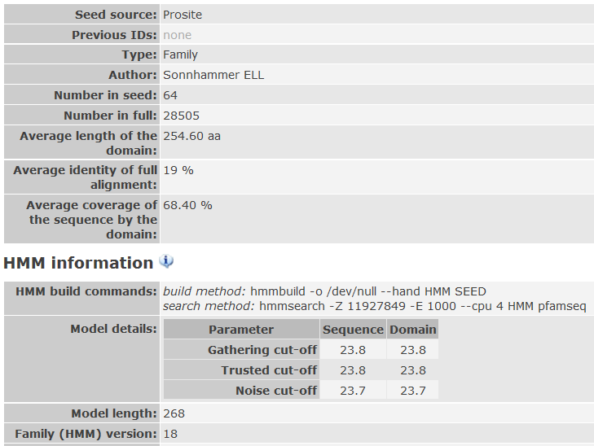
Sample Pfam entry
Each Pfam entry contains:
Seed Multiple Alignment
HMM
Full Multiple Alignment
Annotation

Slide 13
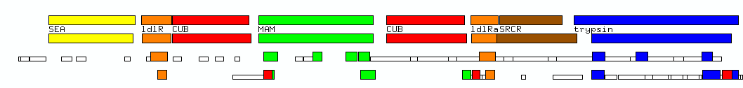

Comparison of protein family databases: an example
Pfam
Prosite*
Prints
Blocks
Smart
(Interpro, ProDom, PIRaln, ProClass, Systers, Picasso etc. not shown)
Example: ENTK_HUMAN (Enteropeptidase precursor)

Slide 14
Intended uses of Pfam
Search a query sequence against HMM library.
Search a domain HMM against a proteome
Analyse domain organisation of entire proteomes

Slide 15
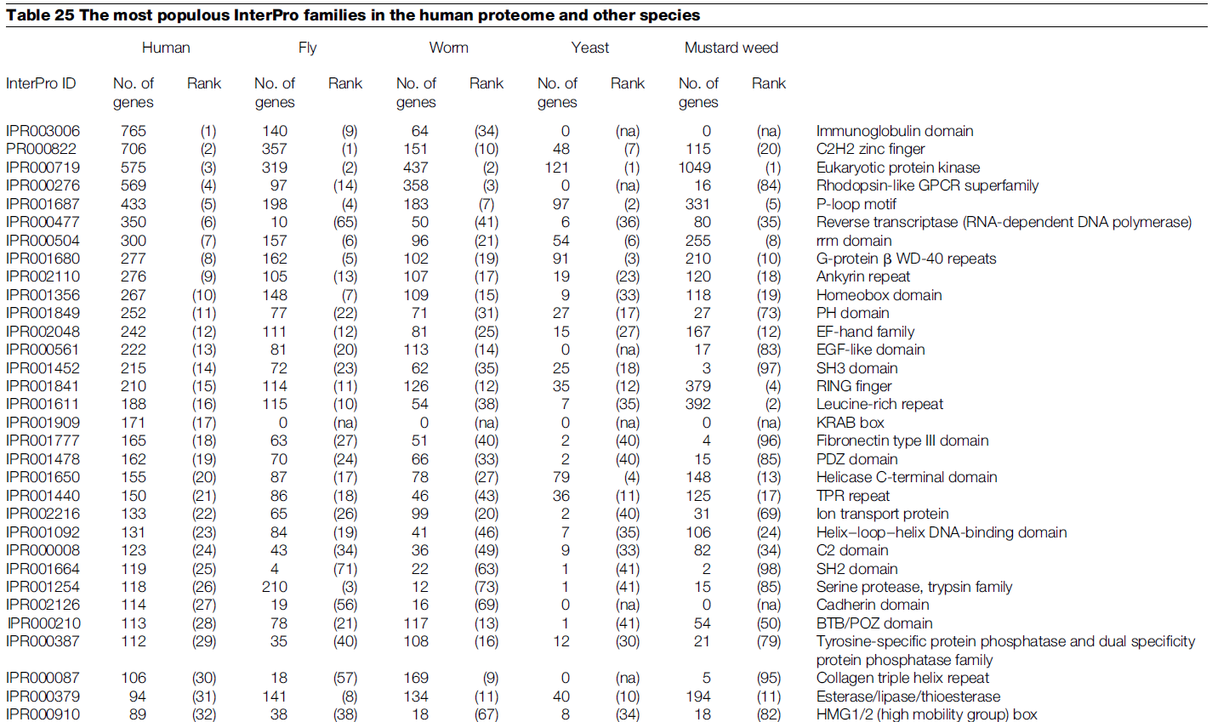
Proteome-scale domain annotation

Slide 16
Protein function annotation

Slide 17
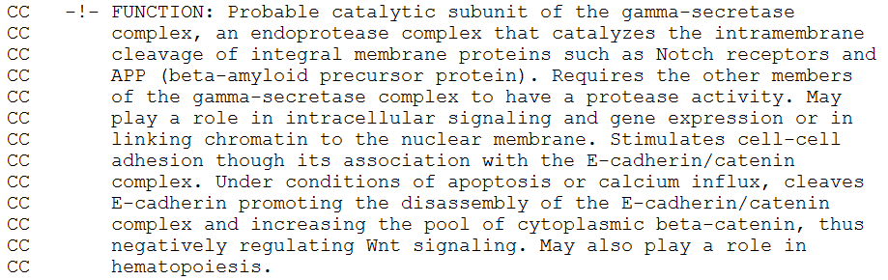
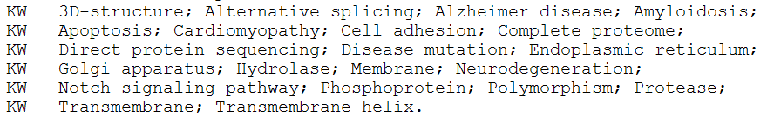
General annotations
UniProt and other sequence databases have (1) free-text comments and (2) more or less controlled vocabularies of keywords

Slide 18
EC numbers
Enzyme Commission number
Defined only for enzymes
Four-part hierarchy, like EC 3.4.11.4
Six top-level classes (first letter)
TC – Transporter Classification, suggested equivalent system for transporter proteins

Slide 19
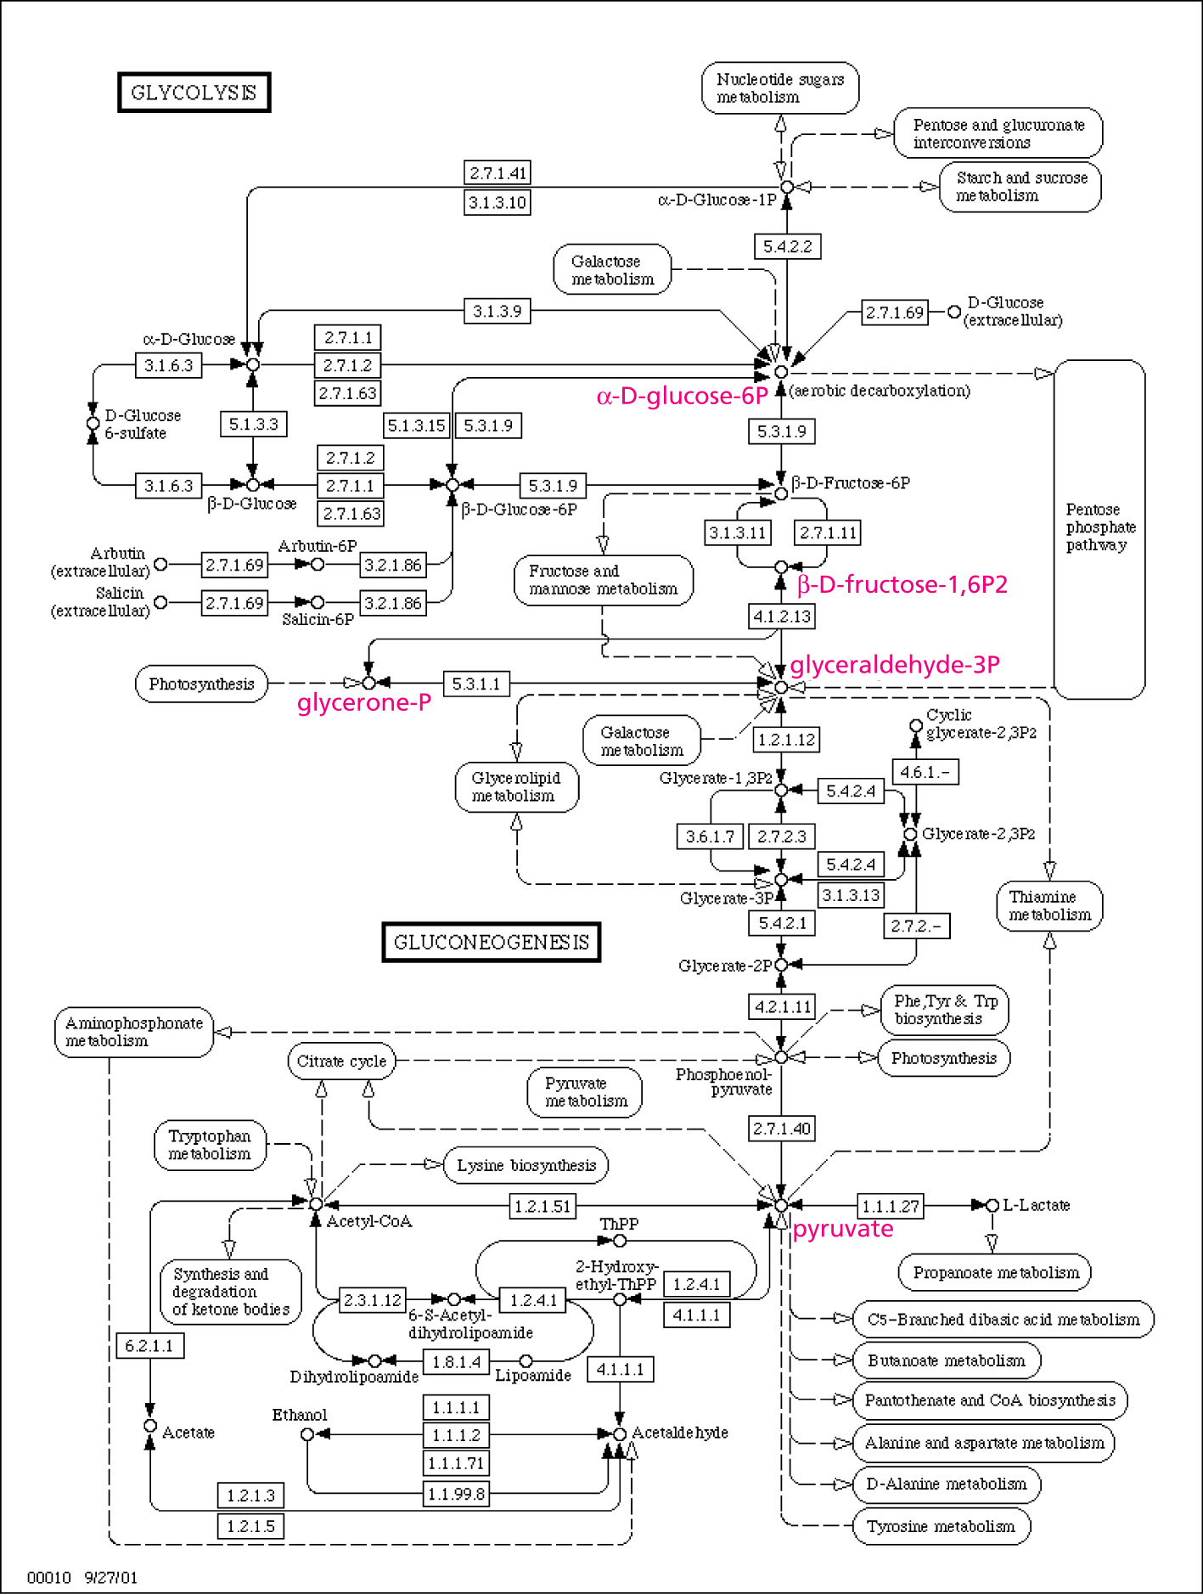
KEGG
KEGG – Kyoto Encyclopedia of Genes and Genomes
Genes are divided into specific functional (particularly metabolic) pathways
Pathway membership is a form of functional classification

Slide 20
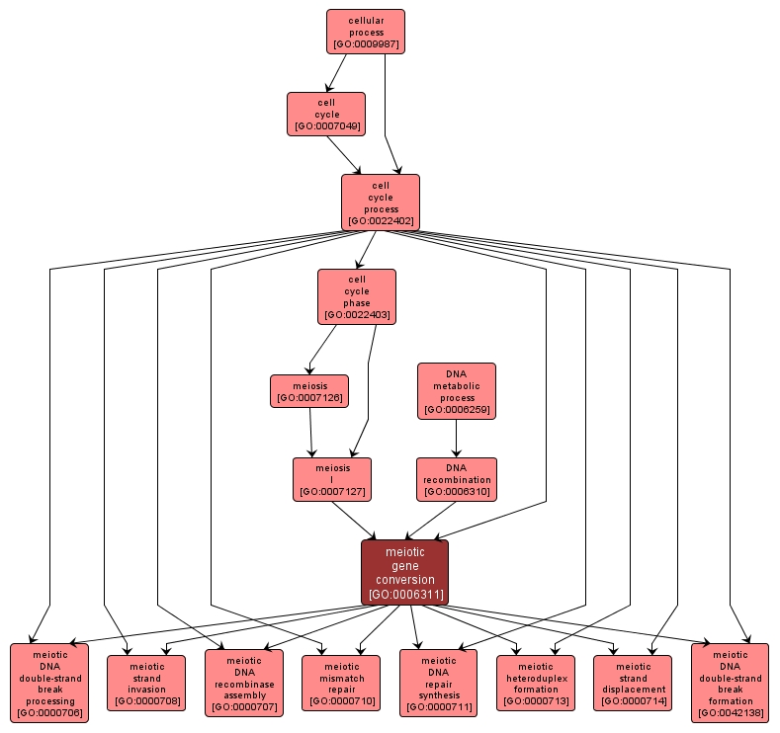
Gene Ontology
GO – Gene Ontology terms
Directed Acyclic Graph
Hierarchical, so terms have one or more parents and can have one or more children
Children more specific, parents more general
Three separate trees: Molecular Function, Biological Process, Cellular Localization

Slide 21
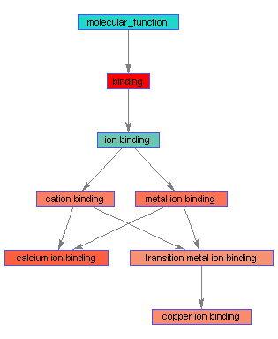
Gene Ontology
Terms are assigned by (1) experiments, (2) predicted by specific software, or (3) transferred via homology/orthology
Different evidence codes are used to display this
Useful for both localization and function annotation

Slide 22
Gene Ontology
Gene Ontology Evidence Codes
  IEA - inferred from electronic annotation
  IC - inferred by curator
  IDA - inferred from direct assay
  IEP - inferred from expression pattern
  IGC - inferred from genomic context
  IGI - inferred from genetic interaction
  IMP - inferred from mutant phenotype
  IPI - inferred from physical interaction
  ISS - inferred from sequence or structural similarity
  RCA - inferred from reviewed computational analysis
  NAS - non-traceable author statement
  ND - no biological data available
  TAS - traceable author statement
  NR - not recorded

Slide 23
Function transfer
Transfer: assign annotations to proteins (such as EC numbers, UniProt keywords or Gene Ontology terms) from other proteins (in other species) based on:
  Orthology
  Phylogenetic consistency
  Same domain architecture
  Significant sequence similarity (e.g. E-value < 10^-5)

Slide 24
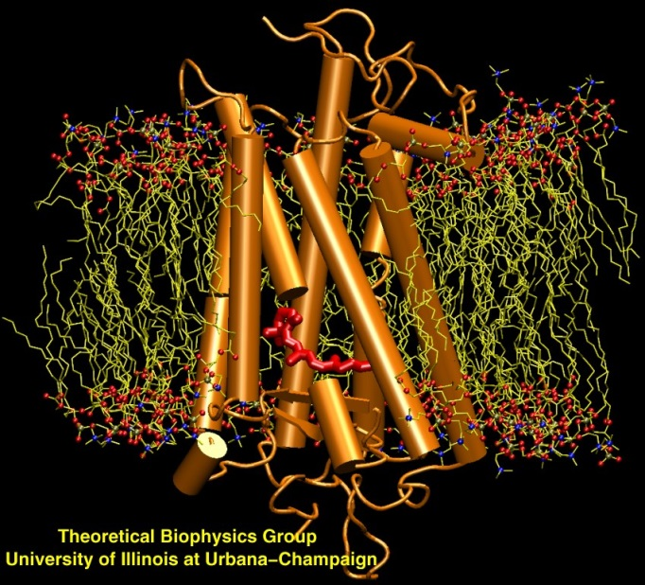
Transmembrane (TM) Proteins
Over 50% of all drug targets
20-30% of all protein sequences
Less than 1% of all solved structures

Slide 25
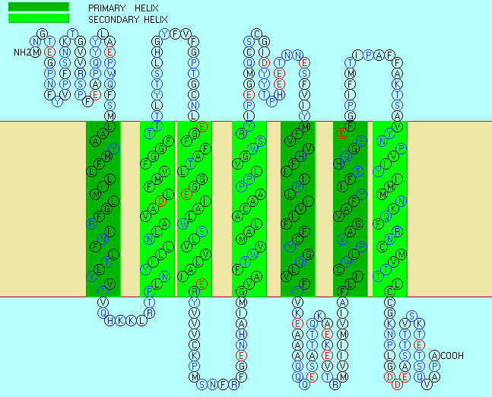

Slide 26
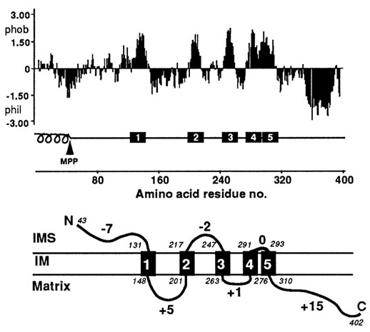
Hydrophobicity plots

Slide 27
TM predictors
TopPred
MEMSAT
PredictProtein
SOSUI
TMHMM
HMMTOP
Phobius
Octopus
Scampi
.
.
lots more

Slide 28
Conflict between signal peptides and TM segments
Cleavage site
Signal peptides:
N-reg
H-reg
C-reg
Mature Protein
1-8 res
+
7-20 res.
3-10 res
TM segments:
Originating
TM helix
Translocated
+
15-35 res.
hydrophobic
Notes:
Ca²⁺-ATPase

Slide 29
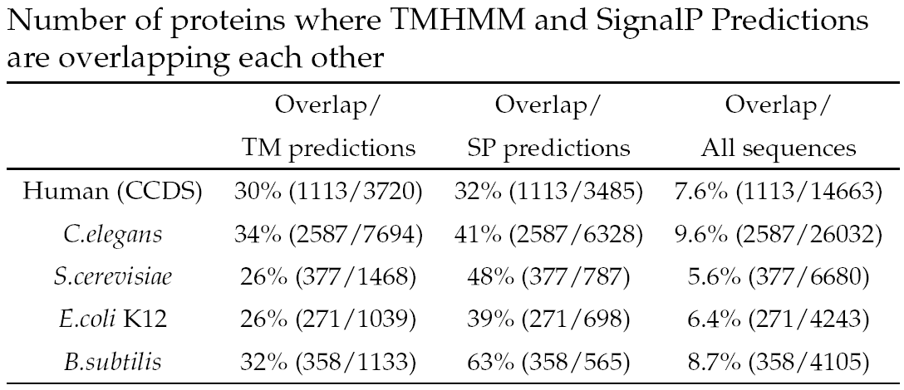
Using ‘conventional’ TM and signal peptide predictors on complete proteomes

Slide 30
Using ‘conventional’ TM and signal peptide predictors on complete proteomes
30-65% of the predicted signal peptides overlap a predicted TM region
25-35% of the predicted TM regions overlap a predicted signal peptide

Slide 31
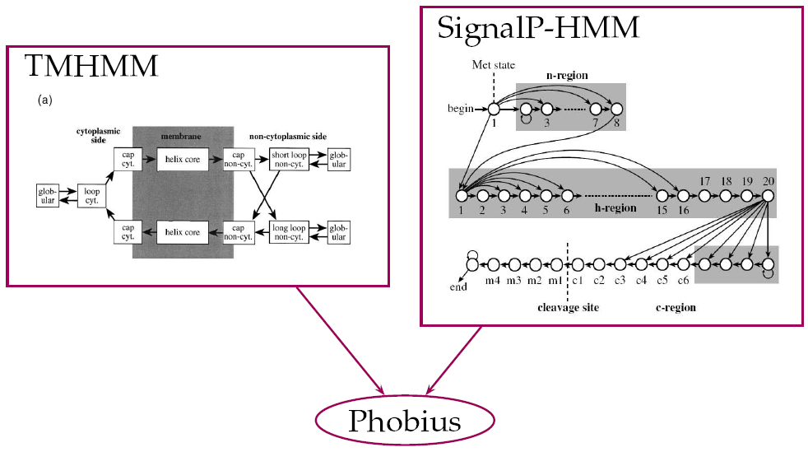
Combined model

Slide 32
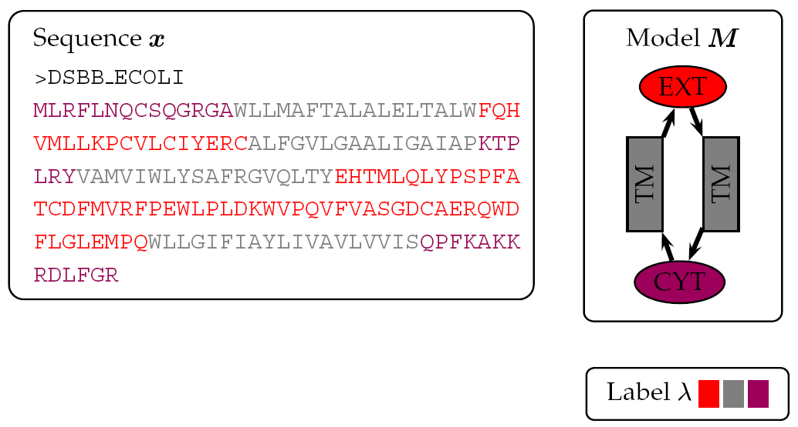
A labeled sequence

Slide 33
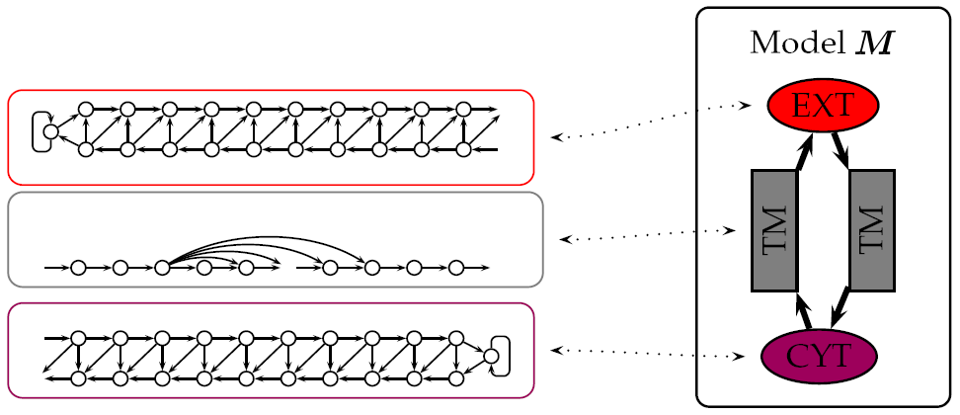
A hidden Markov model

Slide 34
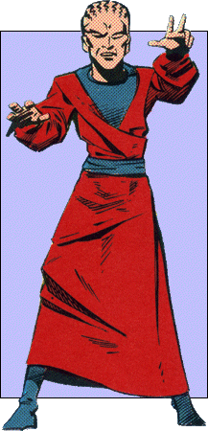
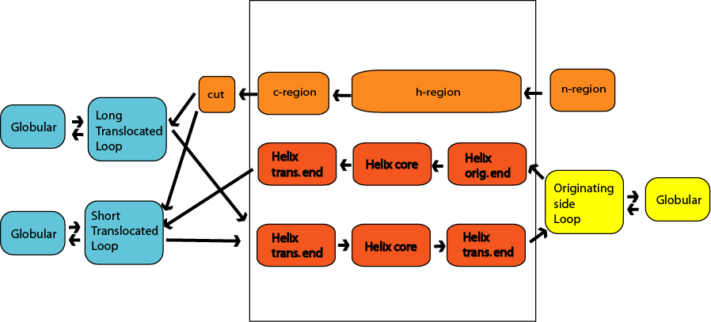
Phobius

Slide 35
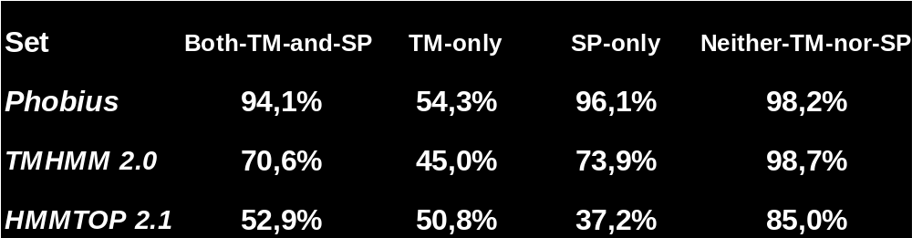
TM Topology accuracy
Correct topology predictions:
Phobius generally predicts TM topology better
Phobius predicts fewer signal peptides as TM segments

Slide 36
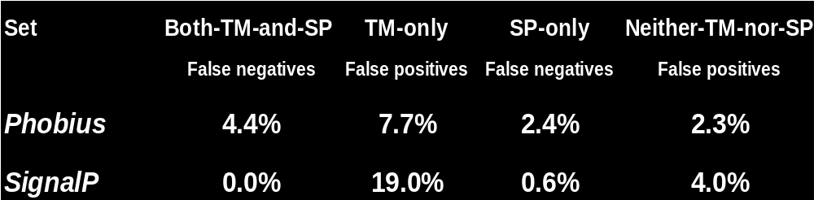
Signal Peptide prediction accuracy
False predictions:
Phobius predicts less TM segments as signal peptides
Phobius detects less false positives when operating on proteins without SPs or TM segments
Phobius is less sensitive to signal peptides

Slide 37
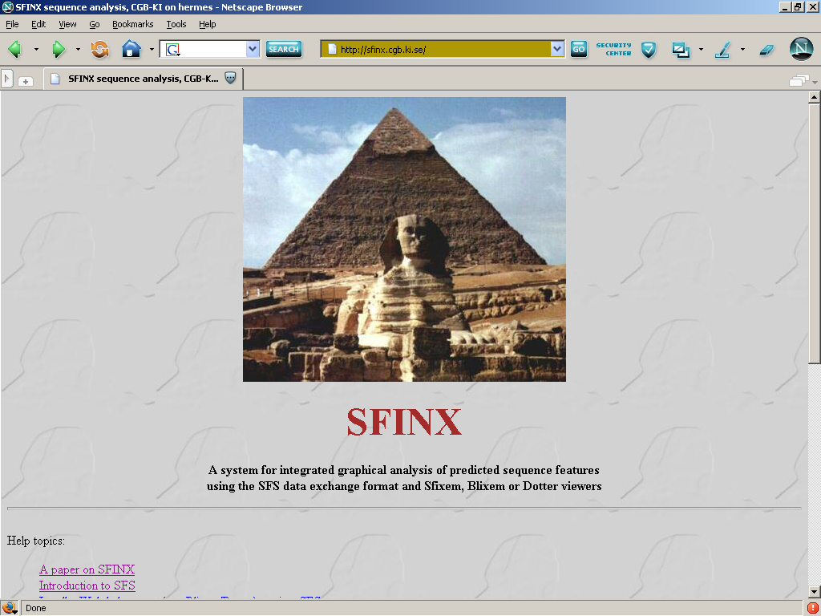
http://sfinx.sbc.su.se
Metaserver

Slide 38
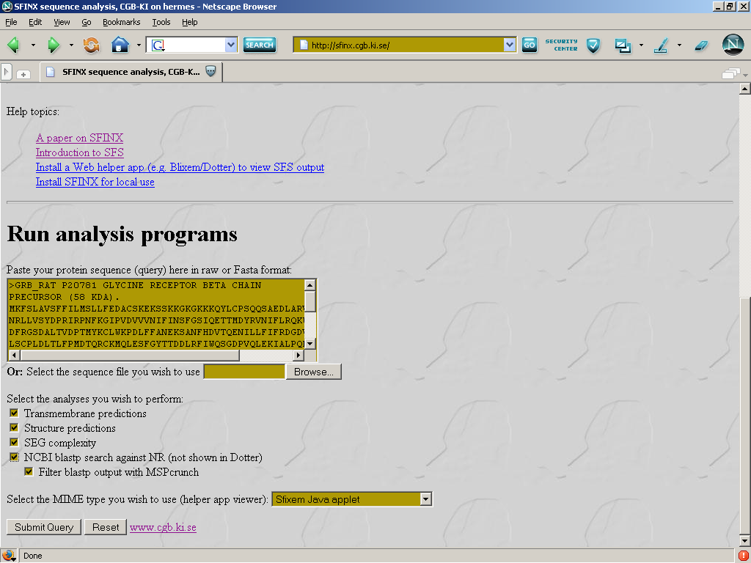
http://sfinx.sbc.su.se

Slide 39
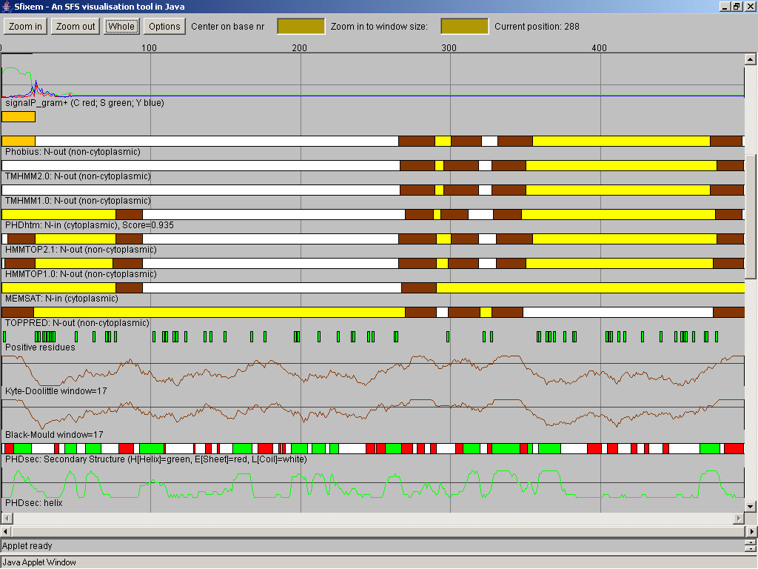
SFINX: Sfixem viewer

Slide 40
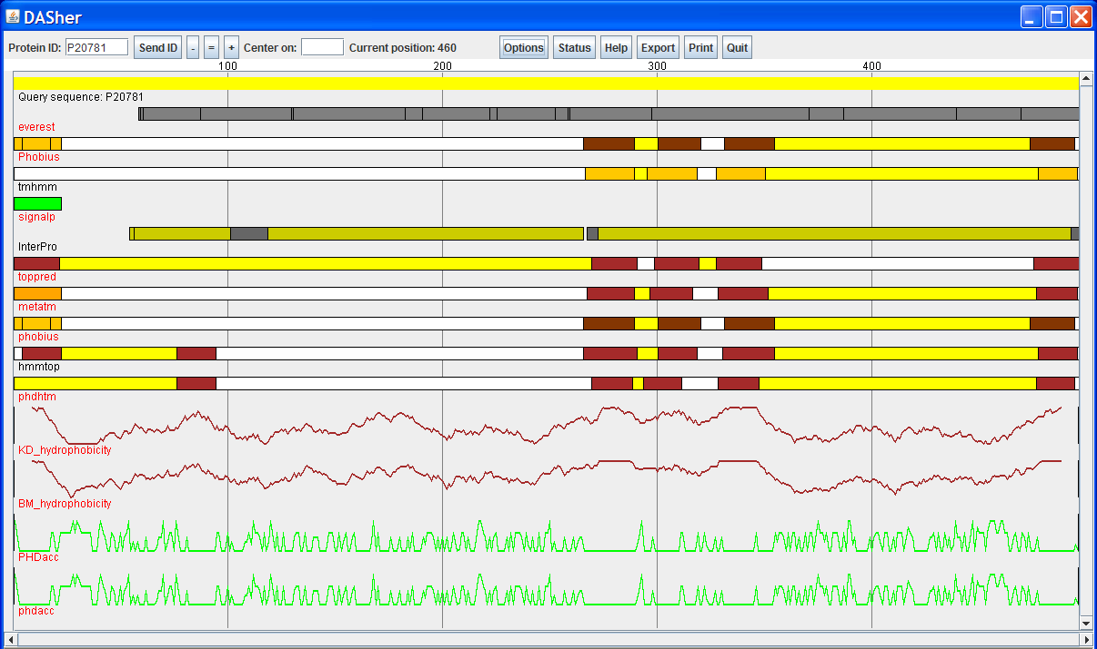
Dasher.sbc.su.se

Slide 41
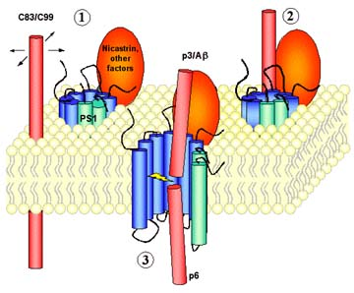
Application: Presenilin

Slide 42
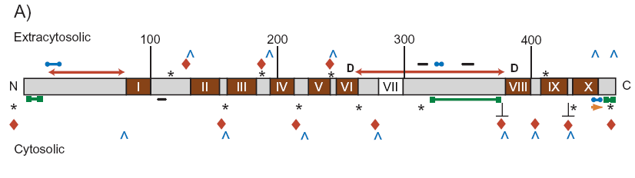
Presenilin topology hypotheses
7-10 TM regions in various orientations
Experiments inconclusive (is part of a complex)‏

Slide 43
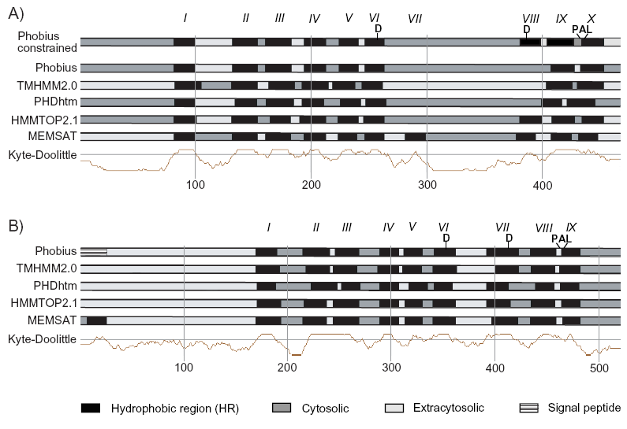
Dasher analysis of Presenilin
Presenilin 1
Presenilin-like 2

Slide 44
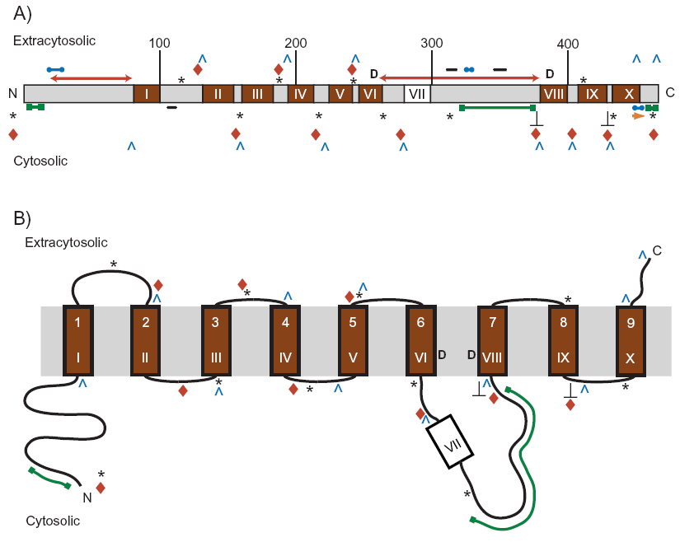

Slide 45
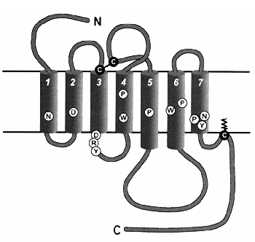
Modelling G-protein coupled receptors (GPCR)‏
Large superfamily
Little sequence homology between subfamilies
No HMM for entire superfamily

Slide 46
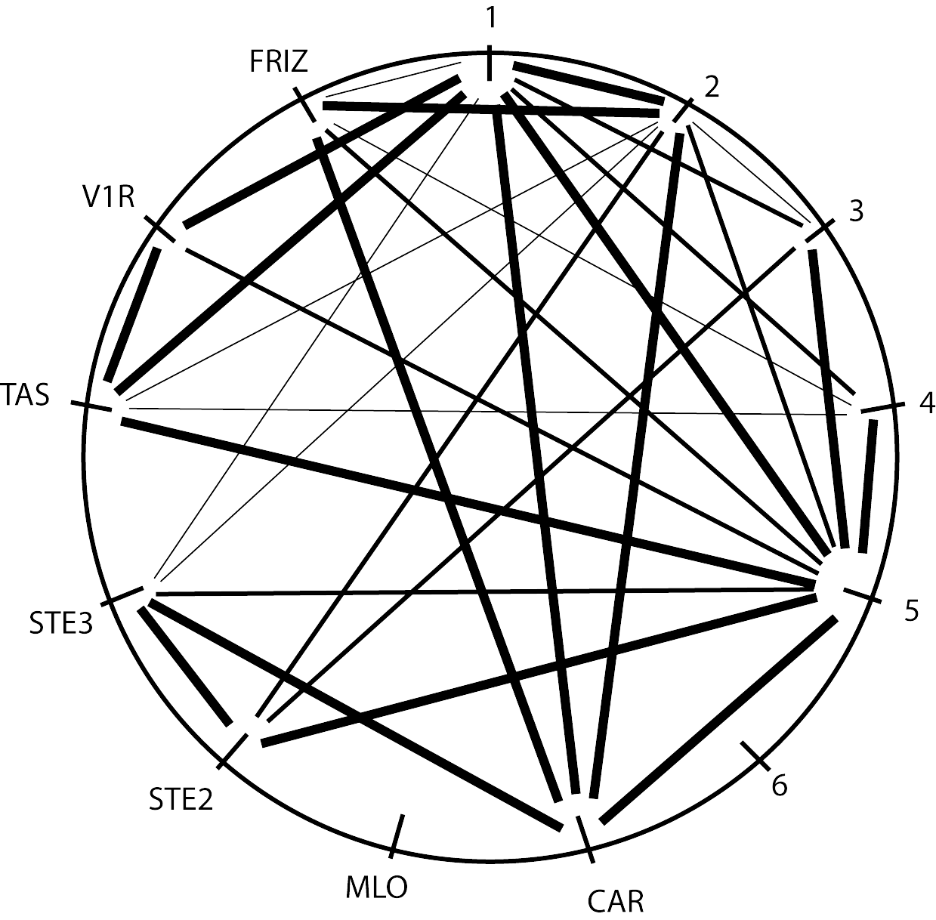
Sequence homology between families

Slide 47
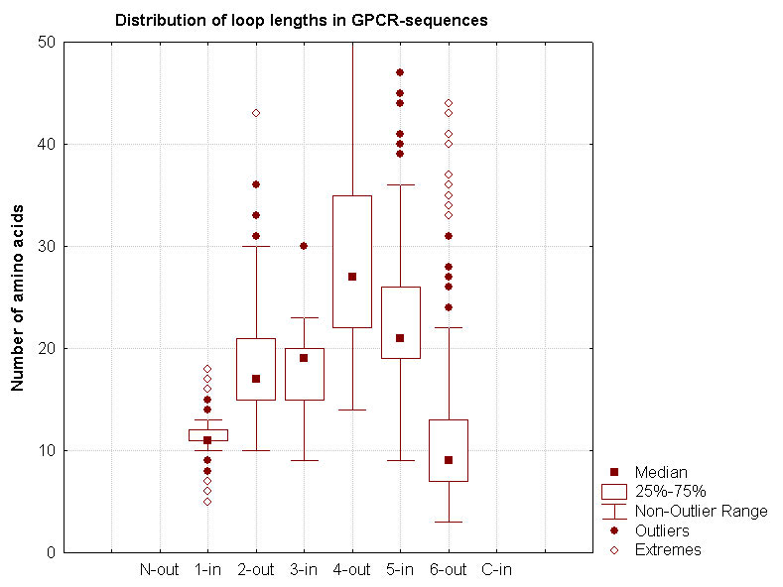
GPCR Loop lengths
Loop 1 (inside) ’always’ short
Loop 3 (inside) also relatively short
Outside loops longer and less conserved in length

Slide 48
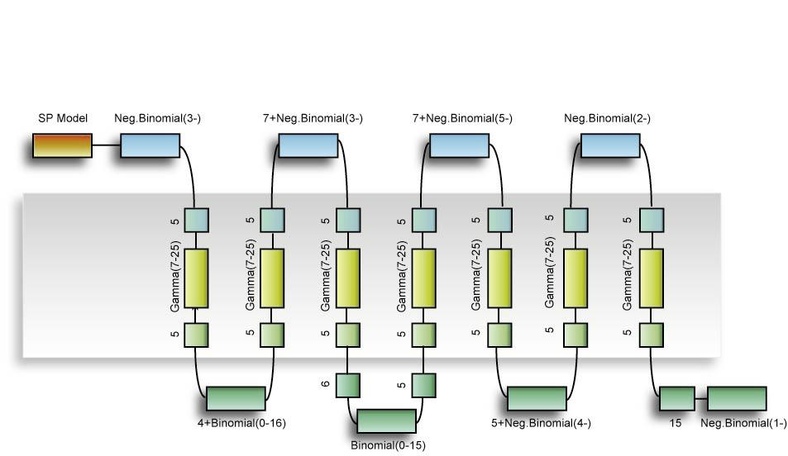
GPCRHMM.sbc.su.se

Slide 49
Conclusions
Many types of functional annotations exist: domains, transmembrane, GO, KEGG, EC, etc.
Function may be assigned computationally by similarity tools such as BLAST and HMMER.
Errors propagate, so be careful with annotations that are transferred this way – use them but with caution
Always try to use several different approaches and investigate their overlap

